Slide 1



LIFE/work balance
We have started a #LIFEworkbalance campaign and we need your help to complete our LIFE/work balance survey.
We hope to publish the results soon, so please give 15 minutes of your time to help us get a true picture of school life.
Want to be a part of this campaign? Take the survey on our website and share it with your colleagues!
© Classroom Secrets Limited 2018

Slide 2

Year 4 – Summer Block 4 – Statistics – Comparison, Sum and Difference
About This Resource:
This PowerPoint has been designed to support your teaching of this small step. It includes a starter activity and an example of each question from the Varied Fluency and Reasoning and Problem Solving resources also provided in this pack. You can choose to work through all examples provided or a selection of them depending on the needs of your class.
National Curriculum Objectives:
Mathematics Year 4: (4S1) Interpret and present discrete and continuous data using appropriate graphical methods, including bar charts and time graphs
Mathematics Year 4: (4S2) Solve comparison, sum and difference problems using information presented in bar charts, pictograms, tables and other graphs
More Year 4 Statistics resources.
Did you like this resource? Don’t forget to review it on our website.
© Classroom Secrets Limited 2019

Slide 3
Year 4 – Summer Block 4 – Statistics
Step 2: Comparison, Sum and Difference
© Classroom Secrets Limited 2019

Slide 4
Introduction
 | A full circle represents 20 children.
 | Three quarters of a circle represents _____ children.
 | Half of a circle represents _____ children.
 | A quarter of a circle represents _____ children.
© Classroom Secrets Limited 2019

Slide 5
Introduction
 | A full circle represents 20 children.
 | Three quarters of a circle represents 15 children.
 | Half of a circle represents 10 children.
 | A quarter of a circle represents 5 children.
© Classroom Secrets Limited 2019

Slide 6
Varied Fluency 1
Use the table to calculate the number of tickets bought altogether.
Sort the films in order from the most to least popular.
Monday’s Cinema Ticket Sales
Film | Tickets
Attack of the Robots | 60
Frostbite | 30
True Love | 40
The Great Adventure | 70
© Classroom Secrets Limited 2019

Slide 7
Varied Fluency 1
Use the table to calculate the number of tickets bought altogether.
200
Sort the films in order from the most to least popular.
The Great Adventure, Attack of the Robots, True Love, Frostbite
Monday’s Cinema Ticket Sales
Film | Tickets
Attack of the Robots | 60
Frostbite | 30
True Love | 40
The Great Adventure | 70
© Classroom Secrets Limited 2019

Slide 8
Varied Fluency 2
Complete the sentences below.
On average, Tom drinks _______ ml more water than Ali.
Jess drinks _______ ml less water than Fay.
Average Water Intake During PE
Tom |  |  | Jess |  |  | Ali |  |  | Fay
80
60
40
20
ml
© Classroom Secrets Limited 2019

Slide 9
Varied Fluency 2
Complete the sentences below.
On average, Tom drinks 20 ml more water than Ali.
Jess drinks 20 ml less water than Fay.
Average Water Intake During PE
Tom |  |  | Jess |  |  | Ali |  |  | Fay
80
60
40
20
ml
© Classroom Secrets Limited 2019

Slide 10
Varied Fluency 3
Calculate the difference between the
number of pears and apples grown.
Which two fruits total 55?
Fruits Grown at Farley Farm Each Year
Strawberries | Pears | Oranges | Apples
= 10 fruits
© Classroom Secrets Limited 2019

Slide 11
Varied Fluency 3
Calculate the difference between the
number of pears and apples grown.
10
Which two fruits total 55?
Oranges and apples
Fruits Grown at Farley Farm Each Year
Strawberries | Pears | Oranges | Apples
= 10 fruits
© Classroom Secrets Limited 2019

Slide 12
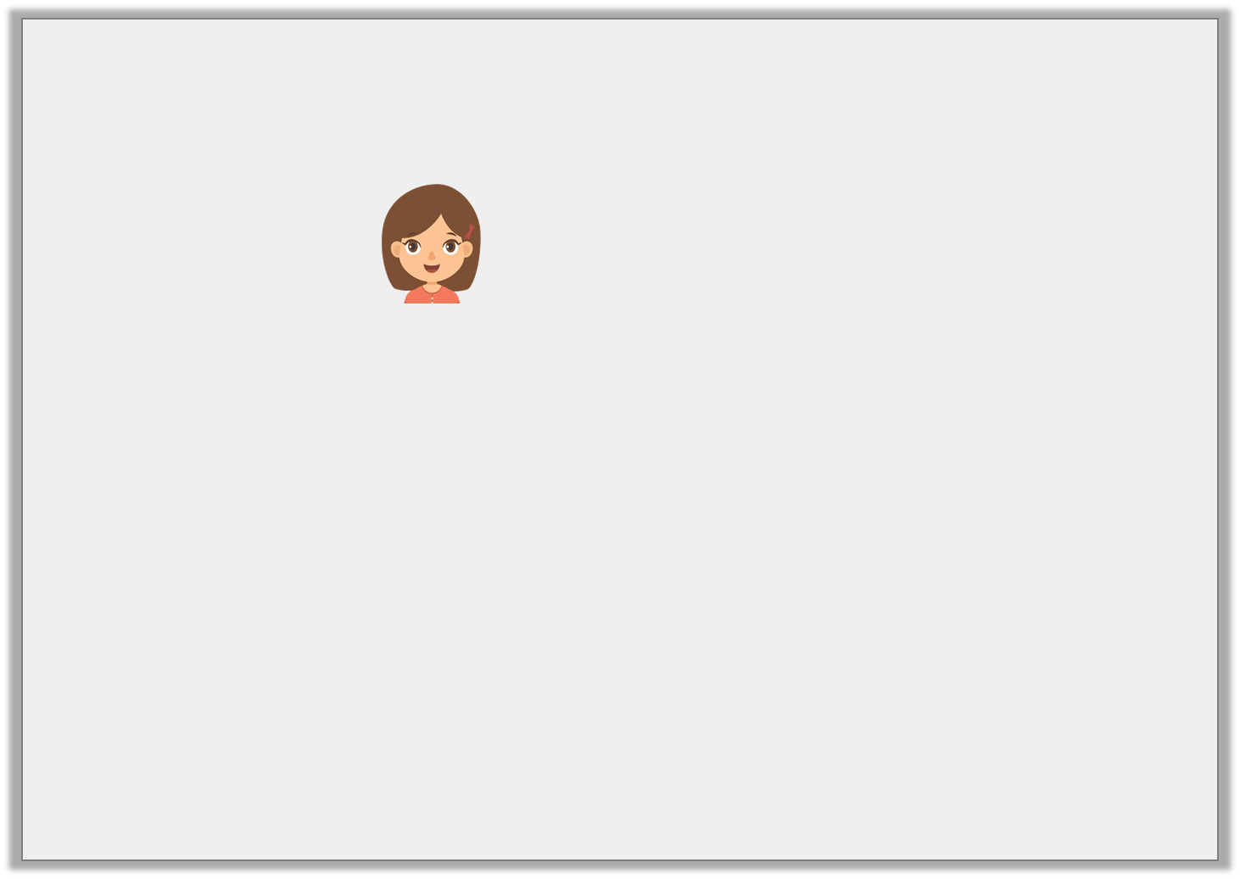
Reasoning 1
Kate says,
Is she correct? Convince me.
There were 20 more votes for consoles than phones.
KS2’s Favourite Gadgets
Laptop
Console
Tablet
Phone
0 | 20 | 40 | 60 | 80 | 100 | 120
© Classroom Secrets Limited 2019

Slide 13
Reasoning 1
Kate says,
Is she correct? Convince me.
Kate is not correct because…
There were 20 more votes for consoles than phones.
KS2’s Favourite Gadgets
Laptop
Console
Tablet
Phone
0 | 20 | 40 | 60 | 80 | 100 | 120
© Classroom Secrets Limited 2019

Slide 14
Reasoning 1
Kate says,
Is she correct? Convince me.
Kate is not correct because there were 90 votes for consoles and 80 votes for phones, so there were 10 more votes for consoles than phones.
There were 20 more votes for consoles than phones.
KS2’s Favourite Gadgets
Laptop
Console
Tablet
Phone
0 | 20 | 40 | 60 | 80 | 100 | 120
© Classroom Secrets Limited 2019

Slide 15
Reasoning 2
Circle the odd one out of A, B and C.
A. 250 people voted for their favourite treats.
B. Crisps received the highest number of votes.
C. 60 people voted for sweets.
Explain your reasoning.
Favourite Treats | Votes
Chocolate | 80
Sweets | 60
Biscuits | 30
Crisps | 90
© Classroom Secrets Limited 2019

Slide 16
Reasoning 2
Circle the odd one out of A, B and C.
A. 250 people voted for their favourite treats.
B. Crisps received the highest number of votes.
C. 60 people voted for sweets.
Explain your reasoning.
A is the odd one out because…
Favourite Treats | Votes
Chocolate | 80
Sweets | 60
Biscuits | 30
Crisps | 90
© Classroom Secrets Limited 2019

Slide 17
Reasoning 2
Circle the odd one out of A, B and C.
A. 250 people voted for their favourite treats.
B. Crisps received the highest number of votes.
C. 60 people voted for sweets.
Explain your reasoning.
A is the odd one out because it is incorrect. 260 people voted for their favourite treats.
Favourite Treats | Votes
Chocolate | 80
Sweets | 60
Biscuits | 30
Crisps | 90
© Classroom Secrets Limited 2019

Slide 18
Problem Solving 1
Fill in the missing data.
There were more donkeys than llamas, but fewer donkeys than goats.
There were 20 more ponies than llamas.
Animals at the Petting Zoo
Ponies | Llamas | Donkeys | Goats
= 10 animals
© Classroom Secrets Limited 2019

Slide 19
Problem Solving 1
Fill in the missing data.
There were more donkeys than llamas, but fewer donkeys than goats.
There were 20 more ponies than llamas.
Animals at the Petting Zoo
Ponies | Llamas | Donkeys | Goats
= 10 animals
© Classroom Secrets Limited 2019

