Slide 1



LIFE/work balance
We have started a #LIFEworkbalance campaign and we need your help to complete our LIFE/work balance survey.
We hope to publish the results soon, so please give 15 minutes of your time to help us get a true picture of school life.
Want to be a part of this campaign? Take the survey on our website and share it with your colleagues!
© Classroom Secrets Limited 2019

Slide 2
Year 4 – Summer Block 5 – Properties of Shape – Lines of Symmetry
About This Resource:
This PowerPoint has been designed to support your teaching of this small step. It includes a starter activity and an example of each question from the Varied Fluency and Reasoning and Problem Solving resources also provided in this pack. You can choose to work through all examples provided or a selection of them depending on the needs of your class.
National Curriculum Objectives:
Mathematics Year 4: (4G2b) Identify lines of symmetry in 2-D shapes presented in different orientations
More Year 4 Properties of Shape resources.
Did you like this resource? Don’t forget to review it on our website.
© Classroom Secrets Limited 2018

Slide 3
Year 4 – Summer Block 5 – Properties of Shape
Step 5: Lines of Symmetry
© Classroom Secrets Limited 2018

Slide 4
Introduction
Which of the following shapes have more than one line of symmetry?
© Classroom Secrets Limited 2018

Slide 5
Introduction
Which of the following shapes have more than one line of symmetry?
© Classroom Secrets Limited 2018

Slide 6
Varied Fluency 1
Which shape has the correct lines of symmetry marked?
A
B
C
© Classroom Secrets Limited 2018

Slide 7
Varied Fluency 1
Which shape has the correct lines of symmetry marked?
Shape A
A
B
C
© Classroom Secrets Limited 2018

Slide 8



Varied Fluency 2
Match the halves which go together to make symmetrical shapes.
B
C
A
D
F
E
© Classroom Secrets Limited 2018

Slide 9
Varied Fluency 2
Match the halves which go together to make symmetrical shapes.
A and C; B and D; E and F
B
C
A
D
F
E
© Classroom Secrets Limited 2018

Slide 10



Varied Fluency 3
Pair the lines of symmetry with the shapes they match.
A
B
C
E
D
F
© Classroom Secrets Limited 2018

Slide 11
Varied Fluency 3
Pair the lines of symmetry with the shapes they match.
A and B; C and F; D and E
A
B
C
E
D
F
© Classroom Secrets Limited 2018

Slide 12



Reasoning 1
Eustace has filled in this Venn diagram with shapes.
Find and explain his mistake.
Vertical line of symmetry
Horizontal line of symmetry
© Classroom Secrets Limited 2018

Slide 13
Reasoning 1
Eustace has filled in this Venn diagram with shapes.
Find and explain his mistake.
Eustace has put the pentagon in the ‘Vertical line of symmetry’ section when in that orientation. It should be in the ‘Horizontal line of symmetry’ section instead.
Vertical line of symmetry
Horizontal line of symmetry
© Classroom Secrets Limited 2018

Slide 14
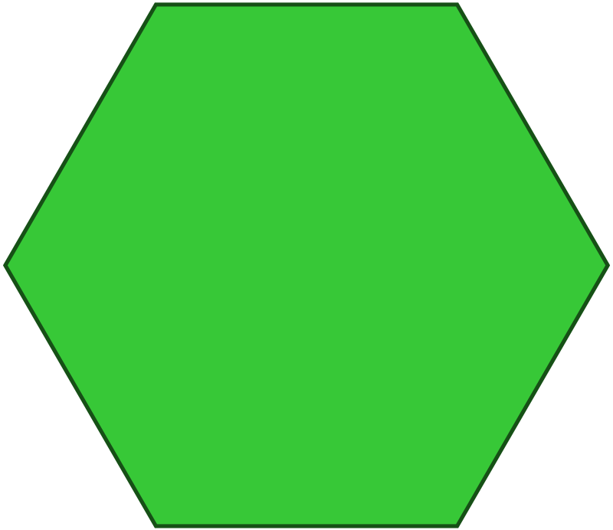
Problem Solving 1
Here is an image made up of several shapes.
How many lines of symmetry does the image (not the individual shapes) have?
© Classroom Secrets Limited 2018

Slide 15
Problem Solving 1
Here is an image made up of several shapes.
How many lines of symmetry does the image (not the individual shapes) have?
The image has 1 line of symmetry.
© Classroom Secrets Limited 2018

Slide 16
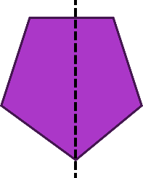
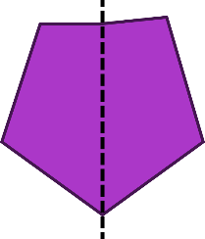
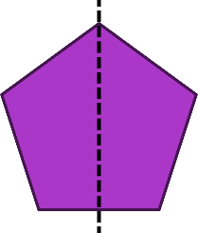
Reasoning 2
Here are 3 attempts at drawing reflections.
Find the reflections that are not symmetrical. Explain why.
A
B
C
© Classroom Secrets Limited 2018

Slide 17
Reasoning 2
Here are 3 attempts at drawing reflections.
Find the reflections that are not symmetrical. Explain why.
Shapes A and B are not symmetrical. The right-hand part of shape A is narrower than the left-hand side. The top-right-hand corner of reflection B is higher and further out than the top-left-hand corner.
A
B
C
© Classroom Secrets Limited 2018

