Slide 1
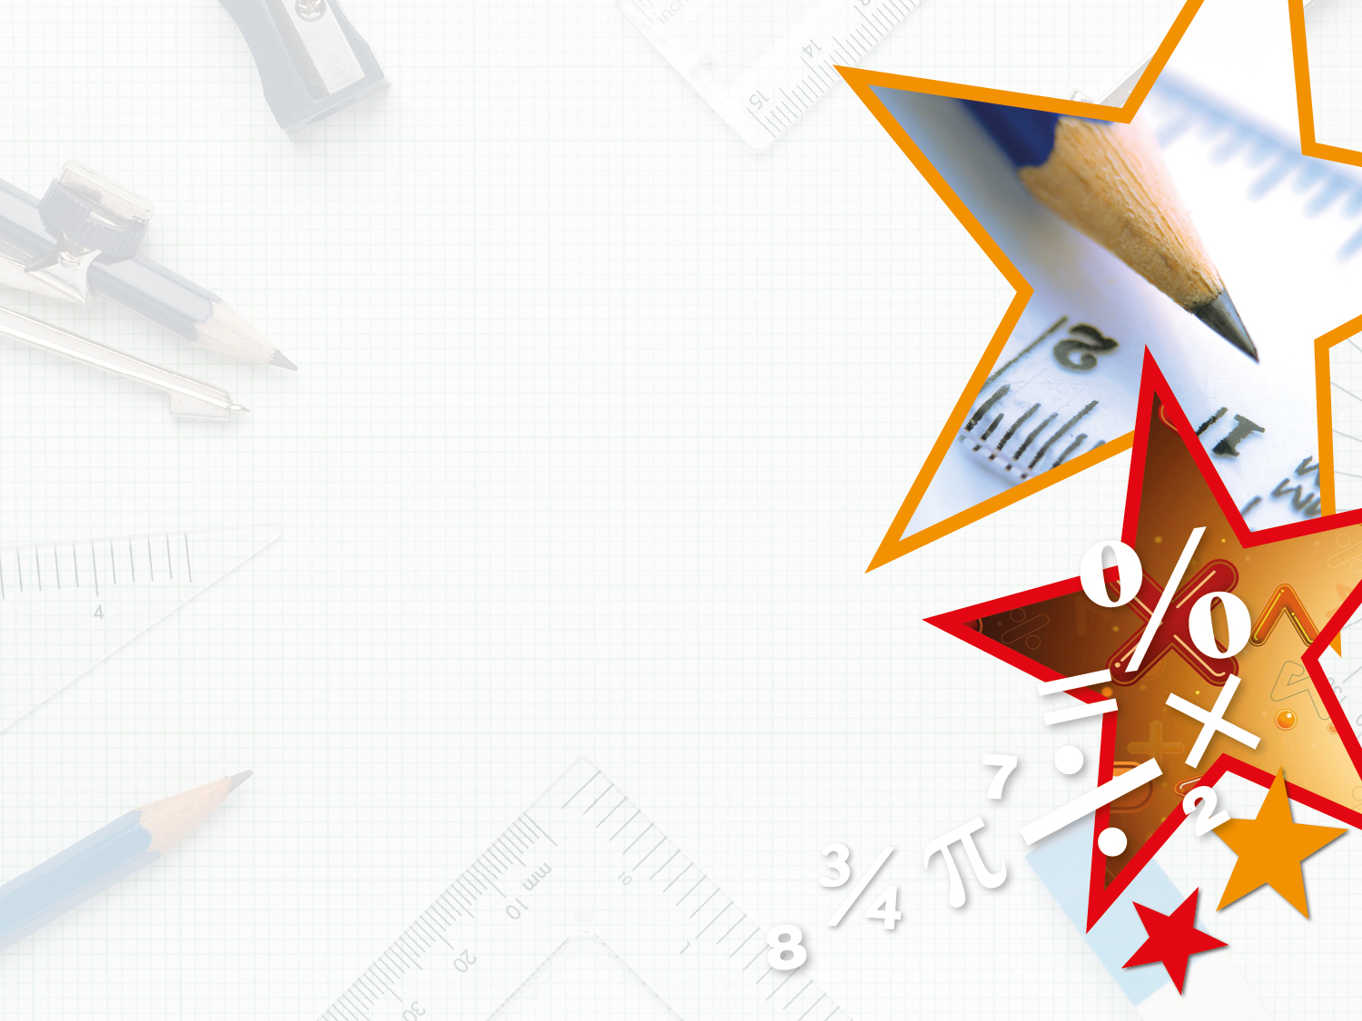


LIFE/work balance
We have started a #LIFEworkbalance campaign and we need your help to complete our LIFE/work balance survey.
We hope to publish the results soon, so please give 15 minutes of your time to help us get a true picture of school life.
Want to be a part of this campaign? Take the survey on our website and share it with your colleagues!
© Classroom Secrets Limited 2019

Slide 2
Year 4 – Summer Block 5 – Properties of Shape – Symmetric Figures
About This Resource:
This PowerPoint has been designed to support your teaching of this small step. It includes a starter activity and an example of each question from the Varied Fluency and Reasoning and Problem Solving resources also provided in this pack. You can choose to work through all examples provided or a selection of them depending on the needs of your class.
National Curriculum Objectives:
Mathematics Year 4: (4G2b) Identify lines of symmetry in 2-D shapes presented in different orientations
Mathematics Year 4: (4G2c) Complete a simple symmetric figure with respect to a specific line of symmetry
More Year 4 Properties of Shapes resources.
Did you like this resource? Don’t forget to review it on our website.
© Classroom Secrets Limited 2018

Slide 3
Year 4 – Summer Block 5 – Properties of Shape
Step 6: Symmetric Figures
© Classroom Secrets Limited 2018

Slide 4
Introduction
Reflect each shape in the mirror line and identify the name of the completed shape.
Shape
A
Shape
B
Shape
D
Shape
C
© Classroom Secrets Limited 2018

Slide 5
Introduction
Reflect each shape in the mirror line and identify the name of the completed shape.
Shape
A
Shape
B
Shape A = square
Shape B = triangle
Shape C = square
Shape D = hexagon
Shape
D
Shape
C
© Classroom Secrets Limited 2018

Slide 6
Varied Fluency 1
True or false?
This pattern has been reflected correctly in the mirror line.
© Classroom Secrets Limited 2018

Slide 7
Varied Fluency 1
True or false?
This pattern has been reflected correctly in the mirror line.
True
© Classroom Secrets Limited 2018

Slide 8
Varied Fluency 2
Draw the line of symmetry.
© Classroom Secrets Limited 2018

Slide 9
Varied Fluency 2
Draw the line of symmetry.
© Classroom Secrets Limited 2018

Slide 10
Varied Fluency 3
Identify the patterns with the correct lines of symmetry.
A
B
C
© Classroom Secrets Limited 2018

Slide 11
Varied Fluency 3
Identify the patterns with the correct lines of symmetry.
A and C
A
B
C
© Classroom Secrets Limited 2018

Slide 12
Varied Fluency 4
Reflect the pattern in the mirror line.
© Classroom Secrets Limited 2018

Slide 13
Varied Fluency 4
Reflect the pattern in the mirror line.
© Classroom Secrets Limited 2018

Slide 14
Problem Solving 1
What is the smallest number of squares that need to be filled so that this pattern has a vertical line of symmetry?
© Classroom Secrets Limited 2018

Slide 15
Problem Solving 1
What is the smallest number of squares that need to be filled so that this pattern has a vertical line of symmetry?
7 more squares, 14 squares altogether.
© Classroom Secrets Limited 2018

Slide 16
Problem Solving 2
Add 4 squares to the pattern below so that it
has a horizontal line of symmetry.
© Classroom Secrets Limited 2018

Slide 17
Problem Solving 2
Add 4 squares to the pattern below so that it
has a horizontal line of symmetry.
© Classroom Secrets Limited 2018

Slide 18
Reasoning 1
Spot the odd one out. Explain your choice.
A
C
B
D
© Classroom Secrets Limited 2018

Slide 19
Reasoning 1
Spot the odd one out. Explain your choice.
C is the odd one out because…
A
C
B
D
© Classroom Secrets Limited 2018

Slide 20
Reasoning 1
Spot the odd one out. Explain your choice.
C is the odd one out because it’s the only pattern that is not symmetrical. All the other patterns have a line of symmetry.
A
C
B
D
© Classroom Secrets Limited 2018

