Slide 2



Diving into Mastery Guidance for Educators
Each activity sheet is split into three sections, diving, deeper and deepest, which are represented by the following icons:
These carefully designed activities take your children through a learning journey, initially ensuring they are fluent with the key concept being taught; then applying this to a range of reasoning and problem-solving activities.
These sheets might not necessarily be used in a linear way. Some children might begin at the ‘Deeper’ section and in fact, others may ‘dive straight in’ to the ‘Deepest’ section if they have already mastered the skill and are applying this to show their depth of understanding.
Diving
Deeper
Deepest

Slide 3
Aim
Recall and use multiplication and division facts for the 3, 4 and 8 multiplication tables.

Slide 4
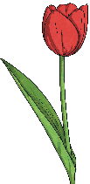

Divide by 8
Diving
Divide the flowers into eight equal groups. How many are in each group? Write a calculation to match your model.
24 ÷ 8 = 3

Slide 5
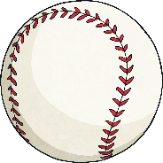
Divide by 8
Diving
Divide the balls into groups of eight. How many groups do you have? Write a calculation to match your model.
16 ÷ 8 = 2

Slide 6
Divide by 8
Diving
Mr Nash is given a box of 72 reading books from the cupboard. Each class receives 8 books. How many classes are there? Complete the bar model to show your answer.
72
9
9
9
9
9
9
9
9
72 ÷ 8 = 9
There are 9 classes.

Slide 7

Divide by 8
Deeper
Match the correct representation with the problem. Explain your reason for each choice.
Johanna grouped
40 children into groups of eight.
Jake has shared
80 cakes between eight plates.
Jennie sorted 40 children into eight equal groups.
40
8 | 8 | 8 | 8 | 8
40 has been divided into 8 groups of 5.
80 has been divided into 8 groups of 10.
40 has been divided into 5 groups of 8.

Slide 8

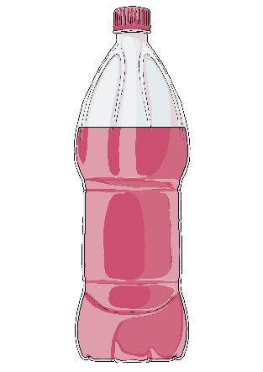
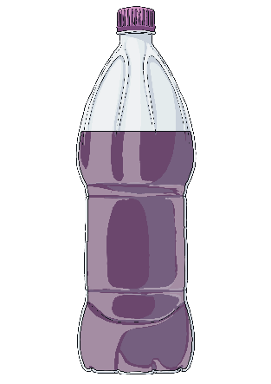
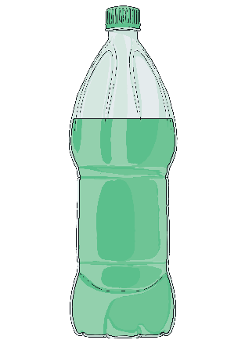
Divide by 8
Deepest
Tommy is mixing some fruity drinks using strawberry, blueberry and green apple juice. He uses some strawberry juice and one bottle of other juice. His mixture makes 29 glasses of fruity drink.
8 glasses
13 glasses
21 glasses
Strawberry
Blueberry
Apple
What ingredients could Tommy have used? Find all the possibilities.
If one bottle of blueberry juice
is used:
29 – 13 = 16
16 ÷ 8 = 2
He used one bottle of blueberry
juice and two bottles of
strawberry juice.
If one bottle of green apple juice
is used:
29 - 21 = 8
8 ÷ 8 = 1
He used one bottle of green apple juice and one bottle of
strawberry juice.

Slide 9
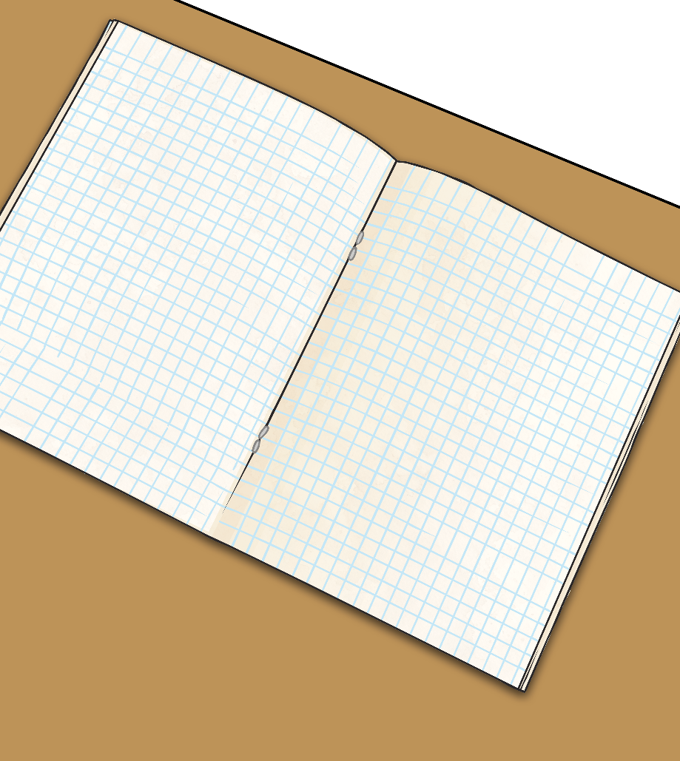
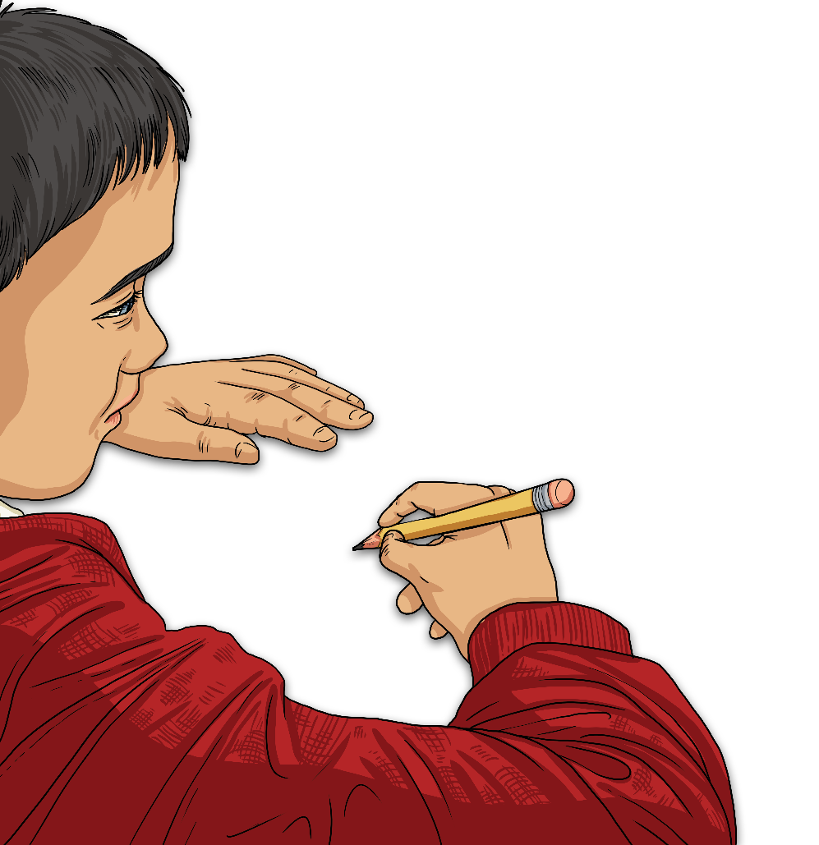
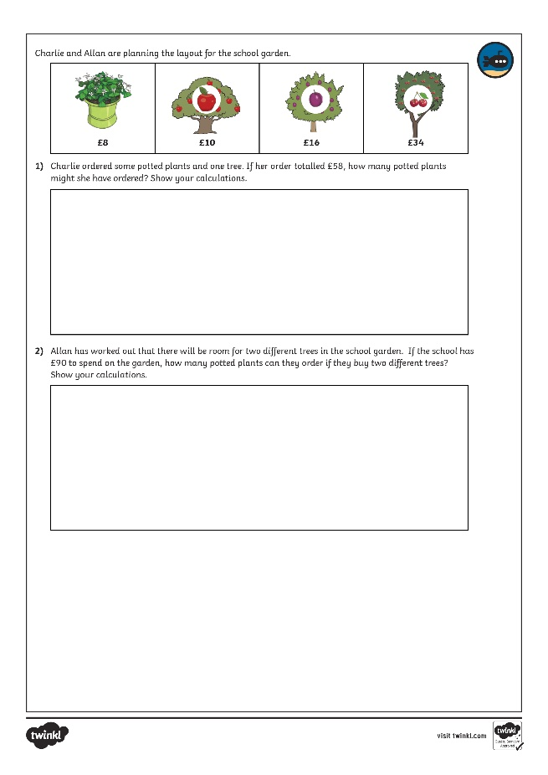
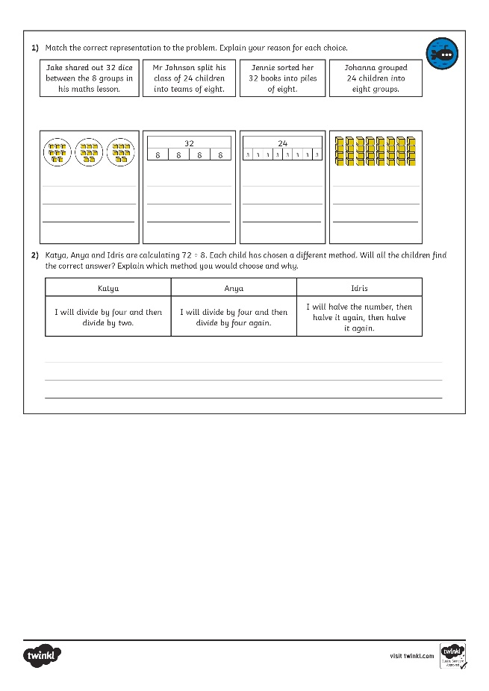
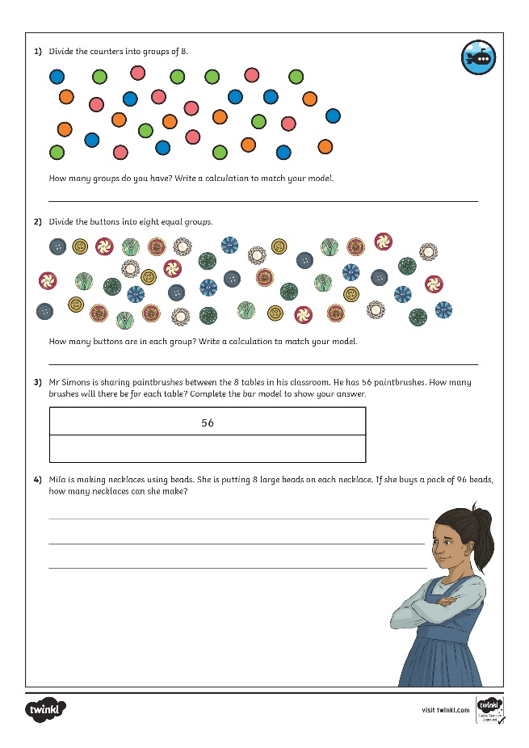
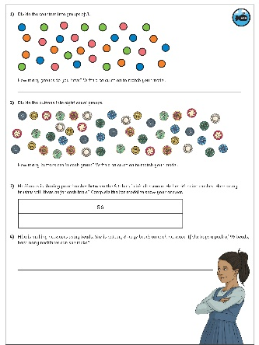
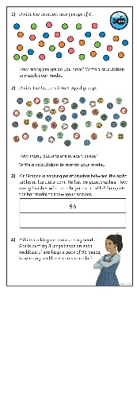
Divide by 8
Dive in by completing your own activity!

Slide 10
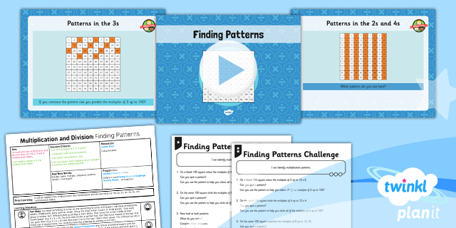
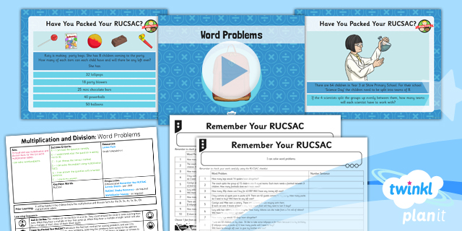

Need Planning to Complement this Resource?
National Curriculum Aim
Recall and use multiplication and division facts for the 3, 4
and 8 multiplication tables.
For more planning resources to support this aim, click here.
Twinkl PlanIt is our award-winning scheme of work
with over 4000 resources.

