Slide 1

World War 2: 1939 - 1945

Slide 2
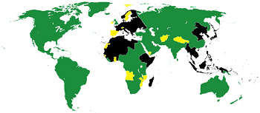
The Allies and The Axis
Sometimes it's better to do something by yourself than to get someone's help. For example, if you want to beat a video game, you don't want someone else to beat the final boss for you. But, imagine if you were trying to achieve something even bigger, like taking over the entire world. Who would you want on your side to help? During World War II (WWII), nearly every country in the world fought on one of two different sides: the Allies and the Axis powers, with the Allies winning by 1945. However, some nations stayed neutral, meaning they didn't fight on either side.

Slide 3



The Allies
United Kingdom
USSR (Russia)
Plus:
France, Australia, Belgium, Brazil, Canada, China, Denmark, Greece, India, Netherlands, New Zealand, Norway, Poland, South Africa, Yugoslavia
USA

Slide 4
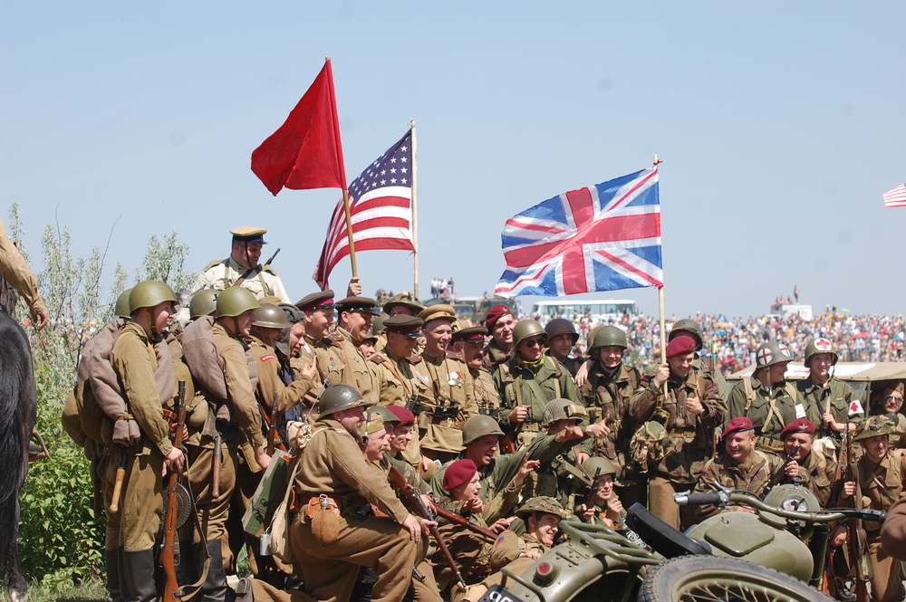
The ALlies
The allies were those countries who stood up to Hitler when he began to take over the European countries. At first it was just Great Britain and France!
At first the USSR (Russia) had signed a secret agreement with the Germans to not fight each other. But the Nazi’s broke this agreement in 1941 and invaded USSR. The USSR then joined the allies to fight against the Axis.
Imperial Japan attacked the US at Pearl Harbour in Hawaii in 1941 which brought the US into the war as a Allied Power.
These four Allied Powers did most of the fighting but most of Europe were also involved in the fight against the Axis.

Slide 5



The Axis
Germany
Italy
Japan

Slide 6
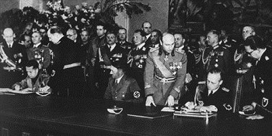
The Axis
Three nations made up the majority of the Axis forces: Nazi Germany, Imperial Japan, and fascist Italy. Both Germany and Italy wanted to change the balance of power in Europe and signed an alliance in 1936. Just a few weeks later, Germany and Japan decided they should have an alliance as well to keep the Soviet Union in check. Finally, the three major powers solidified their agreements by entering into the Tripartite Pact in 1940, which officially created the Axis powers.

Slide 7
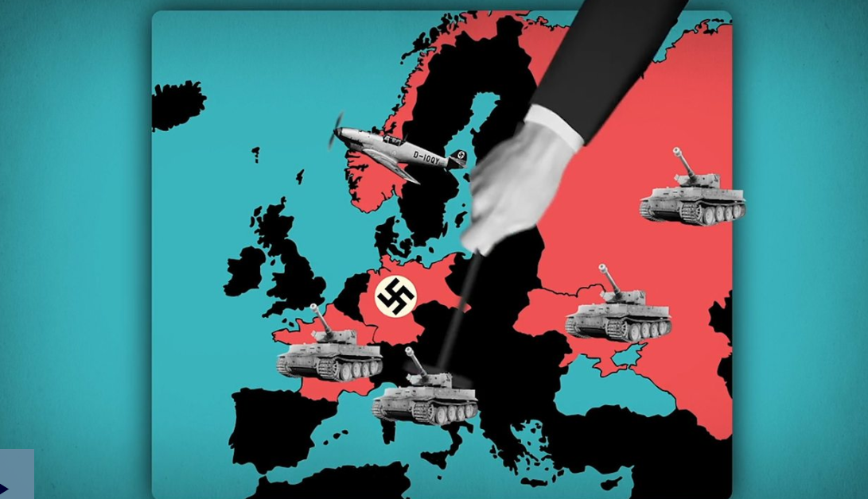
Watch this video to see just how many countries were involved!

Slide 8
Task
Use your notes to create a piece of writing all about the Allies and the Axis. Use paragraph to split you information up and sub-titles.
Ensure you include key vocabulary and clarify meanings so the reader understands the tricky words. Maybe you can get your parents to read it and see if they have any questions about the information you have given.
Edit and improve once you have finished, checking for:
Variety of sentence starters; including fronted adverbials
Capital letters for names
Commas for ambiguity
Spelling of words (use a dictionary or Google)

