Slide 1
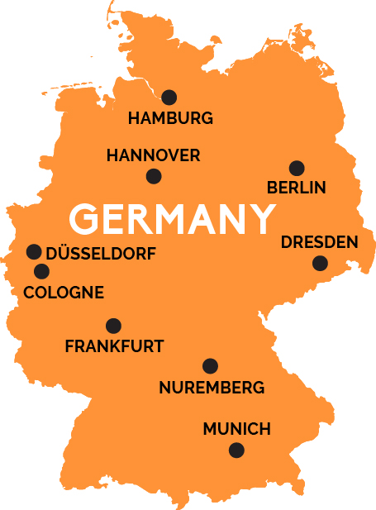
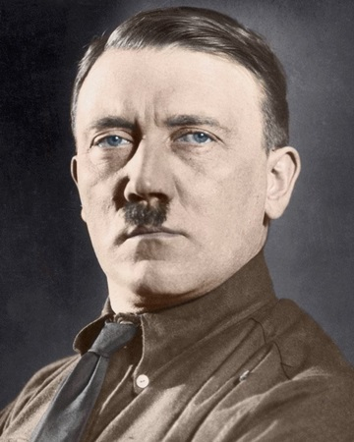
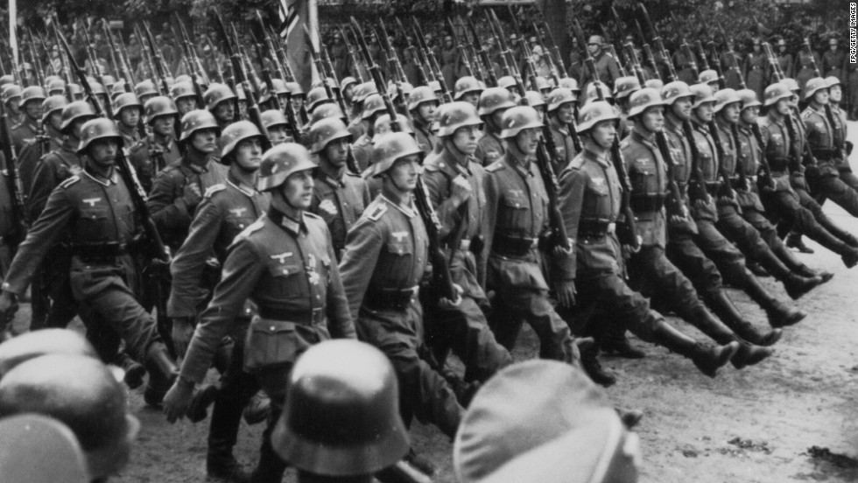
Germany in WW2

Slide 2
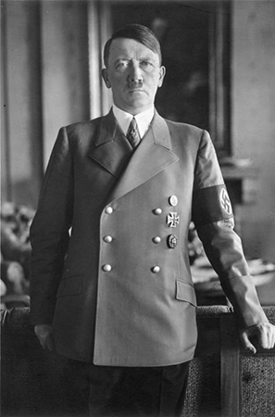
Who was in charge?
Adolf Hitler
Born in April 20, 1889 in Austria. He originally wanted to be an Artist.
Left Vienna in Austria because he didn’t want to fight in the Austrian army. He moved to Munich in Germany.
He joined the Bavarian army and fought in WW1. HE got injured in the Battle of the Somme and was sent to a hospital in Beelitz were morale of the troops and citizens was low. He blamed the Jews for this as he felt the Jews were avoiding the fighting.
Hitler joined a political party called the ‘German Workers’ Party’ and became the head in 1921. This party is now known as the Nazi party.
Hitler eventually became the president and chancellor of the party and therefore dictator of Germany.

Slide 3
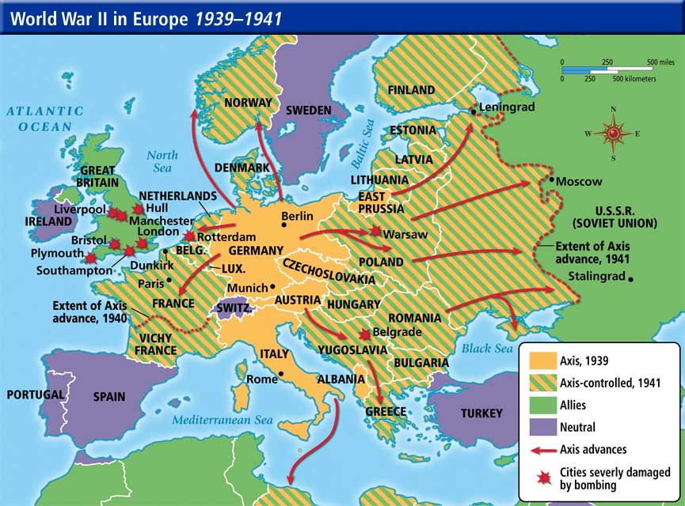
Where did he invade?
Before the war even started Hitler took control of the army and Austria and part of Czechoslovakia.
On September 1939, Hitler invaded Poland.
Once he had conquered Poland and killed thousands of Poles, he turned his attention to Denmark and Norway.
Quickly after Denmark and Norway, he invaded Belgium, the Netherlands and Luxemburg.
Then he set to work on Northern France and within five weeks he had conquered the country.
He fought the Soviet Union (now Russia) but couldn’t take it over.
He also sent axis forces to North Africa.

Slide 4
Where did he invade?
Looking at the map you can see just how much of Europe Hitler tried to invade. The diagonal stripes represent the land the Axis controlled in 1941.
One man dictated and achieved this invasion on a massive scale.

Slide 5
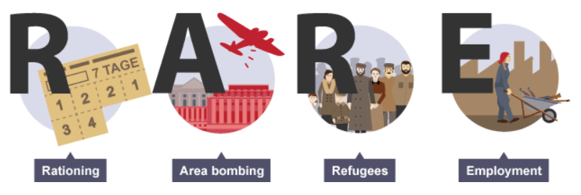
What was Germany like in the war?
Germany was quite similar to Britain during the war. They rationing food and clothes, and had to survive bombing from British forces. There was a huge number of refugees in Germany as well as issues with employment as most of the men had to fight!

Slide 6
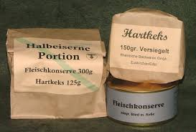
Rationing
Initially, everyday life wasn’t affected too much for the Germans. Rationing was kept to a minimum but became stricter in 1939. Big shortages came in 1944 for the Germans, They ate monotonous food with lots of bread, potatoes and preserves.
Extra ration were given to people who were considered important to the war effort like workers in heavy industries. They also gave extra food to pregnant women and blood donors.
Jewish people had the worst food entitlements.
Clothing was also rationed from 1939, and Nazi officials even raided houses to search for surplus clothes and shoes.

Slide 7
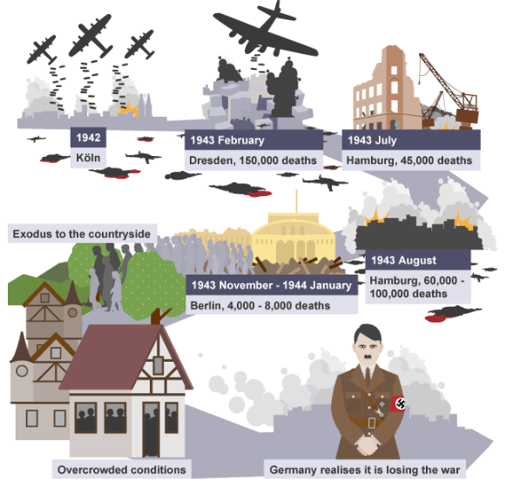
Bombing
Britain targeted their bombing raids to industrial and military targets at first and then switched to treating large industries; cities which included military and civilian targets.
Unlike the British Blitz, German children weren’t evacuated to the countryside.
The raids didn’t have a bog effect on the morale of the German’s as Nazi propaganda downplayed the destruction and number of deaths.

Slide 8
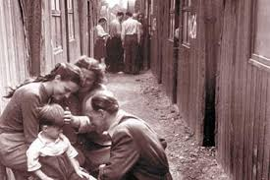
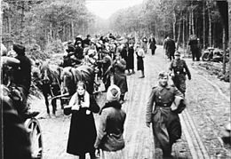
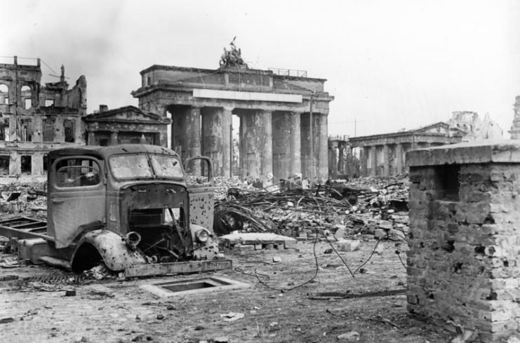
Refugees
Lots of Germans were displaced during the war especially when Britain started bombing cities. Houses and buildings were flattened or burnt down leaving many people homeless.

Slide 9
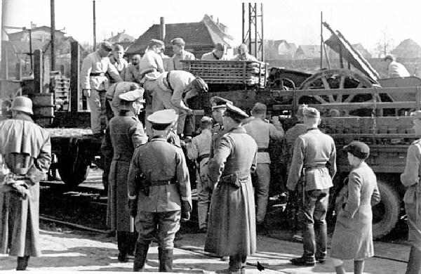
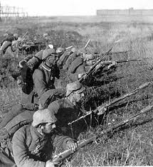
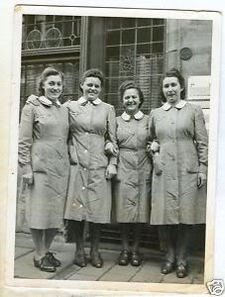
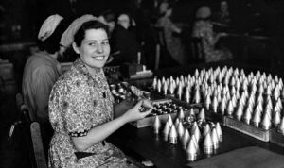
Employment
13.7 million German men served in the army during the war, which created a huge storage of workers on the home front.
Just like in Britain, women played a huge role by working in the military and weapons factories and as medics.
In 1943 women from 17-45 were forced to work.

Slide 10
Task
Write a short diary entry from the point of view of a German child. Try to include as much of the information that you have read from the Powerpoint. You can include:
Thoughts on Adolf Hitler.
What your opinions are on German invading all of the countries.
Rationing
Bombing
Refugees who are populating the cities.
Your Mum, Dad or siblings having to go to work or fight.
Include a date for your diary, thoughts feelings and emotions and key vocabulary.
Also think about the person you are writing in (i.e. first person) and what language you need to use.

