Slide 1
USA and japan
Second World War

Slide 2
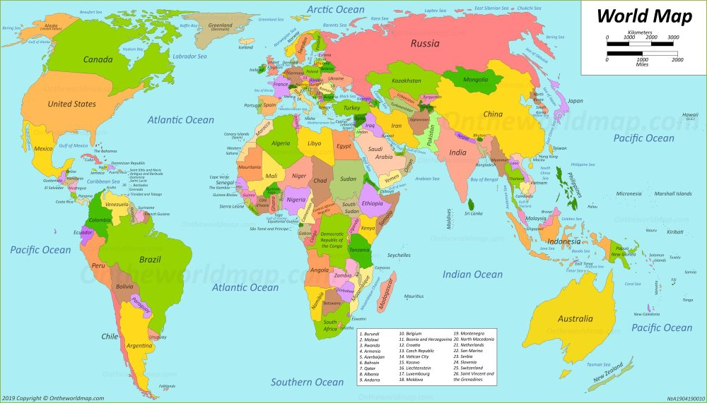
USA
USA didn’t join the fight until 1941, when their base, Pearl Harbour in Hawaii was attacked.
When they joined they were an Allie, fighting against Germany.
TASK:
- Find USA on the map.

Slide 3
JApan
Japan was already at war with China, fighting for the Axis when they attacked the USA at Pearl Harbour in 1941.
TASK:
- Find Japan on the map.

Slide 4
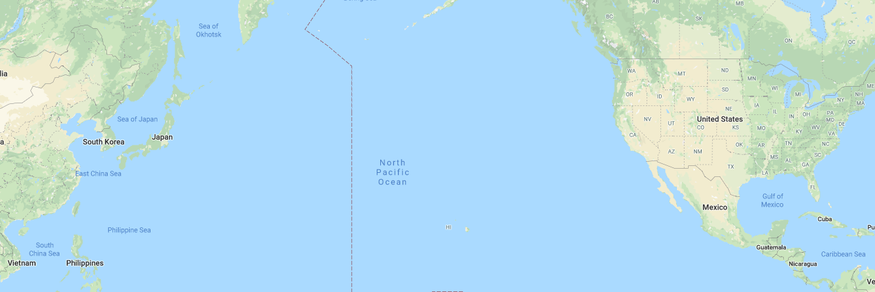
Pearl Harbour
Japan flew planes from Japan to Hawaii to destroy Pearl Harbour where US fighter planes were stored.
TASK: Find Japan and Hawaii on the map to see where the Japanese planes flew too. HINT: Hawaii is HI and isn’t on mainland America.

Slide 5
TASK
Complete the reading comprehension on the History page (choose the difficulty of you feel comfortable with) and then answer this question.
How do the different people involved feel about attack on Pearl Harbour? Draw a spider diagram of emotions for each and a sentence for why. Think about the aftermath as well when answering.
Japanese USA Germany

