Slide 1



LIFE/work balance
We have started a #LIFEworkbalance campaign and we need your help to complete our LIFE/work balance survey.
We hope to publish the results soon, so please give 15 minutes of your time to help us get a true picture of school life.
Want to be a part of this campaign? Take the survey on our website and share it with your colleagues!
© Classroom Secrets Limited 2020

Slide 2
Year 3 – Spring Block 2 – Money – Subtracting Money
About This Resource:
This PowerPoint has been designed to support your teaching of this small step. It includes a starter activity and an example of each question from the Varied Fluency and Reasoning and Problem Solving resources also provided in this pack. You can choose to work through all examples provided or a selection of them depending on the needs of your class.
National Curriculum Objectives:
Mathematics Year 3: (3C1) Add and subtract numbers mentally, including three-digit number and ones
More Year 3 Money resources.
Did you like this resource? Don’t forget to review it on our website.
© Classroom Secrets Limited 2019

Slide 3
Year 3 – Spring Block 2 – Money
Step 4: Subtracting Money
© Classroom Secrets Limited 2019

Slide 4
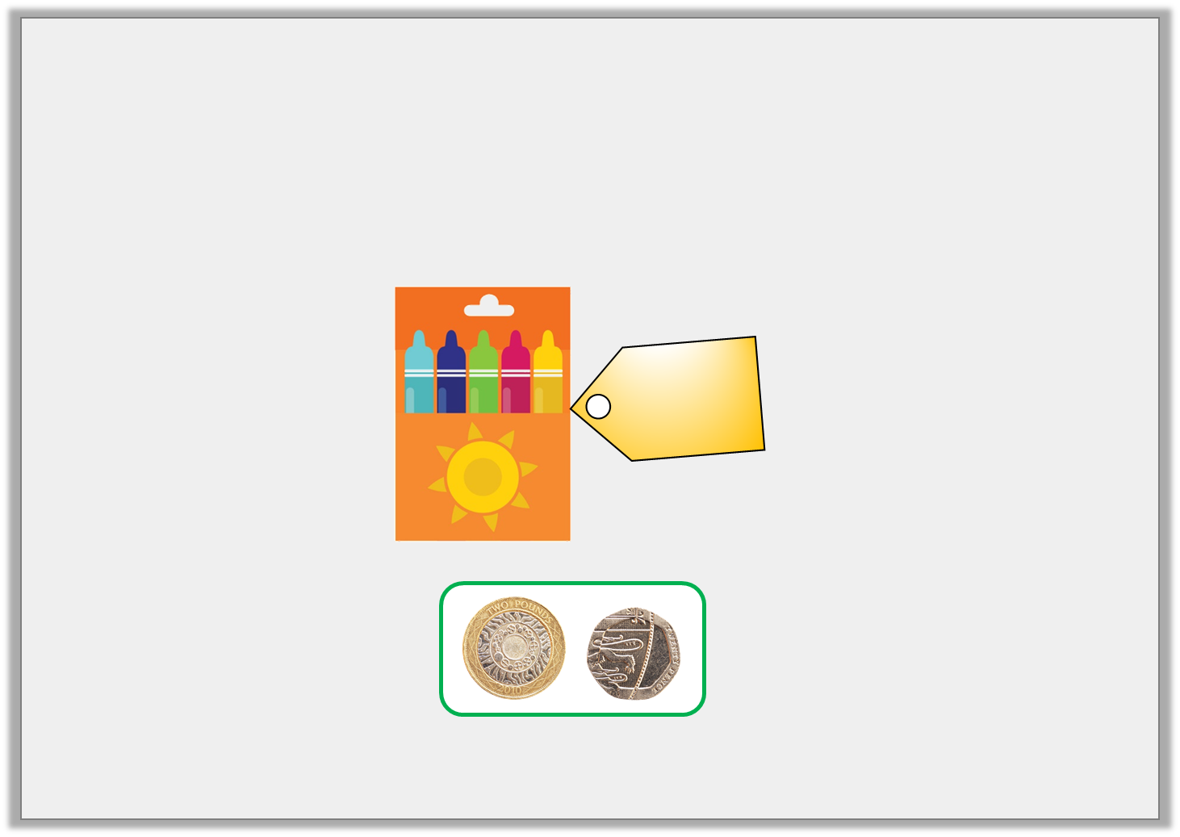
Introduction
Jack is saving to buy a packet of felt tips.
How much more money does he need to save?
£3
and
35p
© Classroom Secrets Limited 2019

Slide 5
Introduction
Jack is saving to buy a packet of felt tips.
How much more money does he need to save?
Jack needs to save another £1 and 15p.
£3
and
35p
© Classroom Secrets Limited 2019

Slide 6
Varied Fluency 1
Complete the missing numbers on the number line.
_____p
£ _____
_____p
75p
£1
£____
£6 and
70p
© Classroom Secrets Limited 2019

Slide 7
Varied Fluency 1
Complete the missing numbers on the number line.
25p
£5
70p
75p
£1
£6
£6 and
70p
© Classroom Secrets Limited 2019

Slide 8
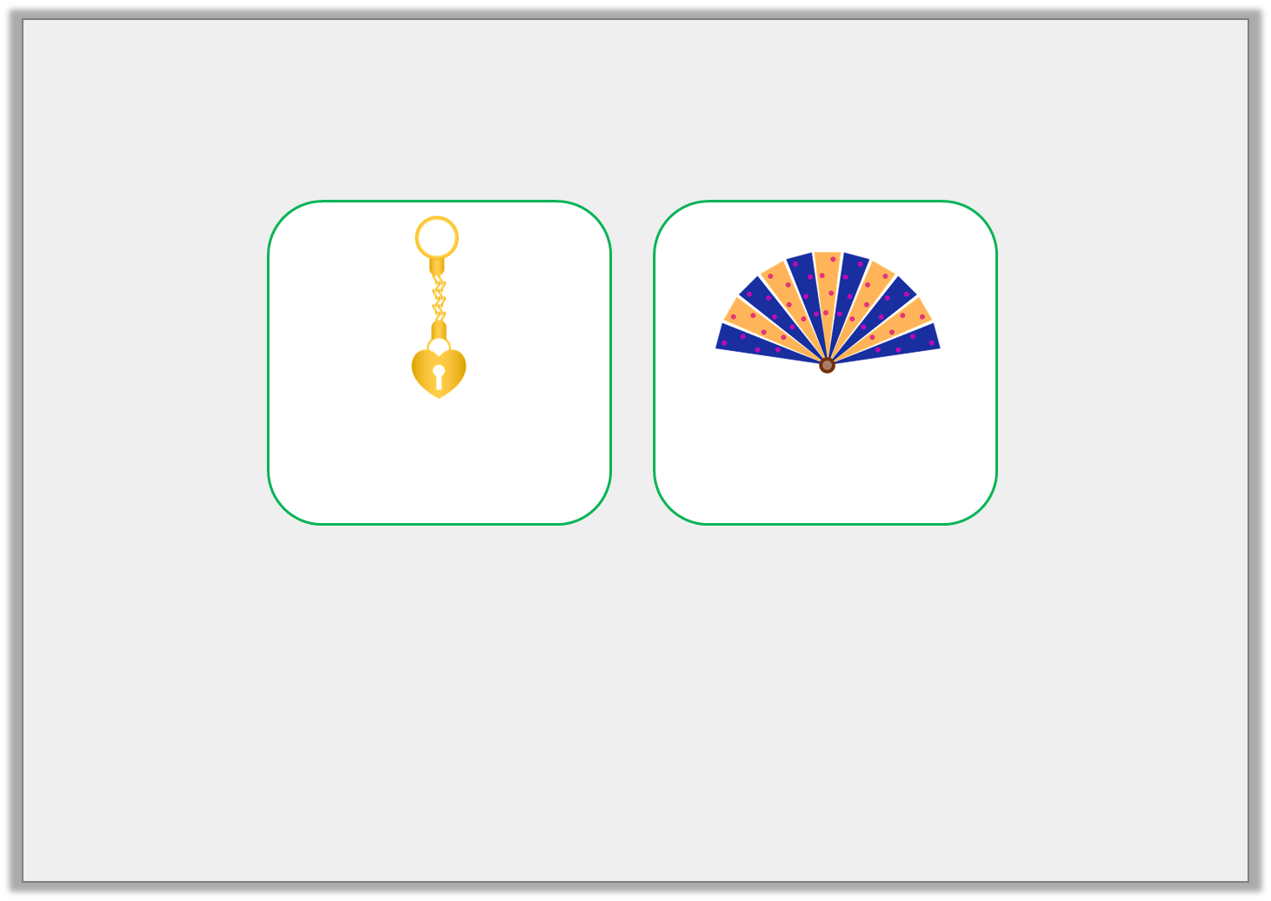
Varied Fluency 2
Shirelle likes two items in the museum’s gift shop.
How much less does the gold keyring cost?
£_____ and ______p
£3 and 60p
£7 and 45p
© Classroom Secrets Limited 2019

Slide 9
Varied Fluency 2
Shirelle likes two items in the museum’s gift shop.
How much less does the gold keyring cost?
£3 and 85p
£3 and 60p
£7 and 45p
© Classroom Secrets Limited 2019

Slide 10
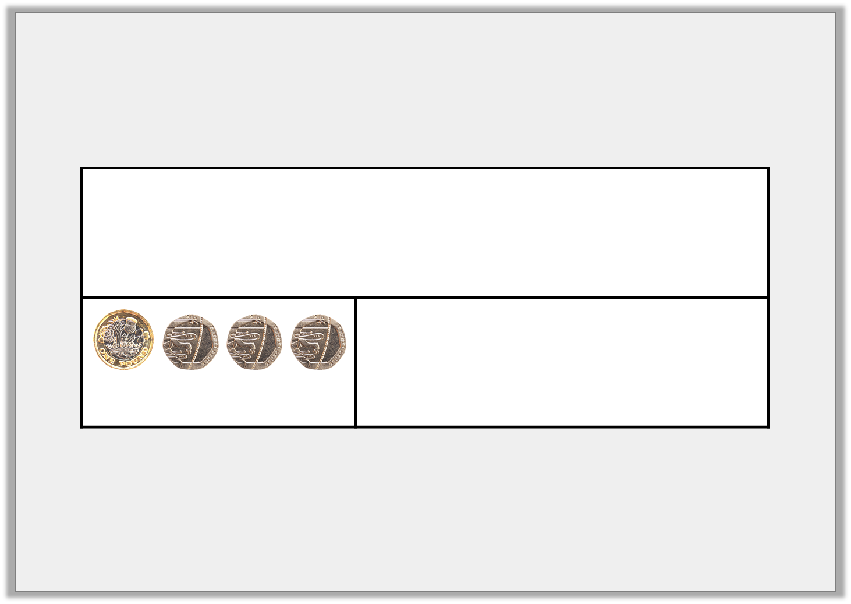
Varied Fluency 3
Saoirse had £7 and 85p in her piggy bank. She spent £1 and 60p. Complete the bar model to show how much she has left.
= £1 and 60p
© Classroom Secrets Limited 2019

Slide 11
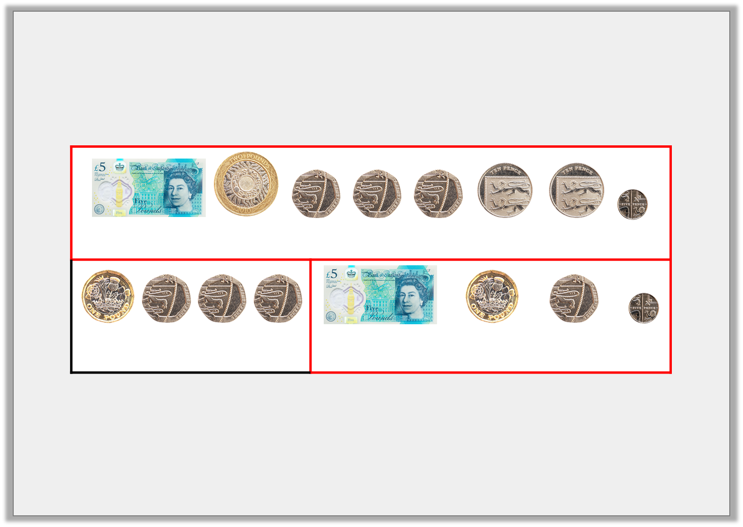
Varied Fluency 3
Saoirse had £7 and 85p in her piggy bank. She spent £1 and 60p. Complete the bar model to show how much she has left.
Saoirse has £6 and 25p left.
= £7 and 85p
= £1 and 60p
= £6 and 25p
© Classroom Secrets Limited 2019

Slide 12
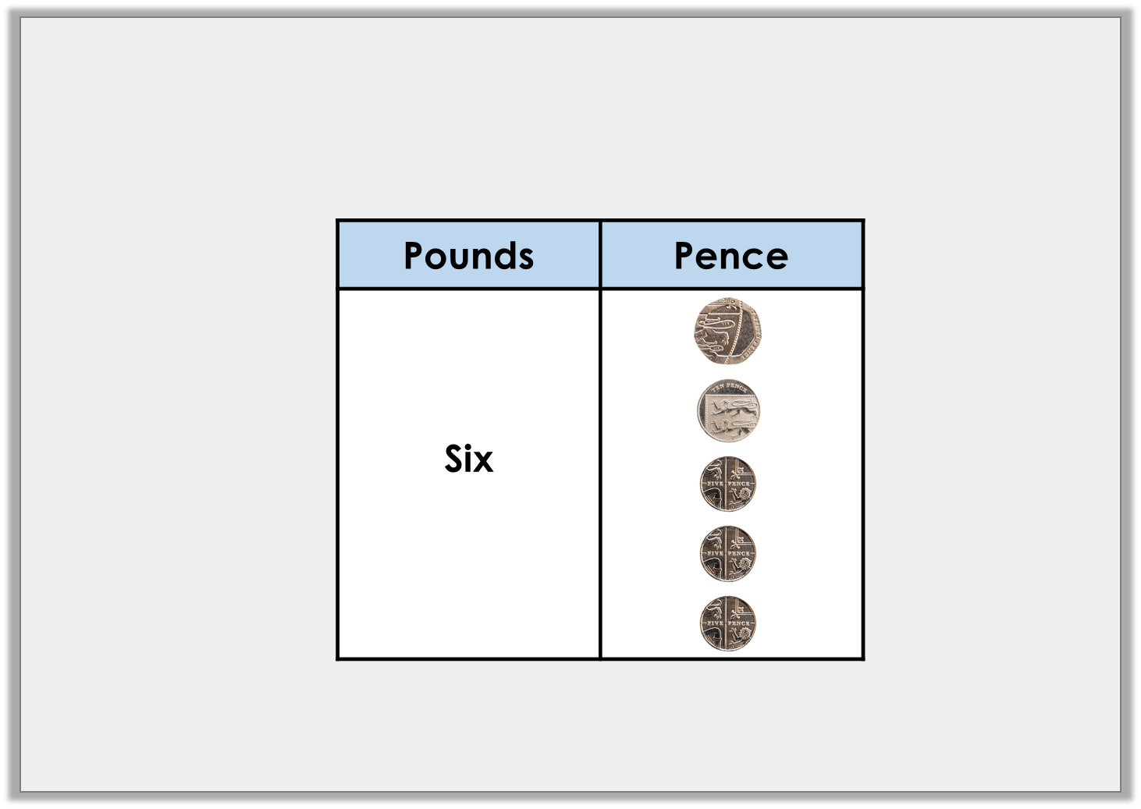
Varied Fluency 4
Take away £2 and 65p from the amount shown below.
How much is left?
© Classroom Secrets Limited 2019

Slide 13
Varied Fluency 4
Take away £2 and 65p from the amount shown below.
How much is left?
£6 and 45p – £2 and 65p = £3 and 80p
© Classroom Secrets Limited 2019

Slide 14

Reasoning 1
Luke and Viola have saved some money.
How much more money does Viola have than Luke?
Explain how you know.
I have £4 and 30p.
Luke
I have £8 and 85p.
Viola
© Classroom Secrets Limited 2019

Slide 15
Reasoning 1
Luke and Viola have saved some money.
How much more money does Viola have than Luke?
Explain how you know.
Viola has £4 and 55p more than Luke because…
I have £4 and 30p.
Luke
I have £8 and 85p.
Viola
© Classroom Secrets Limited 2019

Slide 16
Reasoning 1
Luke and Viola have saved some money.
How much more money does Viola have than Luke?
Explain how you know.
Viola has £4 and 55p more than Luke because £8 and 85p – £4 and 30p = £4 and 55p.
I have £4 and 30p.
Luke
I have £8 and 85p.
Viola
© Classroom Secrets Limited 2019

Slide 17

Reasoning 2
Errol says,
Explain the mistake that Errol has made.
I have £7 and 25p and I spend £3 and 60p on some popcorn. This means I will have
£3 and 60p left.
40p
£3
25p
£3 and
60p
£4
£7
£7 and
25p
© Classroom Secrets Limited 2019

Slide 18
Reasoning 2
Errol says,
Explain the mistake that Errol has made.
Errol has subtracted £3 and 65p…
I have £7 and 25p and I spend £3 and 60p on some popcorn. This means I will have
£3 and 60p left.
40p
£3
25p
£3 and
60p
£4
£7
£7 and
25p
© Classroom Secrets Limited 2019

Slide 19
Reasoning 2
Errol says,
Explain the mistake that Errol has made.
Errol has subtracted £3 and 65p in total, rather than £3 and 60p. The correct subtraction is: £7 and 25p – £3 and 60p = £3 and 65p.
I have £7 and 25p and I spend £3 and 60p on some popcorn. This means I will have
£3 and 60p left.
40p
£3
25p
£3 and
60p
£4
£7
£7 and
25p
© Classroom Secrets Limited 2019

Slide 20
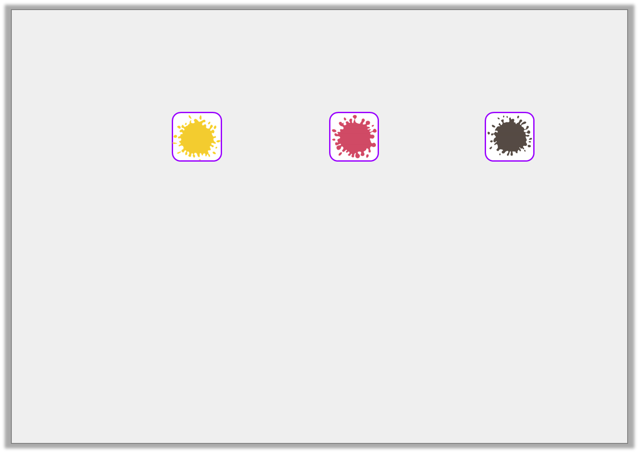
Problem Solving 1
Find possible values of the hidden digits. Complete the subtraction using 4 of the cards below.
Find two possible solutions.
5
7
6
£ |  | and |  | 5p | – | £ |  | and |  | 0p | = | £4 | and | 35p
£ |  | and |  | 5p | – | £ |  | and |  | 0p | = | £4 | and | 35p
© Classroom Secrets Limited 2019

Slide 21
Problem Solving 1
Find possible values of the hidden digits. Complete the subtraction using 4 of the cards below.
Find two possible solutions.
Two different solutions are shown above.
5
7
6
£ | 7 | and | 5 | 5p | – | £ | 3 | and | 2 | 0p | = | £4 | and | 35p
£ | 5 | and | 6 | 5p | – | £ | 1 | and | 3 | 0p | = | £4 | and | 35p
© Classroom Secrets Limited 2019

