Slide 1
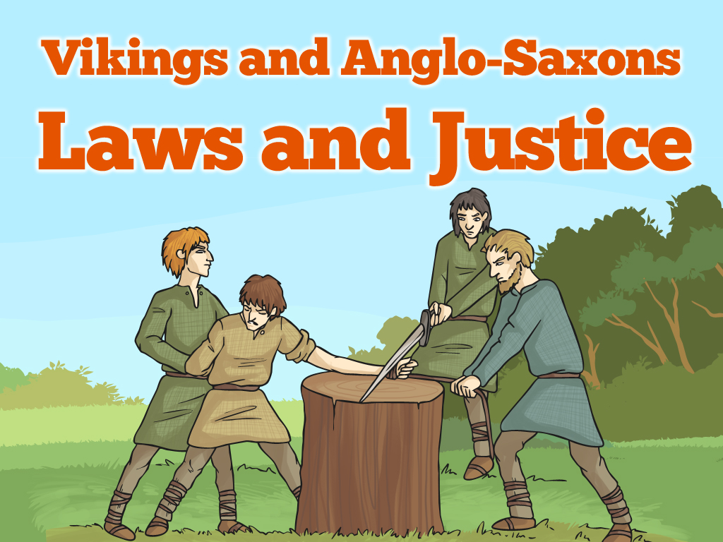


Slide 2
Aim
I can explain how the legal system worked in Anglo-Saxon and
Viking Britain.
Success Criteria
I can demonstrate understanding of crime and punishment in Anglo-Saxon and Viking Britain.
I can compare and contrast the Anglo-Saxon and Viking justice systems with the modern British justice system.

Slide 3

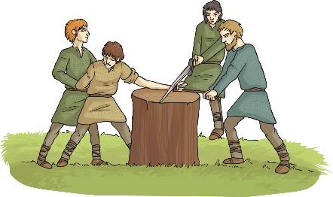
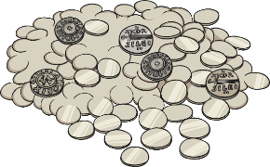
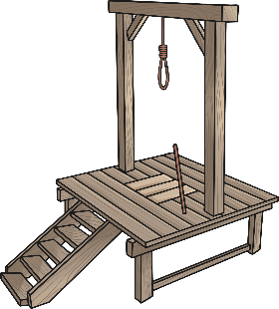
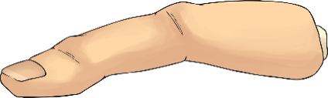
Fair or Foul?
Read the different scenarios and the proposed punishments. Which do you think are fair punishments? Which do you think are foul (unfair)?
Baldwine steals a pig from the market.
Punishment: one of his hands are cut off.
Is this fair? Why/why not?
Elfgar kills his neighbour, Wigmund, when they get into a fight.
Punishment: Elfgar has to pay Wigmund’s family 100 shillings.
Is this fair? Why/why not?
Mildburg is accused of doing magic and being a witch.
Punishment: Mildburg is hung by the neck until he dies.
Is this fair? Why/why not?
Alwin, a slave, tried to run away from his master.
Punishment: he is whipped and his little finger is cut off.
Is this fair? Why/why not?

Slide 4
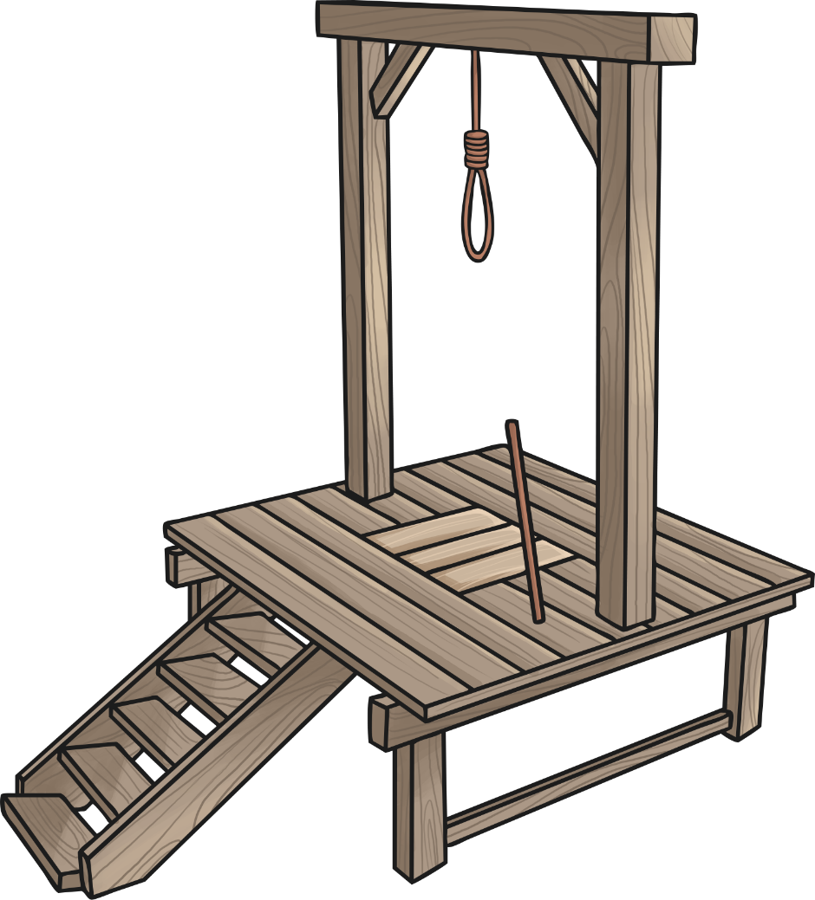
Anglo-Saxon Justice System
Many laws we have in Britain today are not that different from the laws of Anglo-Saxon Britain. However, the punishments were considerably different.
There were no prisons to send criminals to, so punishments were designed to be a huge deterrent to those thinking of breaking the law and they were often pretty brutal!
The different Anglo-Saxon kings and kingdoms had their own laws and punishments.

Slide 5
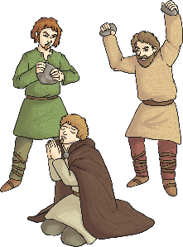

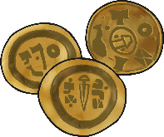
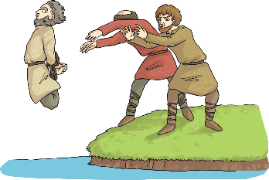
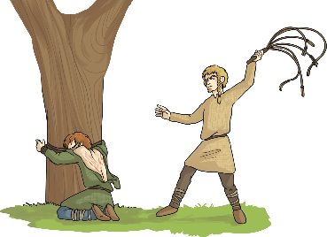

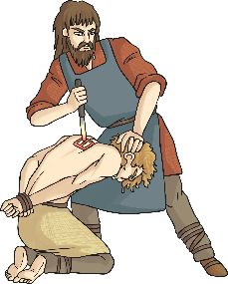
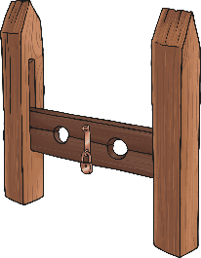
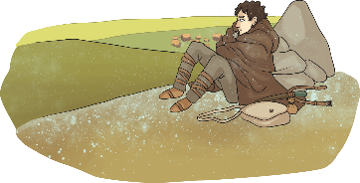
Types of Punishments
Here are some typical Anglo-Saxon punishments…
Paying a fine (if a person could not afford their fine, they could be put into slavery)
Stoning
Hanging
Mutilation (bits of the body cut off)
Drowning
Whipping
Branding (burned with a hot iron rod)
Exile (being sent away)
Stocks
Most punishments were carried out in public to make an example of the guilty person and to deter others from committing the same crime.

Slide 6
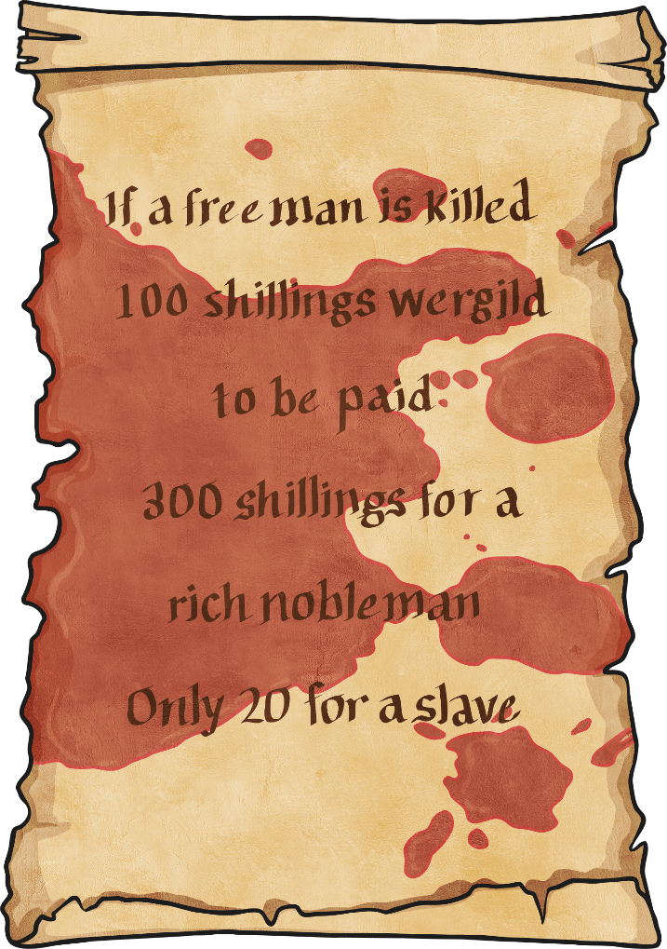
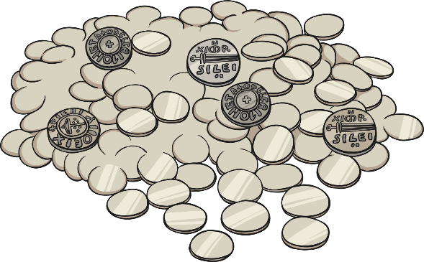
Wergild
Wergild was a payment system used in Anglo-Saxon times to settle disputes between the criminal and the victim or the victim’s family.
Wergild would be paid if someone was killed and the amount depended on how important the victim was.

Slide 7

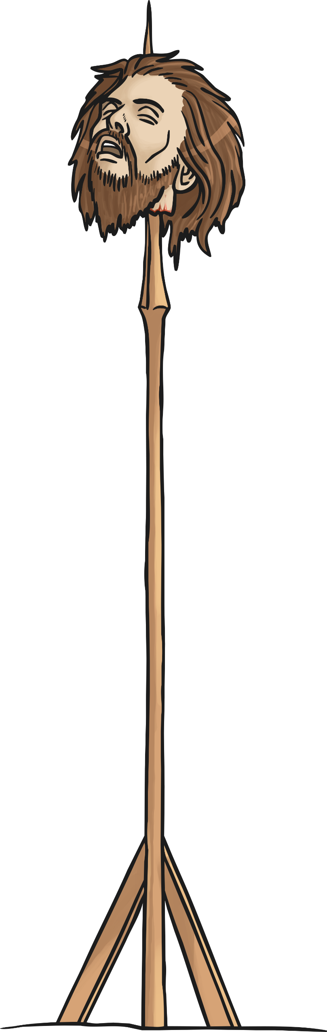
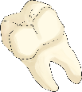



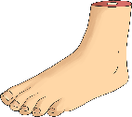
Body Parts
Different parts of the body even had a wergild value. So if you lost a finger in a fight, your attacker would have to pay you compensation.
Look at the chart showing how much different body parts were worth in the wergild system. Use the chart to help you work out how much compensation you would get for the missing body parts on your Missing Body Parts Card.
Body Part | Wergild Value
Broken tooth | 1 shilling
Broken nose | 10 shilling
Lost Finger | 6 shillings
Lost thumb | 20 shillings
Lost foot | 50 shillings

Slide 8

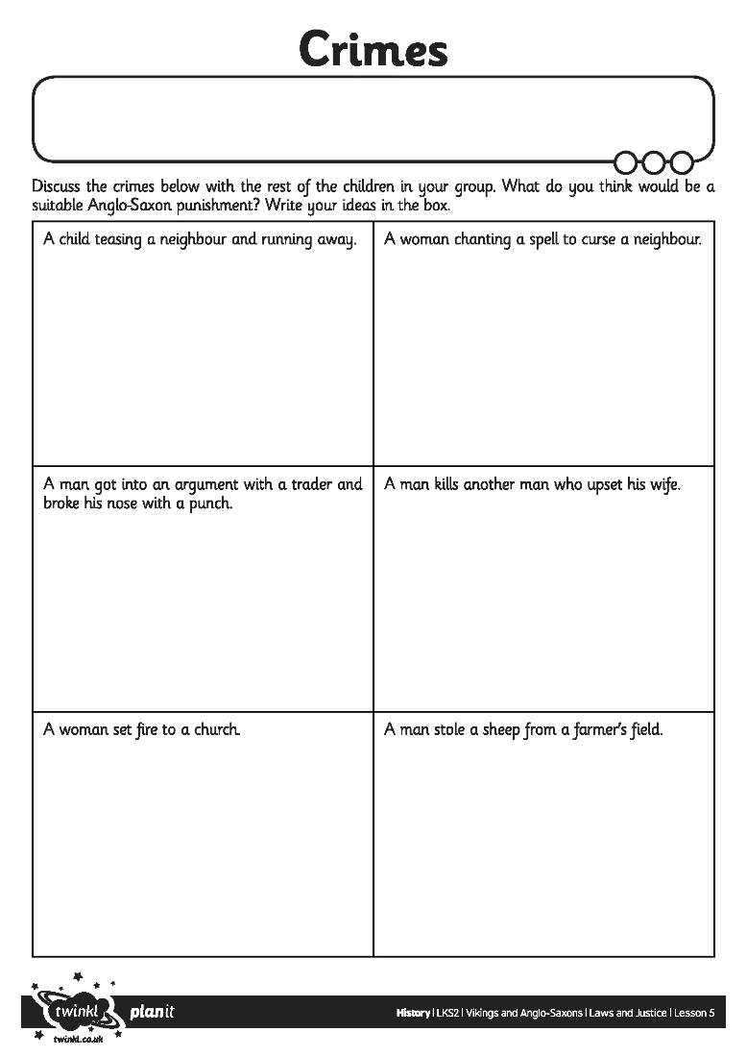
Crimes and Punishments
Discuss the scenarios you have been given with the other children in your group. Based on what you have learnt in the lesson so far, can you decide on a likely Anglo-Saxon punishment and a likely modern day punishment. Make sure you are able to explain your choices and be ready to feed your ideas back to the rest of the class.

Slide 9
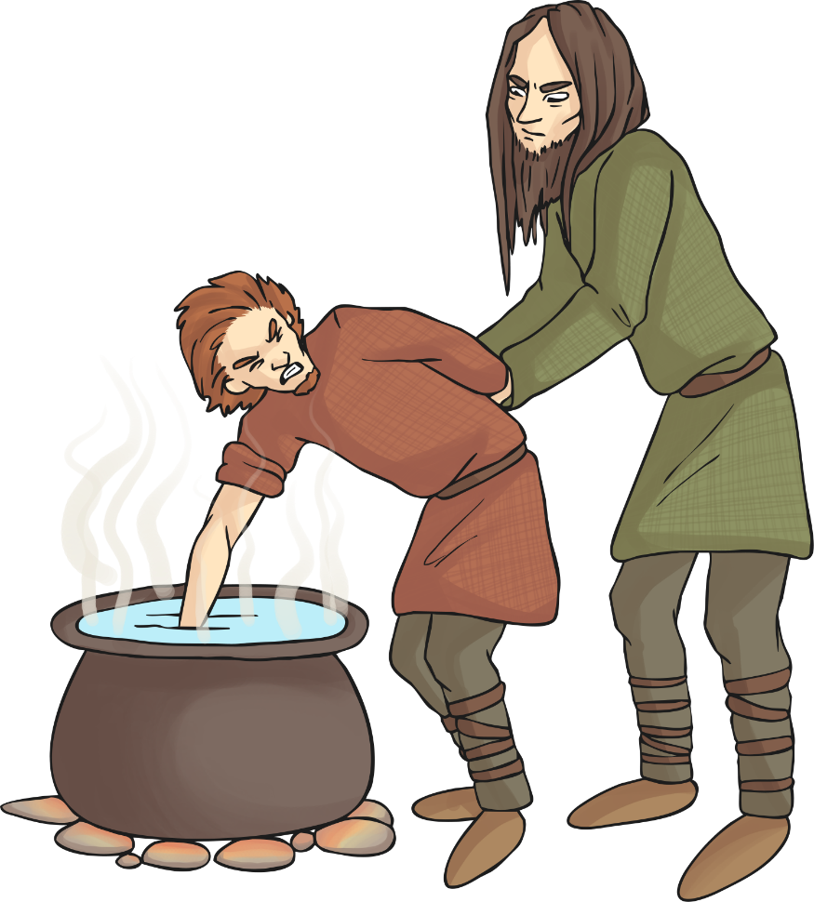
Anglo-Saxon Courts
In Anglo-Saxon Britain, people accused of crimes had to go to court and be tried for their crimes, just like the courts in Britain today.
A jury would decide if the defendant (person accused of the crime) was innocent or guilty and decide on a suitable punishment.
The defendant could choose oath-keepers who would swear they were innocent (a bit like witnesses today).
If the defendant insisted they were innocent and/or a decision could not be reached, sometimes there would be a trial by ordeal through which the Anglo-Saxons believed god would decide if the person was guilty or not. The defendant could choose which ordeal to go through.

Slide 10

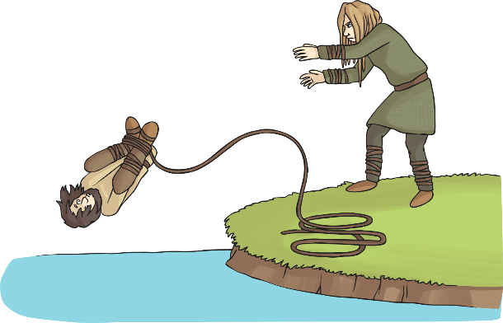
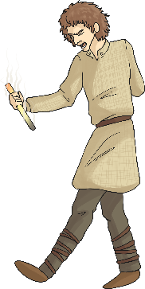

Ordeals
There were three main ordeals in Anglo-Saxon Britain. Who will volunteer to choose to take an ordeal?
Cold Water Ordeal
The person would have their hands and feet tied with rope, be given a drink of holy water and then thrown into an icy cold lake. If they sank to the bottom, they were innocent. If they floated, they were guilty.
Hot Water Ordeal
The person would have to plunge their hand into a pot of boiling hot water and retrieve a stone from the bottom. The hand would be bandaged for three days and then checked. If it was healing without infection, the person was deemed innocent, but if it was infected they were guilty.
Iron Bar Ordeal
The person had to carry a glowing hot iron bar for nine feet. They would then have their hand bandaged for three days. Like the hot water ordeal, if it was healing without infection the person was deemed innocent but if it was infected, they were guilty.

Slide 11

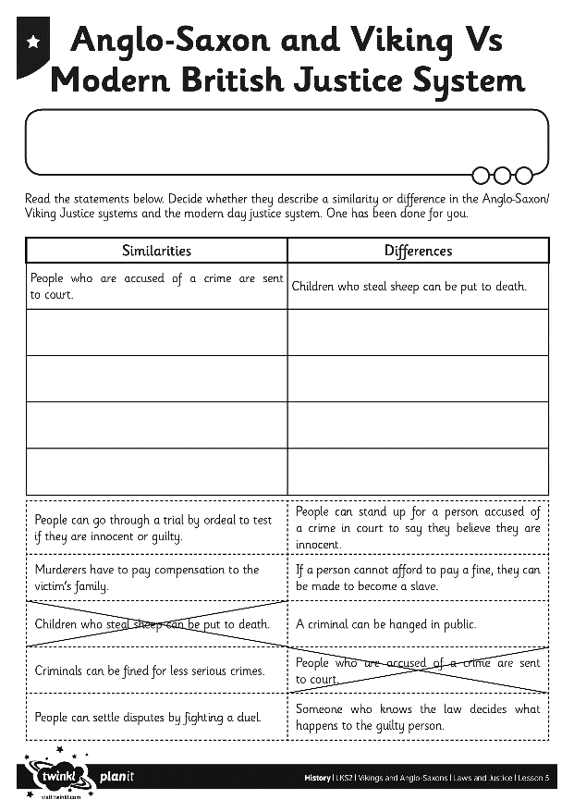
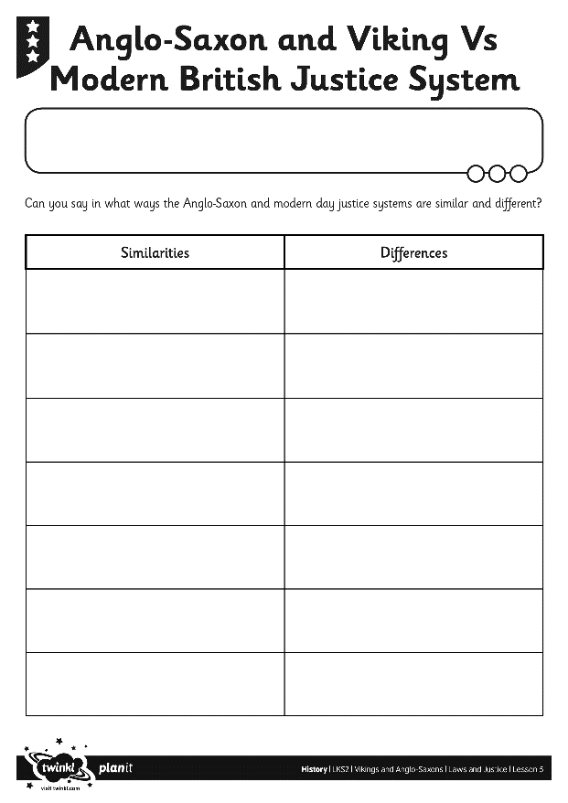
Anglo-Saxons and Vikings Vs Modern Britain Justice Systems
How does the Anglo-Saxon justice system compare to the system we have in Britain today?
Which aspects are similar and which are different?
Complete the chart to show the similarities and differences.

