Slide 2



Diving into Mastery Guidance for Educators
Each activity sheet is split into three sections, diving, deeper and deepest, which are represented by the following icons:
These carefully designed activities take your children through a learning journey, initially ensuring they are fluent with the key concept being taught; then applying this to a range of reasoning and problem-solving activities.
These sheets might not necessarily be used in a linear way. Some children might begin at the ‘Deeper’ section and in fact, others may ‘dive straight in’ to the ‘Deepest’ section if they have already mastered the skill and are applying this to show their depth of understanding.
Diving
Deeper
Deepest

Slide 3
Aim
Recall and use multiplication and division facts for the 3, 4 and 8 multiplication tables.

Slide 4
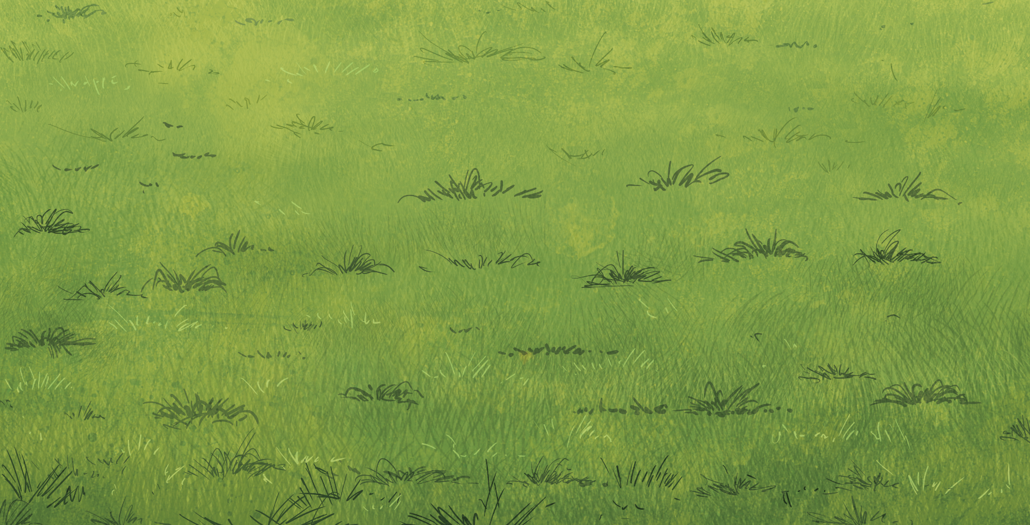

Divide by 3
Diving
Divide the balls into three equal groups. How many balls are in each group? Write a calculation to match your model.
12 ÷ 3 = 4

Slide 5
Divide by 3
Diving
Divide the balls into groups of three. How many groups do you have? Write a calculation to match your model.
15 ÷ 3 = 5

Slide 6
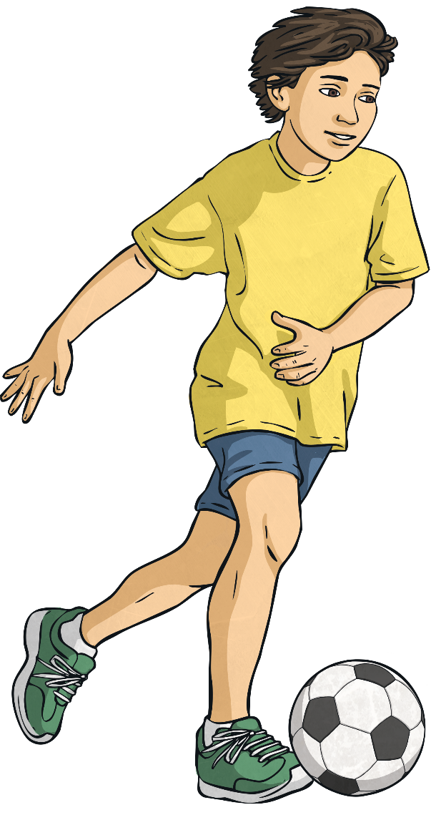
Divide by 3
Diving
Mr Ringer buys a case of 27 footballs for his school. Each class receives 3 balls. How many classes are there?
Complete the bar model to show your answer.
27
27
3 | 3 | 3 | 3 | 3 | 3 | 3 | 3 | 3
There are 9 classes.

Slide 7

Divide by 3
Deeper
Match the correct calculation with the problem.
Explain your reason for each choice.
Jennie sorted 27 children into three equal groups.
Jake has shared nine cakes between three plates.
Johanna grouped 27 children into groups of three.
27
9 | 9 | 9
27 has been divided into 3 groups of 9.
27 has been divided into 9 groups of 3.
9 has been divided into 3 groups of 3.

Slide 8

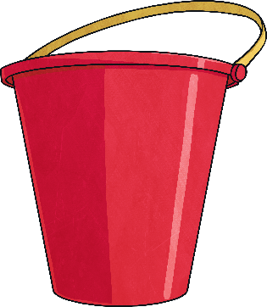

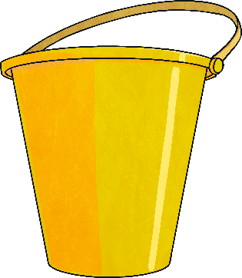
Divide by 3
Deepest
3 points
4 points
7 points
Barack threw some balls into the buckets and scored 13 points.
All the balls landed in the red bucket except one, which landed in a different bucket.
How many balls could Barack have thrown? Find all the possibilities.
One ball landed in the blue bucket.
13 – 4 = 9
9 ÷ 3 = 3
He threw 4 balls. 3 landed in the red bucket and one in the blue bucket.
One ball landed in the yellow bucket.
13 – 7 = 6
6 ÷ 3 = 2
He threw 3 balls. 2 landed in the red bucket and one in the blue bucket.

Slide 9
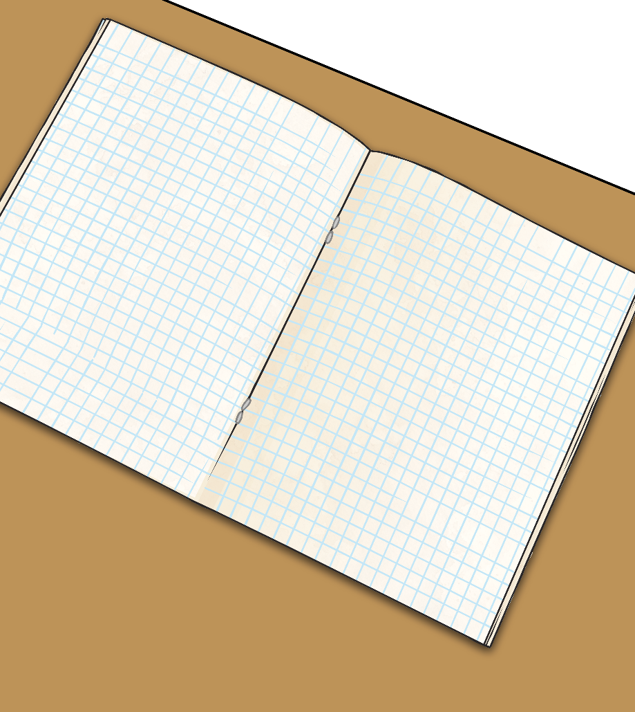
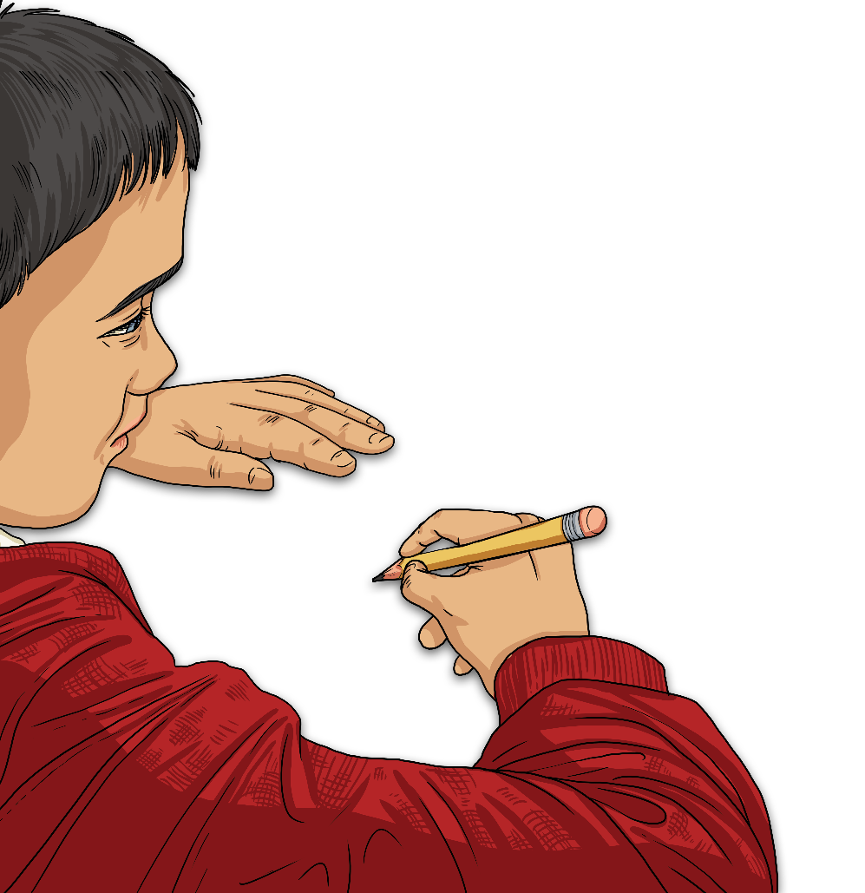
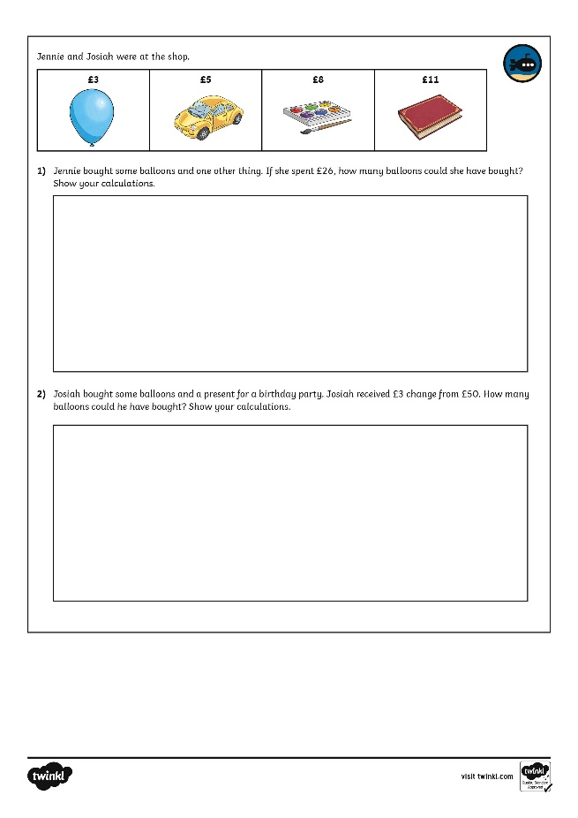
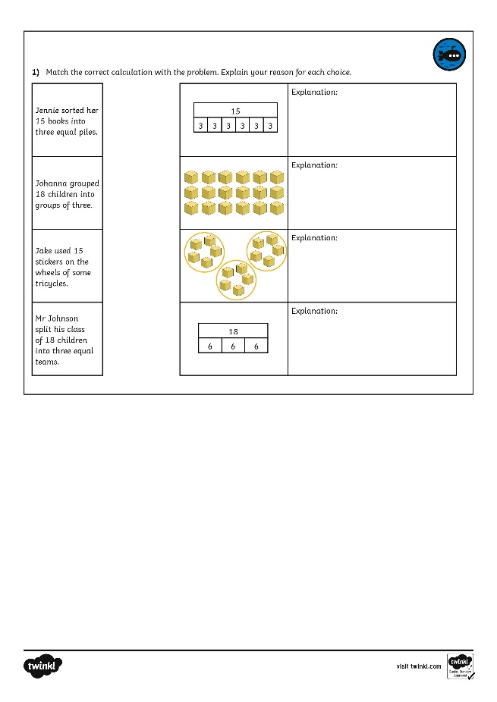
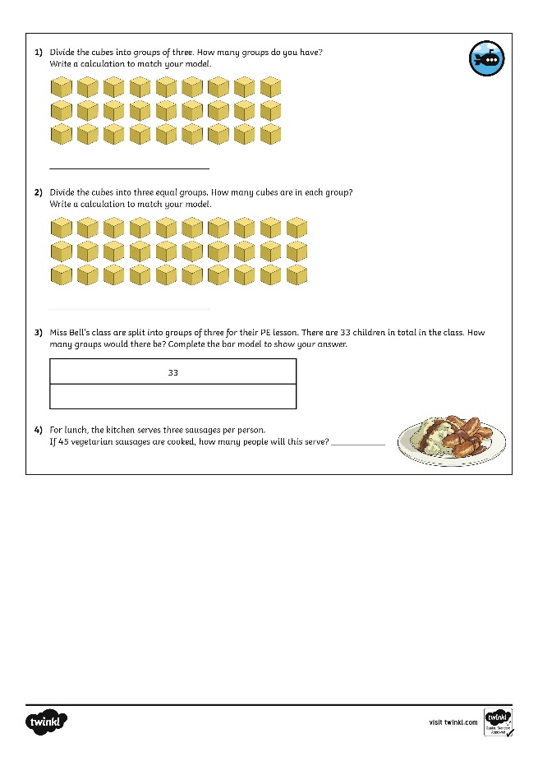
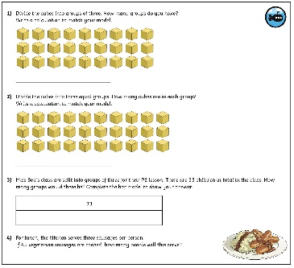
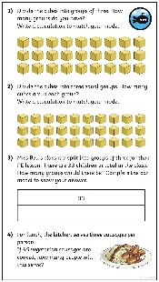
Divide by 3
Dive in by completing your own activity!

Slide 10
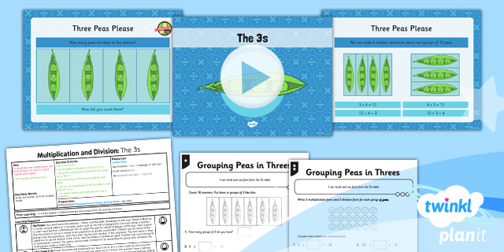
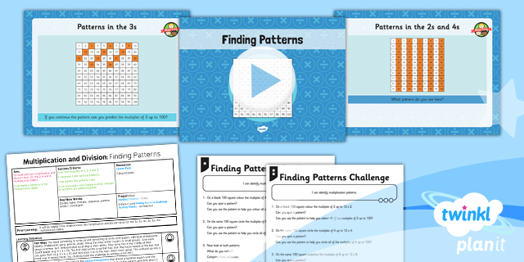

Need Planning to Complement this Resource?
National Curriculum Aim
Recall and use multiplication and division facts for the 3, 4 and 8 multiplication tables.
For more planning resources to support this aim, click here.
Twinkl PlanIt is our award-winning scheme of work with over 4000 resources.

