Slide 1
17/12/2020
L.I: To Divide by 4

Slide 3

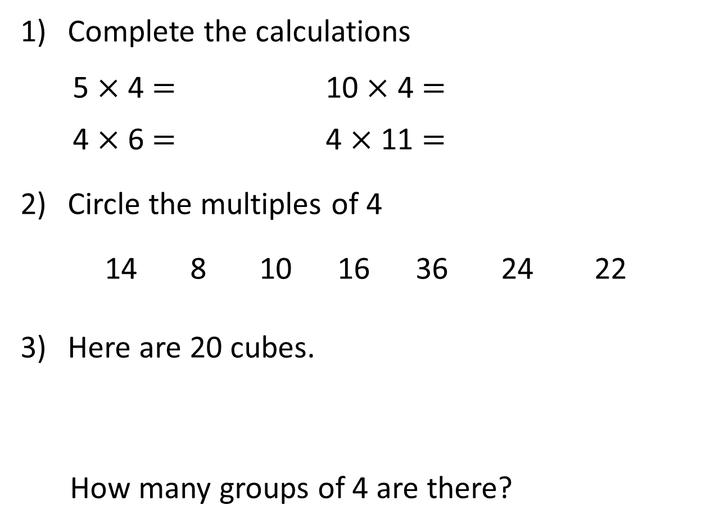
Complete the calculations
5 $×$ 4 $=$ 10 $×$ 4 $=$
4 $×$ 6 $=$ 4 $×$ 11 $=$
Circle the multiples of 4
14 8 10 16 36 24 22
Here are 20 cubes.
How many groups of 4 are there?

Slide 4
Complete the calculations
5 $×$ 4 $=$ 10 $×$ 4 $=$
4 $×$ 6 $=$ 4 $×$ 11 $=$
Circle the multiples of 4
14 8 10 16 36 24 22
Here are 20 cubes.
How many groups of 4 are there?
20
40
24
44
5

Slide 6




Alex and Ron have 20 cubes.
They share the cubes into 4 equal towers.
How many cubes will be in each tower?
There are 5 cubes in each tower.
20 $÷$ 4 $=$ 5
Have a think

Slide 7

Alex and Ron have 20 cubes.
They use the cubes to build towers of 4
How many towers of 4 can they build?
They can build 5 towers of 4
20 $÷$ 4 $=$ 5
Have a think

Slide 8
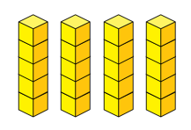
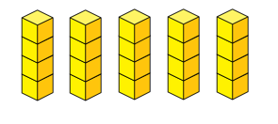
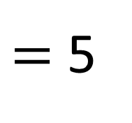
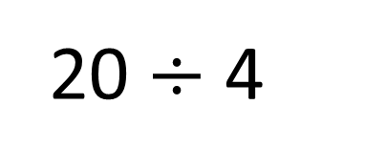
20 $÷$ 4
$=$ 5
Shared into 4 equal towers
There are 5 cubes in each tower.
Grouped into towers of 4
There are 5 towers of 4 cubes.

Slide 9






Here are 12 cakes.
They are shared equally between 4 plates.
They are divided into groups of 4
Have a think

Slide 10


They are shared equally between 4 plates.
There will be 3 cakes on each plate.
12 $÷$ 4 $=$ 3

Slide 11

They are grouped into plates of 4
There will be 3 plates of 4 cakes.
12 $÷$ 4 $=$ 3

Slide 12
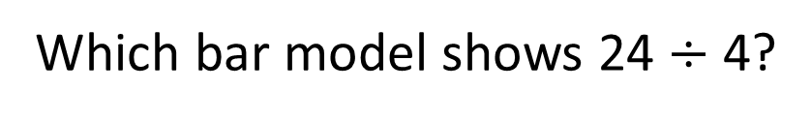
Can you draw 2 bar models to show 28 divided by 4?
Which bar model shows 24 $÷$ 4?
24
4 | 4 | 4 | 4 | 4 | 4
24 divided into groups of 4
24
6 | 6 | 6 | 6
24 divided into 4 equal parts

Slide 13
Can you draw 2 bar models to show 28 divided by 4?
28
4 | 4 | 4 | 4 | 4 | 4 | 4
28 divided into groups of 4
28
7 | 7 | 7 | 7
28 divided into 4 equal parts

Slide 14
Have a go at questions 1 - 4 on the worksheet

Slide 15



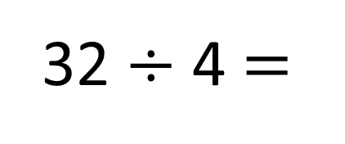
32 $÷$ 4 $=$
The baker has 32 bread rolls.
He puts them into packs of 4
How many packs can he fill?
8
$+$ 4
0
4
8
12
16
20
24
28
32
$−$ 4
0
4
8
12
16
20
24
28
32

Slide 16


Multiples of 4 are all even numbers.
So all even numbers can be grouped into 4s
12
8
16
10
Have a think

Slide 17
Have a go at the rest of the questions on the worksheet

