Slide 1



LIFE/work balance
We have started a #LIFEworkbalance campaign and we need your help to complete our LIFE/work balance survey.
We hope to publish the results soon, so please give 15 minutes of your time to help us get a true picture of school life.
Want to be a part of this campaign? Take the survey on our website and share it with your colleagues!
© Classroom Secrets Limited 2019

Slide 2
Year 3 – Spring Block 1 – Multiplication and Division – Comparing Statements
About This Resource:
This PowerPoint has been designed to support your teaching of this small step. It includes a starter activity and an example of each question from the Varied Fluency and Reasoning and Problem Solving resources also provided in this pack. You can choose to work through all examples provided or a selection of them depending on the needs of your class.
National Curriculum Objectives:
Mathematics Year 3: (3C6) Recall and use multiplication and division facts for the 3, 4 and 8 multiplication tables
Mathematics Year 3: (3C7) Write and calculate mathematical statements for multiplication and division using the multiplication tables that they know, including for two-digit numbers times one-digit numbers, using mental and progressing to formal written methods
More Year 3 Multiplication and Division resources.
Did you like this resource? Don’t forget to review it on our website.
© Classroom Secrets Limited 2018

Slide 3
Year 3 – Spring Block 1 – Multiplication and Division
Step 1: Comparing Statements
© Classroom Secrets Limited 2018

Slide 4
Introduction
Match the array to the correct multiplication and work out the answers.
7 x 2
8 x 4
5 x 3
© Classroom Secrets Limited 2018

Slide 5
Introduction
Match the array to the correct multiplication and work out the answers.
8 x 4 = 32
7 x 2 = 14
5 x 3 = 15
© Classroom Secrets Limited 2018

Slide 6
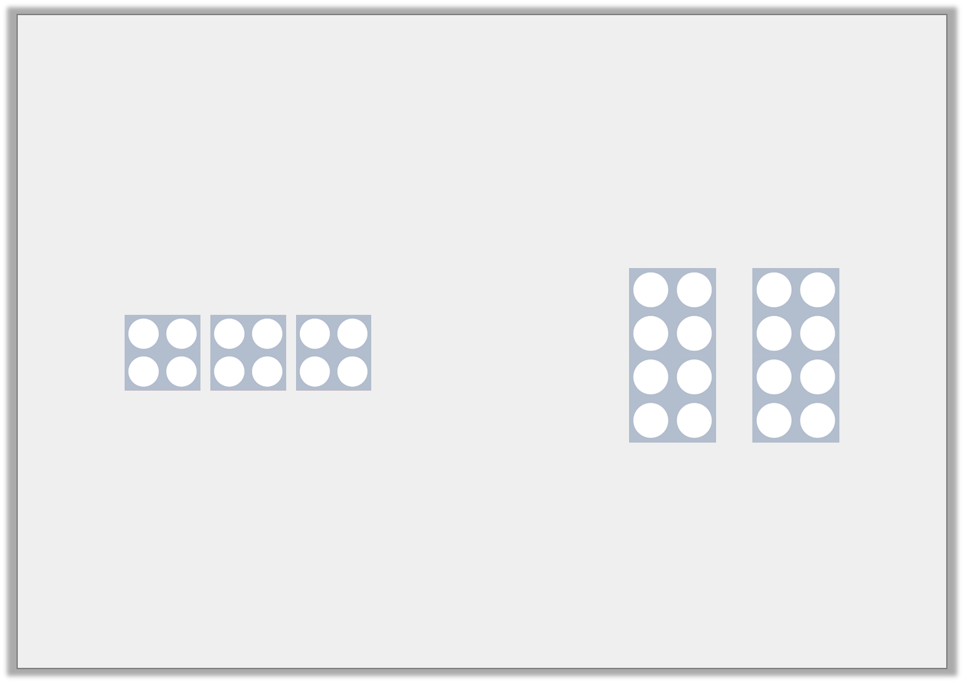
Varied Fluency 1
Circle the symbol to make the statement correct.
<
>
=
© Classroom Secrets Limited 2018

Slide 7
Varied Fluency 1
Circle the symbol to make the statement correct.
<
>
=
© Classroom Secrets Limited 2018

Slide 8
Varied Fluency 2
True or false?
>
 | x |  | =
 | x |  | =
© Classroom Secrets Limited 2018

Slide 9
Varied Fluency 2
True or false?
False, 2 x 3 = 6 = 3 x 2 = 6
>
2 | x | 3 | = | 6
3 | x | 2 | = | 6
© Classroom Secrets Limited 2018

Slide 10
Varied Fluency 3
Complete the bar models.
Use <, > or = to make the statement correct.
6 x ? = 18
4 | 4 | 4 | 4
© Classroom Secrets Limited 2018

Slide 11
Varied Fluency 3
Complete the bar models.
Use <, > or = to make the statement correct.
6 x 3 = 18
3 | 3 | 3 | 3 | 3 | 3
16
4 | 4 | 4 | 4
>
© Classroom Secrets Limited 2018

Slide 12
Varied Fluency 4
Use <, > or = to complete the number comparison statements.
A. | 3 x 8 |  | 4 + 4 + 4 + 4 + 4
B. | 32 ÷ 8 |  | 24 ÷ 4
C. | 36 ÷ 3 |  | 6 x 3
© Classroom Secrets Limited 2018

Slide 13
Varied Fluency 4
Use <, > or = to complete the number comparison statements.
A. | 3 x 8 | > | 4 + 4 + 4 + 4 + 4
B. | 32 ÷ 8 | < | 24 ÷ 4
C. | 36 ÷ 3 | < | 6 x 3
© Classroom Secrets Limited 2018

Slide 14
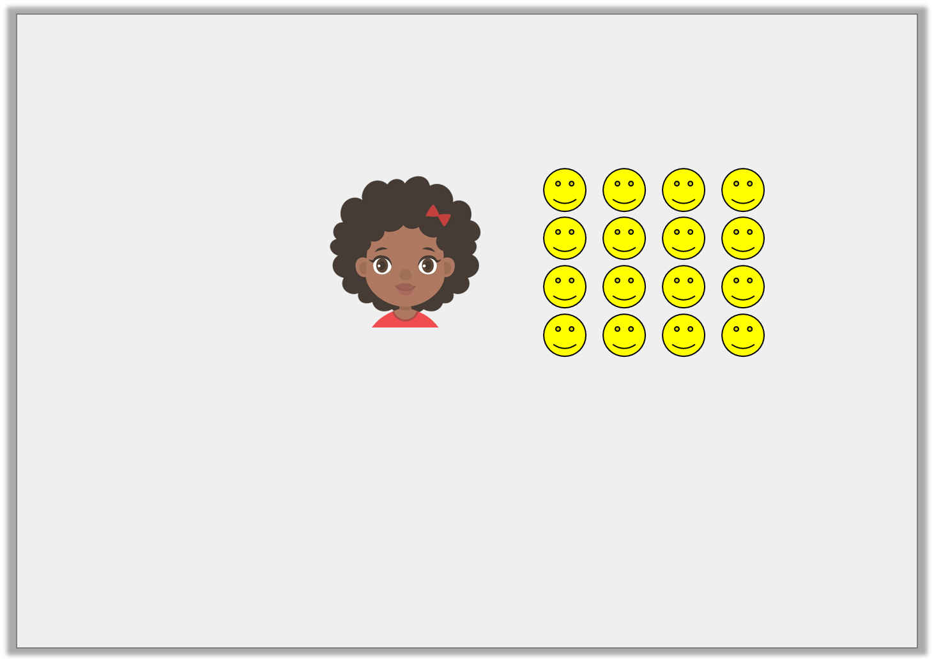
Reasoning 1
Nia says,
Is Nia correct? Explain how you know.
16 ÷ 4 = 4 x 4
© Classroom Secrets Limited 2018

Slide 15
Reasoning 1
Nia says,
Is Nia correct? Explain how you know.
Nia is incorrect because…
16 ÷ 4 = 4 x 4
© Classroom Secrets Limited 2018

Slide 16
Reasoning 1
Nia says,
Is Nia correct? Explain how you know.
Nia is incorrect because 16 ÷ 4 = 4 and 4 x 4 = 16.
It should be 16 ÷ 4 = 4 < 4 x 4 = 16.
16 ÷ 4 = 4 x 4
© Classroom Secrets Limited 2018

Slide 17
Problem Solving 1
Use the digit cards to complete the statement.
Find 3 different possibilities.
8
2
3
9
4
12
 | x | 3 | > | 5 | x
© Classroom Secrets Limited 2018

Slide 18
Problem Solving 1
Use the digit cards to complete the statement.
Find 3 different possibilities.
Various answers, for example: 8 x 3 > 5 x 4; 9 x 3 > 5 x 3
8
2
3
9
4
12
 | x | 3 | > | 5 | x
12
2
© Classroom Secrets Limited 2018

Slide 19
Reasoning 2
Spot the odd one out. Explain why.
A. 4 x 4 = 4 + 4 + 4 + 4
B. 3 x 6 = 6 x 3
C. 7 x 4 > 8 x 5
D. 9 x 3 > 6 x 4
© Classroom Secrets Limited 2018

Slide 20
Reasoning 2
Spot the odd one out. Explain why.
C is the odd one out because…
A. 4 x 4 = 4 + 4 + 4 + 4
B. 3 x 6 = 6 x 3
C. 7 x 4 > 8 x 5
D. 9 x 3 > 6 x 4
© Classroom Secrets Limited 2018

Slide 21
Reasoning 2
Spot the odd one out. Explain why.
C is the odd one out because it is the only incorrect statement.
7 x 4 = 28 and 8 x 5 = 40. The statement should be 7 x 4 < 8 x 5.
A. 4 x 4 = 4 + 4 + 4 + 4
B. 3 x 6 = 6 x 3
C. 7 x 4 > 8 x 5
D. 9 x 3 > 6 x 4
© Classroom Secrets Limited 2018

