Slide 1


Year 3 – Summer Block 1 – Fractions – Order Fractions
About This Resource:
This PowerPoint has been designed to support your teaching of this small step. It includes a starter activity and an example of each question from the Varied Fluency and Reasoning and Problem Solving resources also provided in this pack. You can choose to work through all examples provided or a selection of them depending on the needs of your class.
National Curriculum Objectives:
Mathematics Year 3: (3F2) Recognise and show, using diagrams, equivalent fractions with small denominators
Mathematics Year 3: (3F3) Compare and order unit fractions and fractions with the same denominators
Mathematics Year 3: (3F4) Add and subtract fractions with the same denominator within one whole
Mathematics Year 3: (3F10) Solve problems that involve the above objectives
More Year 3 Fractions resources.
Did you like this resource? Don’t forget to review it on our website.
© Classroom Secrets Limited 2019

Slide 2
Year 3 – Summer Block 1 – Fractions
Step 5: Order Fractions
© Classroom Secrets Limited 2019

Slide 3
Introduction
Use <, > and = to complete the statements below.
3
4
3
4
3
5
© Classroom Secrets Limited 2019

Slide 4
Introduction
Use <, > and = to complete the statements below.
3
<
>
4
3
4
3
5
© Classroom Secrets Limited 2019

Slide 5
Varied Fluency 1
Complete the missing numerators from these ordered fractions.
3 |  |  |  | 5 |  |  |  | 7
10 |  | 10 |  | 10 |  | 10 |  | 10
© Classroom Secrets Limited 2019

Slide 6
Varied Fluency 1
Complete the missing numerators from these ordered fractions.
3 |  | 4 |  | 5 |  | 6 |  | 7
10 |  | 10 |  | 10 |  | 10 |  | 10
© Classroom Secrets Limited 2019

Slide 7
Varied Fluency 2
Order the fractions in ascending order.
5 |  | 1 |  | 0 |  | 2
5 |  | 5 |  | 5 |  | 5
© Classroom Secrets Limited 2019

Slide 8
Varied Fluency 2
Order the fractions in ascending order.
5 |  | 1 |  | 0 |  | 2
5 |  | 5 |  | 5 |  | 5
0 |  | 1 |  | 2 |  | 5
5 |  | 5 |  | 5 |  | 5
© Classroom Secrets Limited 2019

Slide 9
Varied Fluency 3
Order the fractions in descending order.
5 |  | 7 |  | 1 |  | 3
12 |  | 12 |  | 12 |  | 12
6 |  | 11 |  | 10 |  | 0
12 |  | 12 |  | 12 |  | 12
© Classroom Secrets Limited 2019

Slide 10
Varied Fluency 3
Order the fractions in descending order.
11 |  | 10 |  | 7 |  | 6
12 |  | 12 |  | 12 |  | 12
5 |  | 3 |  | 1 |  | 0
12 |  | 12 |  | 12 |  | 12
© Classroom Secrets Limited 2019

Slide 11
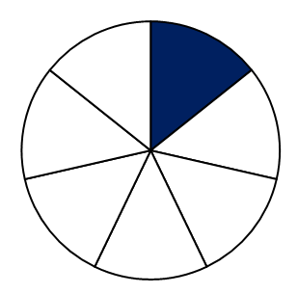


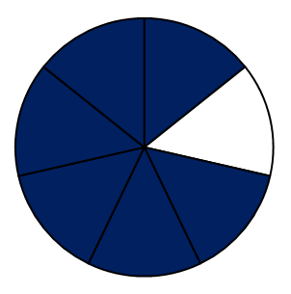

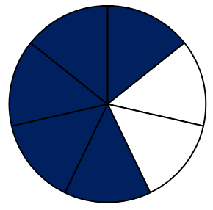
Varied Fluency 4
What is the missing fraction in this sequence?
© Classroom Secrets Limited 2019

Slide 12
Varied Fluency 4
What is the missing fraction in this sequence?
3
7
© Classroom Secrets Limited 2019

Slide 13
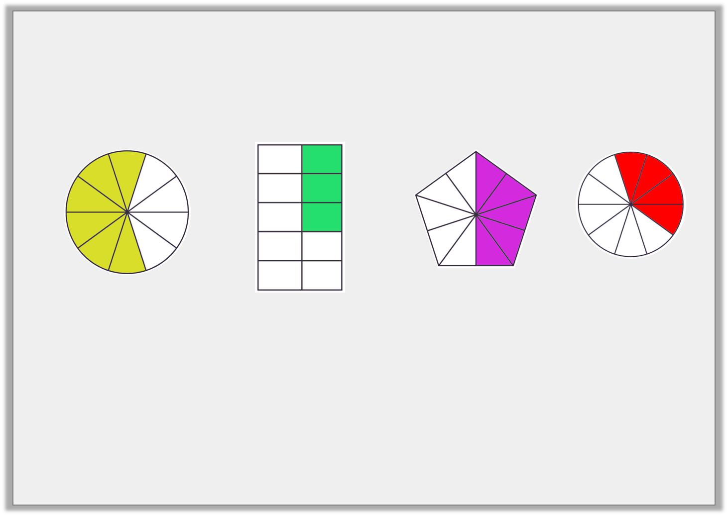
Reasoning 1
Sally has put these fractions in order from smallest to largest. Is she correct?
Explain your answer.
1
2
3
4
© Classroom Secrets Limited 2019

Slide 14
Reasoning 1
Sally has put these fractions in order from smallest to largest. Is she correct?
Explain your answer.
Sally is incorrect because…
1
2
3
4
© Classroom Secrets Limited 2019

Slide 15
Reasoning 1
Sally has put these fractions in order from smallest to largest. Is she correct?
Explain your answer.
Sally is incorrect because 1 is larger than 2 and 3, and 4 is smaller than 1 and 3.
1
2
3
4
© Classroom Secrets Limited 2019

Slide 16
Problem Solving 1
Use the images to help you complete the fractions.
What is the next fraction in this sequence?
© Classroom Secrets Limited 2019

Slide 17
Problem Solving 1
Use the images to help you complete the fractions.
What is the next fraction in this sequence?
6
11
© Classroom Secrets Limited 2019

Slide 18
Problem Solving 2
Which is the incorrect fraction in this sequence?
1
2
3
4
5
© Classroom Secrets Limited 2019

Slide 19
Problem Solving 2
Which is the incorrect fraction in this sequence?
1
2
3
4
5
© Classroom Secrets Limited 2019

