Slide 1



LIFE/work balance
We have started a #LIFEworkbalance campaign and we need your help to complete our LIFE/work balance survey.
We hope to publish the results soon, so please give 15 minutes of your time to help us get a true picture of school life.
Want to be a part of this campaign? Take the survey on our website and share it with your colleagues!
© Classroom Secrets Limited 2019

Slide 2
Year 3 – Summer Block 1 – Fractions – Add Fractions
About This Resource:
This PowerPoint has been designed to support your teaching of this small step. It includes a starter activity and an example of each question from the Varied Fluency and Reasoning and Problem Solving resources also provided in this pack. You can choose to work through all examples provided or a selection of them depending on the needs of your class.
National Curriculum Objectives:
Mathematics Year 3: (3F4) Add and subtract fractions with the same denominator within one whole [for example, 5/7 + 1/7 = 6/7 ]
Mathematics Year 3: (3F10) Solve problems that involve the above objectives
More Year 3 Fractions resources.
Did you like this resource? Don’t forget to review it on our website.
© Classroom Secrets Limited 2018

Slide 3
Year 3 – Summer Block 1 – Fractions
Step 6: Add Fractions
© Classroom Secrets Limited 2018

Slide 4

Introduction
Order these fractions from smallest to largest.
2
8
one eighth
4
8
six eighths
eight eighths
© Classroom Secrets Limited 2018

Slide 5
Introduction
Order these fractions from smallest to largest.
7
2
1
2
8
one eighth
4
4
8
5
6
six eighths
3
8
eight eighths
© Classroom Secrets Limited 2018

Slide 6
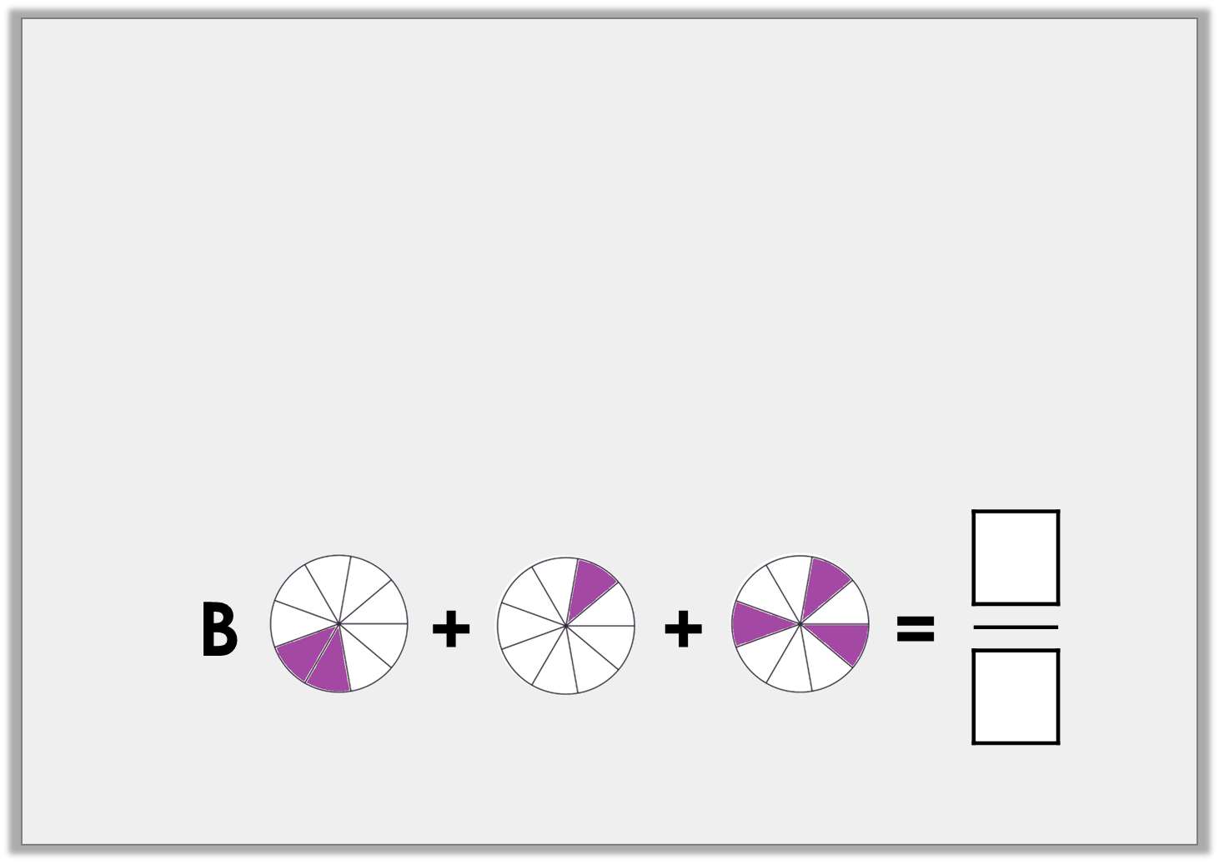
Varied Fluency 1
Complete these equations.
A |  | + |  | + |  | =
© Classroom Secrets Limited 2018

Slide 7
Varied Fluency 1
Complete these equations.
A |  | + |  | + |  | = | 7
 |  |  |  |  |  |  | 9
6
9
© Classroom Secrets Limited 2018

Slide 8
Varied Fluency 2
Complete this equation.
 | + | 2 | + | 1 | = | 5
6 |  | 6 |  | 6
© Classroom Secrets Limited 2018

Slide 9
Varied Fluency 2
Complete this equation.
2 | + | 2 | + | 1 | = | 5
6 |  | 6 |  | 6 |  | 6
© Classroom Secrets Limited 2018

Slide 10
Varied Fluency 3
True or false?
4 | + | 2 | + | 3 | = | 9
11 |  | 11 |  | 11 |  | 33
© Classroom Secrets Limited 2018

Slide 11
Varied Fluency 3
True or false?
False.
4 | + | 2 | + | 3 | = | 9
11 |  | 11 |  | 11 |  | 11
© Classroom Secrets Limited 2018

Slide 12
Varied Fluency 4
Complete this part whole model.
4
12
1
12
2
12
© Classroom Secrets Limited 2018

Slide 13
Varied Fluency 4
Complete this part whole model.
4
12
1
12
7
12
2
12
© Classroom Secrets Limited 2018

Slide 14

Reasoning 1
Quinn says,
Is she correct? Explain why.
4 | + | 3 | + | 1 | = | 8
10 |  | 10 |  | 10 |  | 30
© Classroom Secrets Limited 2018

Slide 15
Reasoning 1
Quinn says,
Is she correct? Explain why.
She is incorrect because…
4 | + | 3 | + | 1 | = | 8
10 |  | 10 |  | 10 |  | 30
© Classroom Secrets Limited 2018

Slide 16
Reasoning 1
Quinn says,
Is she correct? Explain why.
She is incorrect because she has added the denominators as well as the numerators.
4 | + | 3 | + | 1 | = | 8
10 |  | 10 |  | 10 |  | 30
© Classroom Secrets Limited 2018

Slide 17

Problem Solving 1
This is the answer.
What fractions could you have added together to get this answer?
Find three possible combinations.
© Classroom Secrets Limited 2018

Slide 18
Problem Solving 1
This is the answer.
What fractions could you have added together to get this answer?
Find three possible combinations.
Various possible answers including
, and
0 | + | 6
9 |  | 9
1 | + | 5
9 |  | 9
2 | + | 4
9 |  | 9
© Classroom Secrets Limited 2018

Slide 19

Problem Solving 2
Jonas cuts a loaf of bread into 9 pieces and shares it between his friends. He ate two slices of bread, Candice ate three slices and Lola ate one slice. What fraction of the bread have they eaten altogether? How do you know?
© Classroom Secrets Limited 2018

Slide 20
Problem Solving 2
Jonas cuts a loaf of bread into 9 pieces and shares it between his friends. He ate two slices of bread, Candice ate three slices and Lola ate one slice. What fraction of the bread have they eaten altogether? How do you know?
2 | + | 3 | + | 1 | = | 6
9 |  | 9 |  | 9 |  | 9
© Classroom Secrets Limited 2018

