Slide 1


LIFE/work balance
We have started a #LIFEworkbalance campaign and we need your help to complete our LIFE/work balance survey.
We hope to publish the results soon, so please give 15 minutes of your time to help us get a true picture of school life.
Want to be a part of this campaign? Take the survey on our website and share it with your colleagues!
© Classroom Secrets Limited 2019

Slide 2

Year 3 – Summer Block 1 – Fractions – Subtract Fractions
About This Resource:
This PowerPoint has been designed to support your teaching of this small step. It includes a starter activity and an example of each question from the Varied Fluency and Reasoning and Problem Solving resources also provided in this pack. You can choose to work through all examples provided or a selection of them depending on the needs of your class.
National Curriculum Objectives:
Mathematics Year 3: (3F4) Add and subtract fractions with the same denominator within one whole [for example, 5/7 + 1/7 = 6/7 ]
Mathematics Year 3: (3F10) Solve problems that involve the above objectives
More Year 3 Fractions resources.
Did you like this resource? Don’t forget to review it on our website.
© Classroom Secrets Limited 2018

Slide 3
Year 3 – Summer Block 1 – Fractions
Step 7: Subtract Fractions
© Classroom Secrets Limited 2018

Slide 4
Introduction
Match up the fraction cards that give the same total.
2 | + | 3 |  | 5 | + | 2 |  | 4 | + | 2 |  | 1 | + | 3
8 |  | 8 |  | 8 |  | 8 |  | 8 |  | 8 |  | 8 |  | 8
6 | + | 1 |  | 2 | + | 2 |  | 4 | + | 1 |  | 5 | + | 1
8 |  | 8 |  | 8 |  | 8 |  | 8 |  | 8 |  | 8 |  | 8
© Classroom Secrets Limited 2018

Slide 5
Introduction
Match up the fraction cards that give the same total.
2 | + | 3 |  | 5 | + | 2 |  | 4 | + | 2 |  | 1 | + | 3
8 |  | 8 |  | 8 |  | 8 |  | 8 |  | 8 |  | 8 |  | 8
6 | + | 1 |  | 2 | + | 2 |  | 4 | + | 1 |  | 5 | + | 1
8 |  | 8 |  | 8 |  | 8 |  | 8 |  | 8 |  | 8 |  | 8
© Classroom Secrets Limited 2018

Slide 6
Varied Fluency 1
Complete the calculation.
9 | – | 3 | =
11 |  | 11
© Classroom Secrets Limited 2018

Slide 7
Varied Fluency 1
Complete the calculation.
9 | – | 3 | = | 6
11 |  | 11 |  | 11
© Classroom Secrets Limited 2018

Slide 8
Varied Fluency 2
Fill in the missing numerator.
11 | – |  | = | 4
12 |  | 12 |  | 12
© Classroom Secrets Limited 2018

Slide 9
Varied Fluency 2
Fill in the missing numerator.
11 | – | 7 | = | 4
12 |  | 12 |  | 12
© Classroom Secrets Limited 2018

Slide 10
Varied Fluency 3
Write a statement to match the images.
–
=
© Classroom Secrets Limited 2018

Slide 11
Varied Fluency 3
Write a statement to match the images.
–
=
4 | – | 3 | = | 1
6 |  | 6 |  | 6
© Classroom Secrets Limited 2018

Slide 12
Varied Fluency 4
Draw an image to match the statement.
5 | – | 2 | = | 3
6 |  | 6 |  | 6
© Classroom Secrets Limited 2018

Slide 13
Varied Fluency 4
Draw an image to match the statement.
e.g.
5 | – | 2 | = | 3
6 |  | 6 |  | 6
© Classroom Secrets Limited 2018

Slide 14
Varied Fluency 5
Ten-twelfths subtract seven-twelfths equals three-twelfth.
True or False?
© Classroom Secrets Limited 2018

Slide 15
Varied Fluency 5
Ten-twelfths subtract seven-twelfths equals three-twelfth.
True or False?
True
10 | – | 7 | = | 3
12 |  | 12 |  | 12
© Classroom Secrets Limited 2018

Slide 16
Problem Solving 1
Lisa has of a chocolate cake.
She gives Talia six-elevenths of the cake.
How many elevenths does she have left?
9
11
© Classroom Secrets Limited 2018

Slide 17
Problem Solving 1
Lisa has of a chocolate cake.
She gives Talia six-elevenths of the cake.
How many elevenths does she have left?
9
11
9 | – | 6 | = | 3
11 |  | 11 |  | 11
© Classroom Secrets Limited 2018

Slide 18
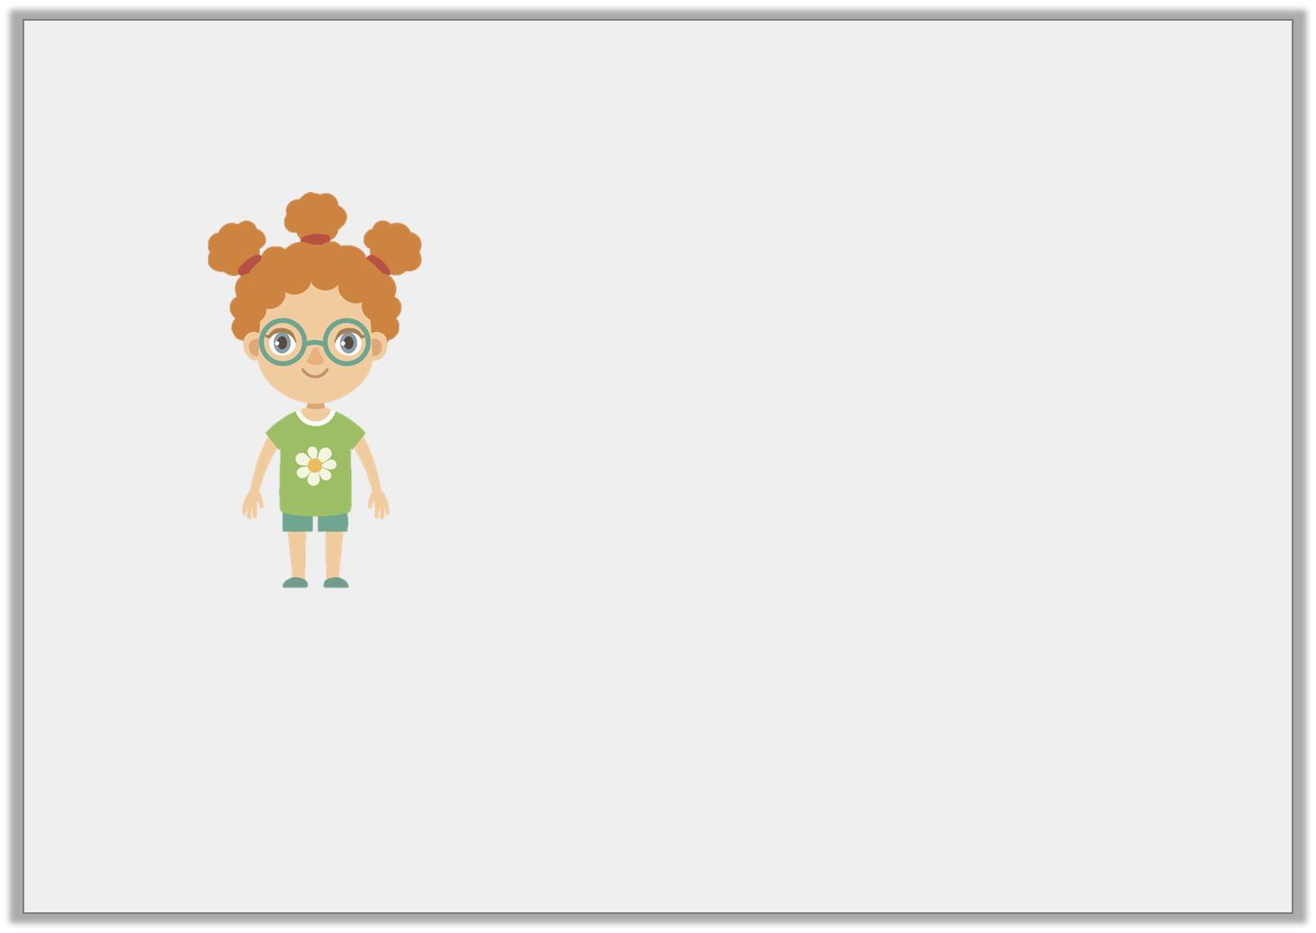
Reasoning 1
Is Seren correct?
Explain your answer.
4
12
11
12
I subtract from .
Jack has .
I have more than Jack.
7
12
Seren
© Classroom Secrets Limited 2018

Slide 19
Reasoning 1
Is Seren correct?
Explain your answer.
Seren is wrong because...
4
12
11
12
I subtract from .
Jack has .
I have more than Jack.
7
12
Seren
© Classroom Secrets Limited 2018

Slide 20
Reasoning 1
Is Seren correct?
Explain your answer.
Seren is wrong because they both have .
4
12
11
12
I subtract from .
Jack has .
I have more than Jack.
7
12
Seren
7
12
© Classroom Secrets Limited 2018

Slide 21
Problem Solving 2
Choose fractions to make the part whole model correct.
6
9
8
9
6
9
1
9
7
9
© Classroom Secrets Limited 2018

Slide 22
Problem Solving 2
Choose fractions to make the part whole model correct.
6
9
8
9
6
9
1
9
1
9
8
9
7
9
© Classroom Secrets Limited 2018

