Slide 1
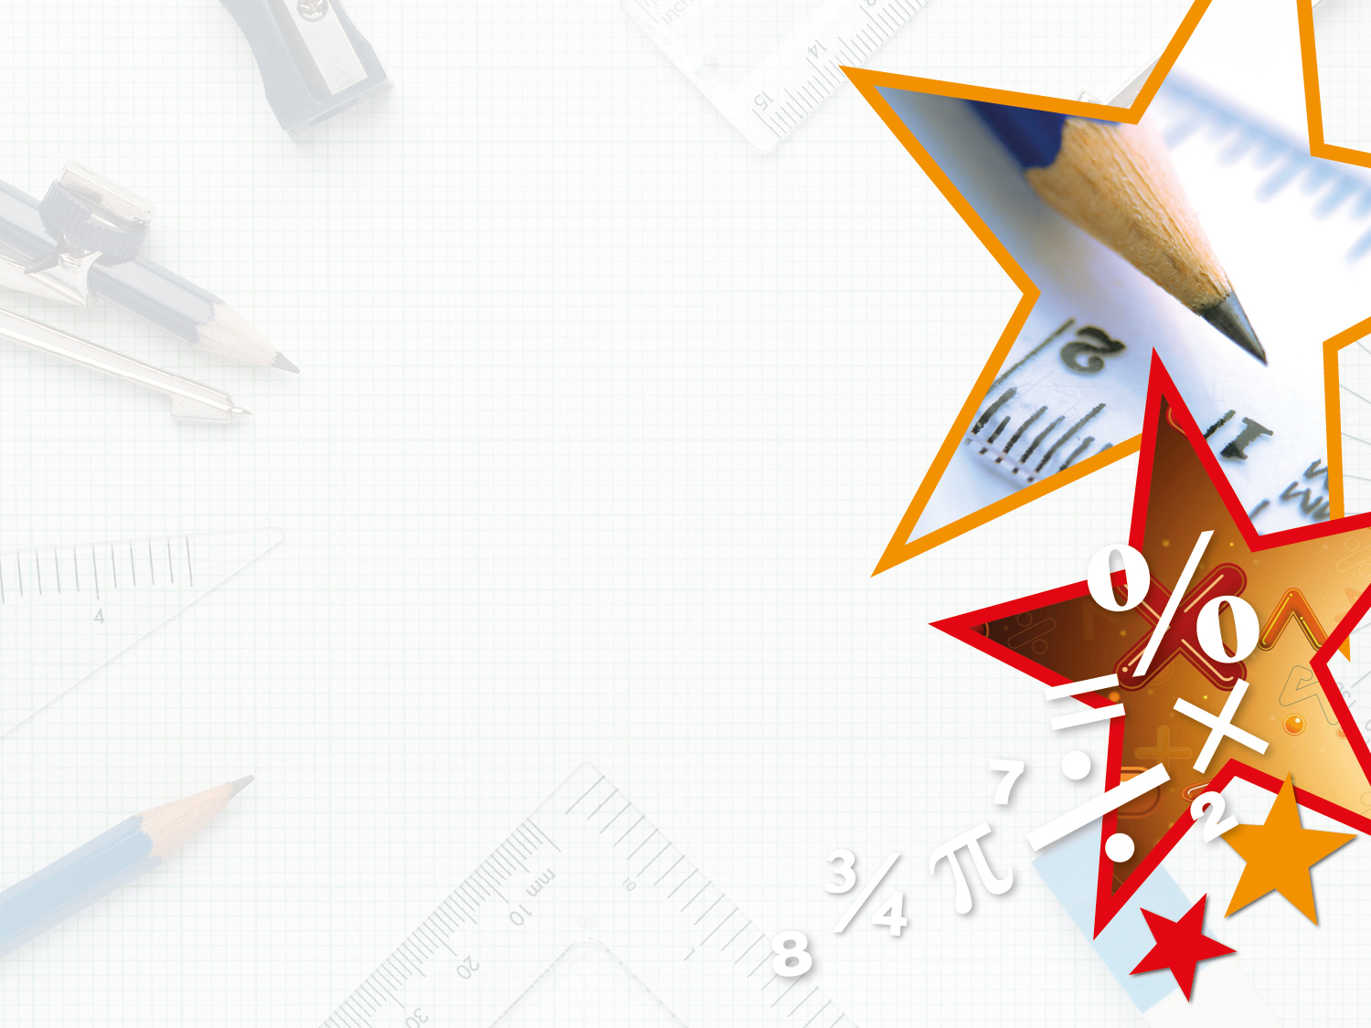

Year 4 – Summer Block 1 – Decimals – Write Decimals
About This Resource:
This PowerPoint has been designed to support your teaching of this small step. It includes a starter activity and an example of each question from the Varied Fluency and Reasoning and Problem Solving resources also provided in this pack. You can choose to work through all examples provided or a selection of them depending on the needs of your class.
National Curriculum Objectives:
Mathematics Year 4: (4F6b) Recognise and write decimal equivalents of any number of tenths or hundredths
Mathematics Year 4: (4F10b) Solve simple measure and money problems involving fractions and decimals to two decimal places
More Year 4 Decimals resources.
Did you like this resource? Don’t forget to review it on our website.
© Classroom Secrets Limited 2018

Slide 2
Year 4 – Summer Block 1 – Decimals
Step 2: Write Decimals
© Classroom Secrets Limited 2018

Slide 3
Introduction
What decimals are represented by this hundred square?
© Classroom Secrets Limited 2018

Slide 4
Introduction
What decimals are represented by this hundred square?
0.16
0.24
0.2
0.37
0.03
© Classroom Secrets Limited 2018

Slide 5
Varied Fluency 1
This decimal is written in words:
Ten tenths and seven hundredths
Rewrite it in decimal form.
© Classroom Secrets Limited 2018

Slide 6
Varied Fluency 1
This decimal is written in words:
Ten tenths and seven hundredths
Rewrite it in decimal form.
1.07
© Classroom Secrets Limited 2018

Slide 7
Varied Fluency 2
Which underlined digit is worth three hundredths?
3.21
1.32
2.13
© Classroom Secrets Limited 2018

Slide 8
Varied Fluency 2
Which underlined digit is worth three hundredths?
3.21
1.32
2.13
three ones
three tenths
three hundredths
© Classroom Secrets Limited 2018

Slide 9
Varied Fluency 3
Write this decimal in words.
2.54
© Classroom Secrets Limited 2018

Slide 10
Varied Fluency 3
Write this decimal in words.
Two ones, five tenths and four hundredths.
2.54
© Classroom Secrets Limited 2018

Slide 11
Varied Fluency 4
Complete the part whole model.
0.30
0.02
© Classroom Secrets Limited 2018

Slide 12
Varied Fluency 4
Complete the part whole model.
0.32
0.30
0.02
© Classroom Secrets Limited 2018

Slide 13
Varied Fluency 5
Arrange the digit cards to make a number with two decimal places that has four hundredths.
.
4
7
8
© Classroom Secrets Limited 2018

Slide 14
Varied Fluency 5
Arrange the digit cards to make a number with two decimal places that has four hundredths.
.
4
7
8
7
.
8
4
8
.
7
4
© Classroom Secrets Limited 2018

Slide 15
Reasoning 1
Which statements are true?
Explain why the false statements are incorrect.
7.23
a. The number has one decimal place.
b. The number has two hundredths.
c. The number has two tenths.
d. The number has three hundredths.
© Classroom Secrets Limited 2018

Slide 16
Reasoning 1
Which statements are true?
Explain why the false statements are incorrect.
7.23
a. The number has one decimal place: False, because the number has two decimal places.
b. The number has two hundredths: False, because the number has 3 hundredths.
c. The number has two tenths: True
d. The number has three hundredths: True
© Classroom Secrets Limited 2018

Slide 17
Reasoning 2
Douglas and Sophia are partitioning a number.
Who is correct? Explain why.
Douglas
Sophia
0.42
0.42
0.4
0.2
0.4
0.02
© Classroom Secrets Limited 2018

Slide 18
Reasoning 2
Douglas and Sophia are partitioning a number.
I know Sophia is correct and Douglas is incorrect because…
Douglas
Sophia
0.42
0.42
0.4
0.2
0.4
0.02
© Classroom Secrets Limited 2018

Slide 19
Reasoning 2
Douglas and Sophia are partitioning a number.
Sophia is correct. I know Douglas is incorrect because he has partitioned the number into 4 tenths and 2 tenths instead of 2 hundredths.
Douglas
Sophia
0.42
0.42
0.4
0.2
0.4
0.02
© Classroom Secrets Limited 2018

Slide 20
Problem Solving 1
What is the greatest number you can make?
What is the smallest number you can make?
You need to use all the counters and have a counter in each column.
Ones | Tenths | Hundredths
© Classroom Secrets Limited 2018

Slide 21
Problem Solving 1
What is the greatest number you can make?
What is the smallest number you can make?
You need to use all the counters and have a counter in each column.
Ones | Tenths | Hundredths
4.11
Ones | Tenths | Hundredths
1.14
© Classroom Secrets Limited 2018

