Slide 1


LIFE/work balance
We have started a #LIFEworkbalance campaign and we need your help to complete our LIFE/work balance survey.
We hope to publish the results soon, so please give 15 minutes of your time to help us get a true picture of school life.
Want to be a part of this campaign? Take the survey on our website and share it with your colleagues!
© Classroom Secrets Limited 2019

Slide 2
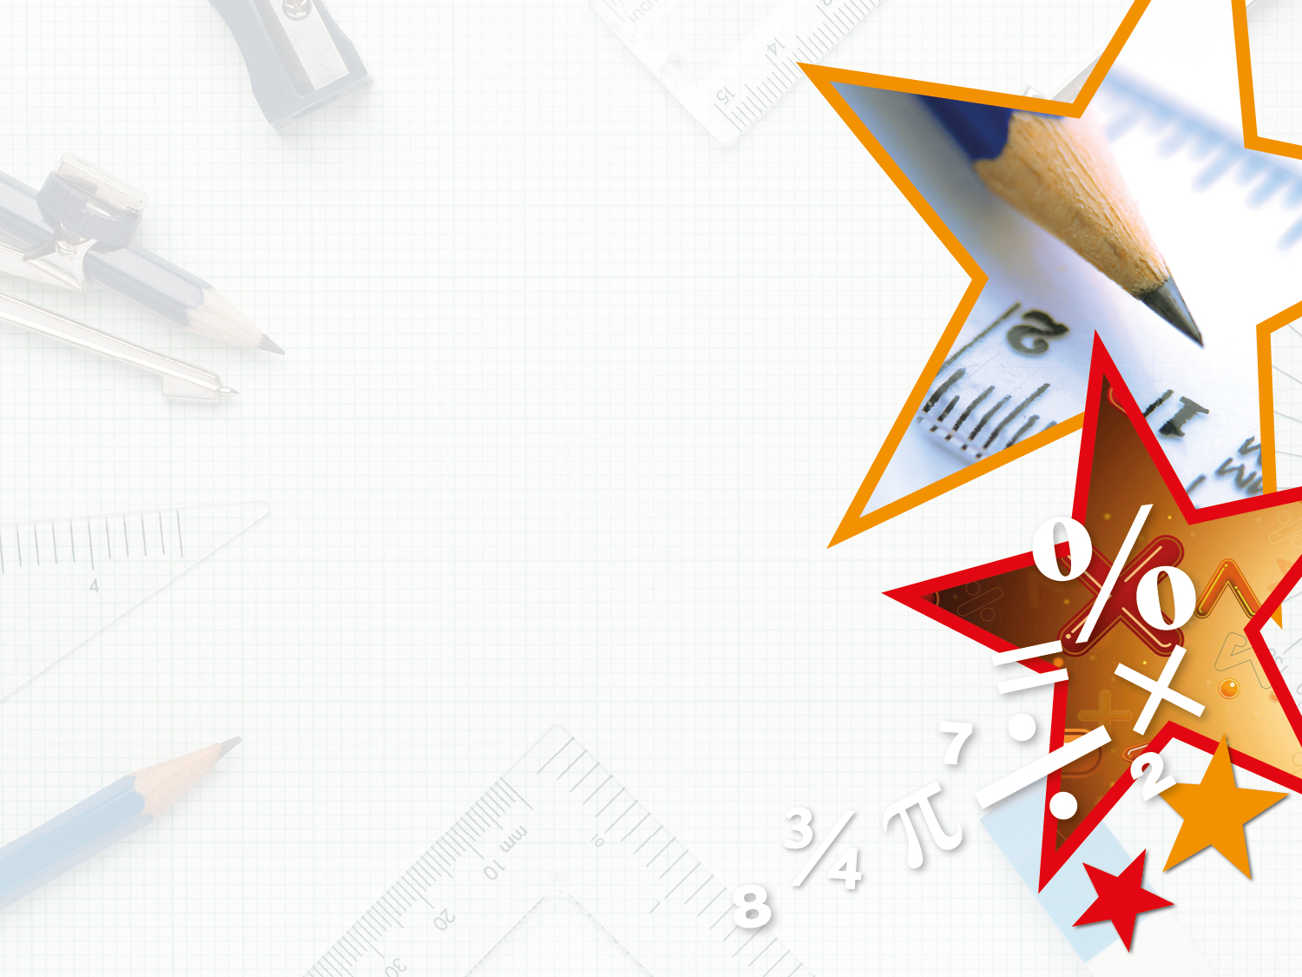
Year 4 – Summer Block 1 – Decimals – Round Decimals
About this Resource:
This PowerPoint has been designed to support your teaching of this small step. It includes a starter activity and an example of each question from the Varied Fluency and Reasoning and Problem Solving resources also provided in this pack. You can choose to work through all examples provided or a selection of them depending on the needs of your class.
National Curriculum Objectives:
Mathematics Year 4: (4F8) Compare numbers with the same number of decimal places up to two decimal places
Mathematics Year 4: (4F7) Round decimals with one decimal place to the nearest whole number
More Year 4 Decimals resources.
Did you like this resource? Don’t forget to review it on our website.
© Classroom Secrets Limited 2019

Slide 3
Year 4 – Summer Block 1 – Decimals
Step 5: Round Decimals
© Classroom Secrets Limited 2019

Slide 4
Introduction
Complete the missing numbers on the number line.
 |  |  | 1.8 |  | 2.0
© Classroom Secrets Limited 2019

Slide 5
Introduction
Complete the missing numbers on the number line.
1.5 | 1.6 | 1.7 | 1.8 | 1.9 | 2.0 | 2.1 | 2.2 | 2.3 | 2.4
© Classroom Secrets Limited 2019

Slide 6
Varied Fluency 1
Which of these decimals is closest to 1?
Which of these decimals is closest to 2?
1.2 | 1.7 | 1.6 | 1.4 | 1.3
1 |  |  |  |  | 1.5 |  |  |  |  | 2
© Classroom Secrets Limited 2019

Slide 7
Varied Fluency 1
Which of these decimals is closest to 1?
Which of these decimals is closest to 2?
1.2 is closest to 1
1.7 is closest to 2
1.2 | 1.7 | 1.6 | 1.4 | 1.3
1 |  |  |  |  | 1.5 |  |  |  |  | 2
© Classroom Secrets Limited 2019

Slide 8
Varied Fluency 2
Fill in the number line with the missing whole number and the decimals which round up to it.
5 | 5.1 | 5.2 | 5.3 | 5.4 | A | 5.6 | B | 5.8 | C | D
© Classroom Secrets Limited 2019

Slide 9
Varied Fluency 2
Fill in the number line with the missing whole number and the decimals which round up to it.
5 | 5.1 | 5.2 | 5.3 | 5.4 | A | 5.6 | B | 5.8 | C | D
A | = | 5.5
B | = | 5.7
C | = | 5.9
D | = | 6
© Classroom Secrets Limited 2019

Slide 10
Varied Fluency 3
Do the decimals round up or down?
Which whole number do they round to?
4.6 | 4.9 | 4.1 | 4.5 | 4.4
4 |  |  |  |  | 4.5 |  |  |  |  | 5
© Classroom Secrets Limited 2019

Slide 11
Varied Fluency 3
Do the decimals round up or down?
Which whole number do they round to?
4.6 rounds up to 5; 4.9 rounds up to 5;
4.1 rounds down to 4; 4.5 rounds up to 5;
4.4 rounds down to 4.
4.6 | 4.9 | 4.1 | 4.5 | 4.4
4 |  |  |  |  | 4.5 |  |  |  |  | 5
© Classroom Secrets Limited 2019

Slide 12
Varied Fluency 4
Fill in the gaps using these decimals and whole numbers.
________ rounds up to ________ .
________ rounds down to ________ .
________ rounds up to ________ .
6.4 | 7 | 6 | 6.5 | 9 | 8.8
© Classroom Secrets Limited 2019

Slide 13
Varied Fluency 4
Fill in the gaps using these decimals and whole numbers.
6.5 rounds up to 7.
6.4 rounds down to 6.
8.8 rounds up to 9 .
6.4 | 7 | 6 | 6.5 | 9 | 8.8
© Classroom Secrets Limited 2019

Slide 14
Problem Solving 1
Nia used number cards to make three decimals, but then her cards got mixed up!
She remembers that her decimals rounded to 3, 6 and 8.
What might have been the three decimals Nia made?
3
8
3
4
5
5
© Classroom Secrets Limited 2019

Slide 15
Problem Solving 1
Nia used number cards to make three decimals, but then her cards got mixed up!
She remembers that her decimals rounded to 3, 6 and 8.
What might have been the three decimals Nia made?
Various possible answers, for example: 3.4, 5.5, 8.3
3
8
3
4
5
5
© Classroom Secrets Limited 2019

Slide 16
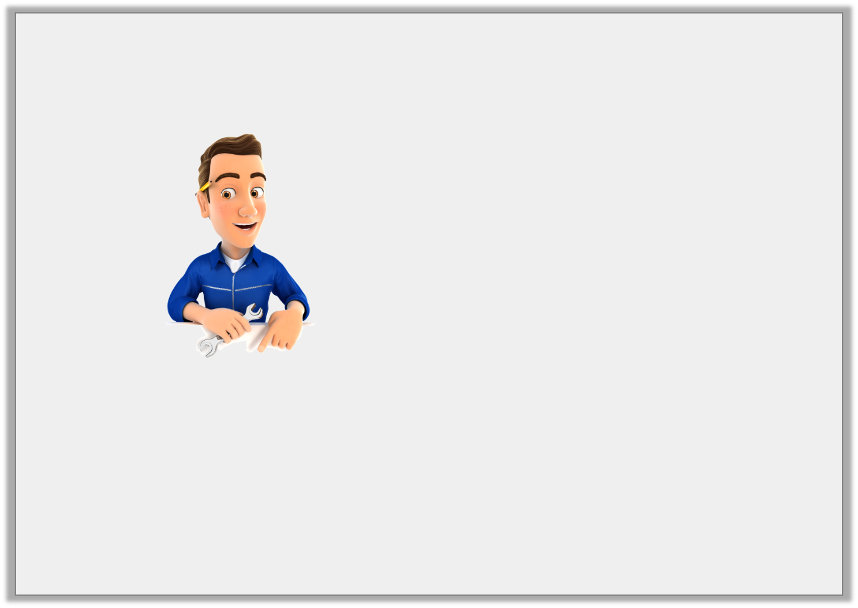
Reasoning 1
Two cars are different lengths. Both lengths round to 3m.
There is a difference of 0.7m between the actual lengths of the two cars.
Is what the mechanic says possible?
Explain your answer.
© Classroom Secrets Limited 2019

Slide 17
Reasoning 1
Two cars are different lengths. Both lengths round to 3m.
There is a difference of 0.7m between the actual lengths of the two cars.
Is what the mechanic says possible?
Explain your answer.
Yes it is possible because
© Classroom Secrets Limited 2019

Slide 18
Reasoning 1
Two cars are different lengths. Both lengths round to 3m.
There is a difference of 0.7m between the actual lengths of the two cars.
Is what the mechanic says possible?
Explain your answer.
Yes it is possible because one car could be 2.7m long and the other could be 3.4m long. Both lengths round to 3m and the difference between them is 0.7m.
There are other possible answers.
© Classroom Secrets Limited 2019

Slide 19
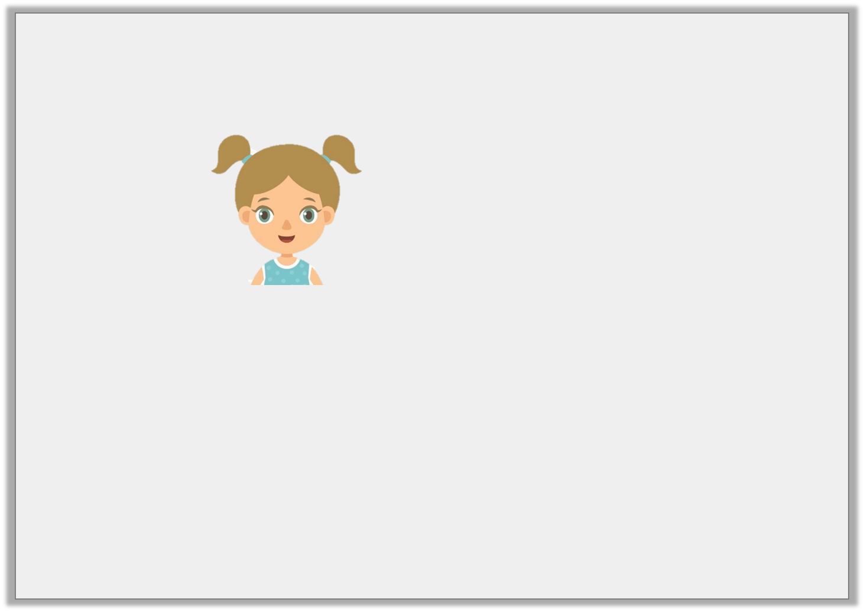
Problem Solving 2
Maya is thinking of a number.
What is Maya’s decimal?
My decimal does not contain the number 3. It rounds down to 5. The number of tenths in my decimal is odd.
© Classroom Secrets Limited 2019

Slide 20
Problem Solving 2
Maya is thinking of a number.
What is Maya’s decimal?
Maya’s decimal is 5.1
My decimal does not contain the number 3. It rounds down to 5. The number of tenths in my decimal is odd.
© Classroom Secrets Limited 2019

