Slide 1



LIFE/work balance
We have started a #LIFEworkbalance campaign and we need your help to complete our LIFE/work balance survey.
We hope to publish the results soon, so please give 15 minutes of your time to help us get a true picture of school life.
Want to be a part of this campaign? Take the survey on our website and share it with your colleagues!
© Classroom Secrets Limited 2019

Slide 2
Year 3 – Summer Block 3 – Properties of Shape – Right Angles in Shapes
About This Resource:
This PowerPoint has been designed to support your teaching of this small step. It includes a starter activity and an example of each question from the Varied Fluency and Reasoning and Problem Solving resources also provided in this pack. You can choose to work through all examples provided or a selection of them depending on the needs of your class.
National Curriculum Objectives:
Mathematics Year 3: (3G4a) Recognise angles as a property of shape or a description of a turn
Mathematics Year 3: (3G4b) Identify right angles, recognise that two right angles make a half-turn, three make three quarters of a turn and four a complete turn; identify whether angles are greater than or less than a right angle
More Year 3 Properties of Shapes resources.
Did you like this resource? Don’t forget to review it on our website.
© Classroom Secrets Limited 2019

Slide 3
Year 3 – Summer Block 3 – Properties of Shape
Step 2: Right Angles in Shapes
© Classroom Secrets Limited 2019

Slide 4
Introduction
Look around your classroom.
Name some objects that have a right angle in them.
© Classroom Secrets Limited 2019

Slide 5
Introduction
Look around your classroom.
Name some objects that have a right angle in them.
Example answers:
Door frames, windowsills, shelves, book covers, walls.
© Classroom Secrets Limited 2019

Slide 6
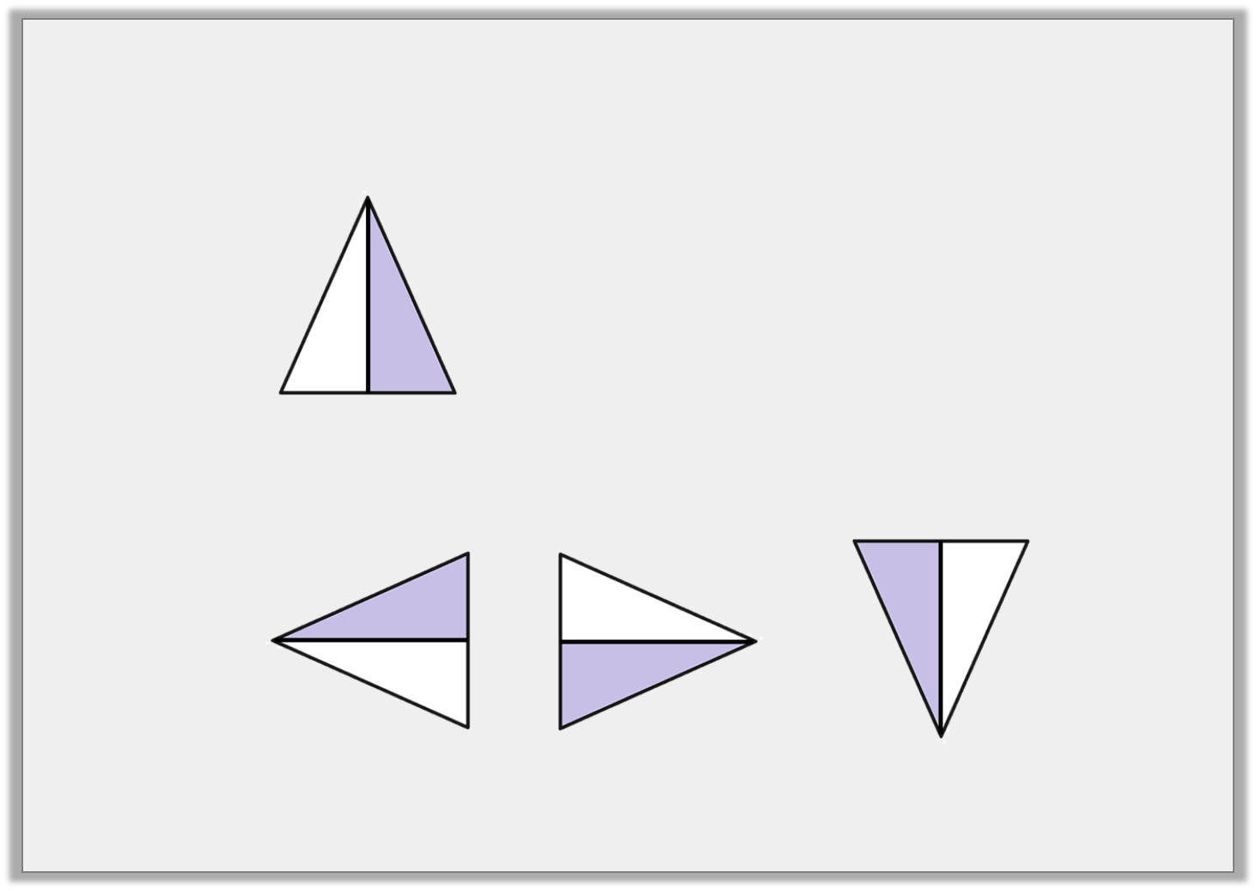
Varied Fluency 1
Tick the shape that has turned one right angle anti-clockwise.
Start:
Finish:
© Classroom Secrets Limited 2019

Slide 7
Varied Fluency 1
Tick the shape that has turned one right angle anti-clockwise.
Start:
Finish:
✓
© Classroom Secrets Limited 2019

Slide 8
Varied Fluency 2
Tick any shapes that contain right angles.
© Classroom Secrets Limited 2019

Slide 9
Varied Fluency 2
Tick any shapes that contain right angles.
✓
✓
© Classroom Secrets Limited 2019

Slide 10
Varied Fluency 3
How many right angles are in each shape?
© Classroom Secrets Limited 2019

Slide 11
Varied Fluency 3
How many right angles are in each shape?
3
2
4
0
© Classroom Secrets Limited 2019

Slide 12
Varied Fluency 4
This shape has 2 right angles. True or false?
© Classroom Secrets Limited 2019

Slide 13
Varied Fluency 4
This shape has 2 right angles. True or false?
True
© Classroom Secrets Limited 2019

Slide 14

Problem Solving 1
Match the statements to the correct shape.
My shape has half the number of right angles as Sam’s shape.
Courtney
My shape has enough right angles to complete 1 full turn.
Sam
Sam’s shape has four more right angles than mine.
Lila
© Classroom Secrets Limited 2019

Slide 15
Problem Solving 1
Match the statements to the correct shape.
My shape has half the number of right angles as Sam’s shape.
Courtney
My shape has enough right angles to complete 1 full turn.
Sam
Sam’s shape has four more right angles than mine.
Lila
© Classroom Secrets Limited 2019

Slide 16
Problem Solving 2
Sort the shapes into the Carroll Diagram.
 | Has fewer than 3 right angles | Has 3 or more right angles
Has at least 4 sides
Does not have 4 sides
© Classroom Secrets Limited 2019

Slide 17
Problem Solving 2
Sort the shapes into the Carroll Diagram.
 | Has fewer than 3 right angles | Has 3 or more right angles
Has at least 4 sides
Does not have 4 sides
© Classroom Secrets Limited 2019

Slide 18
Reasoning 1
Which shape is the odd one out?
Explain why.
A
B
C
D
© Classroom Secrets Limited 2019

Slide 19
Reasoning 1
Which shape is the odd one out?
Explain why.
D is the odd one out because …
A
B
C
D
© Classroom Secrets Limited 2019

Slide 20
Reasoning 1
Which shape is the odd one out?
Example answer:
Explain why.
D is the odd one out because it is the only shape without right angles.
A
B
C
D
© Classroom Secrets Limited 2019

