Slide 1
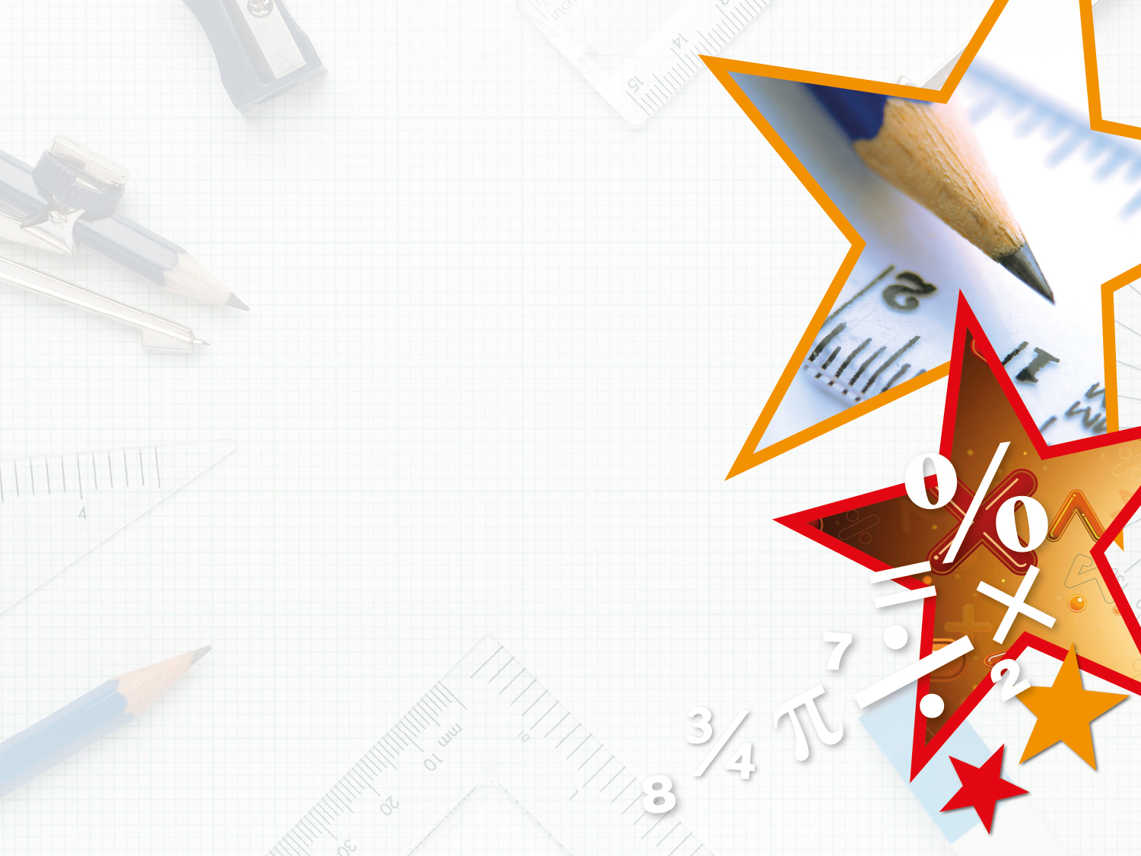

Year 3 – Summer Block 3 – Properties of Shapes – Compare Angles
About This Resource:
This PowerPoint has been designed to support your teaching of this small step. It includes a starter activity and an example of each question from the Varied Fluency and Reasoning and Problem Solving resources also provided in this pack. You can choose to work through all examples provided or a selection of them depending on the needs of your class.
National Curriculum Objectives:
Mathematics Year 3: (3G4a) Recognise that angles are a property of a shape or a description of a turn
Mathematics Year 3: (3G4b) Identify right angles, recognise that two right angles make a half turn, three make three quarters of a turn and four a complete turn; identify whether angles are greater than or less than a right angle.
More Year 3 Properties of Shapes resources.
Did you like this resource? Don’t forget to review it on our website.
© Classroom Secrets Limited 2019

Slide 2
Year 3 – Summer Block 3 – Properties of Shapes
Step 3: Compare Angles
© Classroom Secrets Limited 2019

Slide 3
Introduction
Make a table to show which times make acute angles,
obtuse angles or right angles between the hour hand
and the minute hand.
9:00
10:45
11:15
8:55
3:40
3:00
© Classroom Secrets Limited 2019

Slide 4
Introduction
Make a table to show which times make acute angles,
obtuse angles or right angles between the hour hand
and the minute hand.
9:00
10:45
11:15
8:55
3:40
3:00
Acute angles | Obtuse angles | Right angles
10:45 8:55 | 3:40 11:15 | 9:00 3:00
© Classroom Secrets Limited 2019

Slide 5
Varied Fluency 1
Label each of these angles as either obtuse, acute or right angle.
© Classroom Secrets Limited 2019

Slide 6
Varied Fluency 1
Label each of these angles as either obtuse, acute or right angle.
obtuse
right angle
acute
© Classroom Secrets Limited 2019

Slide 7
Varied Fluency 2
Draw four different acute angles.
90° angle cut out given for reference.
© Classroom Secrets Limited 2019

Slide 8
Varied Fluency 2
Draw four different acute angles.
Various possible answers, for example:
1
2
3
90° angle cut out given for reference.
4
© Classroom Secrets Limited 2019

Slide 9
Varied Fluency 3
Label all the angles in this shape as obtuse, acute or right angle.
© Classroom Secrets Limited 2019

Slide 10
Varied Fluency 3
Label all the angles in this shape as obtuse, acute or right angle.
right
obtuse
obtuse
obtuse
obtuse
right
© Classroom Secrets Limited 2019

Slide 11
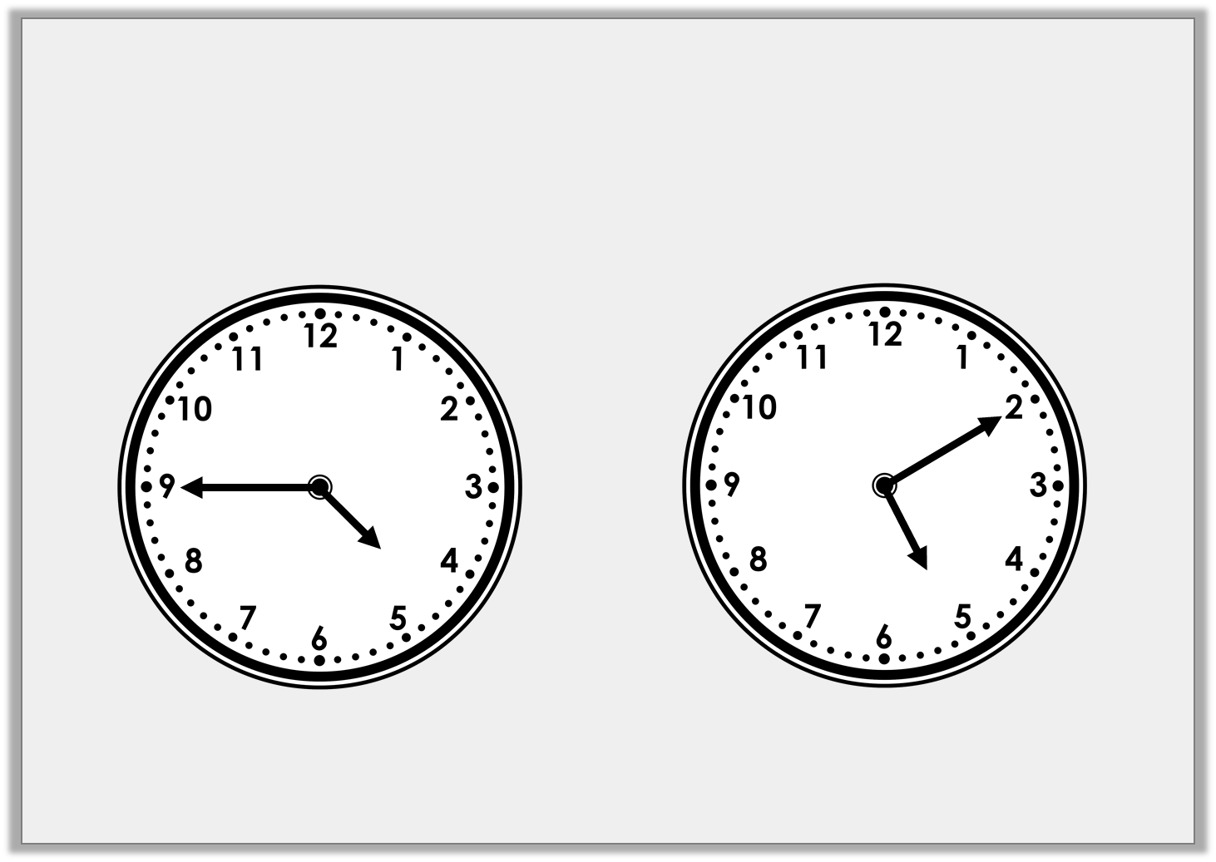
Varied Fluency 4
Has the minute hand moved through an acute or obtuse angle to get from a to b?
a
b
© Classroom Secrets Limited 2019

Slide 12
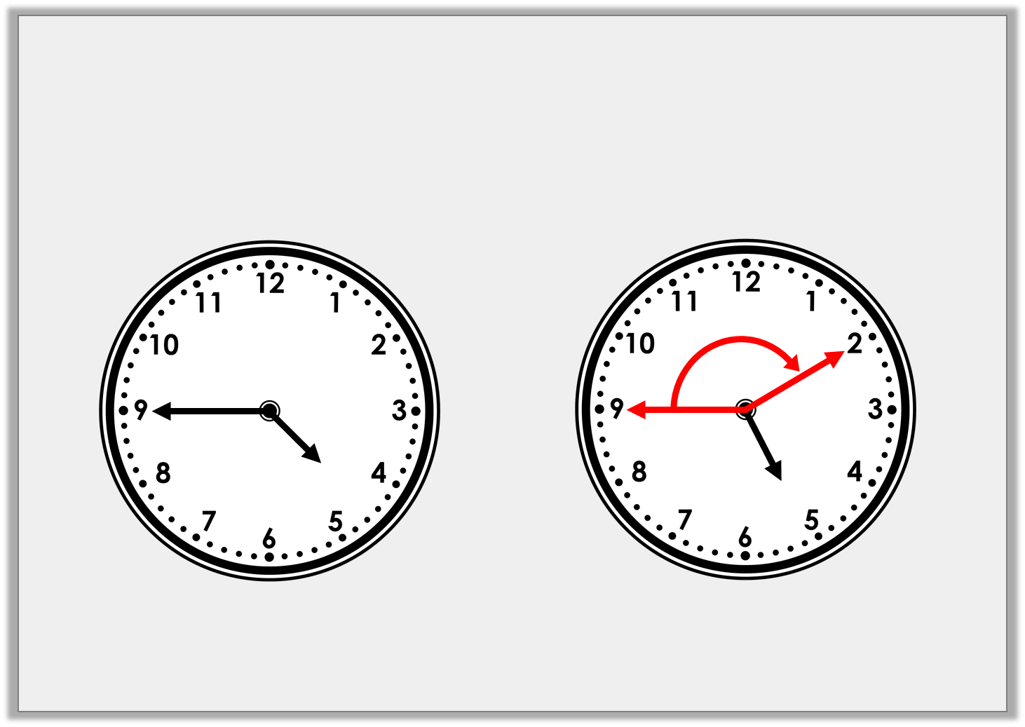
Varied Fluency 4
Has the minute hand moved through an acute or obtuse angle to get from a to b?
Obtuse
a
b
© Classroom Secrets Limited 2019

Slide 13
Problem Solving 1
Draw a shape with…
6 obtuse angles
90° angle cut out given for reference.
© Classroom Secrets Limited 2019

Slide 14
Problem Solving 1
Draw a shape with…
6 obtuse angles
Various possible answers, for example:
90° angle cut out given for reference.
© Classroom Secrets Limited 2019

Slide 15
Problem Solving 2
Make a table to show how many acute, obtuse and
right angles are in both of these shapes:
© Classroom Secrets Limited 2019

Slide 16
Problem Solving 2
Make a table to show how many acute, obtuse and
right angles are in both of these shapes:
Right angles | 2
Obtuse | 6
Acute | 2
© Classroom Secrets Limited 2019

Slide 17
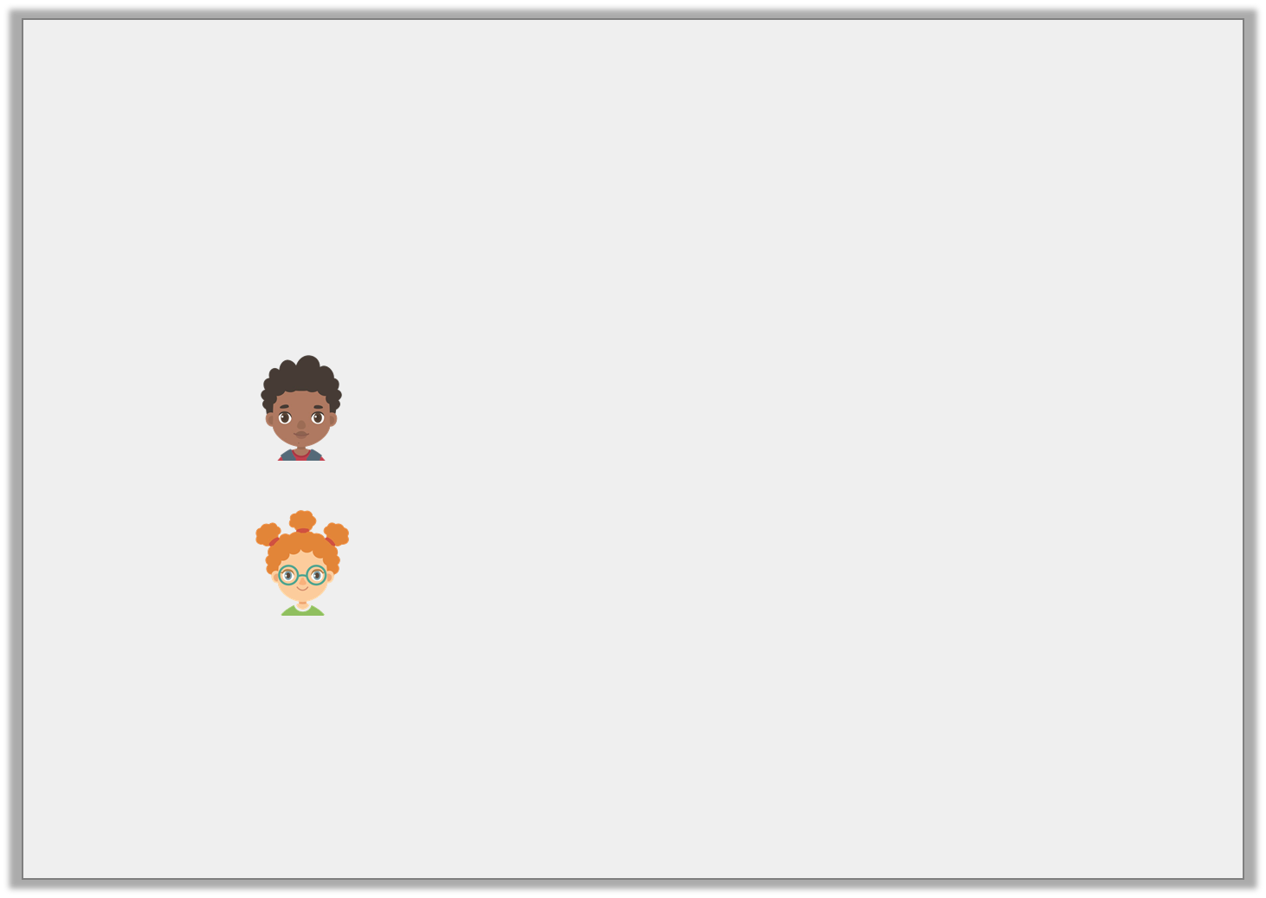
Reasoning 1
Year 3 have been asked to describe the angles in this shape:
Who is correct? Explain how you know.
All of this shape’s internal
angles are right angles.
Mo
This shape has 6 internal
angles altogether.
Lily
© Classroom Secrets Limited 2019

Slide 18
Reasoning 1
Year 3 have been asked to describe the angles in this shape:
Who is correct? Explain how you know.
Lily is correct because…
All of this shape’s internal
angles are right angles.
Mo
This shape has 6 internal
angles altogether.
Lily
© Classroom Secrets Limited 2019

Slide 19
Reasoning 1
Year 3 have been asked to describe the angles in this shape:
Who is correct? Explain how you know.
Lily is correct because this shape has 6 corners.
Mo is incorrect because the shape is not a rectangle, therefore, all of its internal angles cannot be 90°.
All of this shape’s internal
angles are right angles.
Mo
This shape has 6 internal
angles altogether.
Lily
© Classroom Secrets Limited 2019

