Slide 1
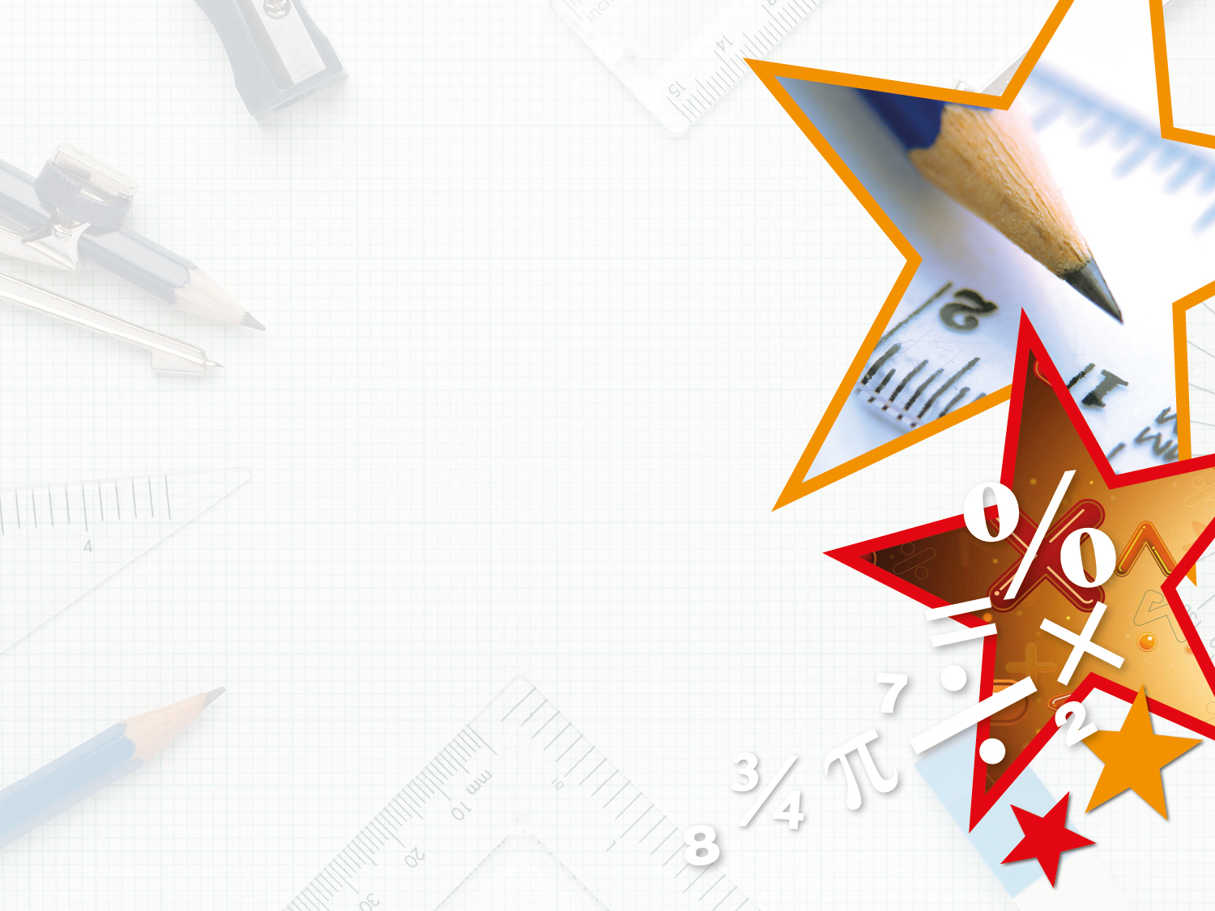


LIFE/work balance
We have started a #LIFEworkbalance campaign and we need your help to complete our LIFE/work balance survey.
We hope to publish the results soon, so please give 15 minutes of your time to help us get a true picture of school life.
Want to be a part of this campaign? Take the survey on our website and share it with your colleagues!
© Classroom Secrets Limited 2019

Slide 2
Year 3 – Summer Block 3 – Properties of Shapes – Horizontal and Vertical
About This Resource:
This PowerPoint has been designed to support your teaching of this small step. It includes a starter activity and an example of each question from the Varied Fluency and Reasoning and Problem Solving resources also provided in this pack. You can choose to work through all examples provided or a selection of them depending on the needs of your class.
National Curriculum Objectives:
Mathematics Year 3: (3G2) Identify horizontal and vertical lines
More Year 3 Properties of Shapes resources.
Did you like this resource? Don’t forget to review it on our website.
© Classroom Secrets Limited 2018

Slide 3
Year 3 – Summer Block 3 – Properties of Shapes
Step 5: Horizontal and Vertical
© Classroom Secrets Limited 2018

Slide 4
Introduction
How many horizontal lines are there?
How many vertical lines are there?
© Classroom Secrets Limited 2018

Slide 5
Introduction
How many horizontal lines are there?
How many vertical lines are there?
5 horizontal
© Classroom Secrets Limited 2018

Slide 6
Introduction
How many horizontal lines are there?
How many vertical lines are there?
6 vertical
© Classroom Secrets Limited 2018

Slide 7
Varied Fluency 1
Draw the vertical lines of symmetry in these objects.
W
© Classroom Secrets Limited 2018

Slide 8
Varied Fluency 1
Draw the vertical lines of symmetry in these objects.
W
© Classroom Secrets Limited 2018

Slide 9
Varied Fluency 2
Fill in the table below.
Object | Type of lines – horizontal, vertical or both?
© Classroom Secrets Limited 2018

Slide 10
Varied Fluency 2
Fill in the table below.
Object | Type of lines –horizontal, vertical or both?
 | both
 | vertical
 | horizontal
 | both
© Classroom Secrets Limited 2018

Slide 11


Varied Fluency 3
Which of the images below has a vertical line of symmetry?
© Classroom Secrets Limited 2018

Slide 12

Varied Fluency 3
Which of the images below has a vertical line of symmetry?

© Classroom Secrets Limited 2018

Slide 13
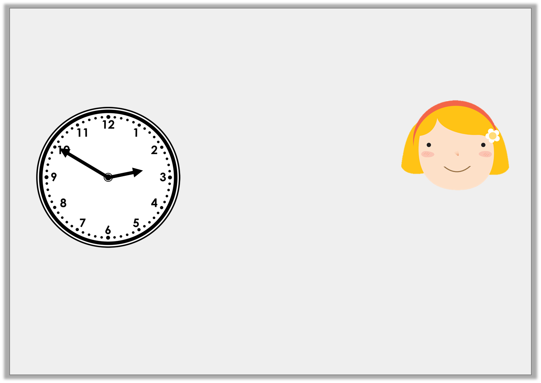
Reasoning 1
Ruby is looking for horizontal and vertical lines. The time is now:
Is she correct? Explain how you know.
In 10 minutes, one hand will be horizontal and one hand will be vertical.
© Classroom Secrets Limited 2018

Slide 14
Reasoning 1
Ruby is looking for horizontal and vertical lines. The time is now:
Is she correct? Explain how you know.
Ruby is correct because…
In 10 minutes, one hand will be horizontal and one hand will be vertical.
© Classroom Secrets Limited 2018

Slide 15
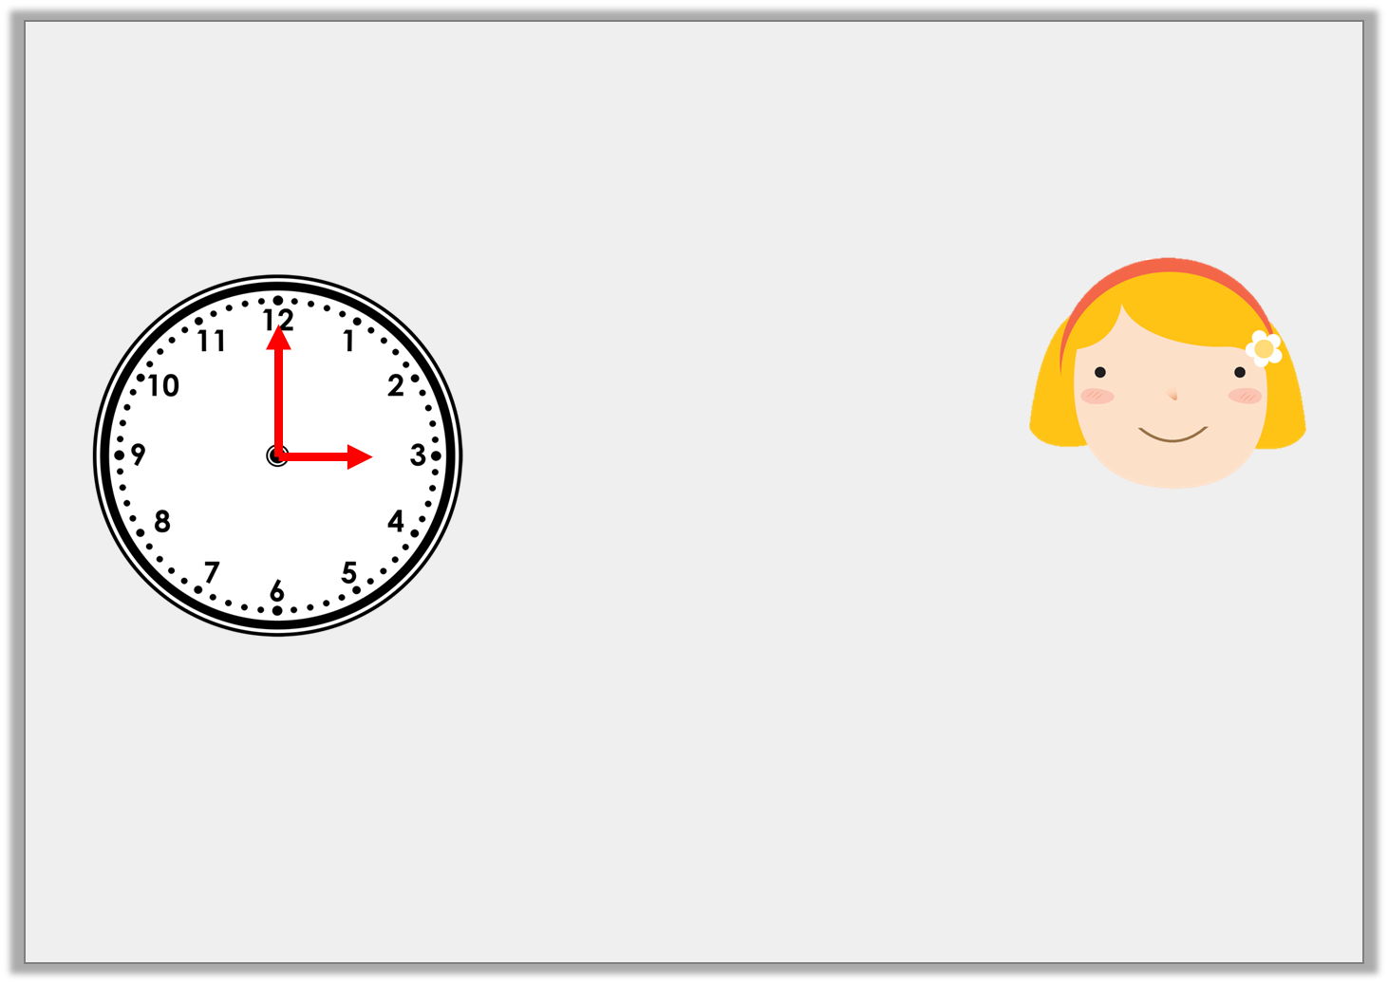
Reasoning 1
Ruby is looking for horizontal and vertical lines. The time is now:
Is she correct? Explain how you know.
Ruby is correct because at 3 o’clock the hour hand will be pointing to 3 so it will be horizontal and the minute hand will be pointing at 12 so it will be vertical.
In 10 minutes, one hand will be horizontal and one hand will be vertical.
© Classroom Secrets Limited 2018

Slide 16

Problem Solving 1
Anna and her friends are writing their names in capital letters.
Which friend has more vertical lines in the
letters of their name than Anna?
ANNA
BILL
TANYA
KYLIE
© Classroom Secrets Limited 2018

Slide 17
Problem Solving 1
Anna and her friends are writing their names in capital letters.
Which friend has more vertical lines in the
letters of their name than Anna?
4
ANNA
4
BILL
4
5
TANYA
KYLIE
© Classroom Secrets Limited 2018

Slide 18
Reasoning 2
Considering the lines of symmetry, which shape
is the odd one out?
Explain your answer.
T
+
© Classroom Secrets Limited 2018

Slide 19
Reasoning 2
Considering the lines of symmetry, which shape
is the odd one out?
Explain your answer.
The cross is the odd one out because…
T
+
© Classroom Secrets Limited 2018

Slide 20
Reasoning 2
Considering the lines of symmetry, which shape
is the odd one out?
Explain your answer.
The cross is the odd one out because it is the only shape with a horizontal and a vertical line of symmetry.
T
+
© Classroom Secrets Limited 2018

