Slide 1



LIFE/work balance
We have started a #LIFEworkbalance campaign and we need your help to complete our LIFE/work balance survey.
We hope to publish the results soon, so please give 15 minutes of your time to help us get a true picture of school life.
Want to be a part of this campaign? Take the survey on our website and share it with your colleagues!
© Classroom Secrets Limited 2020

Slide 2
Year 4 – Spring Block 3 – Noun Phrases – Modifying Adjectives and Nouns
About This Resource:
This PowerPoint has been designed to support your teaching of this small step. It includes a starter activity and an example of each question from the Varied Fluency and Application and Reasoning resources also provided in this pack. You can choose to work through all examples provided or a selection of them depending on the needs of your class.
National Curriculum Objectives:
English Year 4: (4G3.2) Noun phrases expanded by the addition of modifying adjectives, nouns and preposition phrases (e.g. the teacher expanded to: the strict maths teacher with curly hair)​
More resources from our Grammar, Punctuation and Spelling scheme of work.
Did you like this resource? Don’t forget to review it on our website.
© Classroom Secrets Limited 2019

Slide 3
Year 4 – Spring Block 3 – Noun Phrases – Modifying Adjectives and Nouns
Notes and Guidance:
Having recapped identifying noun phrases in the previous step, children can now move on to modifying adjectives and nouns.
A modifier is a word or phrase which is added to a noun or adjective in order to make it more specific. For example: Secondary school teacher. The addition of ‘Secondary school’ to ‘teacher’ tells the reader that the person is a specific kind of teacher therefore modifying the word ‘teacher’. ’Secondary’ modifies the word ‘school’.
In this step, children will begin to identify and use adjectives and nouns as modifiers to create specific information.
Focused Questions
Which word is the modifier?
How has the adjective in this sentence modified the noun?
© Classroom Secrets Limited 2019

Slide 4
Year 4 – Spring Block 3 – Noun Phrases
Step 2: Modifying Adjectives and Nouns
© Classroom Secrets Limited 2019

Slide 5
Introduction
Identify the noun phrases in each of the sentences and phrases below.
The crafty raven with jet black feathers.
The tiny box beside the tree.
The scientist identified the miraculous cure after years of research.
© Classroom Secrets Limited 2019

Slide 6
Introduction
Identify the noun phrases in each of the sentences and phrases below.
The crafty raven with jet black feathers.
The tiny box beside the tree.
The scientist identified the miraculous cure after years of research.
© Classroom Secrets Limited 2019

Slide 7
Varied Fluency 1
Which modifier is the most suitable to be added to each noun in the sentence below?
The children ate the cake quickly so they could have more time on the trampoline.
huge
excited
birthday
© Classroom Secrets Limited 2019

Slide 8
Varied Fluency 1
Which modifier is the most suitable to be added to each noun in the sentence below?
The excited children ate the birthday cake quickly so they could have more time on the huge trampoline.
huge
excited
birthday
© Classroom Secrets Limited 2019

Slide 9
Varied Fluency 2
Underline three modifiers in the sentence below.
The elegant swan glided gracefully across the wide mountain lake as it waited patiently for its female mate to return.
© Classroom Secrets Limited 2019

Slide 10
Varied Fluency 2
Underline three modifiers in the sentence below.
The elegant swan glided gracefully across the wide mountain lake as it waited patiently for its female mate to return.
Any three of the following: elegant, wide, mountain, female.
© Classroom Secrets Limited 2019

Slide 11
Varied Fluency 3
Which sentence contains a modifier?
A. | After lunch, the sleepy office worker, who had got up early, dozed off in his chair.
B. | Despite the risk, the mouse crept silently around the cat in search of food.
© Classroom Secrets Limited 2019

Slide 12
Varied Fluency 3
Which sentence contains a modifier?
A. | After lunch, the sleepy office worker, who had got up early, dozed off in his chair.
B. | Despite the risk, the mouse crept silently around the cat in search of food.
© Classroom Secrets Limited 2019

Slide 13
Varied Fluency 4
What does the underlined modifier tell us about the sentence?
The efficient emergency nurse, who was on the first night shift, quickly helped the patient onto a bed.
© Classroom Secrets Limited 2019

Slide 14
Varied Fluency 4
What does the underlined modifier tell us about the sentence?
The efficient emergency nurse, who was on the first night shift, quickly helped the patient onto a bed.
Efficient tells us how good the nurse is at their job.
© Classroom Secrets Limited 2019

Slide 15
Reasoning 1
How would including the word ‘interesting’ to describe the book modify the meaning of the sentence?
After reading a chapter of his book, Riley paused to think for a while, then put the book down.
© Classroom Secrets Limited 2019

Slide 16
Reasoning 1
How would including the word ‘interesting’ to describe the book modify the meaning of the sentence?
After reading a chapter of his book, Riley paused to think for a while, then put the book down.
Various possible answers, for example: ‘Interesting’ shows us why…
© Classroom Secrets Limited 2019

Slide 17
Reasoning 1
How would including the word ‘interesting’ to describe the book modify the meaning of the sentence?
After reading a chapter of his book, Riley paused to think for a while, then put the book down.
Various answers, for example: ‘Interesting’ shows us why Riley paused to think about it.
© Classroom Secrets Limited 2019

Slide 18
Application 1
Improve the sentence below by adding two modifiers.
On Fridays, the family come over to my house and we all have a meal together.
© Classroom Secrets Limited 2019

Slide 19
Application 1
Improve the sentence below by adding two modifiers.
On Fridays, the family come over to my house and we all have a meal together.
Various possible answers using two modifiers, for example: On Fridays, the extended family come over to my house and we all have a takeaway meal together.
© Classroom Secrets Limited 2019

Slide 20
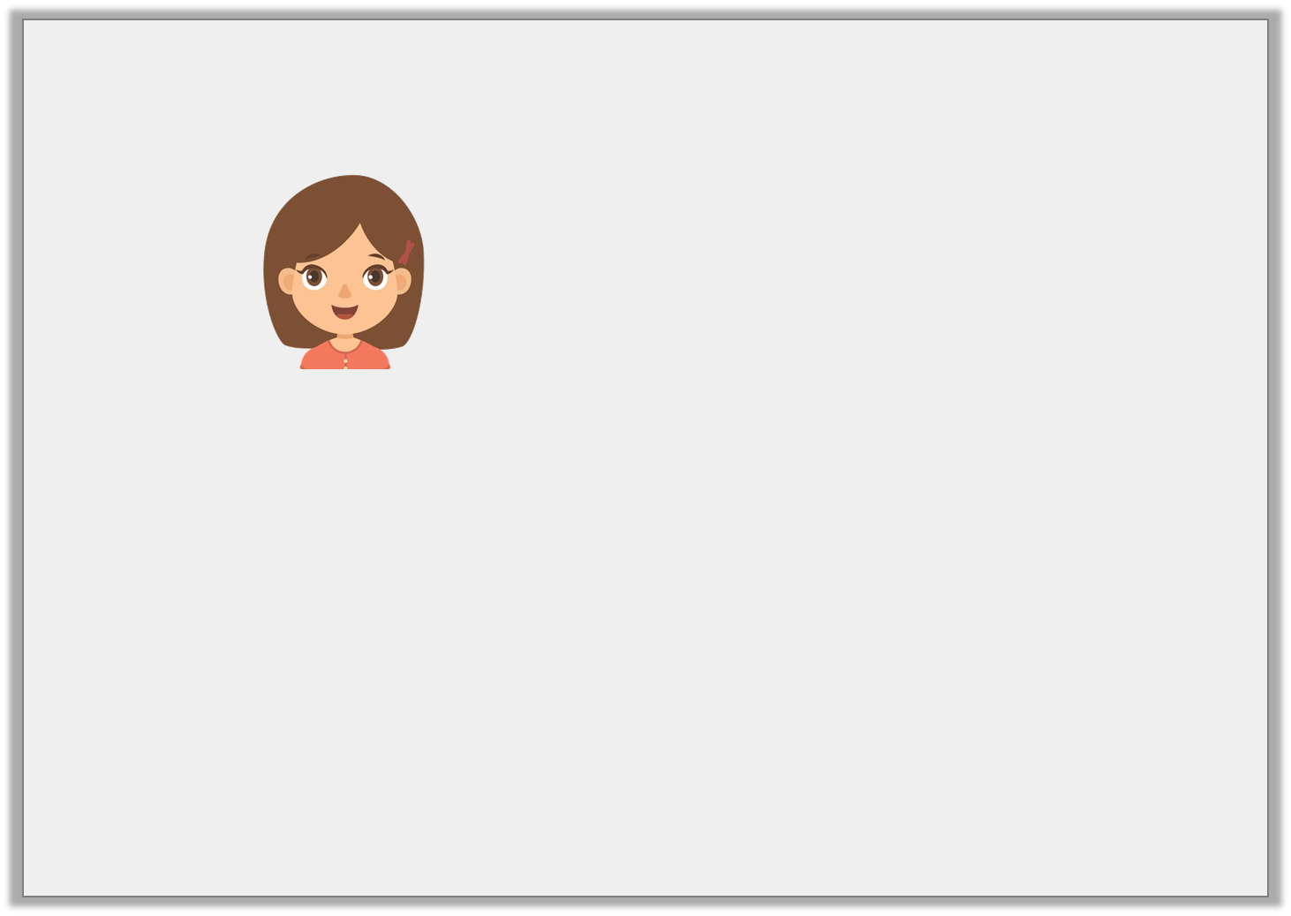
Reasoning 2
Brooke says,
The high chair, which the baby was sitting in, was decorated with pictures of rabbits and teddies and looked adorable.
Is she correct? Explain your answer.
I could add the modifier ‘short’ to the sentence below to describe the high chair.
© Classroom Secrets Limited 2019

Slide 21
Reasoning 2
Brooke says,
The high chair, which the baby was sitting in, was decorated with pictures of rabbits and teddies and looked adorable.
Is she correct? Explain your answer.
She is not correct because a high chair…
I could add the modifier ‘short’ to the sentence below to describe the high chair.
© Classroom Secrets Limited 2019

Slide 22
Reasoning 2
Brooke says,
The high chair, which the baby was sitting in, was decorated with pictures of rabbits and teddies and looked adorable.
Is she correct? Explain your answer.
She is not correct because a high chair wouldn’t be described as short.
I could add the modifier ‘short’ to the sentence below to describe the high chair.
© Classroom Secrets Limited 2019

