Slide 1

Year 4 – Spring Block 3 – Noun Phrases – Determiners Before Modifiers
About This Resource:
This PowerPoint has been designed to support your teaching of this small step. It includes a starter activity and an example of each question from the Varied Fluency and Application and Reasoning resources also provided in this pack. You can choose to work through all examples provided or a selection of them depending on the needs of your class.
National Curriculum Objectives:
English Year 4: (4G3.2) Noun phrases expanded by the addition of modifying adjectives, nouns and preposition phrases (e.g. the teacher expanded to: the strict maths teacher with curly hair)​
More resources from our Grammar, Punctuation and Spelling scheme of work.
Did you like this resource? Don’t forget to review it on our website.
© Classroom Secrets Limited 2019

Slide 2
Year 4 – Spring Block 3 – Noun Phrases – Determiners Before Modifiers
Notes and Guidance
This step focuses on the use of determiners before a modifier.
A determiner is positioned before a modifier in order to specify a noun as known or unknown. For example: My house (known); a house (unknown).
Determiners can be articles (the, a or an), demonstratives (e.g. this, those), possessives (e.g. his, my) or quantifiers (e.g. all, every)
Focused Questions
Is this determiner correct?
Add a determiner so that this noun phrase makes sense.
© Classroom Secrets Limited 2019

Slide 3
Year 4 – Spring Block 3 – Noun Phrases
Step 3: Determiners Before Modifiers
© Classroom Secrets Limited 2019

Slide 4
Introduction
Find the modifiers in the sentences below.
My mum is an important businesswoman.
We saw the St. Peter’s Church spire.
I like sticky icing.
The crumbling castle had open gates.
© Classroom Secrets Limited 2019

Slide 5
Introduction
Find the modifiers in the sentences below.
My mum is an important businesswoman.
We saw the St. Peter’s Church spire.
I like sticky icing.
The crumbling castle had open gates.
© Classroom Secrets Limited 2019

Slide 6
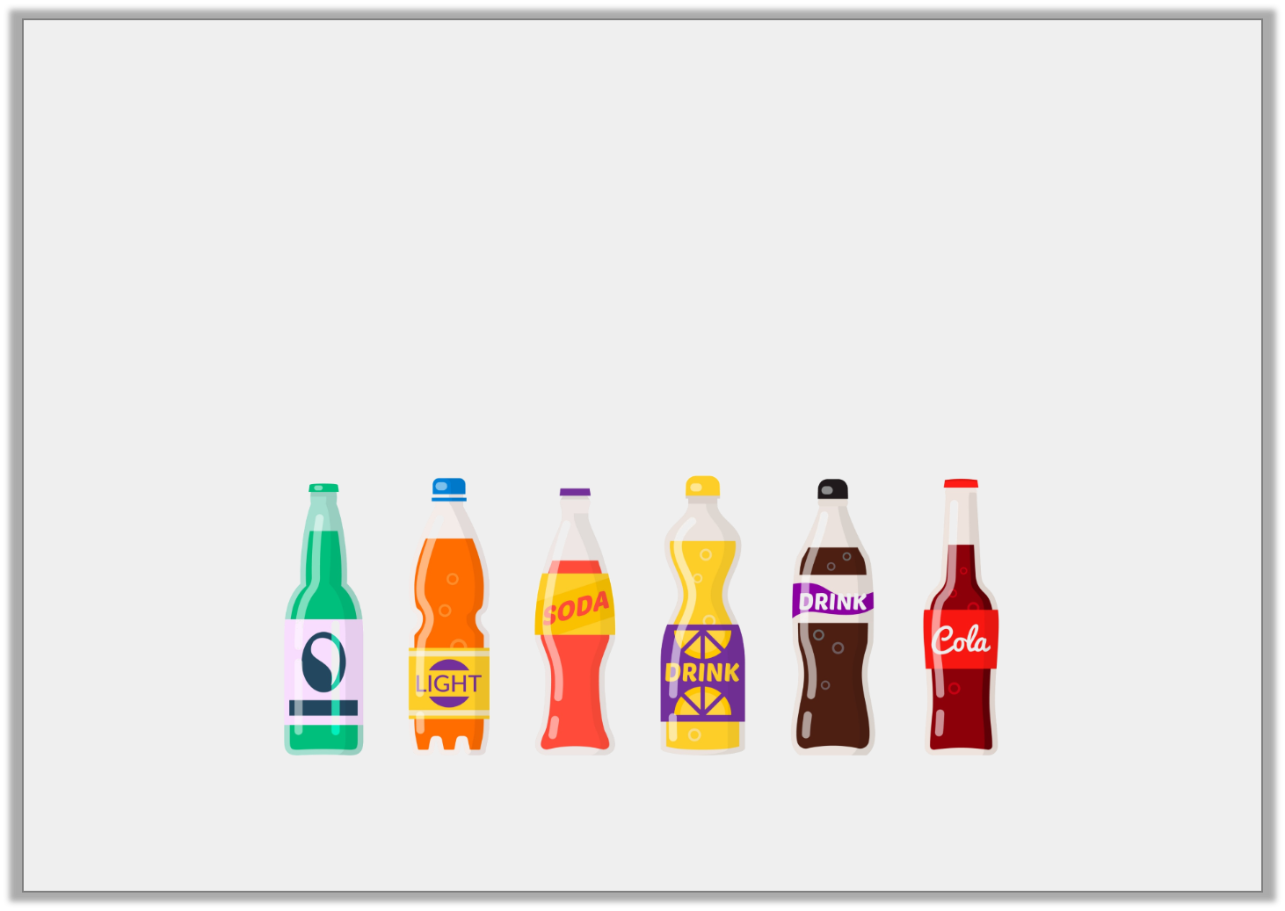
Varied Fluency 1
Underline any determiners in the sentence below.
We can try my new recipe or we can get some cold drinks.
© Classroom Secrets Limited 2019

Slide 7
Varied Fluency 1
Underline any determiners in the sentence below.
We can try my new recipe or we can get some cold drinks.
© Classroom Secrets Limited 2019

Slide 8
Varied Fluency 2
In which sentence below have the determiners and modifiers been used correctly?
The old cockerel croaked but could not wake sleepy the family.
Lifting every heavy box was awful but Miley finished the tiring job.
© Classroom Secrets Limited 2019

Slide 9
Varied Fluency 2
In which sentence below have the determiners and modifiers been used correctly?
The old cockerel croaked but could not wake sleepy the family.
Lifting every heavy box was awful but Miley finished the tiring job.
Sentence B.
© Classroom Secrets Limited 2019

Slide 10
Varied Fluency 3
Circle the determiners which could fill the gap in the sentence below.
Maxwell grabbed __________ shiny apple and dropped the rotting banana.
his | those | a
© Classroom Secrets Limited 2019

Slide 11
Varied Fluency 3
Circle the determiners which could fill the gap in the sentence below.
Maxwell grabbed __________ shiny apple and dropped the rotting banana.
his | those | a
© Classroom Secrets Limited 2019

Slide 12
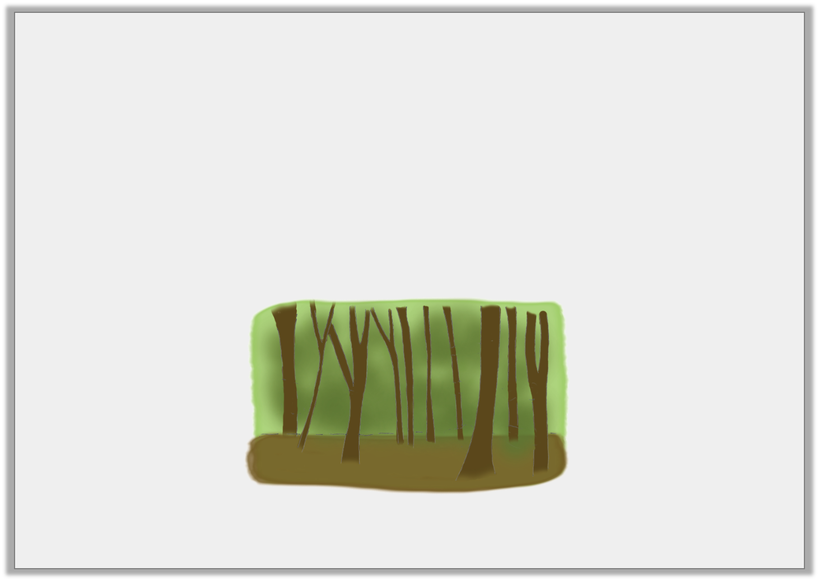
Varied Fluency 4
Which of the underlined words is a possessive determiner?
Phoebe saw the gloomy trees and made sure her timid steps were quiet.
© Classroom Secrets Limited 2019

Slide 13
Varied Fluency 4
Which of the underlined words is a possessive determiner?
Phoebe saw the gloomy trees and made sure her timid steps were quiet.
Her.
© Classroom Secrets Limited 2019

Slide 14
Application 1
Arrange these pieces into a sensible sentence, then underline the determiners.
towering
a
explosion and
There was
huge
the
block of flats fell.
© Classroom Secrets Limited 2019

Slide 15
Application 1
Arrange these pieces into a sensible sentence, then underline the determiners.
There are various possible sentences; for example:
There was a huge explosion and the towering block of flats fell.
towering
a
explosion and
There was
huge
the
block of flats fell.
© Classroom Secrets Limited 2019

Slide 16
Reasoning 1
Choose a determiner to fill the gap in the sentence below.
Those rich girls have their expensive parties but I like seeing __________ friends.
Why did you choose that determiner?
© Classroom Secrets Limited 2019

Slide 17
Reasoning 1
Choose a determiner to fill the gap in the sentence below.
Those rich girls have their expensive parties but I like seeing __________ friends.
Why did you choose that determiner?
I chose the determiner ‘my’, because…
© Classroom Secrets Limited 2019

Slide 18
Reasoning 1
Choose a determiner to fill the gap in the sentence below.
Those rich girls have their expensive parties but I like seeing __________ friends.
Why did you choose that determiner?
I chose the determiner ‘my’, because the writer has just written ‘I’ so is talking about their own friends.
There are other possible choices and explanations.
© Classroom Secrets Limited 2019

Slide 19
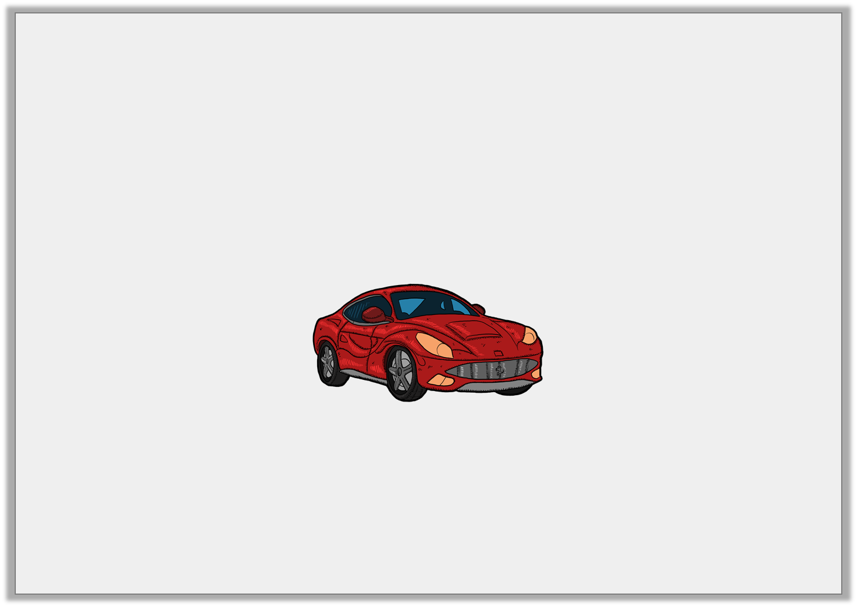
Reasoning 2
Have determiners and modifiers been used correctly in the sentence below?
“This flashy car is so fast,” grinned proud the driver.
© Classroom Secrets Limited 2019

Slide 20
Reasoning 2
Have determiners and modifiers been used correctly in the sentence below?
“This flashy car is so fast,” grinned proud the driver.
No because…
© Classroom Secrets Limited 2019

Slide 21
Reasoning 2
Have determiners and modifiers been used correctly in the sentence below?
“This flashy car is so fast,” grinned proud the driver.
No because the determiner ‘the’ should come before the modifier ‘proud’.
Other answers are possible.
© Classroom Secrets Limited 2019

