Slide 1
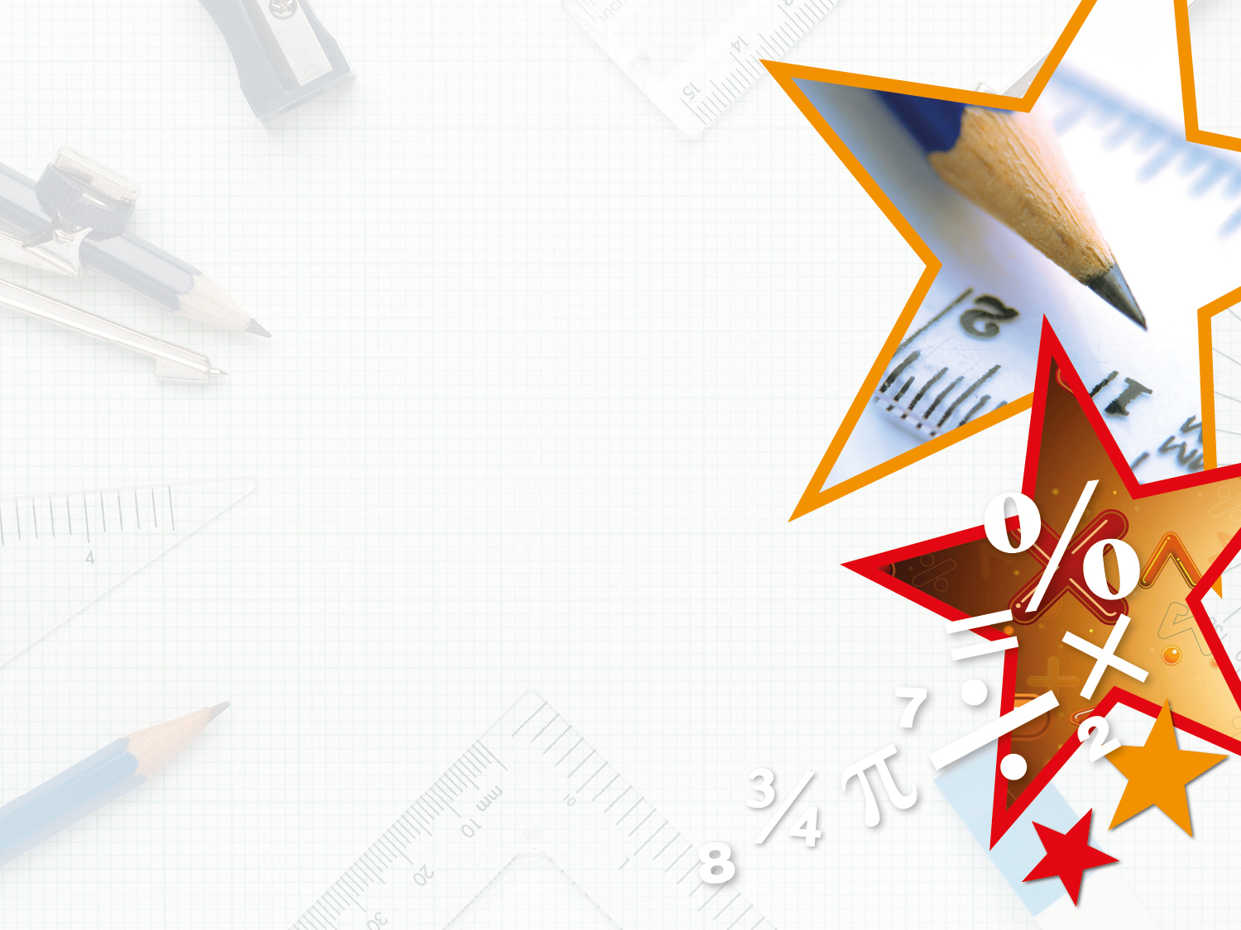


LIFE/work balance
We have started a #LIFEworkbalance campaign and we need your help to complete our LIFE/work balance survey.
We hope to publish the results soon, so please give 15 minutes of your time to help us get a true picture of school life.
Want to be a part of this campaign? Take the survey on our website and share it with your colleagues!
© Classroom Secrets Limited 2018

Slide 2
Year 3 – Summer Block 3 – Properties of Shapes – Draw Accurately
About This Resource:
This PowerPoint has been designed to support your teaching of this small step. It includes a starter activity and an example of each question from the Varied Fluency and Reasoning and Problem Solving resources also provided in this pack. You can choose to work through all examples provided or a selection of them depending on the needs of your class.
National Curriculum Objectives:
Mathematics Year 3: (3G3a) Draw 2-D shapes and make 3-D shapes using modelling materials; recognise 3-D shapes in different orientations and describe them
More Year 3 Properties of Shapes resources.
Did you like this resource? Don’t forget to review it on our website.
© Classroom Secrets Limited 2018

Slide 3
Year 3 – Summer Block 3 – Properties of Shapes
Step 4: Draw Accurately
© Classroom Secrets Limited 2018

Slide 4
Introduction
Find items around your classroom
that match the following measurements:
3cm
5cm
12cm
20cm
30cm
© Classroom Secrets Limited 2018

Slide 5
Introduction
Find items around your classroom
that match the following measurements:
Answers will vary, some examples could include:
3cm: paperclip
5cm: crayon
12cm: scissors
20cm: paintbrush
30cm: lunchbox
© Classroom Secrets Limited 2018

Slide 6
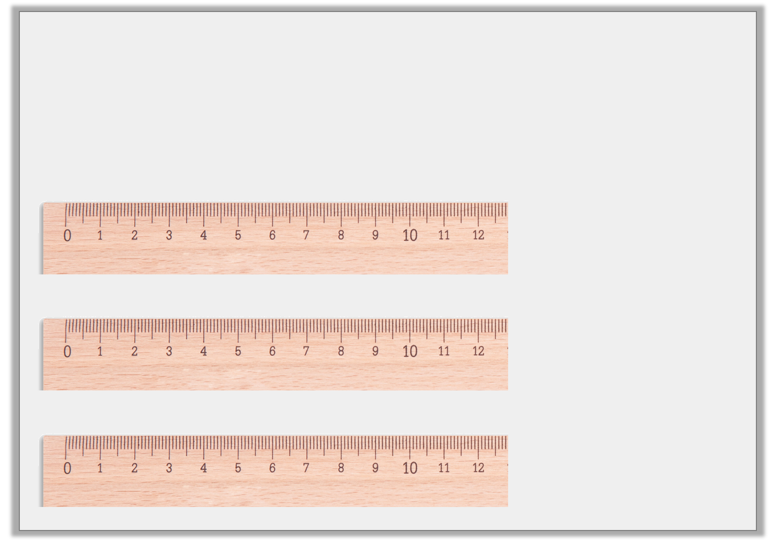
Varied Fluency 1
Measure these lines to the nearest cm and match them to their label.
12cm
11cm
10cm
© Classroom Secrets Limited 2018

Slide 7
Varied Fluency 1
Measure these lines to the nearest cm and match them to their label.
12cm
11cm
10cm
© Classroom Secrets Limited 2018

Slide 8
Varied Fluency 2
Round these lengths to the nearest cm.
 | 8cm 7mm |  |  | 1cm 8mm
 | 7cm 1mm
© Classroom Secrets Limited 2018

Slide 9
Varied Fluency 2
Round these lengths to the nearest cm.
 | 8cm 7mm |  |  | 1cm 8mm
9cm
2cm
 | 7cm 1mm
7cm
© Classroom Secrets Limited 2018

Slide 10
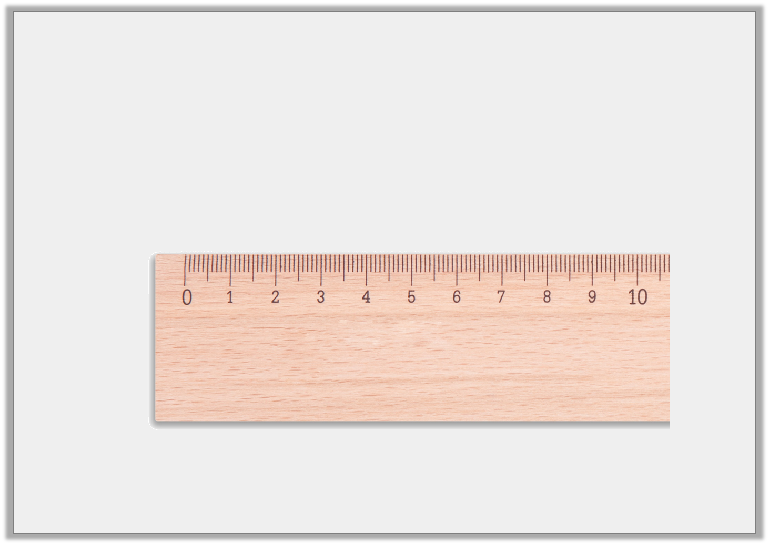
Varied Fluency 3
This line is 5cm long.
True or false?
© Classroom Secrets Limited 2018

Slide 11
Varied Fluency 3
This line is 5cm long.
True or false?
False, it is 5cm 4mm long.
© Classroom Secrets Limited 2018

Slide 12
Varied Fluency 4
Using a ruler, draw these measurements accurately.
 | 1cm 9mm |  |  | 4cm 1mm
 | 5cm 6mm
© Classroom Secrets Limited 2018

Slide 13
Varied Fluency 4
Using a ruler, draw these measurements accurately.
Lines drawn should be exact.
 | 1cm 9mm |  |  | 4cm 1mm
 | 5cm 6mm
© Classroom Secrets Limited 2018

Slide 14
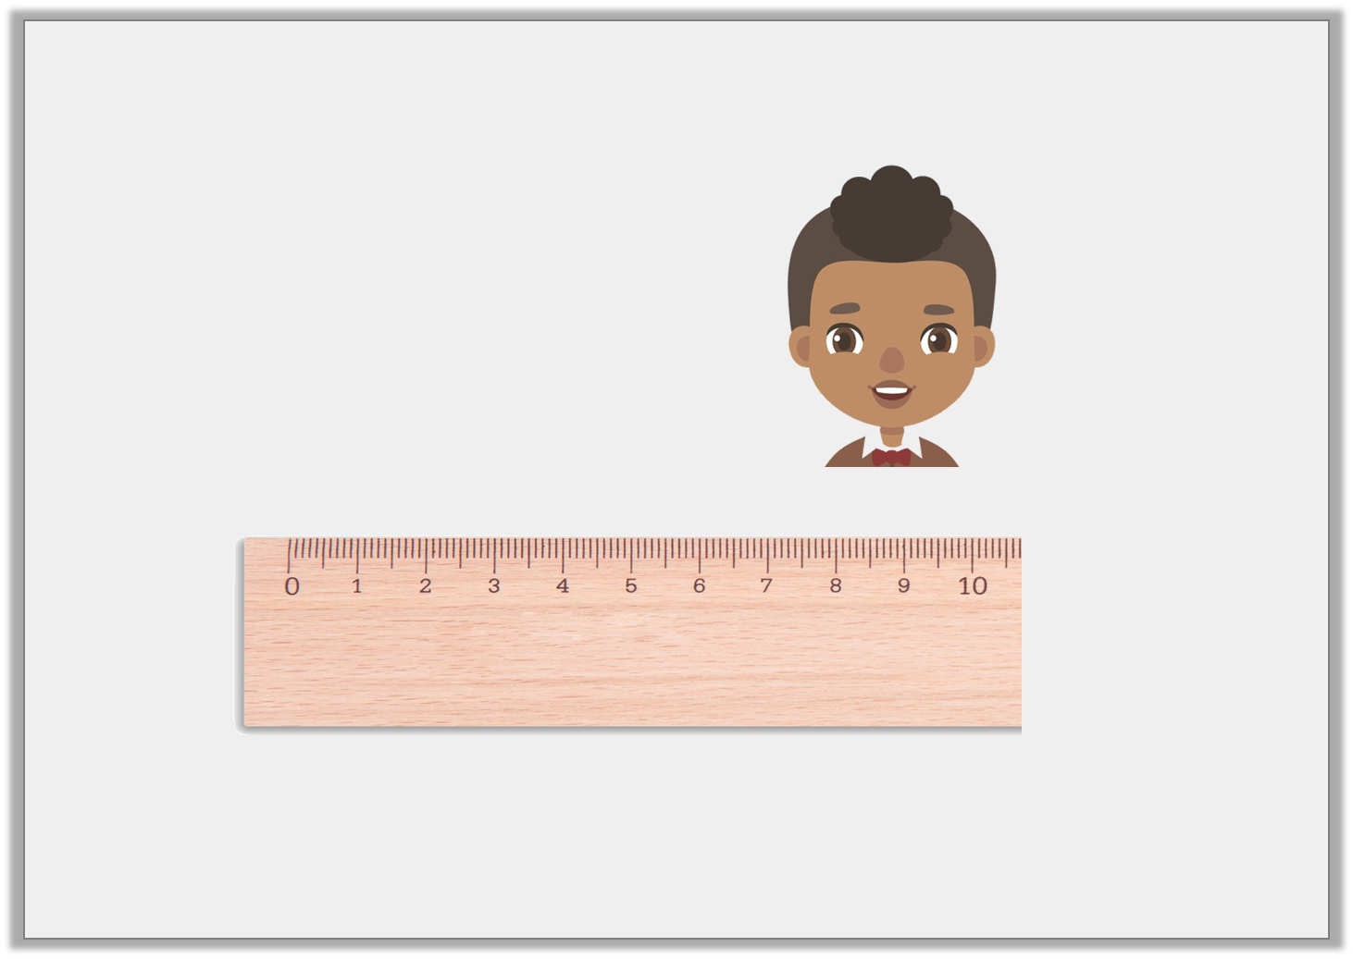
Reasoning 1
Simon has been measuring lines accurately.
Is he correct? Explain how you know.
My line is 9 cm 1mm long.
© Classroom Secrets Limited 2018

Slide 15
Reasoning 1
Simon has been measuring lines accurately.
Is he correct? Explain how you know.
No he is not correct because…
My line is 9 cm 1mm long.
© Classroom Secrets Limited 2018

Slide 16
Reasoning 1
Simon has been measuring lines accurately.
Is he correct? Explain how you know.
No he is not correct because his line is 9cm 6mm long.
My line is 9 cm 1mm long.
© Classroom Secrets Limited 2018

Slide 17
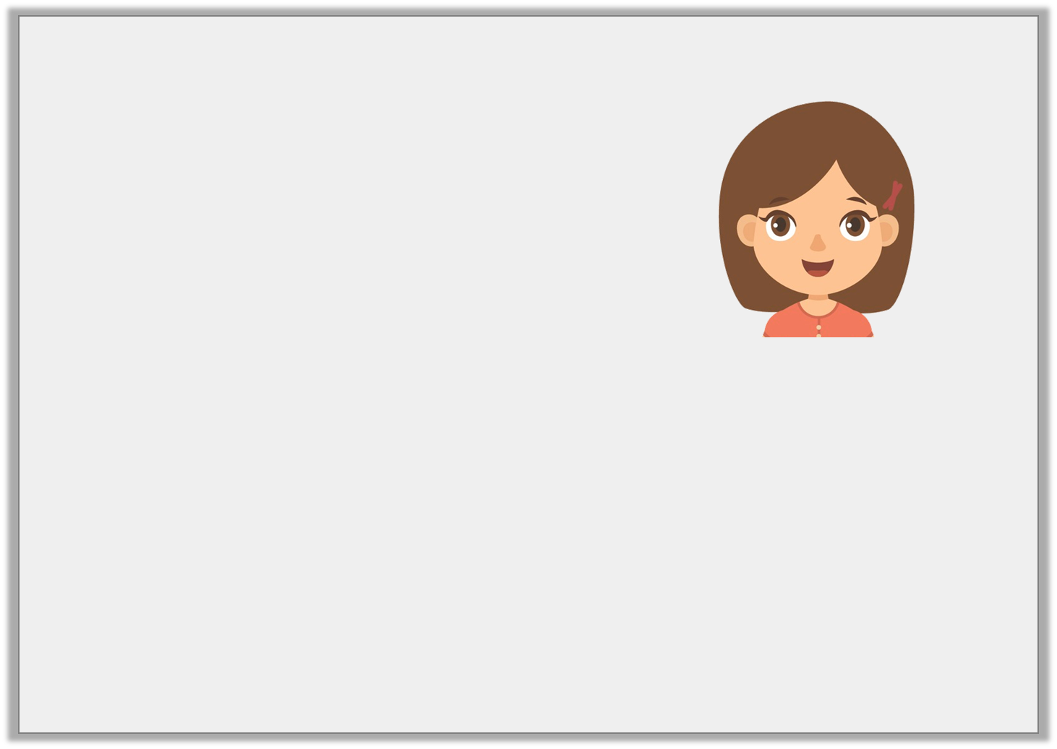
Problem Solving 1
Elsa has drawn some lines.
Draw and label 2 more possible sets of lines in cm and mm that Elsa could have drawn.
5cm 3mm | 3cm 3mm | 3 cm 4mm
My 3 lines make a total of 12cm.
© Classroom Secrets Limited 2018

Slide 18
Problem Solving 1
Elsa has drawn some lines.
Draw and label 2 more possible sets of lines in cm and mm that Elsa could have drawn.
Various possible answers,
for example:
5cm 3mm | 3cm 3mm | 3 cm 4mm
My 3 lines make a total of 12cm.
3cm 5mm | 4cm 4mm | 4 cm 1mm
© Classroom Secrets Limited 2018

Slide 19
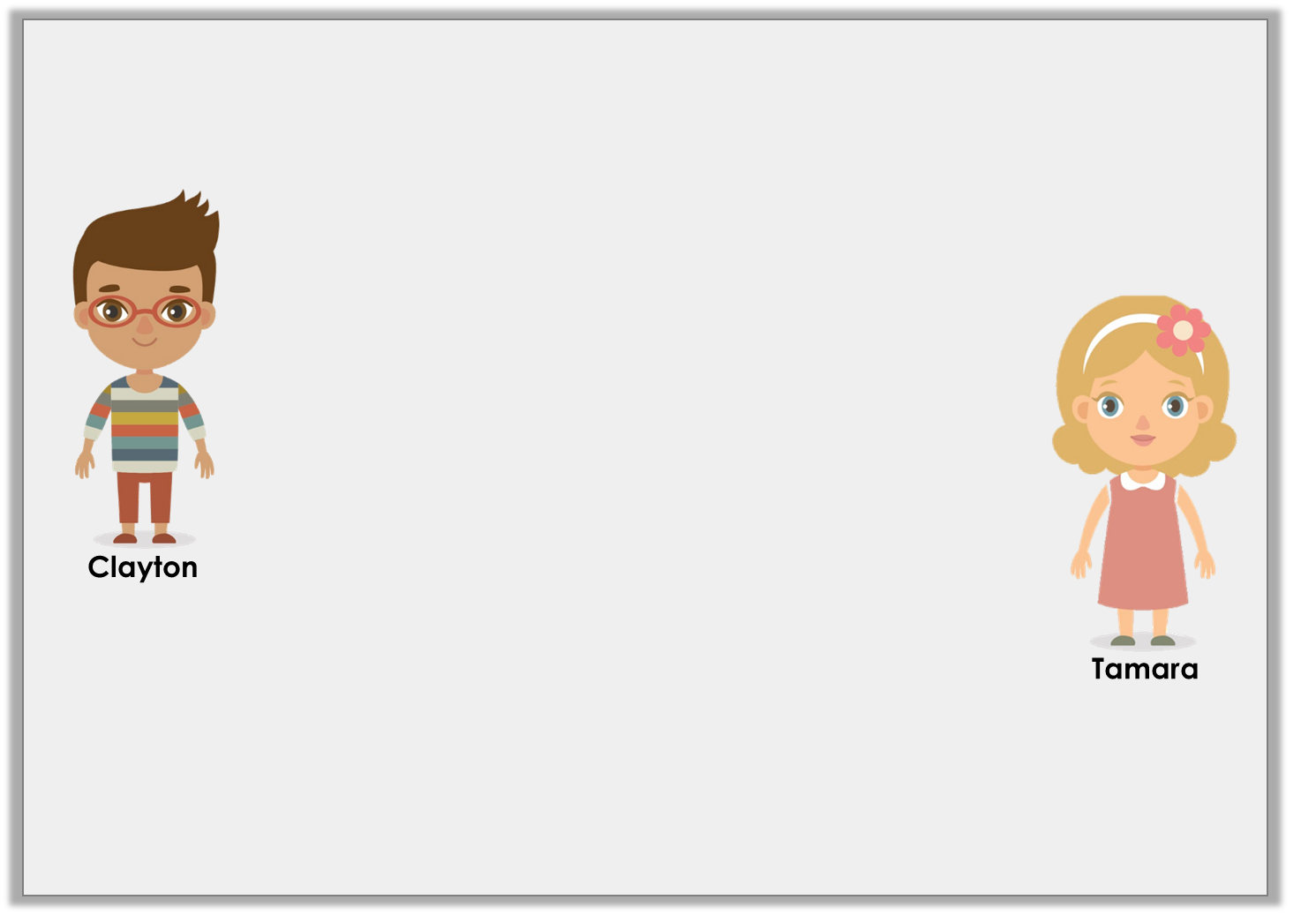
Reasoning 2
Clayton and Tamara are using a ruler to measure lines.
Who is correct? Why?
It doesn’t matter which side of the ruler you use to measure in centimetres, as long as you start on the ‘0’ line.
You have to make sure you are using the correct unit of measurement before you start measuring.
© Classroom Secrets Limited 2018

Slide 20
Reasoning 2
Clayton and Tamara are using a ruler to measure lines.
Who is correct? Why?
Tamara is correct as…
It doesn’t matter which side of the ruler you use to measure in centimetres, as long as you start on the ‘0’ line.
You have to make sure you are using the correct unit of measurement before you start measuring.
© Classroom Secrets Limited 2018

Slide 21
Reasoning 2
Clayton and Tamara are using a ruler to measure lines.
Who is correct? Why?
Tamara is correct as rulers generally measure in both inches and centimetres.
It doesn’t matter which side of the ruler you use to measure in centimetres, as long as you start on the ‘0’ line.
You have to make sure you are using the correct unit of measurement before you start measuring.
© Classroom Secrets Limited 2018

