Slide 1
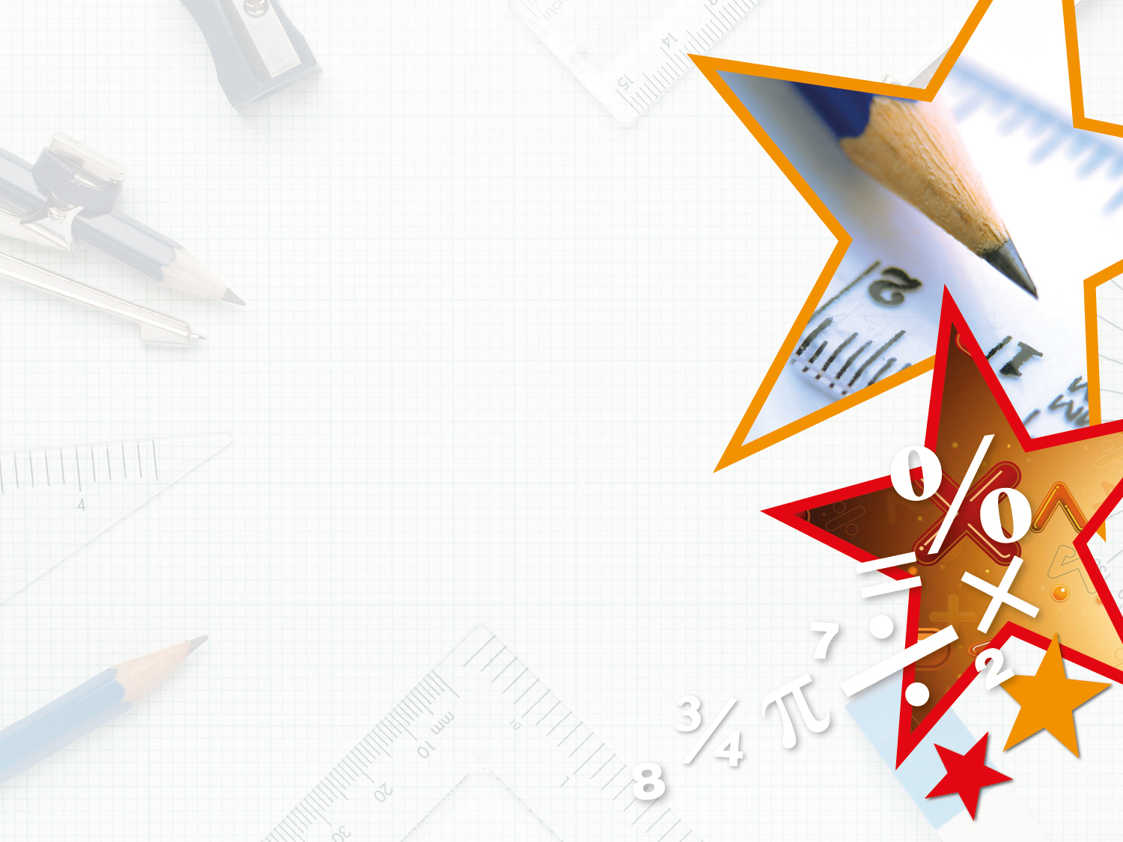

Year 3 – Summer Block 2 – Time – Telling the Time to 5 Minutes
About This Resource:
This PowerPoint has been designed to support your teaching of this small step. It includes a starter activity and an example of each question from the Varied Fluency and Reasoning and Problem Solving resources also provided in this pack. You can choose to work through all examples provided or a selection of them depending on the needs of your class.
National Curriculum Objectives:
Mathematics Year 3: (3M4c) Tell and write the time from an analogue clock, including using Roman numerals from I to XII, and 12-hour and 24-hour clocks
Mathematics Year 3: (3M4d) Estimate and read time with increasing accuracy to the nearest minute; record and compare time in terms of seconds, minutes and hours; use vocabulary such as o’clock, a.m./p.m., morning, afternoon, noon and midnight
More Year 3 Time resources.
Did you like this resource? Don’t forget to review it on our website.
© Classroom Secrets Limited 2019

Slide 2
Year 3 – Summer Block 2 – Time
Step 3: Telling the Time
to 5 Minutes
© Classroom Secrets Limited 2019

Slide 3
Introduction
Roman numerals are sometimes used on clock faces.
Let’s recap them:
1 | = | I
2 | = | II
3 | = | III
4 | = | IV
5 | = | V
6 | = | VI
7 | = | VII
8 | = | VIII
9 | = | IX
10 | = | X
11 | = | XI
12 | = | XII
© Classroom Secrets Limited 2019

Slide 4
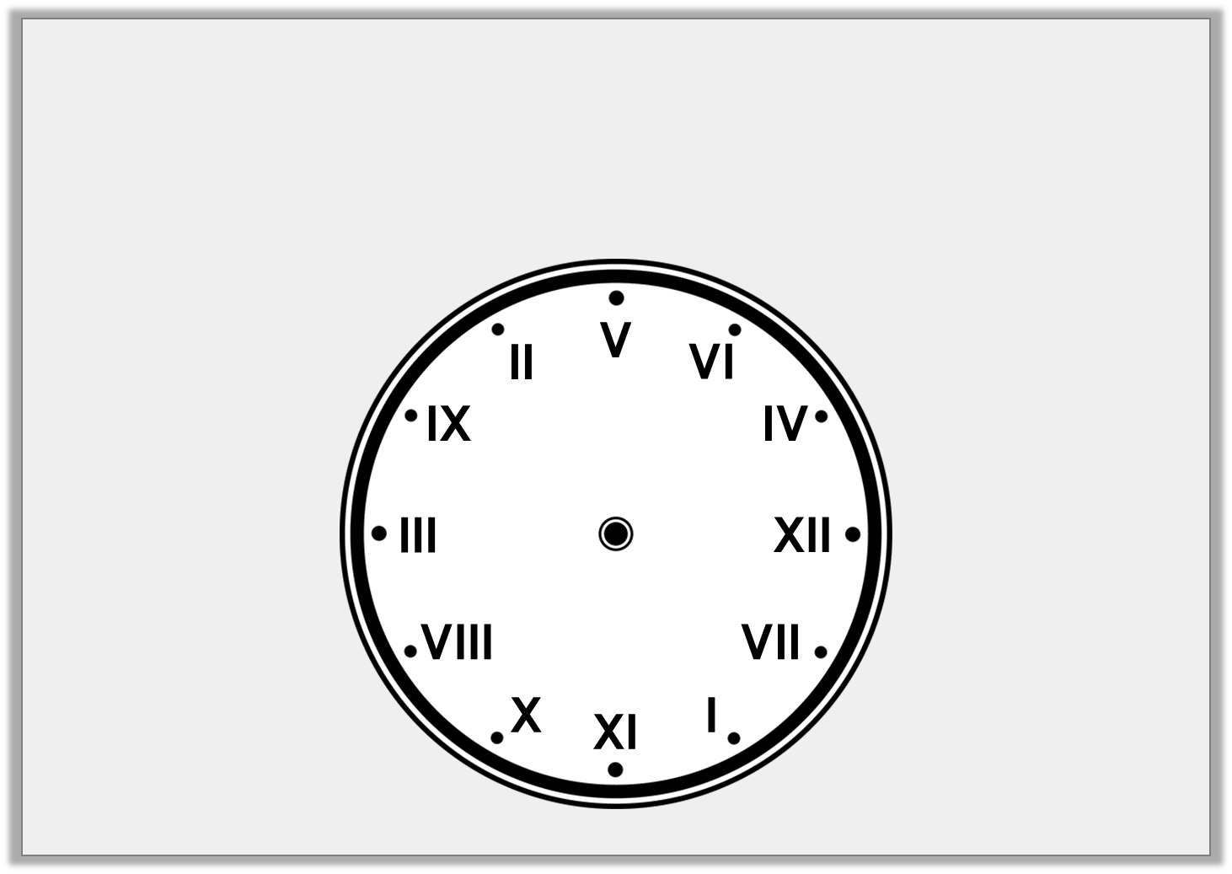
Introduction
The Roman numerals on the clock face have been muddled up.
Put them back into the correct order.
© Classroom Secrets Limited 2019

Slide 5
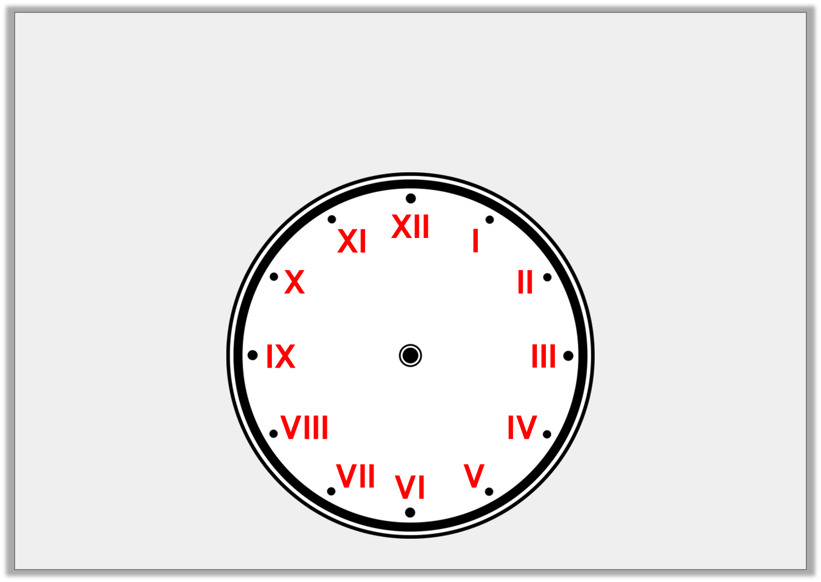
Introduction
The Roman numerals on the clock face have been muddled up.
Put them back into the correct order.
© Classroom Secrets Limited 2019

Slide 6
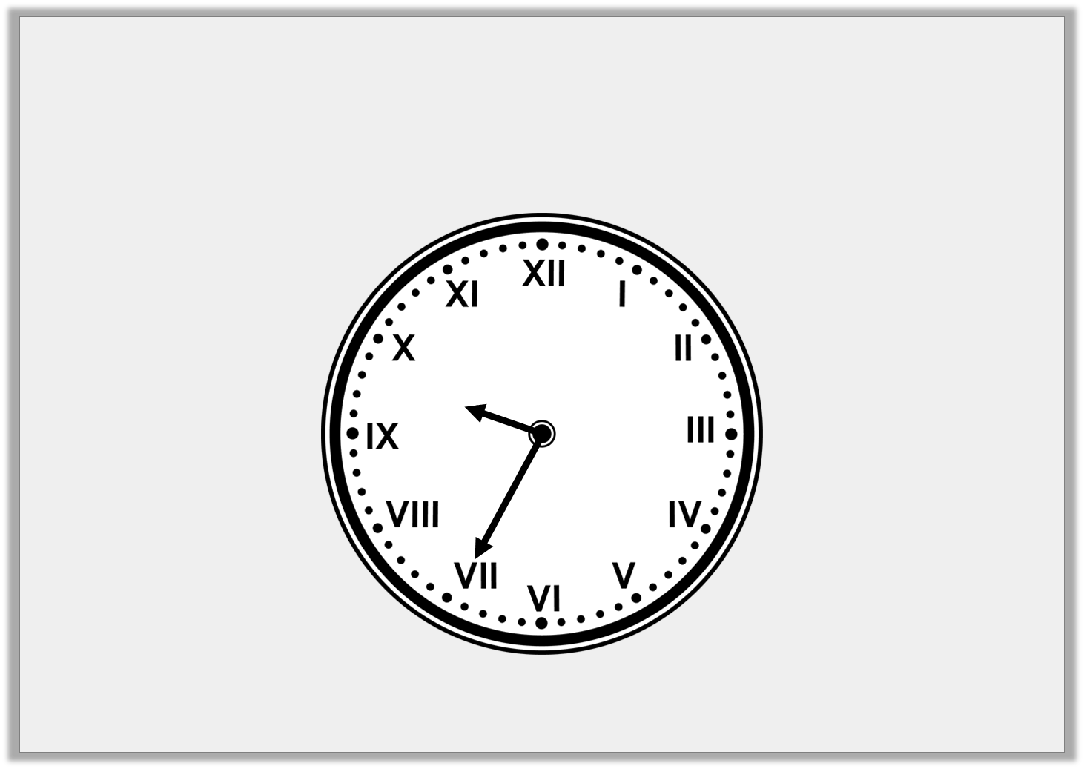
Varied Fluency 1
What time is shown on the clock?
© Classroom Secrets Limited 2019

Slide 7
Varied Fluency 1
What time is shown on the clock?
Twenty-five minutes to ten
© Classroom Secrets Limited 2019

Slide 8
Varied Fluency 2
A clock shows the time twenty minutes past eight.
What number is the minute hand pointing at?
VIII
III
IV
© Classroom Secrets Limited 2019

Slide 9
Varied Fluency 2
A clock shows the time twenty minutes past eight.
What number is the minute hand pointing at?
VIII
III
IV
© Classroom Secrets Limited 2019

Slide 10
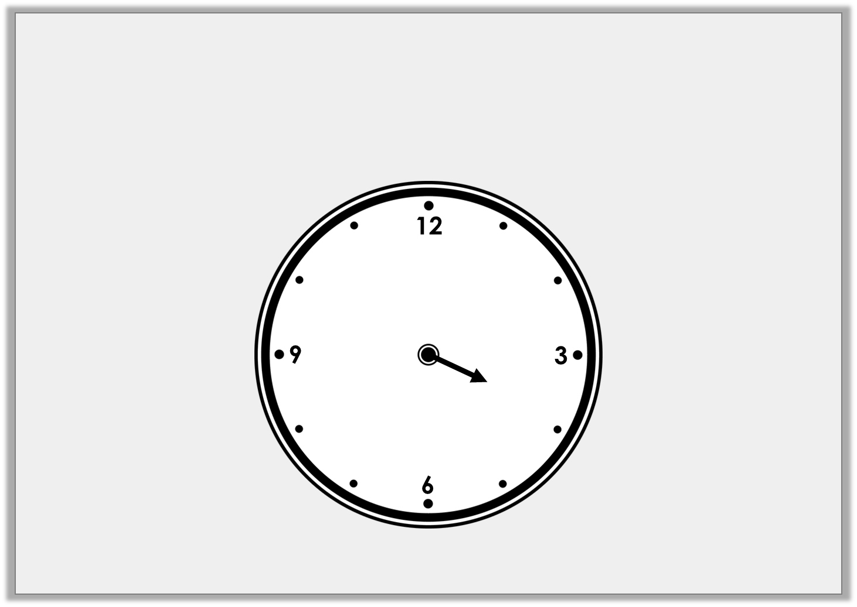
Varied Fluency 3
Draw the missing hand on the clock
so that it reads twenty minutes to four.
© Classroom Secrets Limited 2019

Slide 11
Varied Fluency 3
Draw the missing hand on the clock
so that it reads twenty minutes to four.
© Classroom Secrets Limited 2019

Slide 12
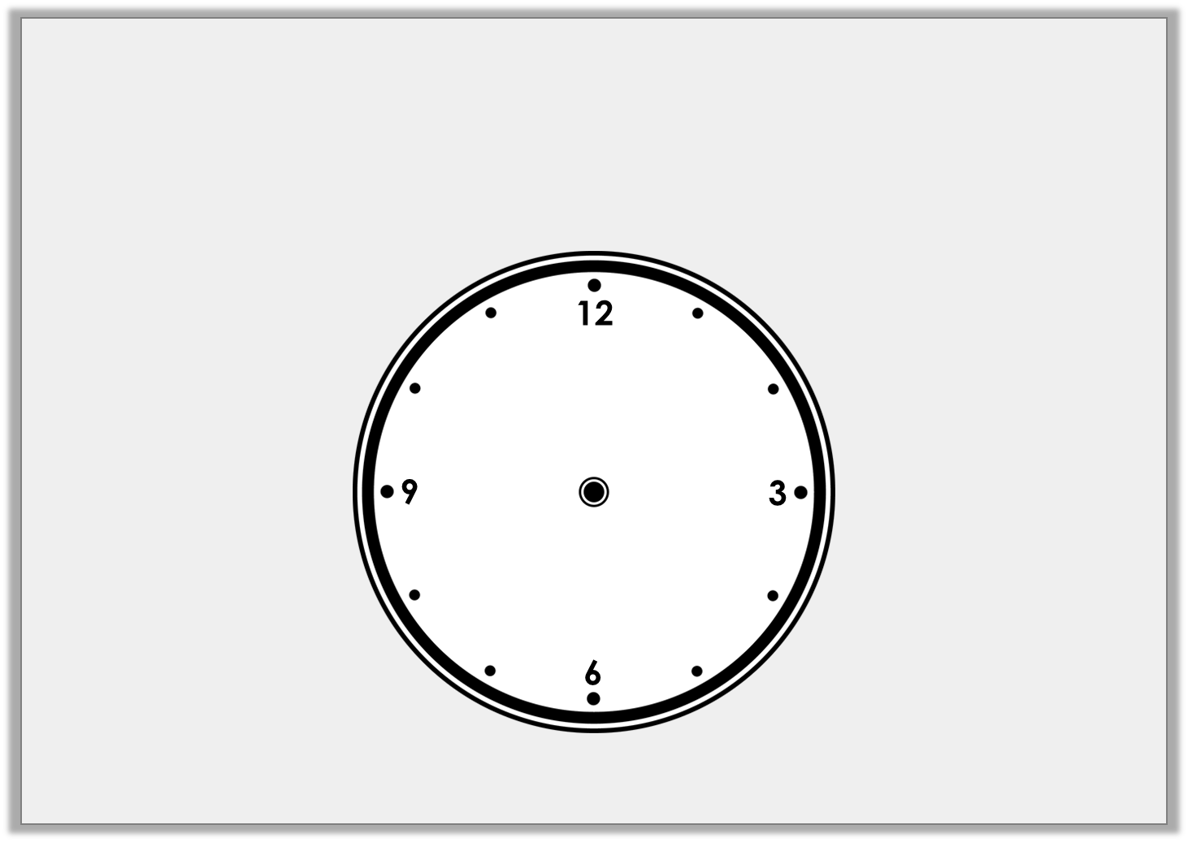
Varied Fluency 4
Draw hands on the clock so that it
reads twenty-five minutes past six.
© Classroom Secrets Limited 2019

Slide 13
Varied Fluency 4
Draw hands on the clock so that it
reads twenty-five minutes past six.
© Classroom Secrets Limited 2019

Slide 14
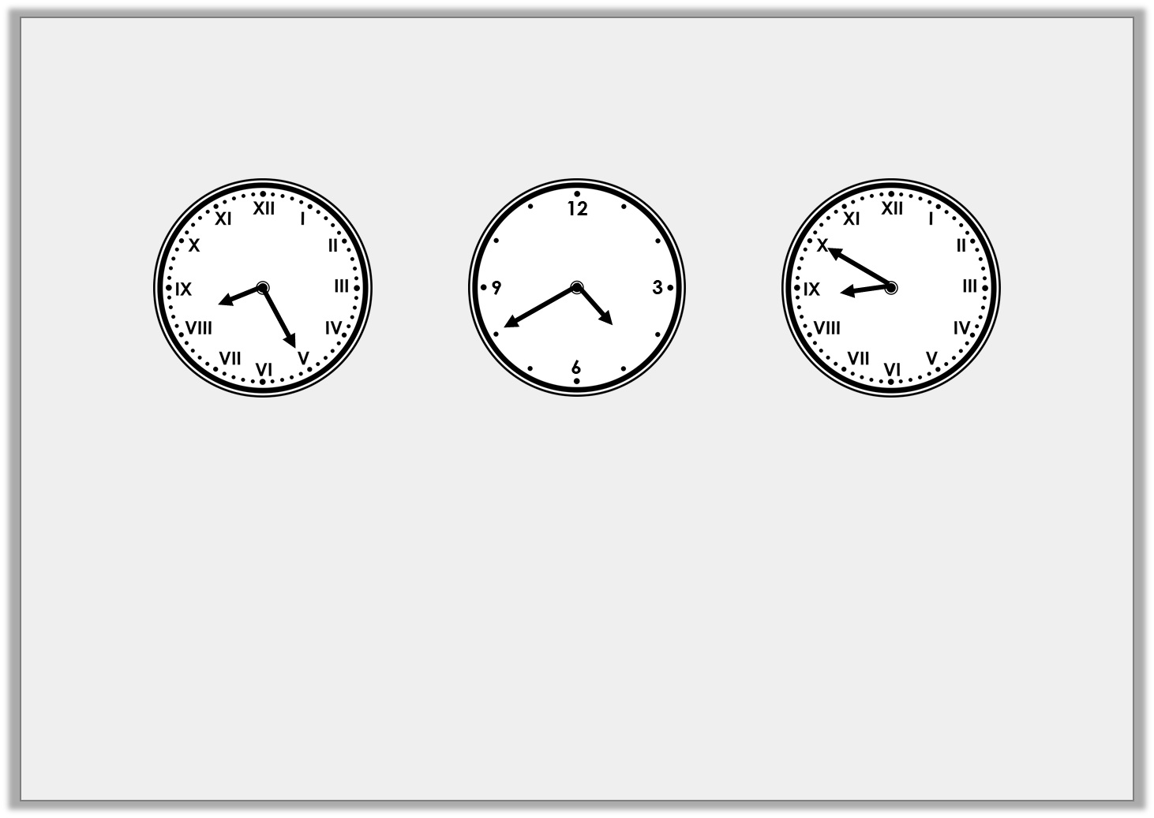
Problem Solving 1
Find the odd one out.
Ten minutes to nine
Twenty-five minutes past eight
Twenty minutes to five
Twenty minutes to four
© Classroom Secrets Limited 2019

Slide 15
Problem Solving 1
Find the odd one out.
Ten minutes to nine
Twenty-five minutes past eight
Twenty minutes to five
Twenty minutes to four
B
C
A
© Classroom Secrets Limited 2019

Slide 16
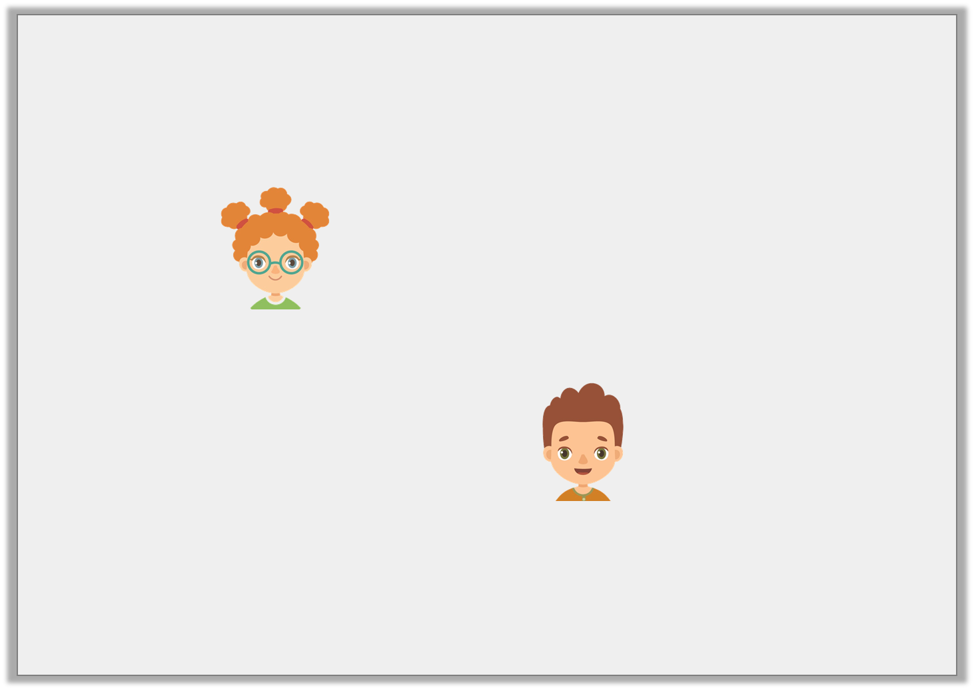
Reasoning 1
Fay and Nick are drawing twenty-five minutes past nine on a clock.
Fay says,
Nick says,
Who is correct? Explain why.
The minute hand
will point at V.
The minute hand
will point at IX.
© Classroom Secrets Limited 2019

Slide 17
Reasoning 1
Fay and Nick are drawing twenty-five minutes past nine on a clock.
Fay says,
Nick says,
Who is correct? Explain why.
Fay is correct because…
The minute hand
will point at V.
The minute hand
will point at IX.
© Classroom Secrets Limited 2019

Slide 18
Reasoning 1
Fay and Nick are drawing twenty-five minutes past nine on a clock.
Fay says,
Nick says,
Who is correct? Explain why.
Fay is correct because the minute hand needs to point at the V or 5 for 25 minutes past. Nick is describing quarter to.
The minute hand
will point at V.
The minute hand
will point at IX.
© Classroom Secrets Limited 2019

Slide 19
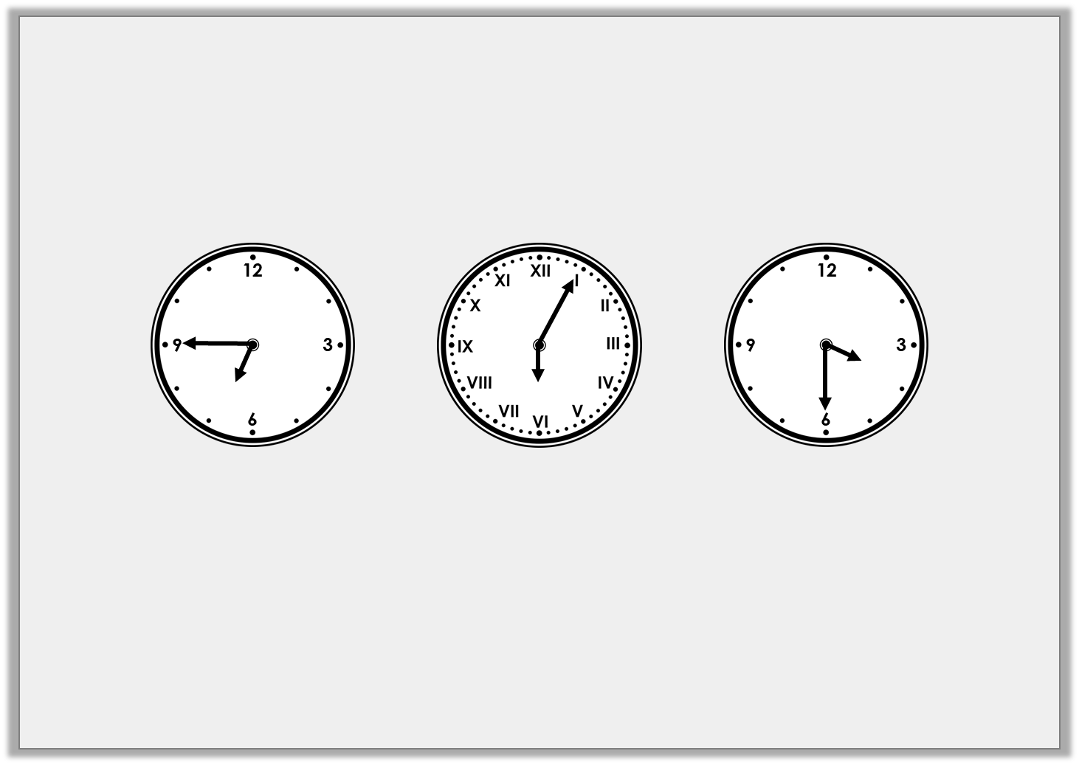
Reasoning 2
Yolanda is seeing a movie that starts at quarter past six.
What is the best time for her to arrive?
Explain why.
A
B
C
© Classroom Secrets Limited 2019

Slide 20
Reasoning 2
Yolanda is seeing a movie that starts at quarter past six.
What is the best time for her to arrive?
Explain why.
B because…
A
B
C
© Classroom Secrets Limited 2019

Slide 21
Reasoning 2
Yolanda is seeing a movie that starts at quarter past six.
What is the best time for her to arrive?
Explain why.
B because she will arrive 10 minutes before the film. She will be half an hour late if she gets there at quarter to seven (A) and too early if she gets there at half past three (C).
A
B
C
© Classroom Secrets Limited 2019

