Slide 1

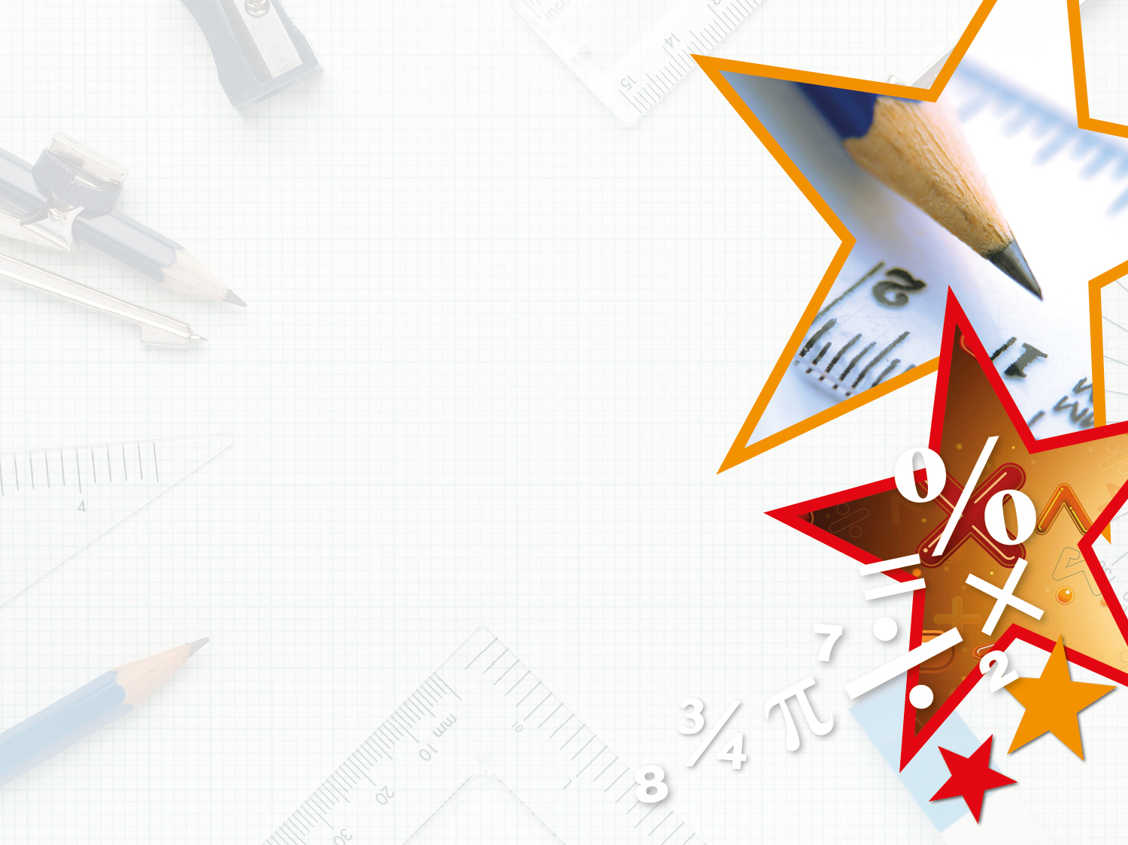

We have started a #LIFEworkbalance campaign and we need your help to complete our LIFE/work balance survey.
We hope to publish the results soon, so please give 15 minutes of your time to help us get a true picture of school life.
Want to be a part of this campaign? Take the survey on our website and share it with your colleagues!
© Classroom Secrets Limited 2019

Slide 2
Year 3 – Summer Block 3 – Properties of Shapes – Recognise and Describe 3D Shapes
Teaching Note:
We have referred to the faces of a prism as rectangular faces rather than parallelograms, which are used in oblique prisms.
About This Resource:
This PowerPoint has been designed to support your teaching of this small step. It includes a starter activity and an example of each question from the Varied Fluency and Reasoning and Problem Solving resources also provided in this pack. You can choose to work through all examples provided or a selection of them depending on the needs of your class.
National Curriculum Objectives:
Mathematics Year 3: (3G3b) Make 3-D shapes using modelling materials; recognise 3-D shapes in different orientations and describe them
More Year 3 Properties of Shapes resources.
Did you like this resource? Don’t forget to review it on our website.
© Classroom Secrets Limited 2018

Slide 3
Year 3 – Summer Block 3 – Properties of Shapes
Step 8: Recognise and Describe 3D Shapes
© Classroom Secrets Limited 2018

Slide 4
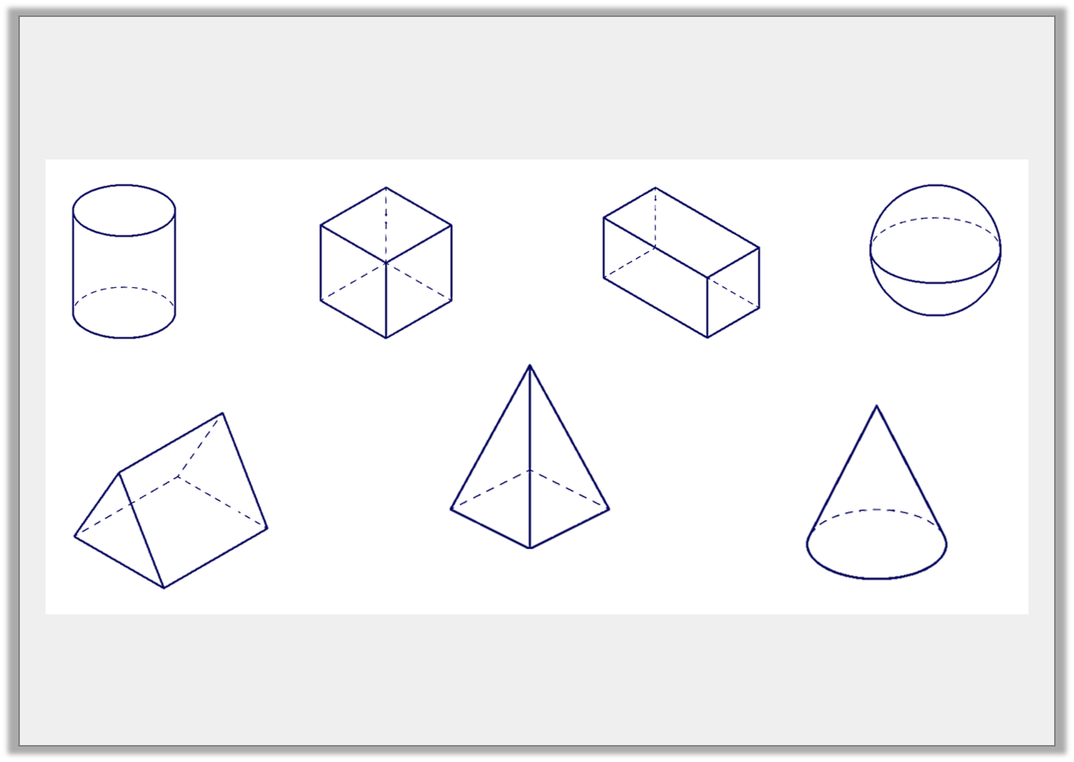
Introduction
Match the name to the 3D shape.
sphere
cylinder
cone
cube
cuboid
triangular prism
square based pyramid
© Classroom Secrets Limited 2018

Slide 5
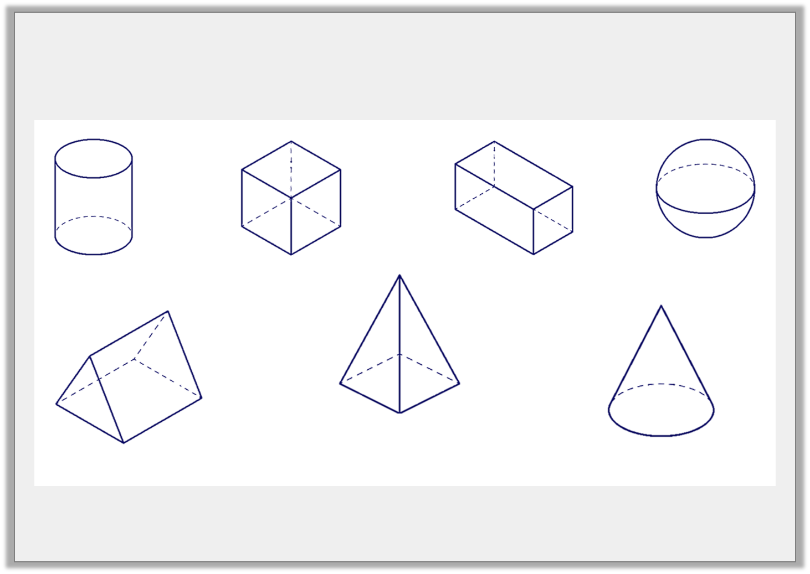
Introduction
Match the name to the 3D shape.
cylinder
cube
cuboid
sphere
square based pyramid
triangular prism
cone
© Classroom Secrets Limited 2018

Slide 6
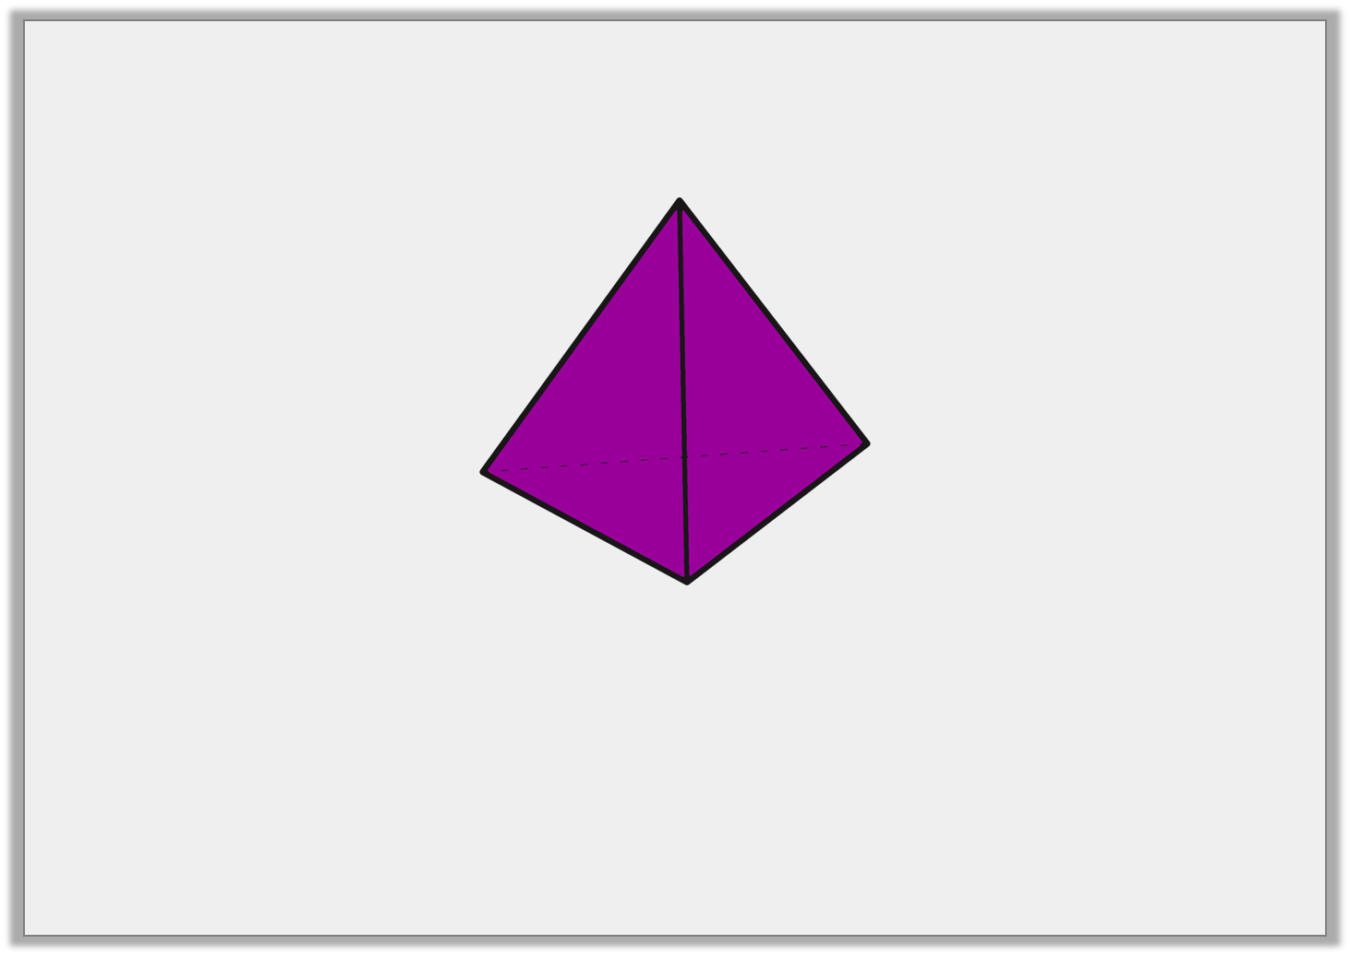
Varied Fluency 1
True or false?
A triangular based pyramid has 4 vertices.
© Classroom Secrets Limited 2018

Slide 7
Varied Fluency 1
True or false?
True
A triangular based pyramid has 4 vertices.
© Classroom Secrets Limited 2018

Slide 8
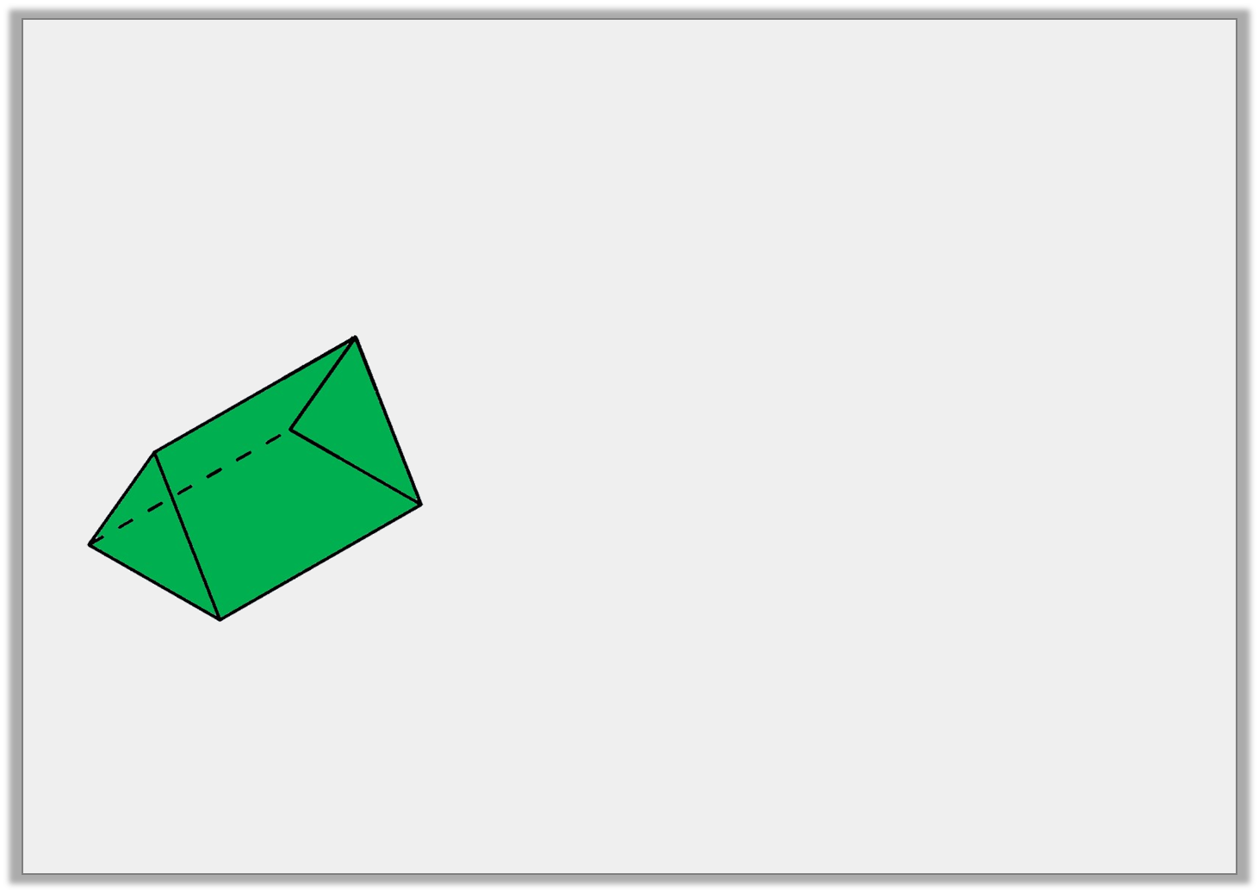
Varied Fluency 2
Tick the statements which relate to the shape.
2 triangular faces
6 vertices
It is a triangular based pyramid
© Classroom Secrets Limited 2018

Slide 9
Varied Fluency 2
Tick the statements which relate to the shape.
2 triangular faces | ✓
6 vertices | ✓
It is a triangular based pyramid
© Classroom Secrets Limited 2018

Slide 10
Varied Fluency 3
Circle the shapes that have more than 5 edges.
cone | square based pyramid | cuboid
© Classroom Secrets Limited 2018

Slide 11
Varied Fluency 3
Circle the shapes that have more than 5 edges.
cone | square based pyramid | cuboid
© Classroom Secrets Limited 2018

Slide 12
Varied Fluency 4
Use >, < or = to complete the statements below.
number of edges in a cuboid |  | number of faces in a triangular prism
number of vertices in a square based pyramid |  | number of faces in a cube
© Classroom Secrets Limited 2018

Slide 13
Varied Fluency 4
Use >, < or = to complete the statements below.
number of edges in a cuboid | > | number of faces in a triangular prism
(12)
(5)
number of vertices in a square based pyramid | < | number of faces in a cube
(5)
(6)
© Classroom Secrets Limited 2018

Slide 14
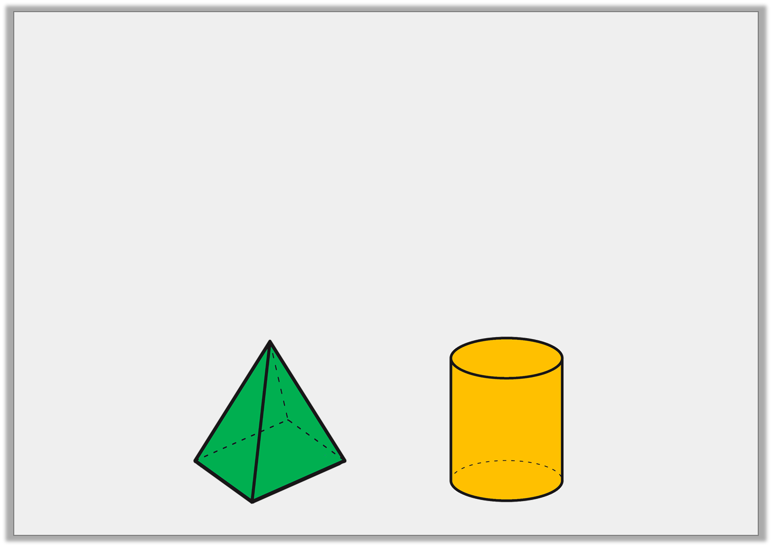
Problem Solving 1
Are the following statements always true, sometimes true or never true?
A) A square based pyramid has 4 vertices.
B) A cylinder has more curved edges than a cone.
© Classroom Secrets Limited 2018

Slide 15
Problem Solving 1
Are the following statements always true, sometimes true or never true?
A) A square based pyramid has 4 vertices.
Never true
B) A cylinder has more curved edges than a cone.
Always true
© Classroom Secrets Limited 2018

Slide 16
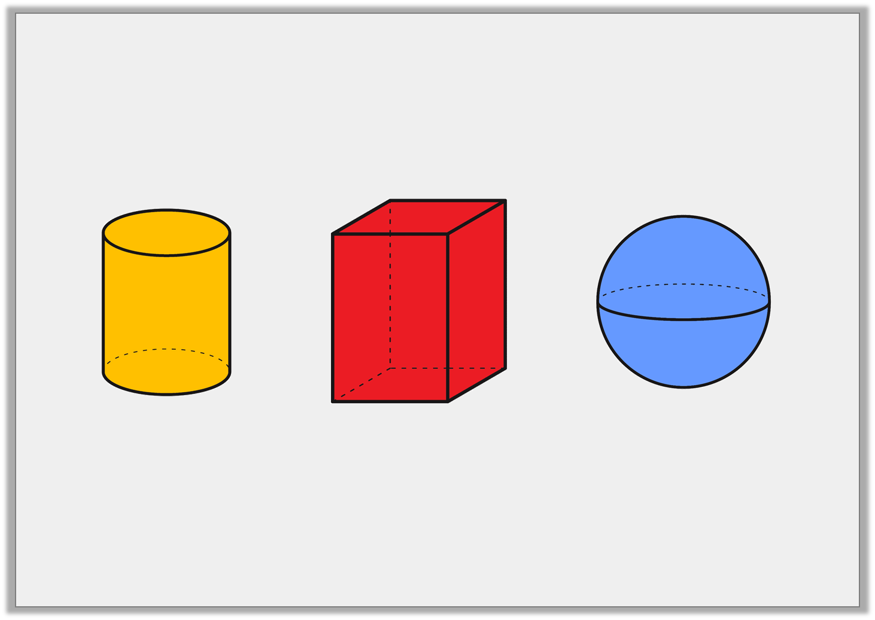
Reasoning 1
Which shape is the odd one out?
Explain your answer.
© Classroom Secrets Limited 2018

Slide 17
Reasoning 1
Which shape is the odd one out?
Explain your answer.
Various possible answers, for example: The cuboid is the odd one out because a cylinder and sphere have a curved surface whereas a cuboid has only flat faces.
© Classroom Secrets Limited 2018

Slide 18
Problem Solving 2
Use the cards below to make as many correct
statements as you can.
1. The number of edges in a cube.
2. The number of edges in a square based pyramid.
3. The number of vertices in a cube.
4. The number of edges in a cuboid.
=
© Classroom Secrets Limited 2018

Slide 19
Problem Solving 2
Use the cards below to make as many correct
statements as you can.
1. The number of edges in a cube.
2. The number of edges in a square based pyramid.
4 = 1
3 = 2
3. The number of vertices in a cube.
4. The number of edges in a cuboid.
=
© Classroom Secrets Limited 2018

