Slide 1
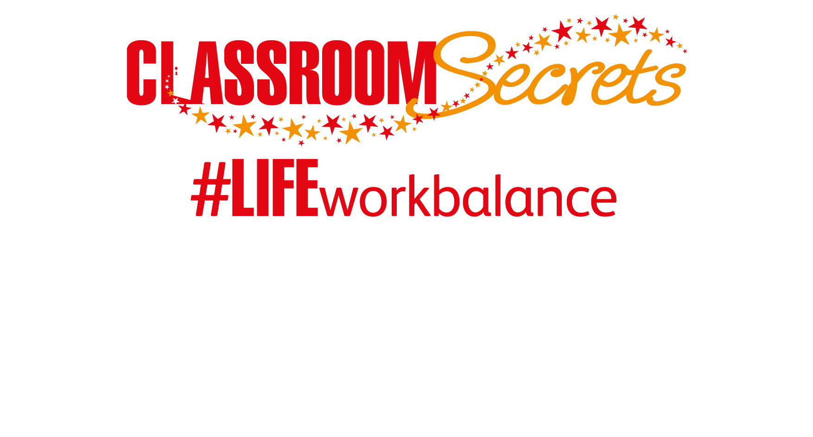

LIFE/work balance
We have started a #LIFEworkbalance campaign and we need your help to complete our LIFE/work balance survey.
We hope to publish the results soon, so please give 15 minutes of your time to help us get a true picture of school life.
Want to be a part of this campaign? Take the survey on our website and share it with your colleagues!
© Classroom Secrets Limited 2019

Slide 2
Year 4 – Autumn Block 3 – Fronted Adverbials
About This Resource:
This PowerPoint has been designed to support your teaching of this small step. It includes a starter activity and an example of each question from the Varied Fluency and Application and Reasoning resources also provided in this pack. You can choose to work through all examples provided or a selection of them depending on the needs of your class.
National Curriculum Objectives:
  Year 4: (4G5.6b) Using fronted adverbials
  Year 4: (4G5.6b) Fronted adverbials [for example, Later that day, I heard the bad news.]
  Year 4: (4G5.6b) Using commas after fronted adverbials
  Terminology for pupils:
  (4G1.6a) adverbial
More resources from our Grammar, Punctuation and Spelling scheme of work.
Did you like this resource? Don’t forget to review it on our website.
© Classroom Secrets Limited 2019

Slide 3
Year 4 – Autumn Block 3 – Fronted Adverbials
Notes and Guidance:
Children should know that a main clause can be expanded by adding an adverbial phrase. They should also know that the location of this adverbial phrase can be moved within the sentence.
From Year 4, children may know that an adverb can give more detail about a verb, an adjective and even other adverbs. They tell us how, when, why, where or how often.
Children should know that all fronted adverbials must be followed by a comma even if it is only one word, i.e. Yesterday, I went to the shops.
Focused Questions
What is an adverbial phrase? What does it do within a sentence?
Can an adverbial phrase move location within a sentence?
Identify the fronted adverbial in this sentence. What punctuation mark should be used after it?
Change this sentence so that the adverbial phrase becomes a fronted adverbial. What have you had to change or add?
© Classroom Secrets Limited 2019

Slide 4
Year 4 – Autumn Block 3 – Fronted Adverbials
Step 3: Time Specific Adverbials
© Classroom Secrets Limited 2019

Slide 5
Introduction
Identify the adverbials that tell us when and how often something happens.
carefully
immediately
occasionally
Before long
often
perhaps
today
Outside
quickly
sometimes
© Classroom Secrets Limited 2019

Slide 6
Introduction
Identify the adverbials that tell us when and how often something happens.
carefully
immediately
occasionally
Before long
often
perhaps
today
Outside
quickly
sometimes
© Classroom Secrets Limited 2019

Slide 7
Varied Fluency 1
Circle the fronted adverbial that tells us when something happened.
Josh was supposed to fly to Spain at 8 o’clock on Tuesday night but his flight was delayed. Eventually, it was time to get on board the crowded aeroplane.
© Classroom Secrets Limited 2019

Slide 8
Varied Fluency 1
Circle the fronted adverbial that tells us when something happened.
Josh was supposed to fly to Spain at 8 o’clock on Tuesday night but his flight was delayed. Eventually, it was time to get on board the crowded aeroplane.
© Classroom Secrets Limited 2019

Slide 9
Varied Fluency 2
Underline the fronted adverbial that describes how often something takes place.
Every week, Suzie goes to football training with her friends and loves improving her skills. On Saturday, they play a match against another football team.
© Classroom Secrets Limited 2019

Slide 10
Varied Fluency 2
Underline the fronted adverbial that describes how often something takes place.
Every week, Suzie goes to football training with her friends and loves improving her skills. On Saturday, they play a match against another football team.
© Classroom Secrets Limited 2019

Slide 11
Varied Fluency 3
Choose the fronted adverbial that tells us when the main clause takes place in the sentence below.
________, a tiny wren swooped down to eat the birdseed, but the seeds were lost in the snow.
Occasionally
Just then
Frequently
© Classroom Secrets Limited 2019

Slide 12
Varied Fluency 3
Choose the fronted adverbial that tells us when the main clause takes place in the sentence below.
________, a tiny wren swooped down to eat the birdseed, but the seeds were lost in the snow.
Just then
Occasionally
Just then
Frequently
© Classroom Secrets Limited 2019

Slide 13
Varied Fluency 4
Choose the fronted adverbial that tells us how often the main clause takes place in the sentence below.
__________, Alice went to the cinema to see a film, but they weren’t showing the one she really wanted to watch.
Regularly
Yesterday
Next year
© Classroom Secrets Limited 2019

Slide 14
Varied Fluency 4
Choose the fronted adverbial that tells us how often the main clause takes place in the sentence below.
__________, Alice went to the cinema to see a film, but they weren’t showing the one she really wanted to watch.
Yesterday
Regularly
Yesterday
Next year
© Classroom Secrets Limited 2019

Slide 15
Application 1
Using the word bank below, write a sentence that could follow this fronted adverbial.
Eventually,...
python | slithered away | huge sigh of relief
and | appeared | garden
© Classroom Secrets Limited 2019

Slide 16
Application 1
Using the word bank below, write a sentence that could follow this fronted adverbial.
Eventually,...
Eventually, the python slithered away into the undergrowth next to my garden and finally I could breathe a huge sigh of relief.
python | slithered away | huge sigh of relief
and | appeared | garden
© Classroom Secrets Limited 2019

Slide 17
Application 2
Rewrite the sentence below so that it begins with a fronted adverbial of time.
My older brother frequently plays tricks on me and I find it very annoying.
© Classroom Secrets Limited 2019

Slide 18
Application 2
Rewrite the sentence below so that it begins with a fronted adverbial of time.
My older brother frequently plays tricks on me and I find it very annoying.
Frequently, my older brother plays tricks on me and I find it very annoying.
© Classroom Secrets Limited 2019

Slide 19
Reasoning 1
Could these words be used in a fronted adverbial about time?
In the distance,
Yearly,
In the morning,
Explain how you know.
© Classroom Secrets Limited 2019

Slide 20
Reasoning 1
Could these words be used in a fronted adverbial about time?
In the distance,
Yearly,
In the morning,
Explain how you know.
In the distance: No because…
Yearly: Yes because…
In the morning: Yes because…
© Classroom Secrets Limited 2019

Slide 21
Reasoning 1
Could these words be used in a fronted adverbial about time?
In the distance,
Yearly,
In the morning,
Explain how you know.
In the distance: No because it’s telling us where something happened.
Yearly: Yes because it’s telling us how often something happens.
In the morning: Yes because it’s telling us when something happened.
© Classroom Secrets Limited 2019

