Slide 1
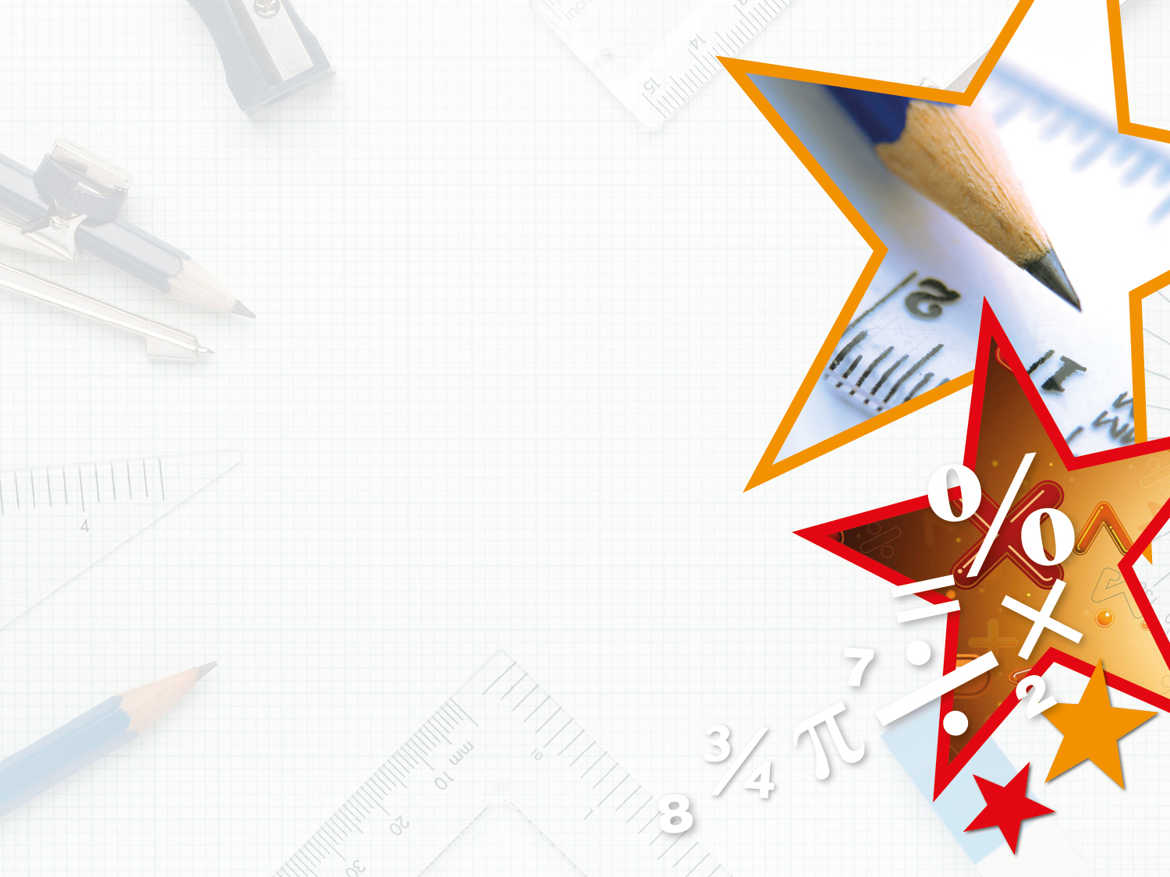


LIFE/work balance
We have started a #LIFEworkbalance campaign and we need your help to complete our LIFE/work balance survey.
We hope to publish the results soon, so please give 15 minutes of your time to help us get a true picture of school life.
Want to be a part of this campaign? Take the survey on our website and share it with your colleagues!
© Classroom Secrets Limited 2018

Slide 2
Year 3 – Summer Block 4 – Mass and Capacity – Measure Mass 1
About This Resource:
This PowerPoint has been designed to support your teaching of this small step. It includes a starter activity and an example of each question from the Varied Fluency and Reasoning and Problem Solving resources also provided in this pack. You can choose to work through all examples provided or a selection of them depending on the needs of your class.
National Curriculum Objectives:
Mathematics Year 3: (3M2b) Measure mass (kg/g)
More Year 3 Mass and Capacity resources.
Did you like this resource? Don’t forget to review it on our website.
© Classroom Secrets Limited 2018

Slide 3
Year 3 – Summer Block 4 – Mass and Capacity
Step 1: Measure Mass 1
© Classroom Secrets Limited 2018

Slide 4
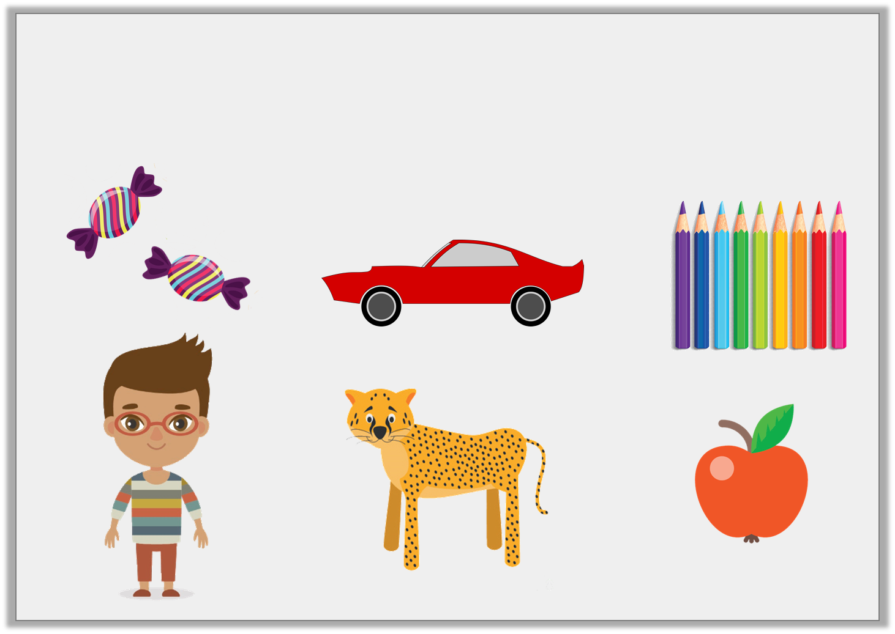
Introduction
Which items would you measure in kilograms?
Which items would you measure in grams?
© Classroom Secrets Limited 2018

Slide 5
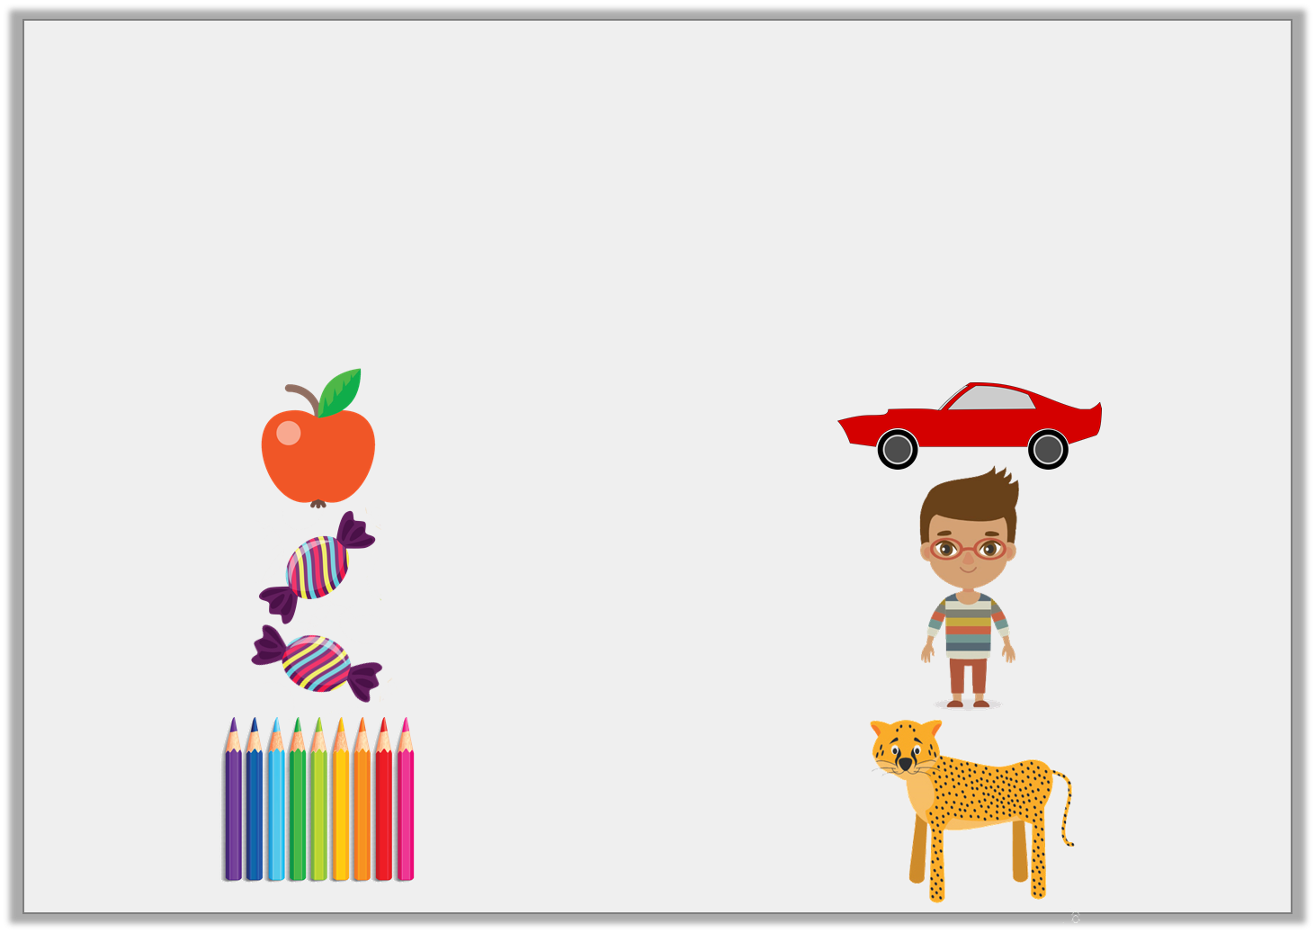
Introduction
Which items would you measure in kilograms?
Which items would you measure in grams?
Grams: Kilograms:
© Classroom Secrets Limited 2018

Slide 6
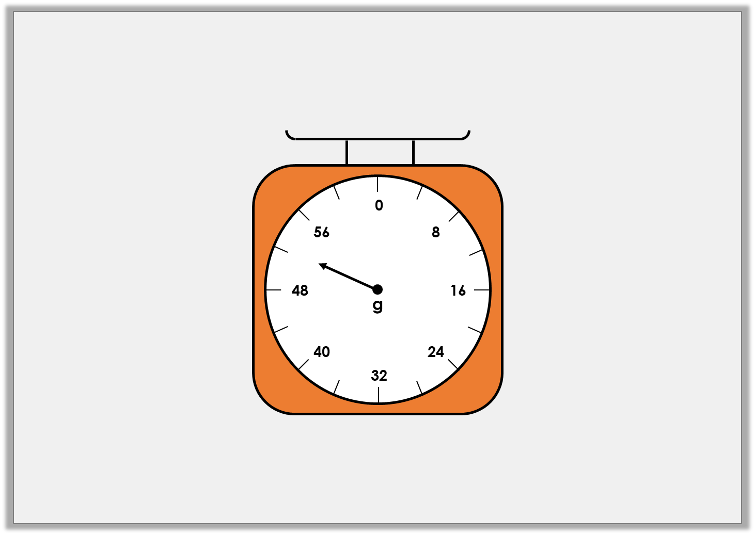
Varied Fluency 1
What mass is the arrow showing on this scale?
© Classroom Secrets Limited 2018

Slide 7
Varied Fluency 1
What mass is the arrow showing on this scale?
52g
© Classroom Secrets Limited 2018

Slide 8
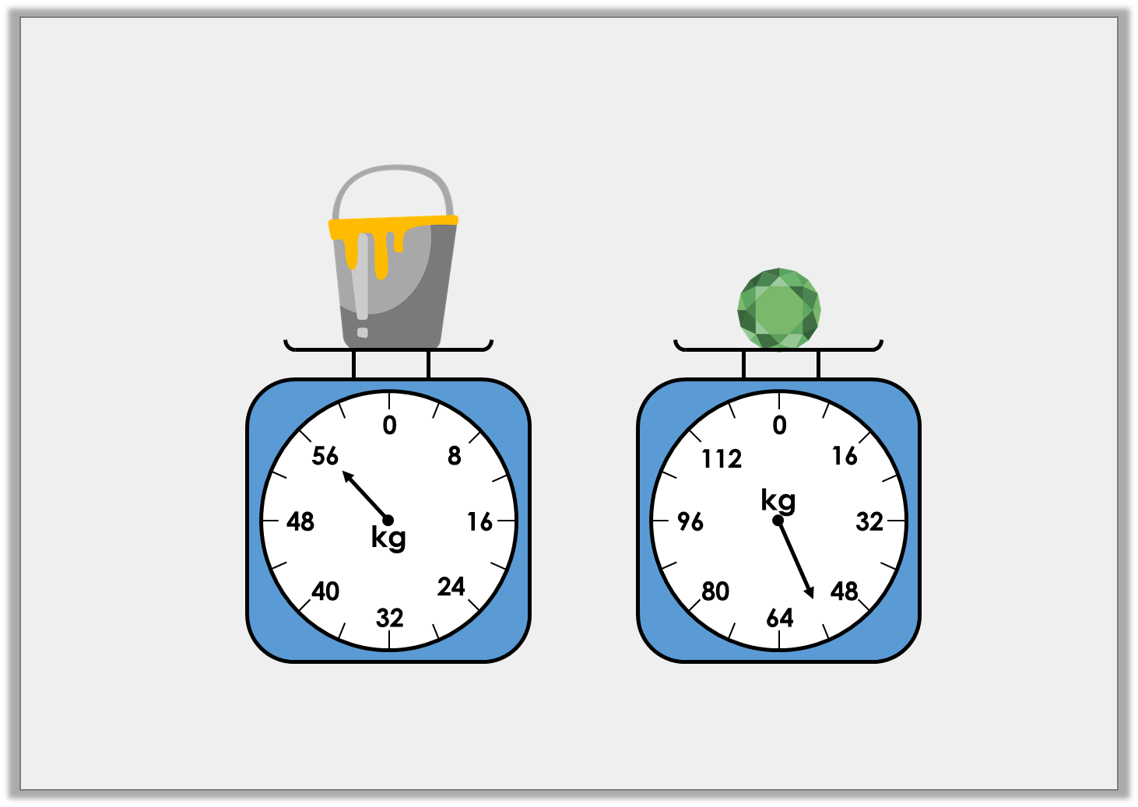
Varied Fluency 2
Which object is the heaviest?
A
B
© Classroom Secrets Limited 2018

Slide 9
Varied Fluency 2
Which object is the heaviest?
A = 56kg B = 56kg
Neither because they weigh exactly the same.
A
B
© Classroom Secrets Limited 2018

Slide 10
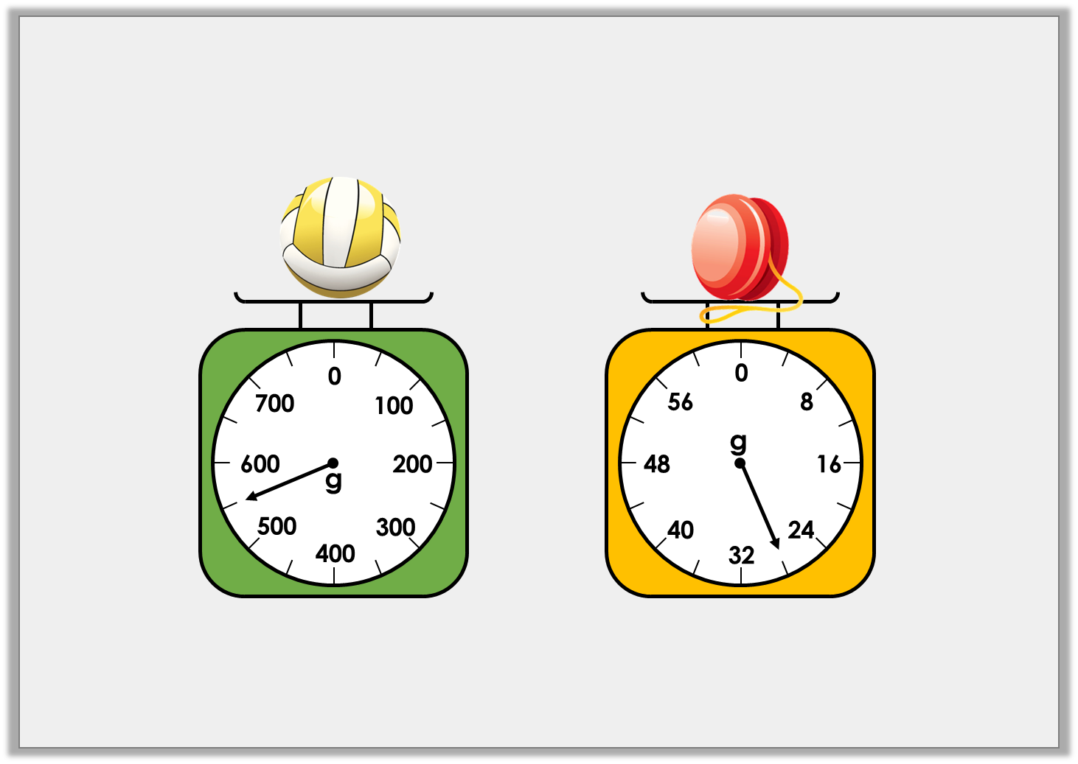
Varied Fluency 3
How much does each object weigh?
A
B
© Classroom Secrets Limited 2018

Slide 11
Varied Fluency 3
How much does each object weigh?
550g 28g
A
B
© Classroom Secrets Limited 2018

Slide 12
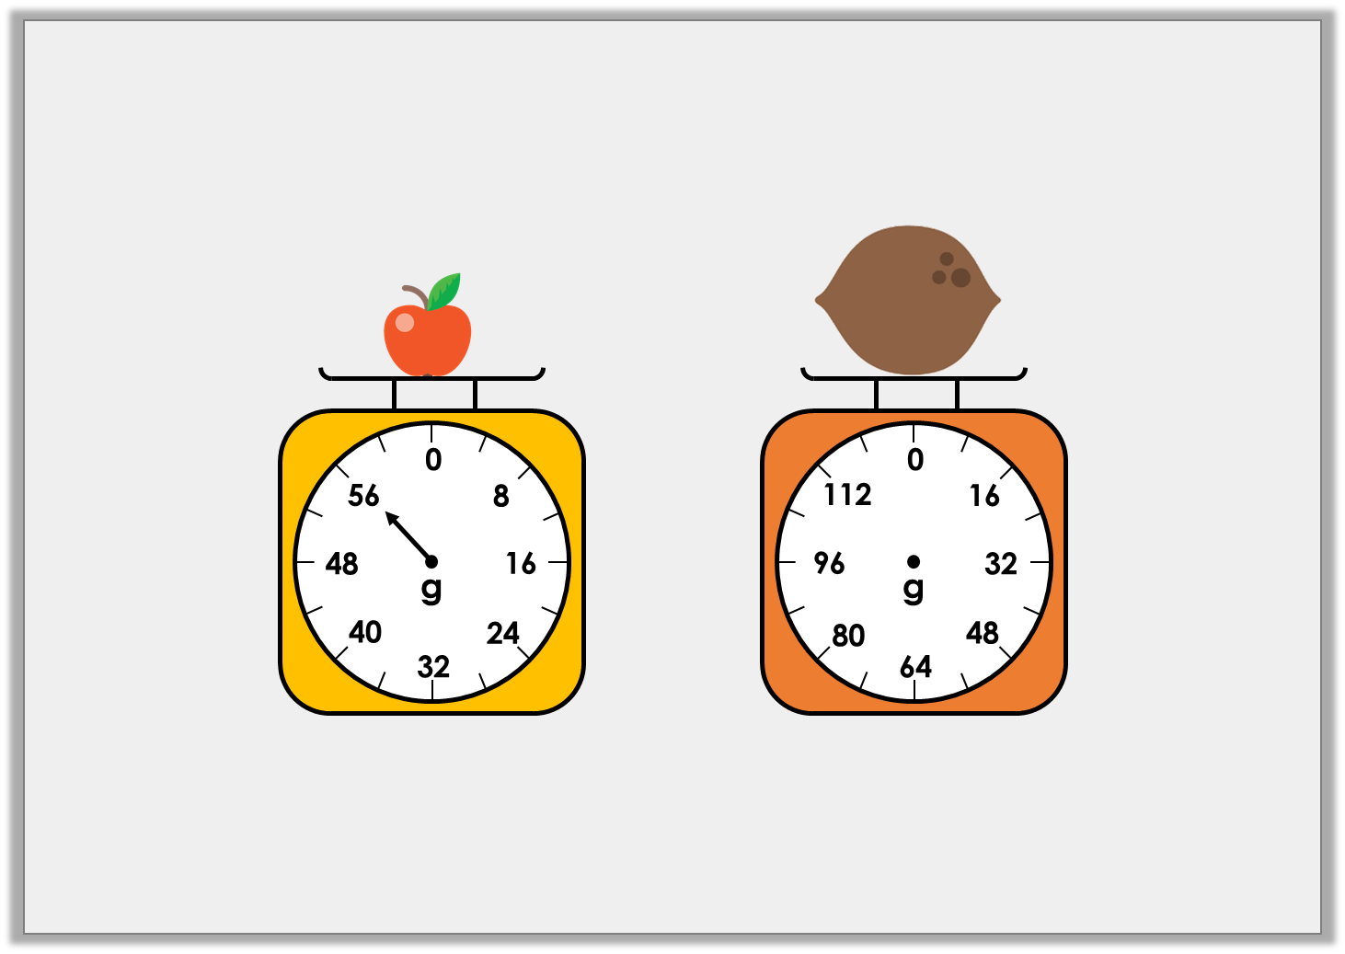
Problem Solving 1
If two apples weigh the same as one coconut,
draw an arrow on the scale to show the weight of the coconut.
© Classroom Secrets Limited 2018

Slide 13
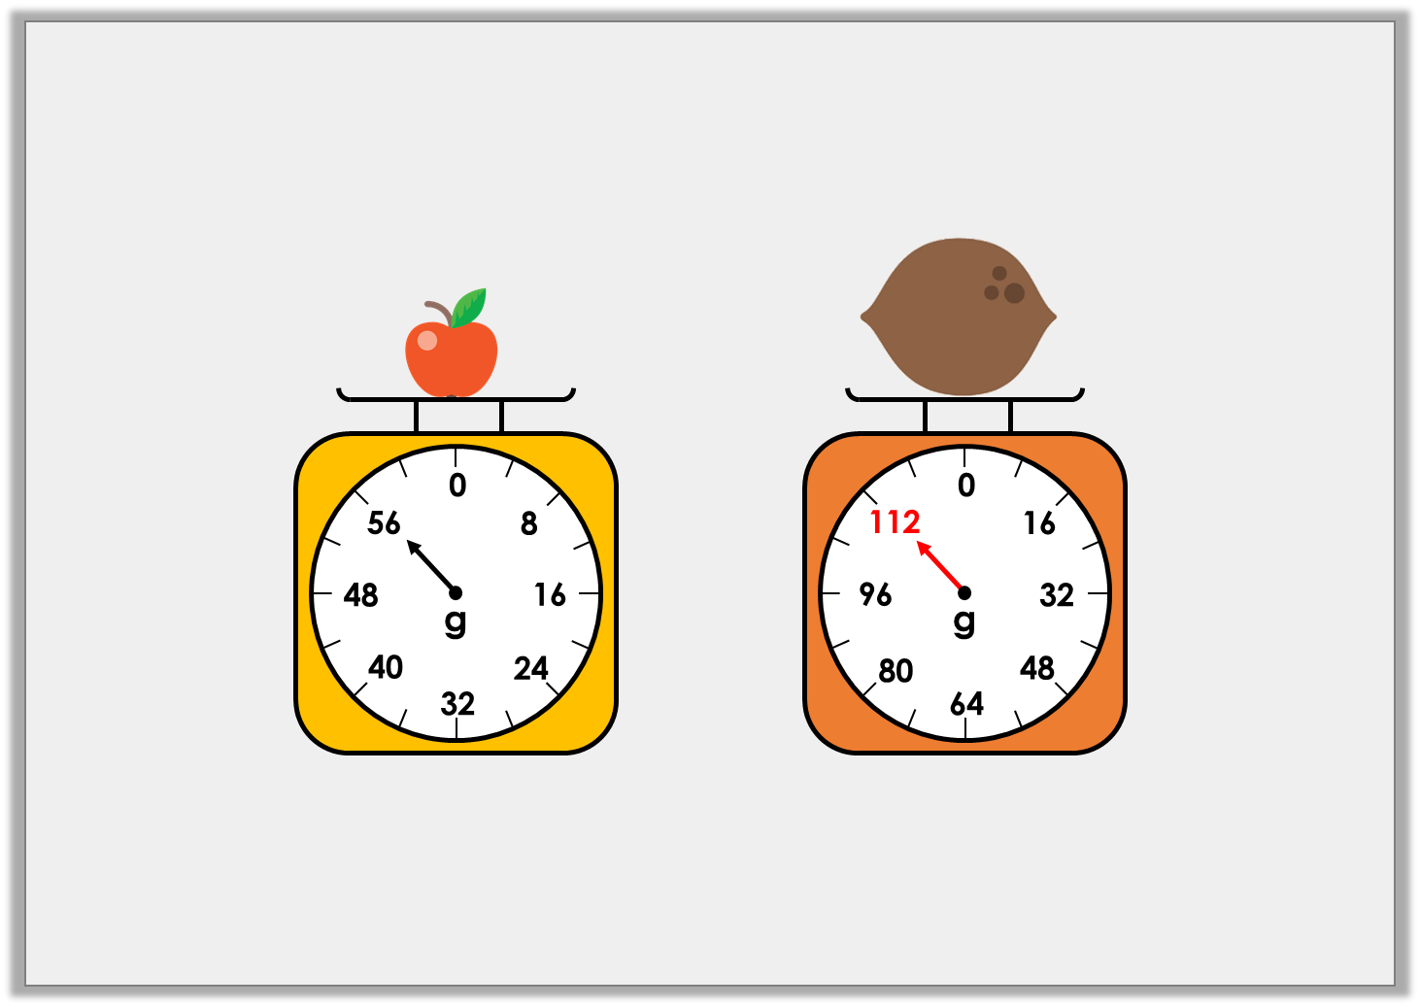
Problem Solving 1
If two apples weigh the same as one coconut,
draw an arrow on the scale to show the weight of the coconut.
© Classroom Secrets Limited 2018

Slide 14
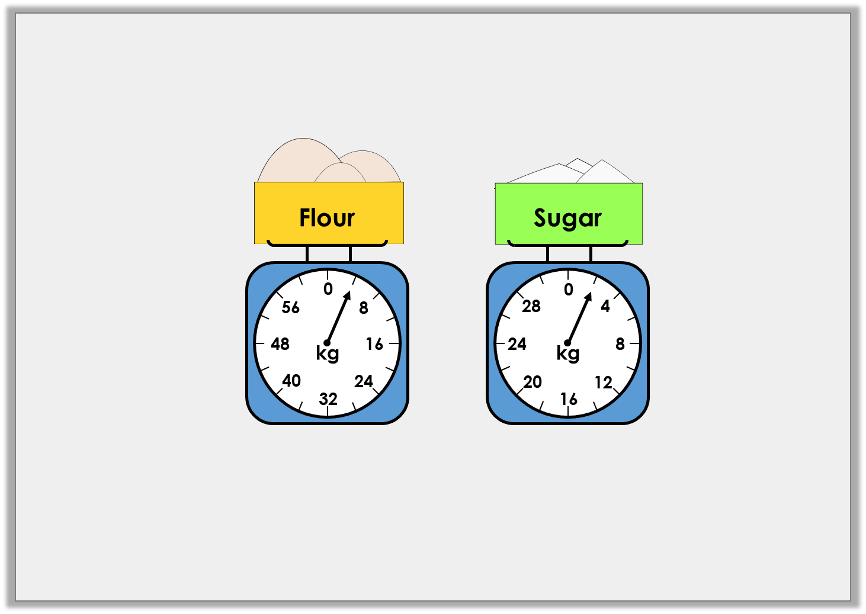
Problem Solving 2
Lizzie is making cakes. She needs 6kg of flour and 6kg of sugar.
How much more of each ingredient does she need?
© Classroom Secrets Limited 2018

Slide 15
Problem Solving 2
Lizzie is making cakes. She needs 6kg of flour and 6kg of sugar.
How much more of each ingredient does she need?
2kg of flour
4kg of sugar
© Classroom Secrets Limited 2018

Slide 16
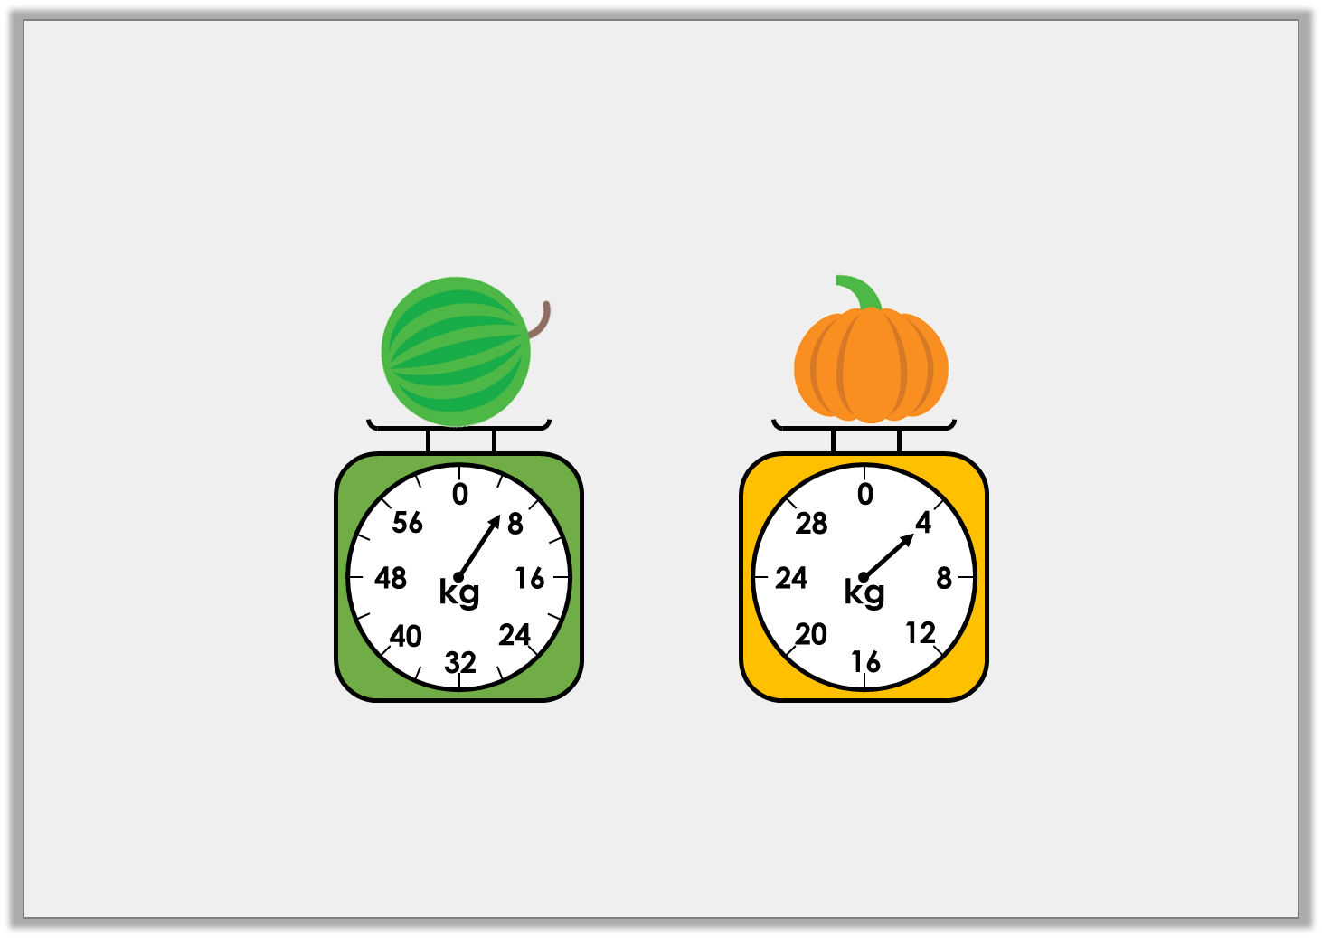
Reasoning 1
Joanne is weighing different items.
She says the watermelon is heavier because the arrow
on the scale is further away from zero.
Is she correct? Explain how you know.
© Classroom Secrets Limited 2018

Slide 17
Reasoning 1
Joanne is weighing different items.
She says the watermelon is heavier because the arrow
on the scale is further away from zero.
Is she correct? Explain how you know.
Joanne is incorrect because…
© Classroom Secrets Limited 2018

Slide 18
Reasoning 1
Joanne is weighing different items.
She says the watermelon is heavier because the arrow
on the scale is further away from zero.
Is she correct? Explain how you know.
Joanne is incorrect because the watermelon weighs 6kg and the pumpkin weighs 4kg. The scales increase in different increments.
© Classroom Secrets Limited 2018

