Slide 1

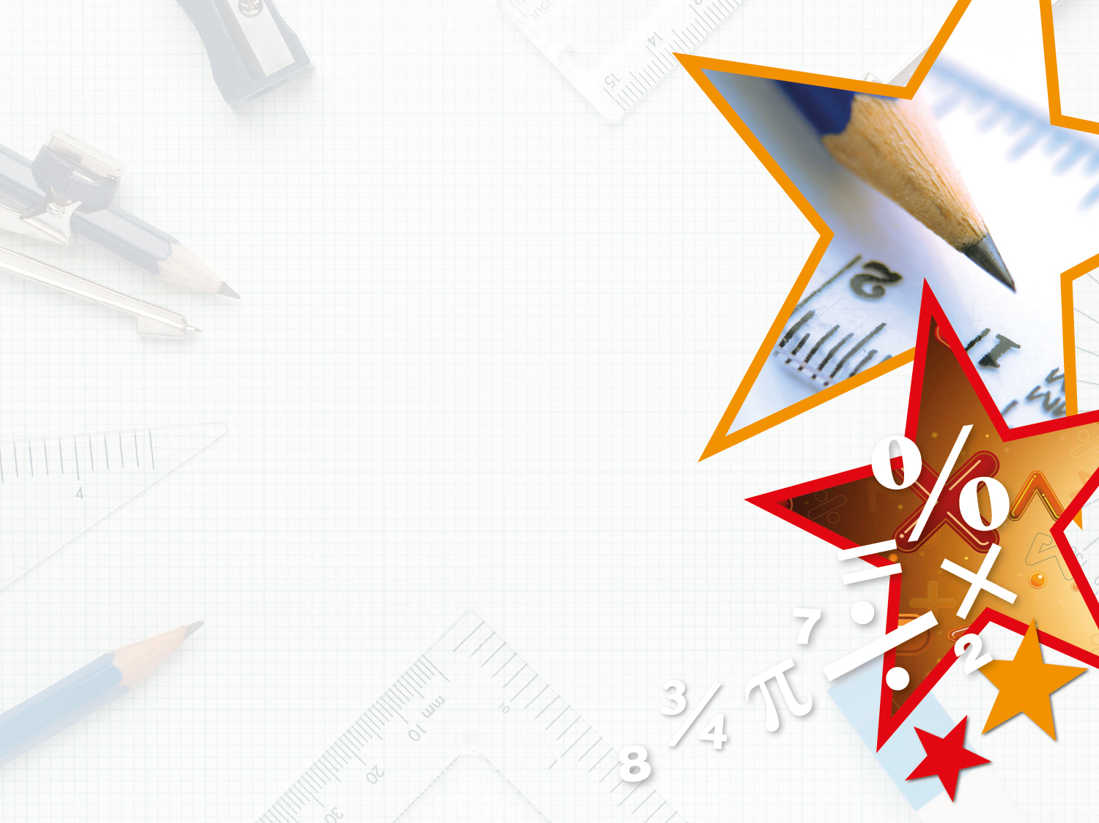

LIFE/work balance
We have started a #LIFEworkbalance campaign and we need your help to complete our LIFE/work balance survey.
We hope to publish the results soon, so please give 15 minutes of your time to help us get a true picture of school life.
Want to be a part of this campaign? Take the survey on our website and share it with your colleagues!
© Classroom Secrets Limited 2018

Slide 2
Year 3 – Summer Block 4 – Mass and Capacity – Measure Mass 2
About This Resource:
This PowerPoint has been designed to support your teaching of this small step. It includes a starter activity and an example of each question from the Varied Fluency and Reasoning and Problem Solving resources also provided in this pack. You can choose to work through all examples provided or a selection of them depending on the needs of your class.
National Curriculum Objectives:
Mathematics Year 3: (3M2b) Measure mass (kg/g)
Mathematics Year 3: (3N1b) Count from 0 in multiples of 4, 8, 50 and 100
More Year 3 Mass and Capacity resources
Did you like this resource? Don’t forget to review it on our website.
© Classroom Secrets Limited 2018

Slide 3
Year 3 – Summer Block 4 – Mass and Capacity
Step 2: Measure Mass 2
© Classroom Secrets Limited 2018
© Classroom Secrets Limited 2018

Slide 4
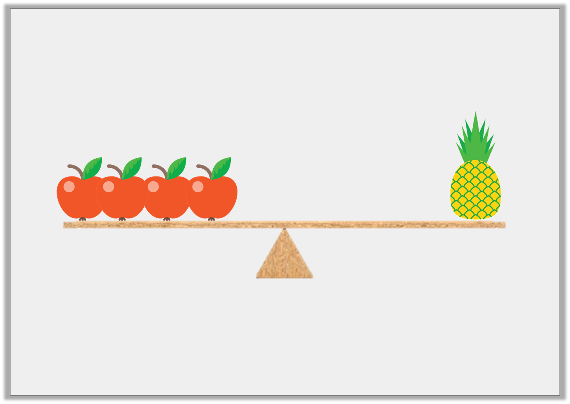
Introduction
Sasha is using scales to measure mass.
The pineapple weighs 60g.
How much does one apple weigh?
© Classroom Secrets Limited 2018
© Classroom Secrets Limited 2018

Slide 5
Introduction
Sasha is using scales to measure mass.
The pineapple weighs 60g.
How much does one apple weigh?
15kg
© Classroom Secrets Limited 2018
© Classroom Secrets Limited 2018

Slide 6
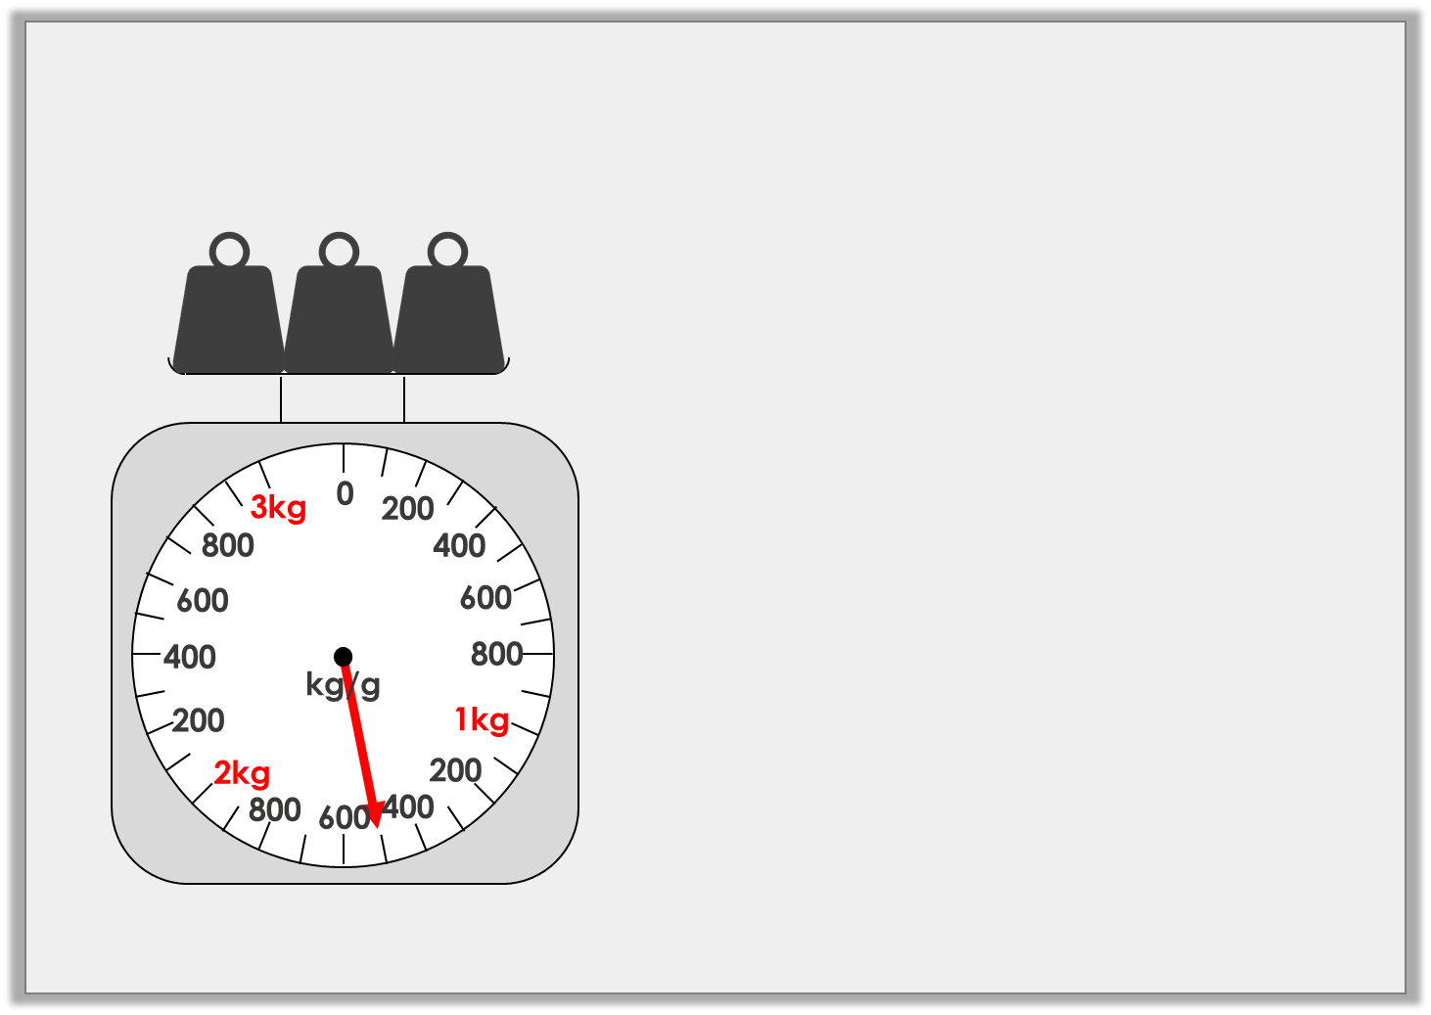
Varied Fluency 1
What mass is shown on the scales?
 | kg |  | g
© Classroom Secrets Limited 2018
© Classroom Secrets Limited 2018

Slide 7
Varied Fluency 1
What mass is shown on the scales?
1 | kg | 500 | g
© Classroom Secrets Limited 2018
© Classroom Secrets Limited 2018

Slide 8
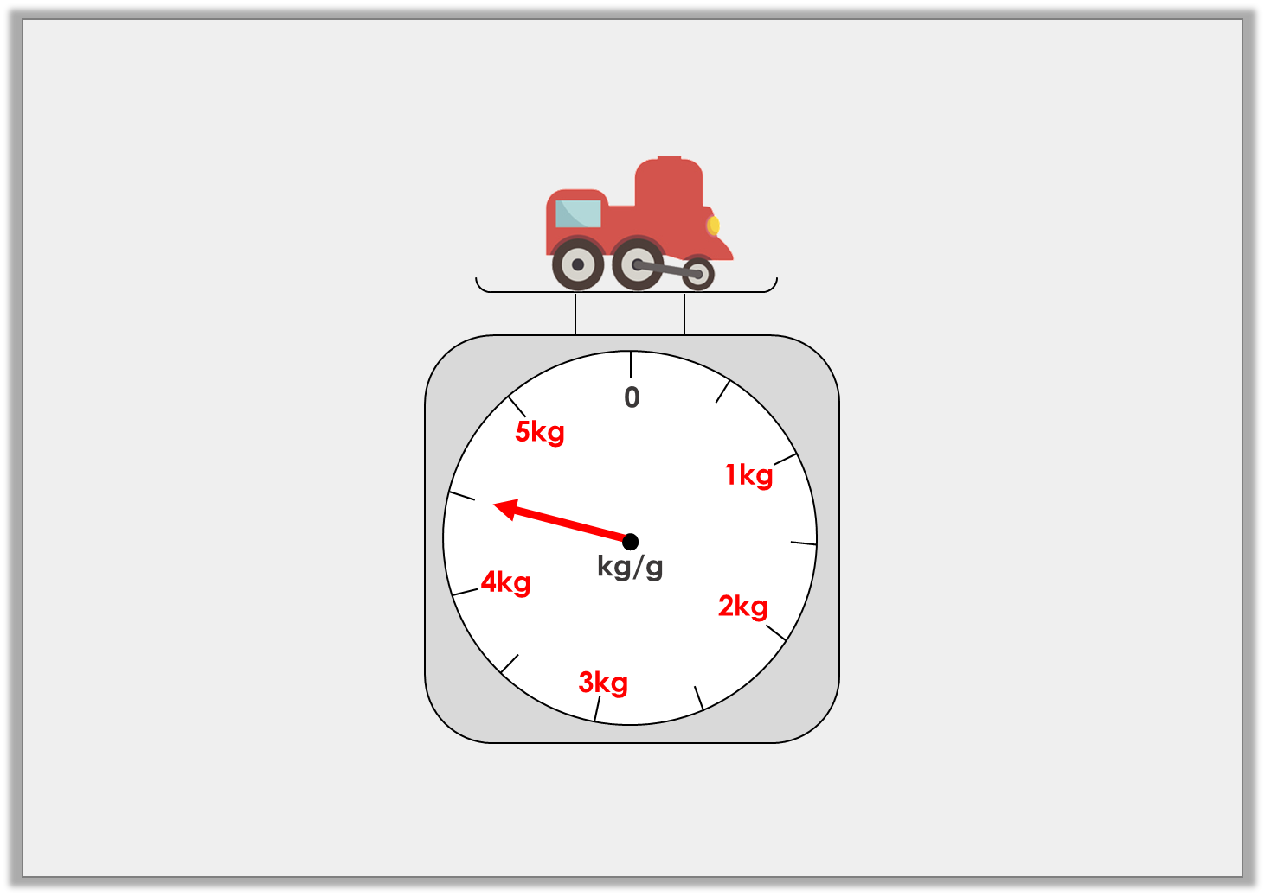
Varied Fluency 2
True or false? The train weighs 3kg and 500g.
© Classroom Secrets Limited 2018
© Classroom Secrets Limited 2018

Slide 9
Varied Fluency 2
True or false? The train weighs 3kg and 500g.
False, the arrow is pointing between 4kg and 5kg, which is 4kg and 500g.
© Classroom Secrets Limited 2018
© Classroom Secrets Limited 2018

Slide 10
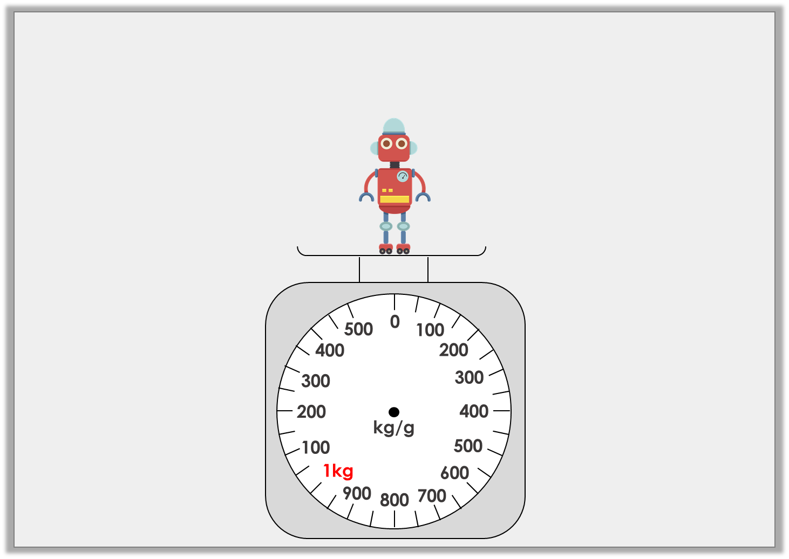
Varied Fluency 3
Draw an arrow on the scales to show that the robot weighs
1kg and 250g.
© Classroom Secrets Limited 2018

Slide 11
Varied Fluency 3
Draw an arrow on the scales to show that the robot weighs
1kg and 250g.
© Classroom Secrets Limited 2018

Slide 12
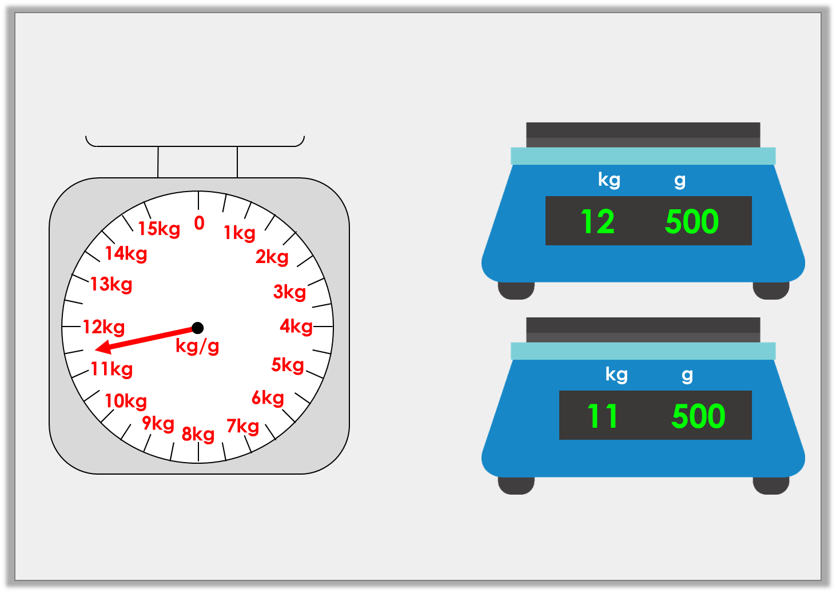
Varied Fluency 4
Match the mass on the scales to the correct digital scale.
A
B
© Classroom Secrets Limited 2018

Slide 13
Varied Fluency 4
Match the mass on the scales to the correct digital scale.
A
B
© Classroom Secrets Limited 2018

Slide 14
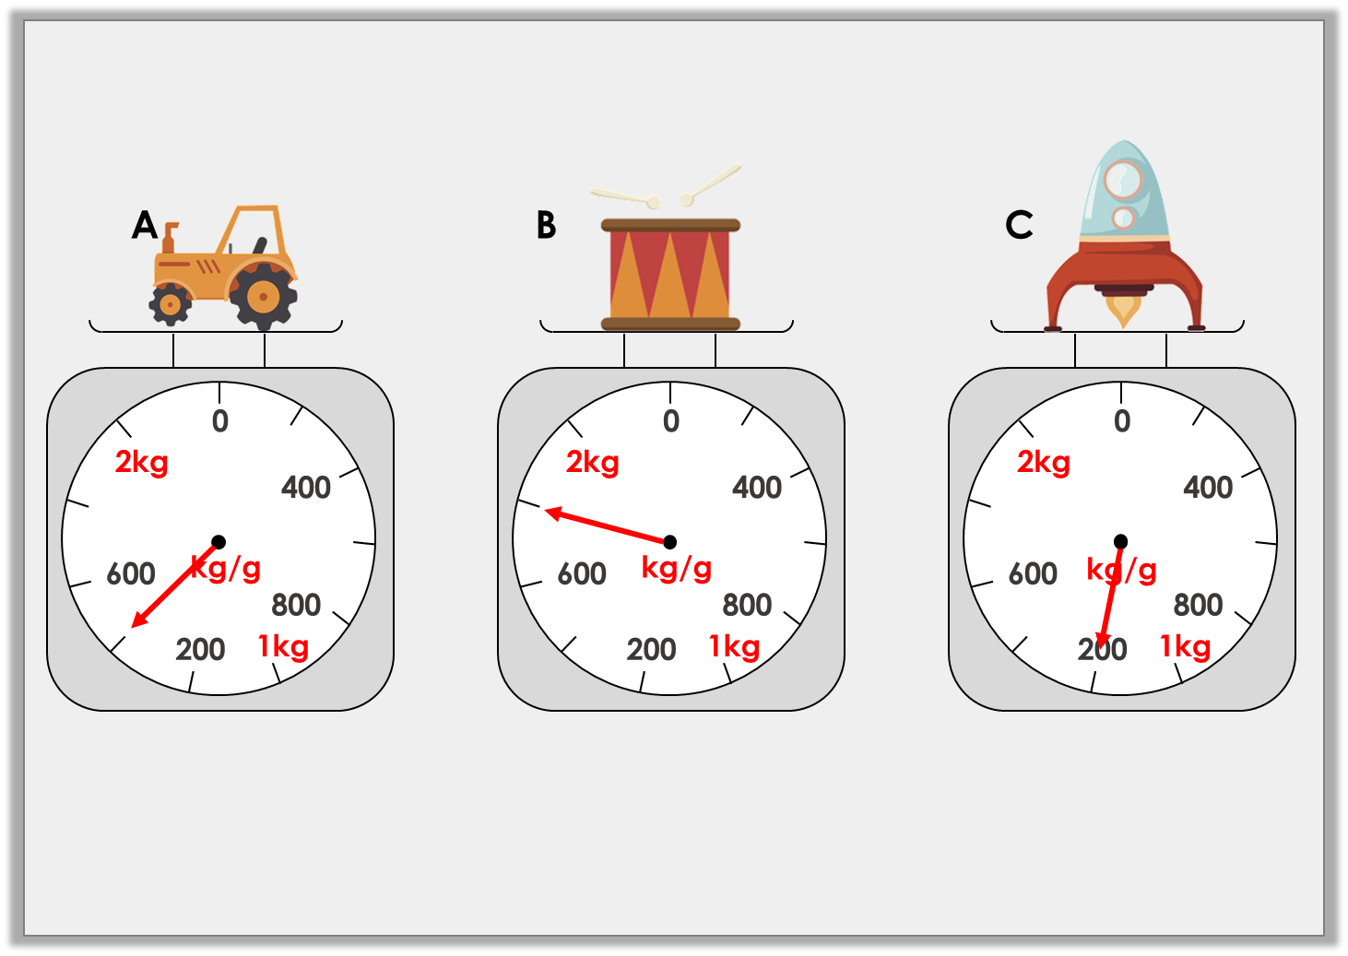
Reasoning 1
Which scale shows the heaviest weight?
Explain your answer.
© Classroom Secrets Limited 2018

Slide 15
Reasoning 1
Which scale shows the heaviest weight?
Explain your answer.
B because…
© Classroom Secrets Limited 2018

Slide 16
Reasoning 1
Which scale shows the heaviest weight?
Explain your answer.
B because 1kg and 800g is heavier than 1kg and 400g and 1kg and 200g.
1kg and 400g
1kg and 800g
1kg and 200g
© Classroom Secrets Limited 2018

Slide 17
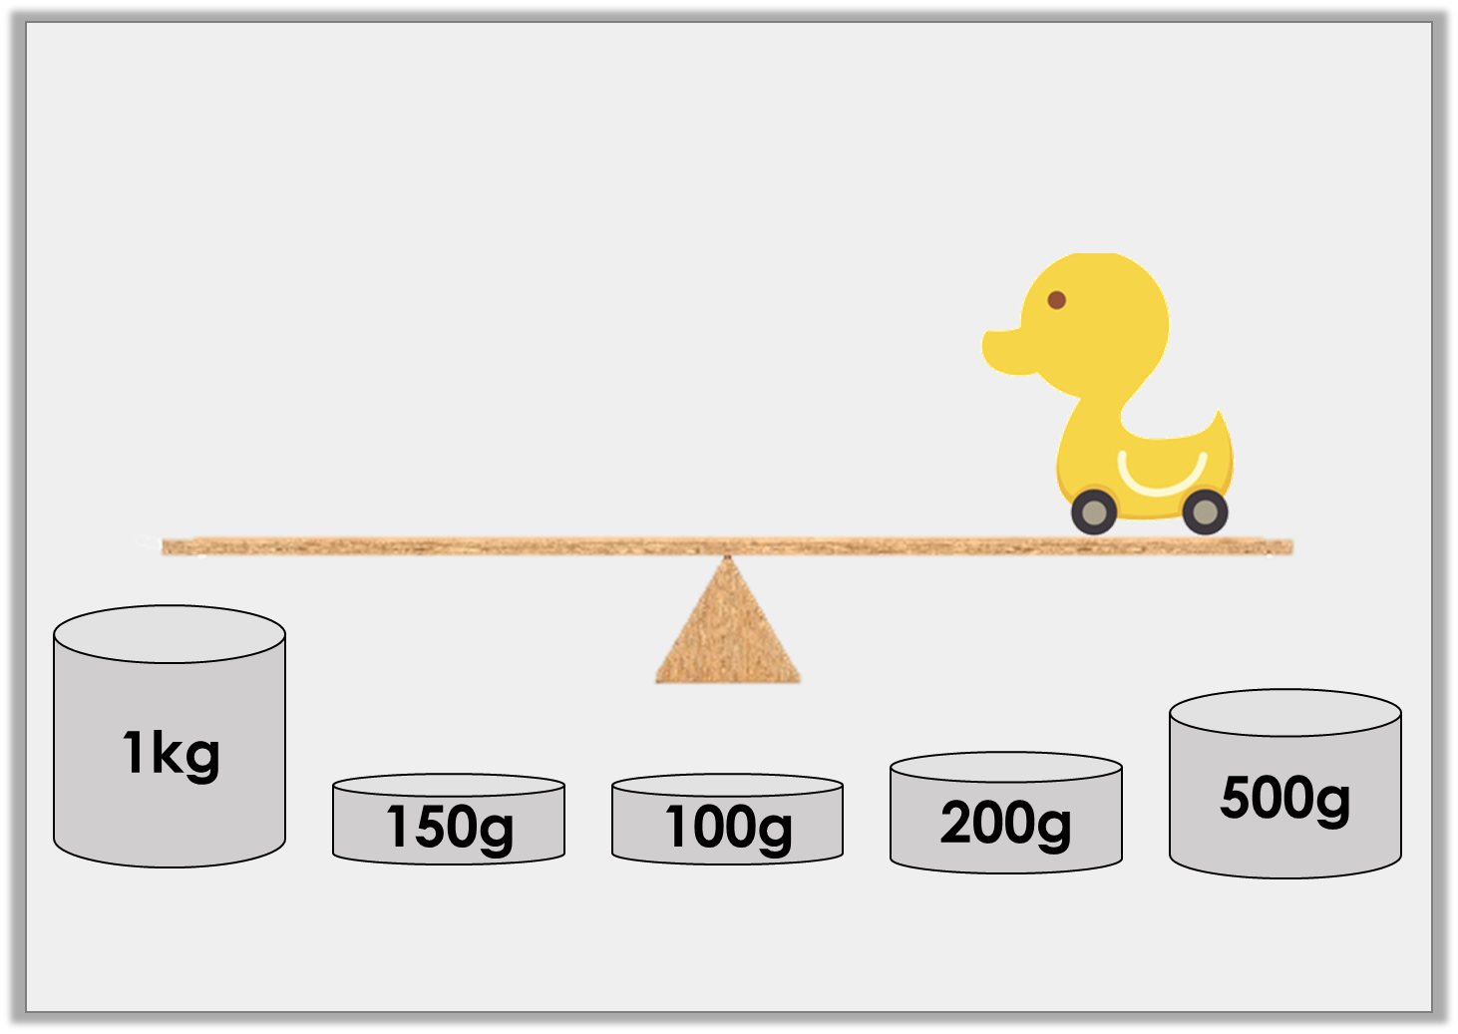
Problem Solving 1
Which weights will balance the scales if the duck weighs 1kg and 350g?
© Classroom Secrets Limited 2018

Slide 18
Problem Solving 1
Which weights will balance the scales if the duck weighs 1kg and 350g?
1kg + 200g + 150g
© Classroom Secrets Limited 2018

Slide 19
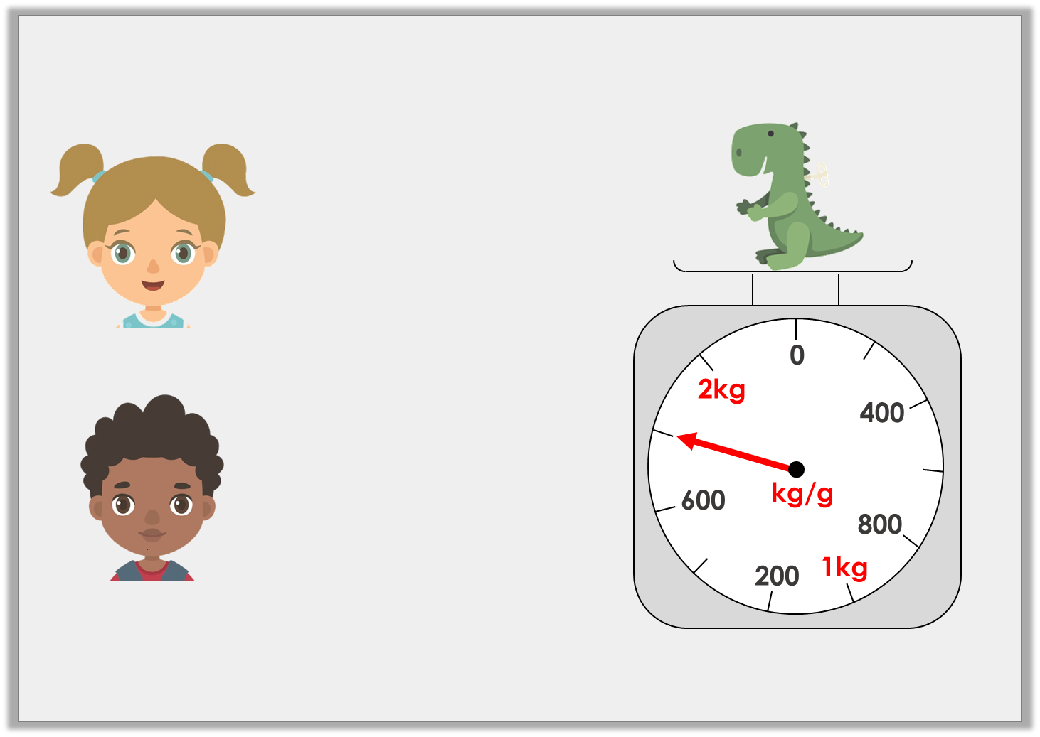
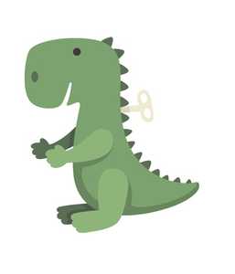
Reasoning 2
Who is correct?
Explain why.
The dinosaur weighs 1kg and 800g.
Martha
The dinosaur weighs 1kg and 400g.
Coleman
© Classroom Secrets Limited 2018

Slide 20
Reasoning 2
Who is correct?
Explain why.
Martha is correct because…
The dinosaur weighs 1kg and 800g.
Martha
The dinosaur weighs 1kg and 400g.
Coleman
© Classroom Secrets Limited 2018

Slide 21
Reasoning 2
Who is correct?
Explain why.
Martha is correct because the scale show 1kg and 800g.
The dinosaur weighs 1kg and 800g.
Martha
The dinosaur weighs 1kg and 400g.
Coleman
© Classroom Secrets Limited 2018

