Slide 1
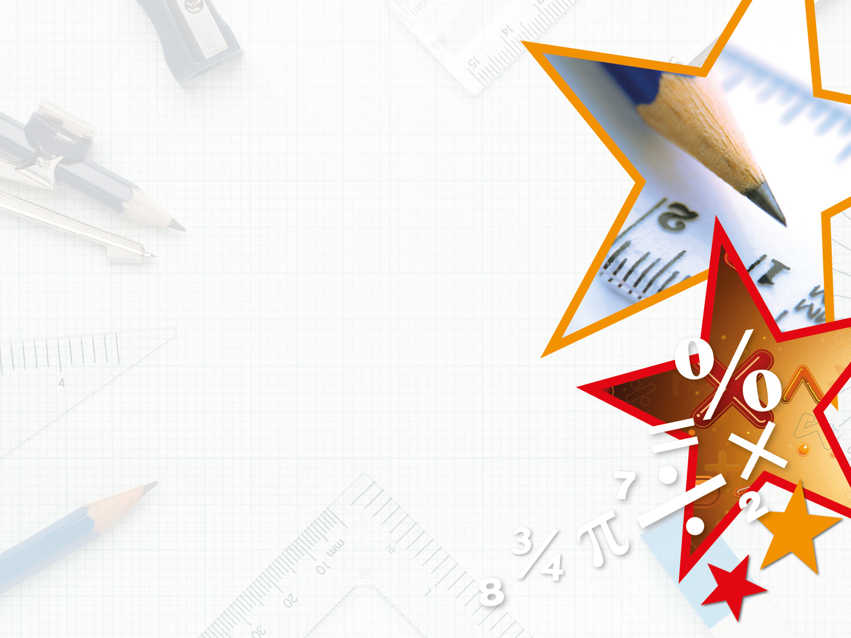


LIFE/work balance
We have started a #LIFEworkbalance campaign and we need your help to complete our LIFE/work balance survey.
We hope to publish the results soon, so please give 15 minutes of your time to help us get a true picture of school life.
Want to be a part of this campaign? Take the survey on our website and share it with your colleagues!
© Classroom Secrets Limited 2019

Slide 2
Year 3 – Summer Block 4 – Mass and Capacity – Measure Capacity 1
About This Resource:
This PowerPoint has been designed to support your teaching of this small step. It includes a starter activity and an example of each question from the Varied Fluency and Reasoning and Problem Solving resources also provided in this pack. You can choose to work through all examples provided or a selection of them depending on the needs of your class.
National Curriculum Objectives:
Mathematics Year 3: (3M1c) Compare volume/capacity (l/ml)
Mathematics Year 3: (3M2c) Measure volume/capacity (l/ml)
More Year 3 Mass and Capacity resources.
Did you like this resource? Don’t forget to review it on our website.
© Classroom Secrets Limited 2018

Slide 3
Year 3 – Summer Block 4 – Mass and Capacity
Step 5: Measure Capacity 1
© Classroom Secrets Limited 2018

Slide 4
Introduction
Complete the missing numbers in these sequences.
50 |  | 100 |  |  |  | 200
100 |  |  |  | 300 |  |  |  | 500
 |  | 100 |  |  |  | 200
A
B
C
© Classroom Secrets Limited 2018

Slide 5
Introduction
Complete the missing numbers in these sequences.
50 |  | 100 |  | 150 |  | 200 |  | 250
100 |  | 200 |  | 300 |  | 400 |  | 500
50 |  | 100 |  | 150 |  | 200 |  | 250
A
B
C
© Classroom Secrets Limited 2018

Slide 6
Varied Fluency 1
Complete the sentence.
The capacity is millilitres.
150ml
50ml
© Classroom Secrets Limited 2018

Slide 7
Varied Fluency 1
Complete the sentence.
The capacity is millilitres.
150ml
50ml
250
© Classroom Secrets Limited 2018

Slide 8
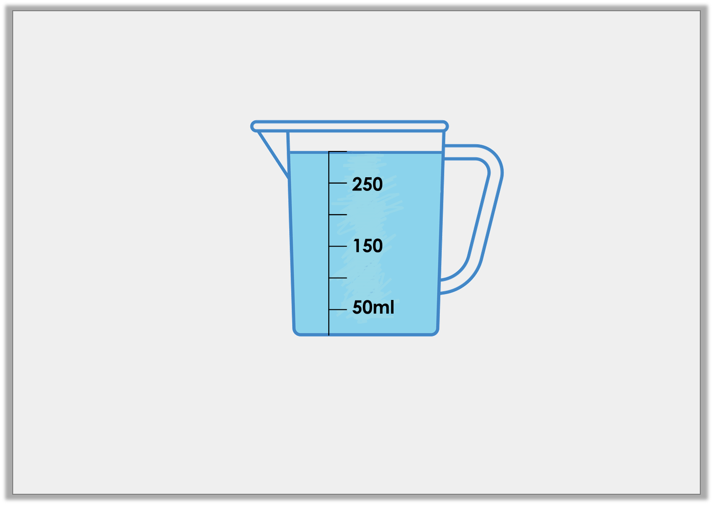
Varied Fluency 2
True or false? There are 300ml of liquid in the jug below.
© Classroom Secrets Limited 2018

Slide 9
Varied Fluency 2
True or false? There are 300ml of liquid in the jug below.
True
© Classroom Secrets Limited 2018

Slide 10
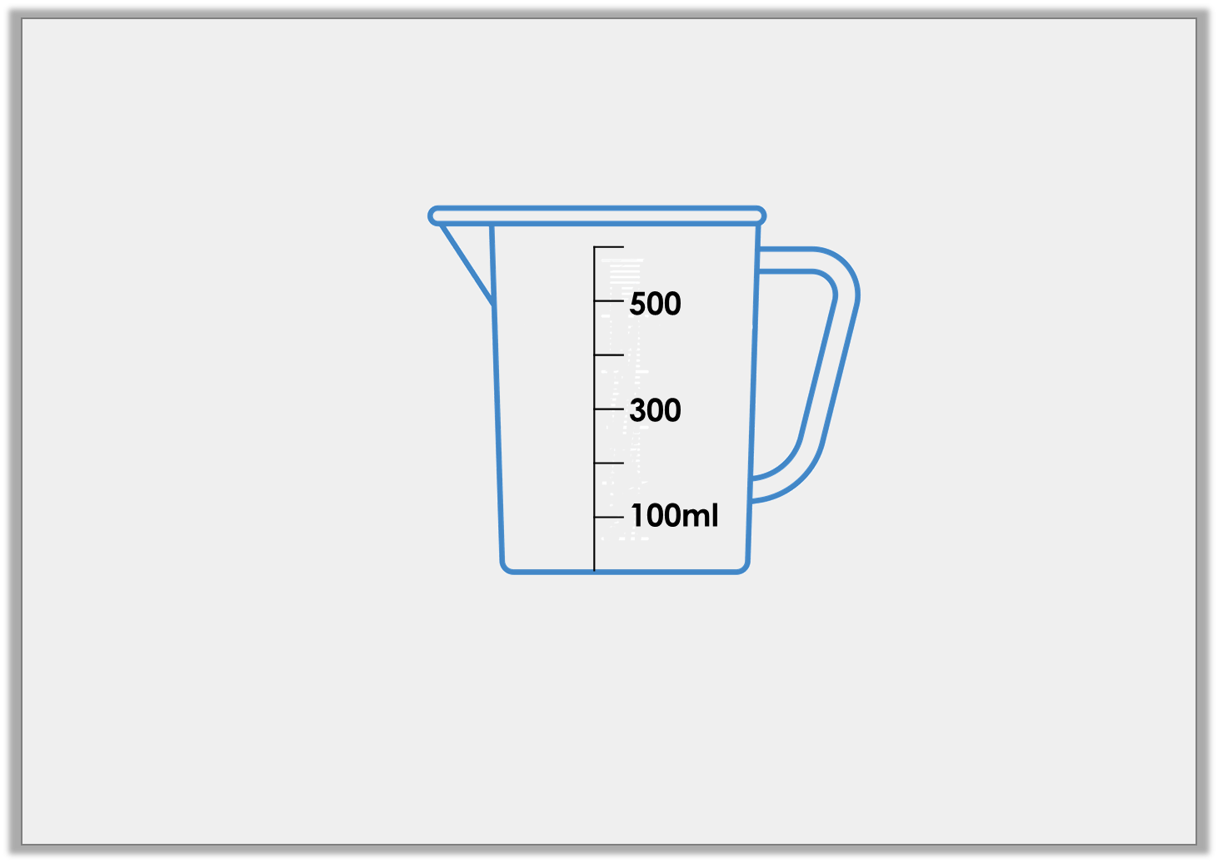
Varied Fluency 3
Draw an arrow to show the water level for a volume of 200ml.
© Classroom Secrets Limited 2018

Slide 11
Varied Fluency 3
Draw an arrow to show the water level for a volume of 200ml.
© Classroom Secrets Limited 2018

Slide 12
Varied Fluency 4
Match the volumes to the correct containers.
A
B
C
200ml
100ml
300
100ml
4L
2L
200ml
3LL
150ml
© Classroom Secrets Limited 2018

Slide 13
Varied Fluency 4
Match the volumes to the correct containers.
A
B
C
200ml
100ml
300
100ml
4L
2L
200ml
3LL
150ml
© Classroom Secrets Limited 2018

Slide 14
Reasoning 1
Which is the odd one out? Explain your answer.
A
B
C
150ml
50ml
300
100ml
400ml
200ml
© Classroom Secrets Limited 2018

Slide 15
Reasoning 1
Which is the odd one out? Explain your answer.
B is the odd one out because the volume of liquid in both A and C is 200ml but the volume in B is 300ml.
A
B
C
150ml
50ml
300
100ml
400ml
200ml
© Classroom Secrets Limited 2018

Slide 16
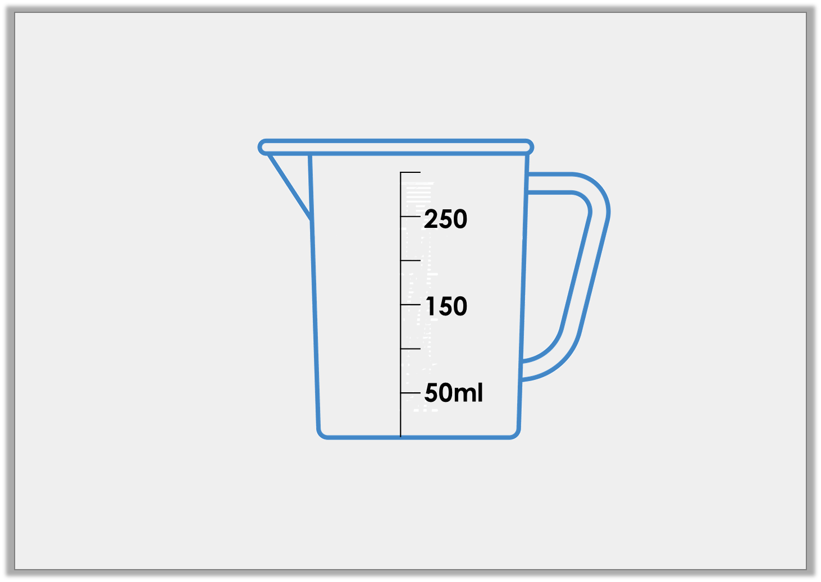
Problem Solving 1
Tom has poured water into the measuring jug below.
The volume is more 50ml than but less than 300ml.
How much water could he have?
Use arrows to label 3 possible answers.
© Classroom Secrets Limited 2018

Slide 17
Problem Solving 1
Tom has poured water into the measuring jug below.
The volume is more 50ml than but less than 300ml.
How much water could he have?
Use arrows to label 3 possible answers.
250ml
200ml
100ml
© Classroom Secrets Limited 2018

Slide 18
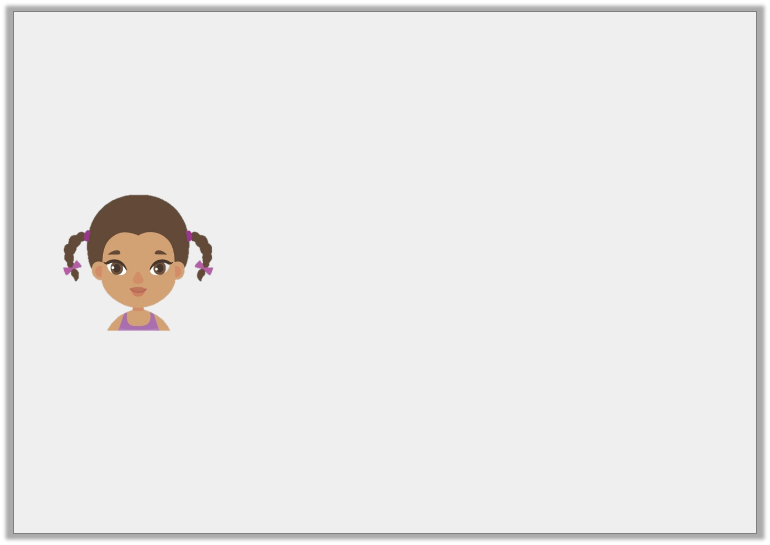
Reasoning 2
Is Aisha correct? Explain your answer.
I have 200ml of liquid in my container.
250
150
50ml
© Classroom Secrets Limited 2018

Slide 19
Reasoning 2
Is Aisha correct? Explain your answer.
Alisha is correct because. . .
I have 200ml of liquid in my container.
250
150
50ml
© Classroom Secrets Limited 2018

Slide 20
Reasoning 2
Is Aisha correct? Explain your answer.
Alisha is correct because the scale is in increments of 50ml. The water level is between 150ml and 250ml so the volume of the liquid is 200ml.
I have 200ml of liquid in my container.
250
150
50ml
© Classroom Secrets Limited 2018

