Slide 1
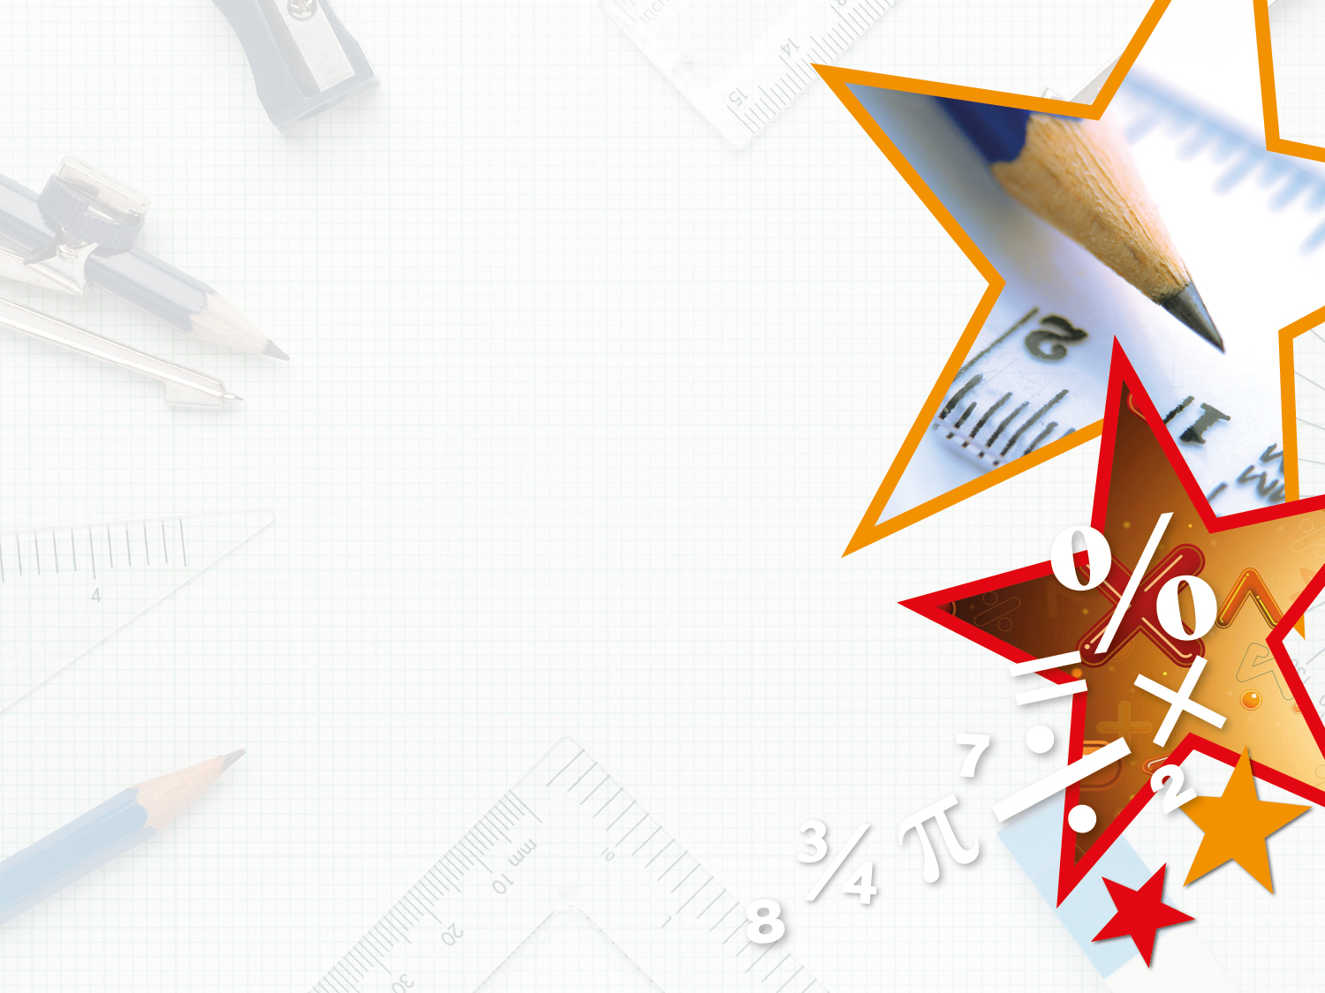


LIFE/work balance
We have started a #LIFEworkbalance campaign and we need your help to complete our LIFE/work balance survey.
We hope to publish the results soon, so please give 15 minutes of your time to help us get a true picture of school life.
Want to be a part of this campaign? Take the survey on our website and share it with your colleagues!
© Classroom Secrets Limited 2018

Slide 2
Year 4 – Summer Block 5 – Properties of Shape – Quadrilaterals
About This Resource:
This PowerPoint has been designed to support your teaching of this small step. It includes a starter activity and an example of each question from the Varied Fluency and Reasoning and Problem Solving resources also provided in this pack. You can choose to work through all examples provided or a selection of them depending on the needs of your class.
National Curriculum Objectives:
Mathematics Year 4: (4G2a) Compare and classify geometric shapes, including quadrilaterals and triangles based on their properties and sizes
More Year 4 Properties of Shapes resources.
Did you like this resource? Don’t forget to review it on our website.
© Classroom Secrets Limited 2018

Slide 3
Year 4 – Summer Block 5 – Properties of Shape
Step 4: Quadrilaterals
© Classroom Secrets Limited 2018

Slide 4
Introduction
Which is the odd one out? Explain your choice.
Name each shape.
© Classroom Secrets Limited 2018

Slide 5
Introduction
Which is the odd one out? Explain your choice.
Example answer:
The pentagon is the odd one out as all of the others are quadrilaterals.
Name each shape.
trapezium
parallelogram
rectangle
square
pentagon
rhombus
© Classroom Secrets Limited 2018

Slide 6
Varied Fluency 1
Draw lines to match the true statements to the shape.
It is a rectangle
It has 5 right angles
It has 3 sides
It has equal sides
It has 4 sides
© Classroom Secrets Limited 2018

Slide 7
Varied Fluency 1
Draw lines to match the true statements to the shape.
It is a rectangle
It has 5 right angles
It has 3 sides
It has equal sides
It has 4 sides
© Classroom Secrets Limited 2018

Slide 8
Varied Fluency 2
Fill in the blanks to describe the shape.
This shape has ______ sides.
It has ______ right angles.
It has ______ pair of parallel sides.
© Classroom Secrets Limited 2018

Slide 9
Varied Fluency 2
Fill in the blanks to describe the shape.
This shape has ______ sides.
It has ______ right angles.
It has ______ pair of parallel sides.
4
0
1
© Classroom Secrets Limited 2018

Slide 10
Varied Fluency 3
Draw the shape using the description below.
The shape has:
4 sides
4 right angles
What shape have you drawn?
© Classroom Secrets Limited 2018

Slide 11
Varied Fluency 3
Draw the shape using the description below.
The shape has:
4 sides
4 right angles
What shape have you drawn?
© Classroom Secrets Limited 2018

Slide 12
Varied Fluency 4
Circle the quadrilaterals.
© Classroom Secrets Limited 2018

Slide 13
Varied Fluency 4
Circle the quadrilaterals.
© Classroom Secrets Limited 2018

Slide 14
Reasoning 1
What is the same about these two shapes?
What is different?
© Classroom Secrets Limited 2018

Slide 15
Reasoning 1
What is the same about these two shapes?
What is different?
Various answers, for example:
Same: 4 sides; 4 right angles; 2 pairs of parallel sides
Different: size; orientation
© Classroom Secrets Limited 2018

Slide 16
Problem Solving 1
Tina is thinking of a shape. It has:
4 equal length sides
No right angles
What shape could Tina be thinking of? Give all possible answers.
© Classroom Secrets Limited 2018

Slide 17
Problem Solving 1
Tina is thinking of a shape. It has:
4 equal length sides
No right angles
What shape could Tina be thinking of? Give all possible answers.
Tina could be thinking of a rhombus.
© Classroom Secrets Limited 2018

Slide 18
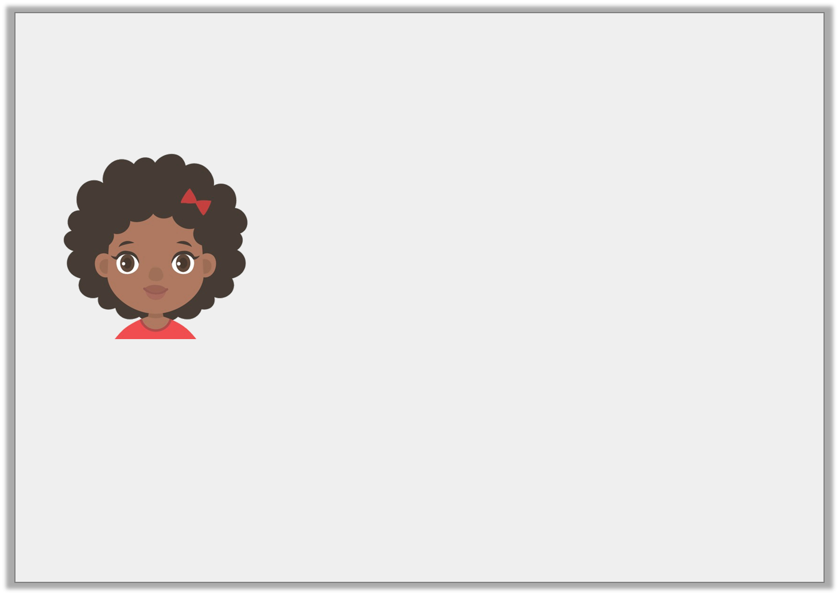
Reasoning 2
Jenny thinks that the shape matches her statement.
Is she correct? Explain your answer.
This quadrilateral has 1 pair of parallel lines and 0 right angles.
© Classroom Secrets Limited 2018

Slide 19
Reasoning 2
Jenny thinks that the shape matches her statement.
Is she correct? Explain your answer.
Jenny is incorrect because…
This quadrilateral has 1 pair of parallel lines and 0 right angles.
© Classroom Secrets Limited 2018

Slide 20
Reasoning 2
Jenny thinks that the shape matches her statement.
Is she correct? Explain your answer.
Jenny is incorrect because this quadrilateral is a parallelogram so it has 2 pairs of parallel lines and no right angles.
This quadrilateral has 1 pair of parallel lines and 0 right angles.
© Classroom Secrets Limited 2018

