Slide 1



LIFE/work balance
We have started a #LIFEworkbalance campaign and we need your help to complete our LIFE/work balance survey.
We hope to publish the results soon, so please give 15 minutes of your time to help us get a true picture of school life.
Want to be a part of this campaign? Take the survey on our website and share it with your colleagues!
© Classroom Secrets Limited 2019

Slide 2
Year 4 – Summer Block 5 – Properties of Shapes – Compare and Order Angles
About This Resource:
This PowerPoint has been designed to support your teaching of this small step. It includes a starter activity and an example of each question from the Varied Fluency and Reasoning and Problem Solving resources also provided in this pack. You can choose to work through all examples provided or a selection of them depending on the needs of your class.
National Curriculum Objectives:
Mathematics Year 4: (4G4) Identify acute and obtuse angles and compare and order angles up to two right angles by size
Mathematics Year 4: (4G2a) Compare and classify geometric shapes, including quadrilaterals and triangles, based on their properties and sizes
More Year 4 Properties of Shape resources.
Did you like this resource? Don’t forget to review it on our website.
© Classroom Secrets Limited 2019

Slide 3
Year 4 – Summer Block 5 – Properties of Shapes
Step 2: Compare and Order Angles
© Classroom Secrets Limited 2019

Slide 4
Introduction
Label these angles as acute, right angle or obtuse.
© Classroom Secrets Limited 2019

Slide 5
Introduction
Label these angles as acute, right angle or obtuse.
Right Angle
Obtuse
Acute
Acute
Obtuse
© Classroom Secrets Limited 2019

Slide 6
Varied Fluency 1
Which angle is the largest?
B
A
C
© Classroom Secrets Limited 2019

Slide 7
Varied Fluency 1
Which angle is the largest?
B
A
C
© Classroom Secrets Limited 2019

Slide 8
Varied Fluency 2
Here are some segments with different sized angles at their points.
Put the angles in order from smallest to largest.
A
D
B
C
© Classroom Secrets Limited 2019

Slide 9
Varied Fluency 2
Here are some segments with different sized angles at their points.
Put the angles in order from smallest to largest.
A
D
B
C
A, C, D, B
© Classroom Secrets Limited 2019

Slide 10

Varied Fluency 3
True or false?
Angle A is smaller than angle B. Angles B and C are the same size.
A
B
C
© Classroom Secrets Limited 2019

Slide 11
Varied Fluency 3
True or false?
Angle A is smaller than angle B. Angles B and C are the same size.
True
A
B
C
© Classroom Secrets Limited 2019

Slide 12
Problem Solving 1
Which of these shapes contains the smallest angle?
A
C
B
© Classroom Secrets Limited 2019

Slide 13
Problem Solving 1
Which of these shapes contains the smallest angle?
A
C
B
© Classroom Secrets Limited 2019

Slide 14
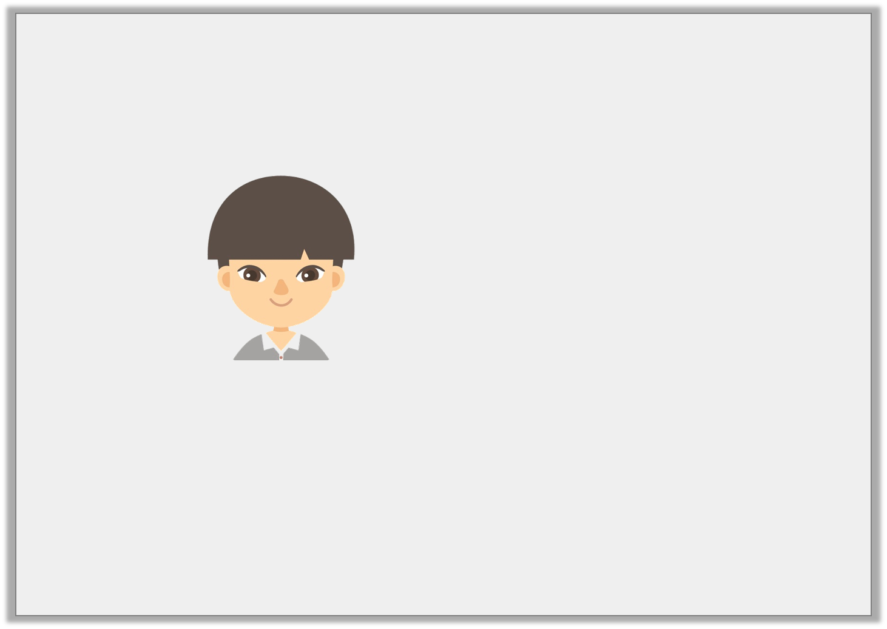
Reasoning 1
Kaito is discussing angles.
Is Kaito correct? Explain your answer.
I have 3 angles. One angle is obtuse, one is 90° and the other is acute. I think that the 90° angle is the smallest angle.
© Classroom Secrets Limited 2019

Slide 15
Reasoning 1
Kaito is discussing angles.
Is Kaito correct? Explain your answer.
Kaito is incorrect because...
I have 3 angles. One angle is obtuse, one is 90° and the other is acute. I think that the 90° angle is the smallest angle.
© Classroom Secrets Limited 2019

Slide 16
Reasoning 1
Kaito is discussing angles.
Is Kaito correct? Explain your answer.
Kaito is incorrect because an acute angle is smaller than 90°.
I have 3 angles. One angle is obtuse, one is 90° and the other is acute. I think that the 90° angle is the smallest angle.
© Classroom Secrets Limited 2019

Slide 17
Problem Solving 2
If you join together the end points of the matching lines below, do they make 4 angles in order from smallest to largest?
Be sure to compare the smallest side of each angle created.
1
2
3
4
© Classroom Secrets Limited 2019

Slide 18
Problem Solving 2
If you join together the end points of the matching lines below, do they make 4 angles in order from smallest to largest?
Be sure to compare the smallest side of each angle created.
Yes
1
2
3
4
© Classroom Secrets Limited 2019

