Slide 1
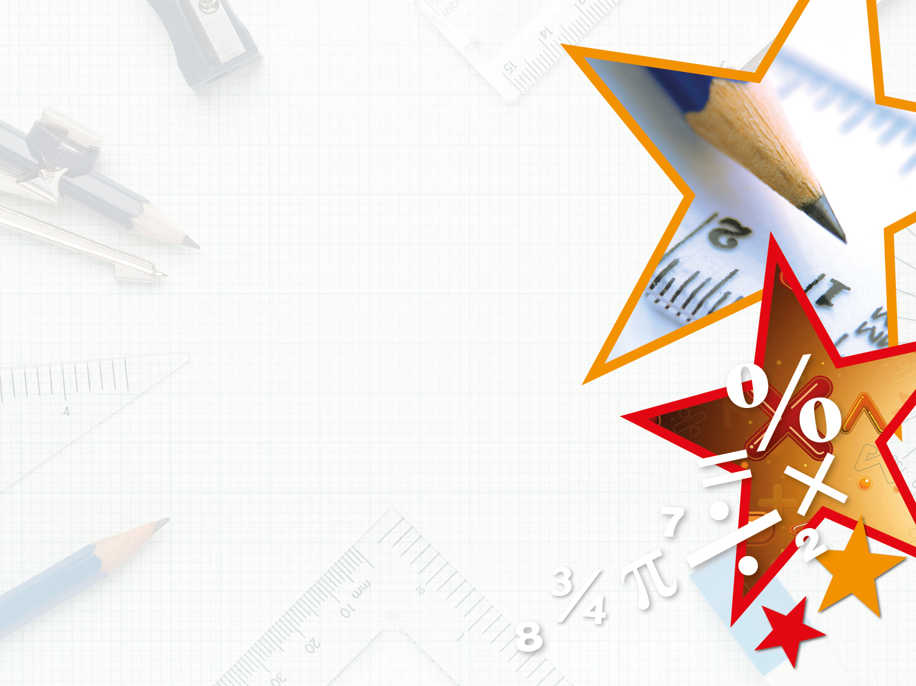


LIFE/work balance
We have started a #LIFEworkbalance campaign and we need your help to complete our LIFE/work balance survey.
We hope to publish the results soon, so please give 15 minutes of your time to help us get a true picture of school life.
Want to be a part of this campaign? Take the survey on our website and share it with your colleagues!
© Classroom Secrets Limited 2018

Slide 2
Year 3 – Summer Block 4 – Mass and Capacity – Compare Mass
About This Resource:
This PowerPoint has been designed to support your teaching of this small step. It includes a starter activity and an example of each question from the Varied Fluency and Reasoning and Problem Solving resources also provided in this pack. You can choose to work through all examples provided or a selection of them depending on the needs of your class.
National Curriculum Objectives:
Mathematics Year 3: (3M1b) Compare mass (kg/g)
More Year 3 Mass and Capacity resources.
Did you like this resource? Don’t forget to review it on our website.
© Classroom Secrets Limited 2018

Slide 3
Year 3 – Summer Block 4 – Mass and Capacity
Step 3: Compare Mass
© Classroom Secrets Limited 2018

Slide 4
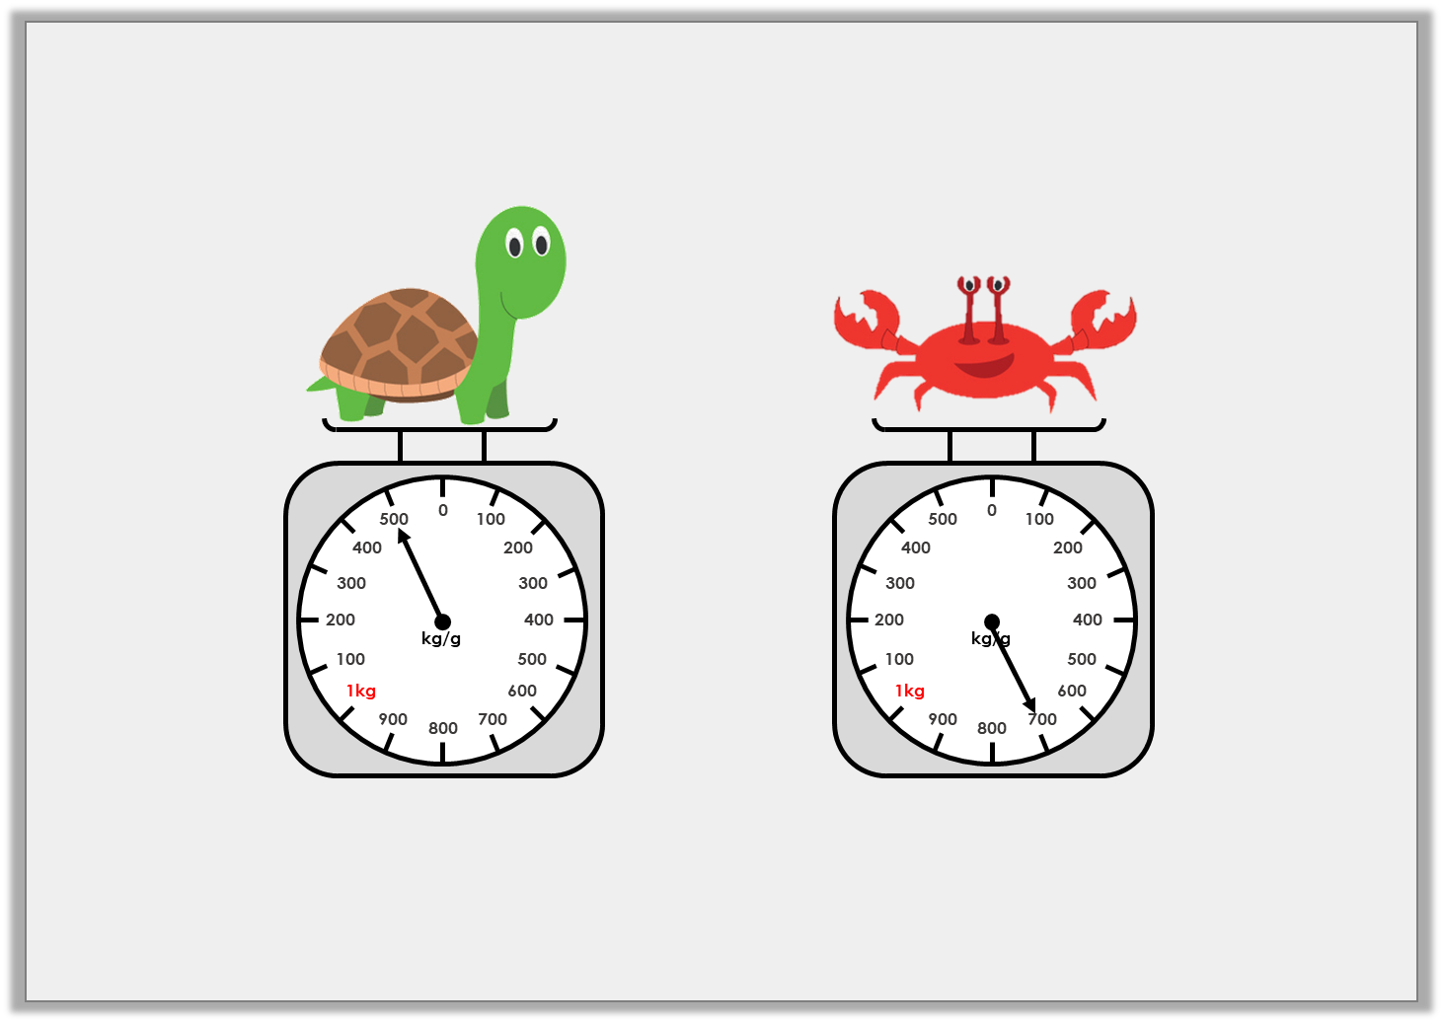
Introduction
Find the mass of these animals and complete the sentences below.
The tortoise weighs |  | kg |  | g
The crab weighs |  | kg |  | g
© Classroom Secrets Limited 2018

Slide 5
Introduction
Find the mass of these animals and complete the sentences below.
The tortoise weighs | 1 | kg | 500 | g
The crab weighs | 0 | kg | 700 | g
© Classroom Secrets Limited 2018

Slide 6
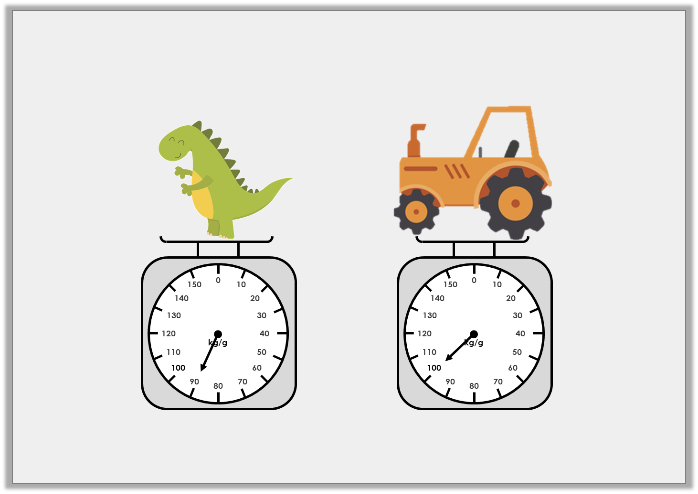
Varied Fluency 1
True or false? The tractor is heavier than the dinosaur.
© Classroom Secrets Limited 2018

Slide 7
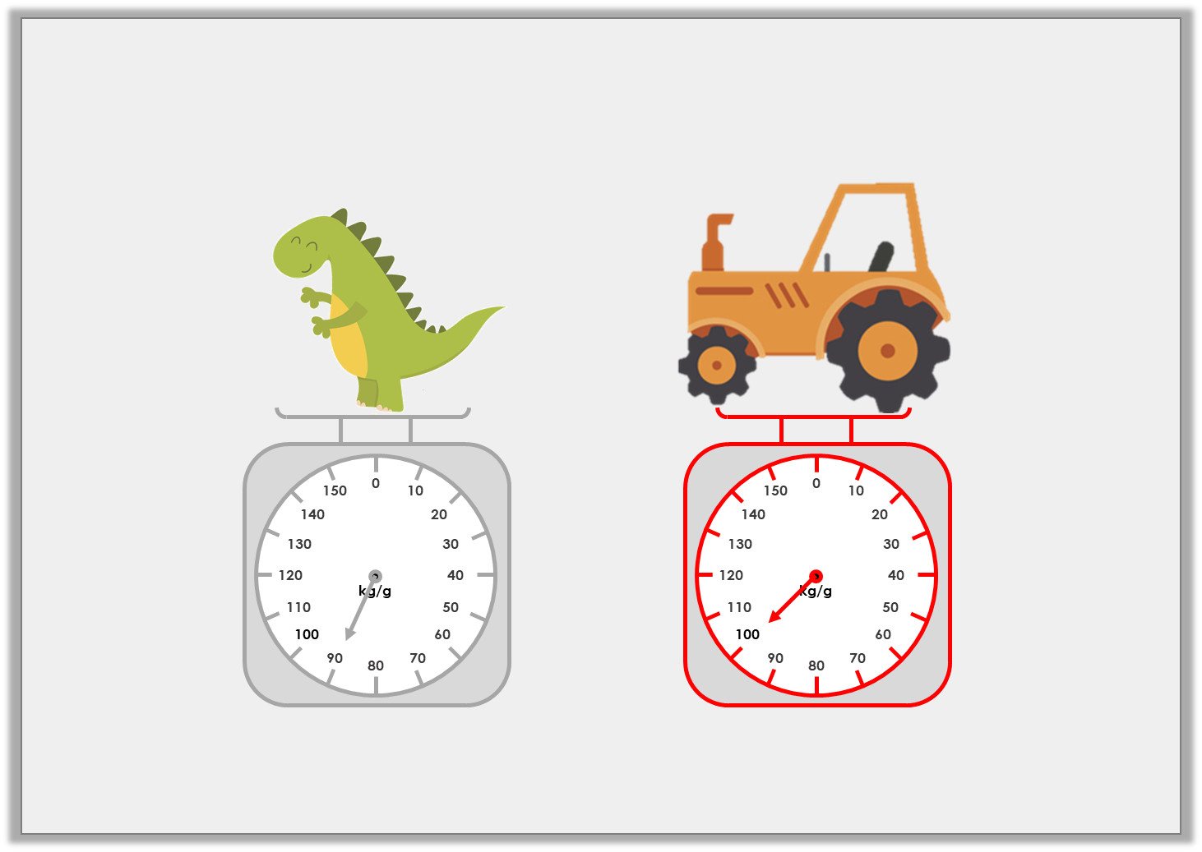
Varied Fluency 1
True or false? The tractor is heavier than the dinosaur.
True
© Classroom Secrets Limited 2018

Slide 8
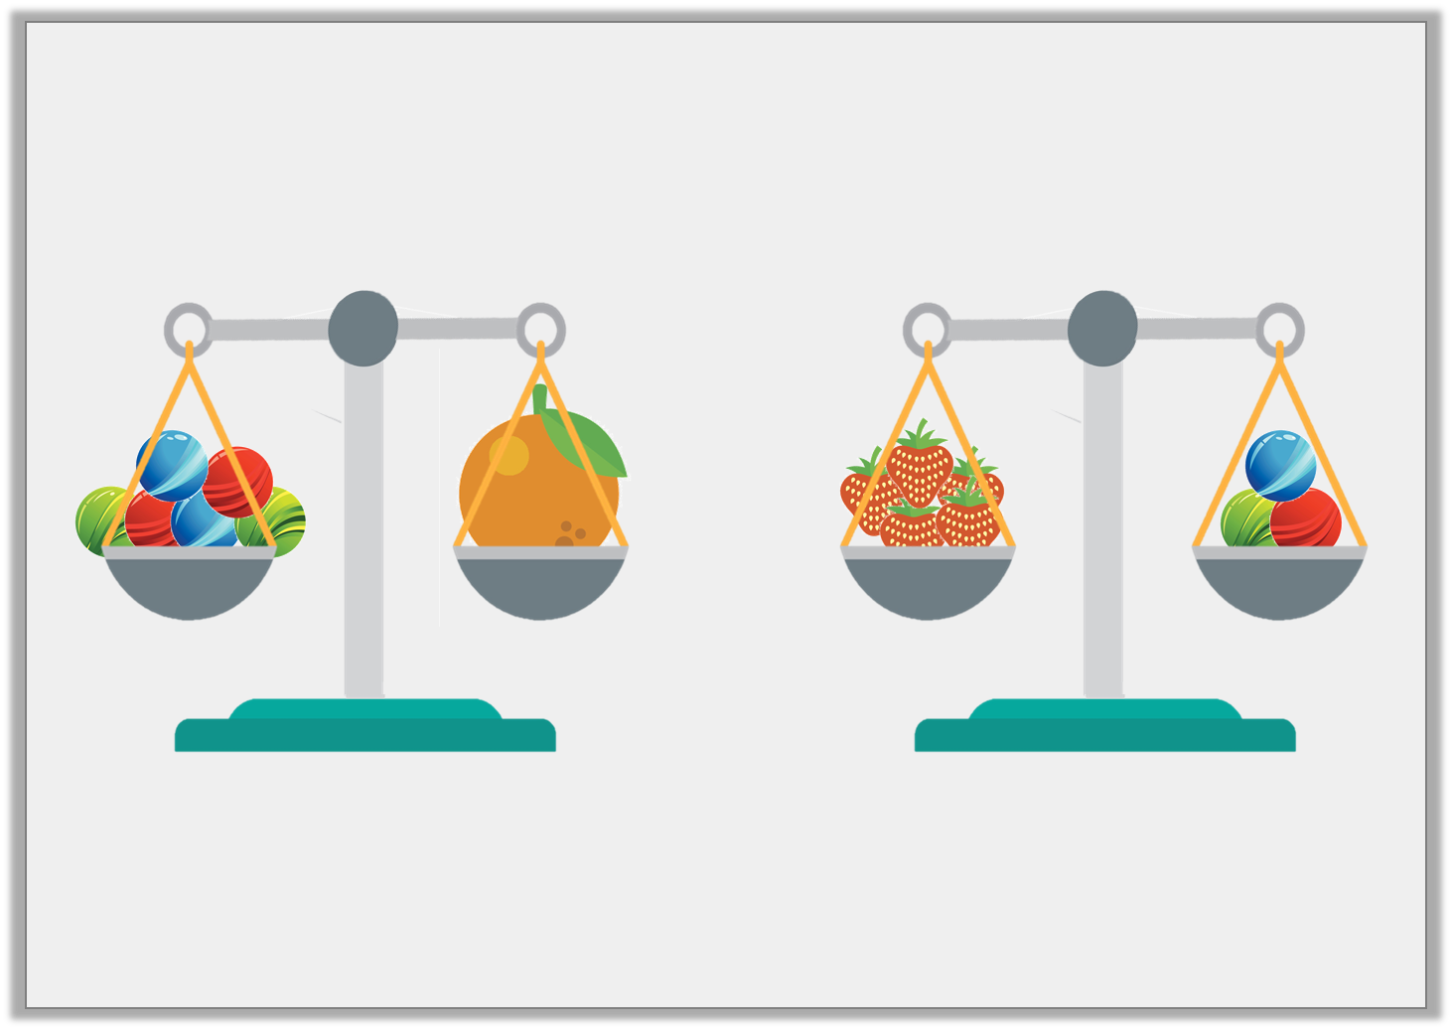
Varied Fluency 2
Which object is the heaviest if one marble weighs 20g?
© Classroom Secrets Limited 2018

Slide 9
Varied Fluency 2
Which object is the heaviest if one marble weighs 20g?
The orange
120g
60g
© Classroom Secrets Limited 2018

Slide 10
Varied Fluency 3
Use < or > to compare the weights.
300g |  | 4kg
© Classroom Secrets Limited 2018

Slide 11
Varied Fluency 3
Use < or > to compare the weights.
300g | < | 4kg
© Classroom Secrets Limited 2018

Slide 12
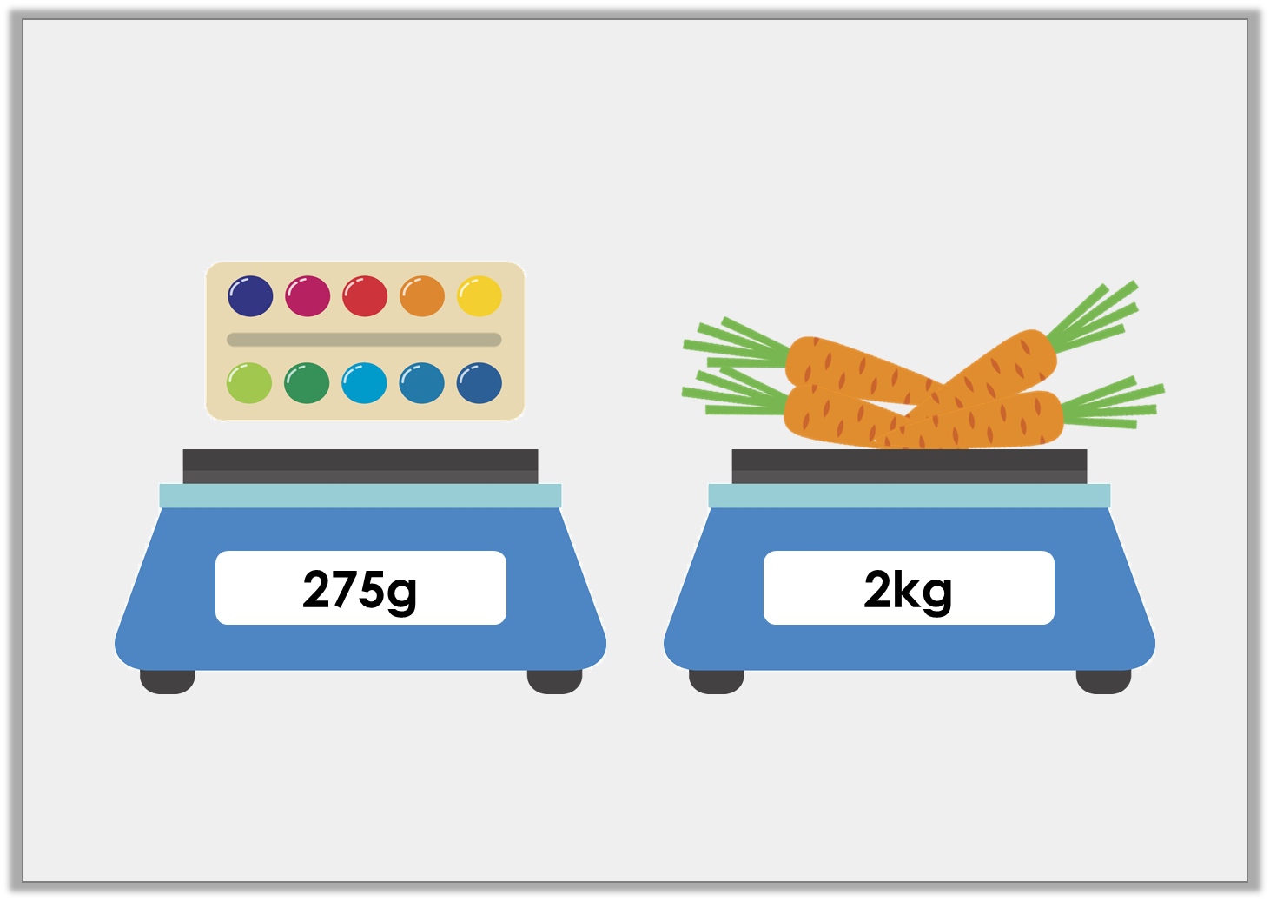
Varied Fluency 4
Which is heavier?
© Classroom Secrets Limited 2018

Slide 13
Varied Fluency 4
Which is heavier?
2kg
© Classroom Secrets Limited 2018

Slide 14
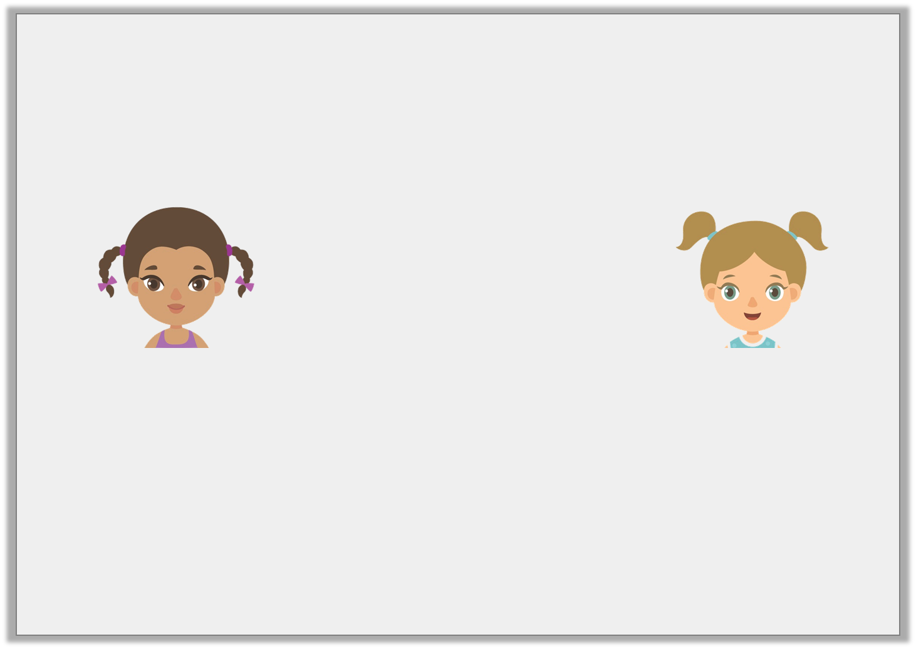
Reasoning 1
Joanna and her friend are comparing the weights of their dogs. Joanna says hers is the lightest.
Is she correct? Explain your answer.
26kg
25kg
Joanna
Rachel
© Classroom Secrets Limited 2018

Slide 15
Reasoning 1
Joanna and her friend are comparing the weights of their dogs. Joanna says hers is the lightest.
Is she correct? Explain your answer.
Joanna is wrong because….
26kg
25kg
Joanna
Rachel
© Classroom Secrets Limited 2018

Slide 16
Reasoning 1
Joanna and her friend are comparing the weights of their dogs. Joanna says hers is the lightest.
Is she correct? Explain your answer.
Joanna is wrong because her dog weighs 100g more than Rachel’s dog.
26kg
25kg
Joanna
Rachel
© Classroom Secrets Limited 2018

Slide 17
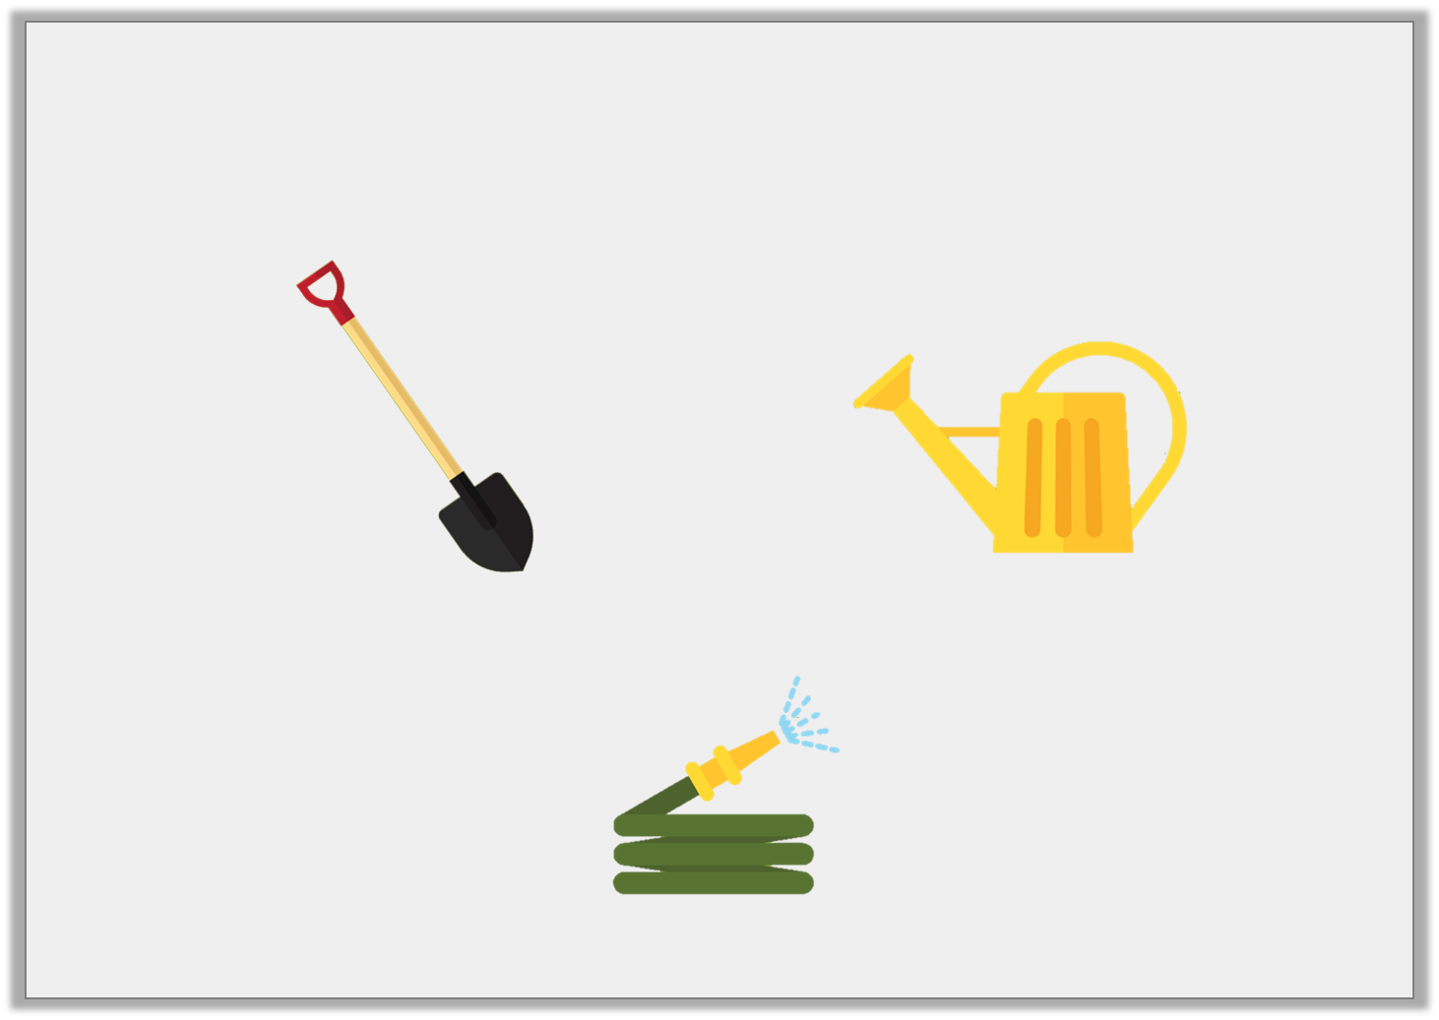
Problem Solving 1
The hose weighs more than two watering cans but less than the spade. Its weight is a multiple of 5. What could the hose weigh?
Write down 3 possibilities.
350g
150g
© Classroom Secrets Limited 2018

Slide 18
Problem Solving 1
The hose weighs more than two watering cans but less than the spade. Its weight is a multiple of 5. What could the hose weigh?
Write down 3 possibilities.
Various possible answers, for example: 305g, 315g, 320g
350g
150g
© Classroom Secrets Limited 2018

Slide 19
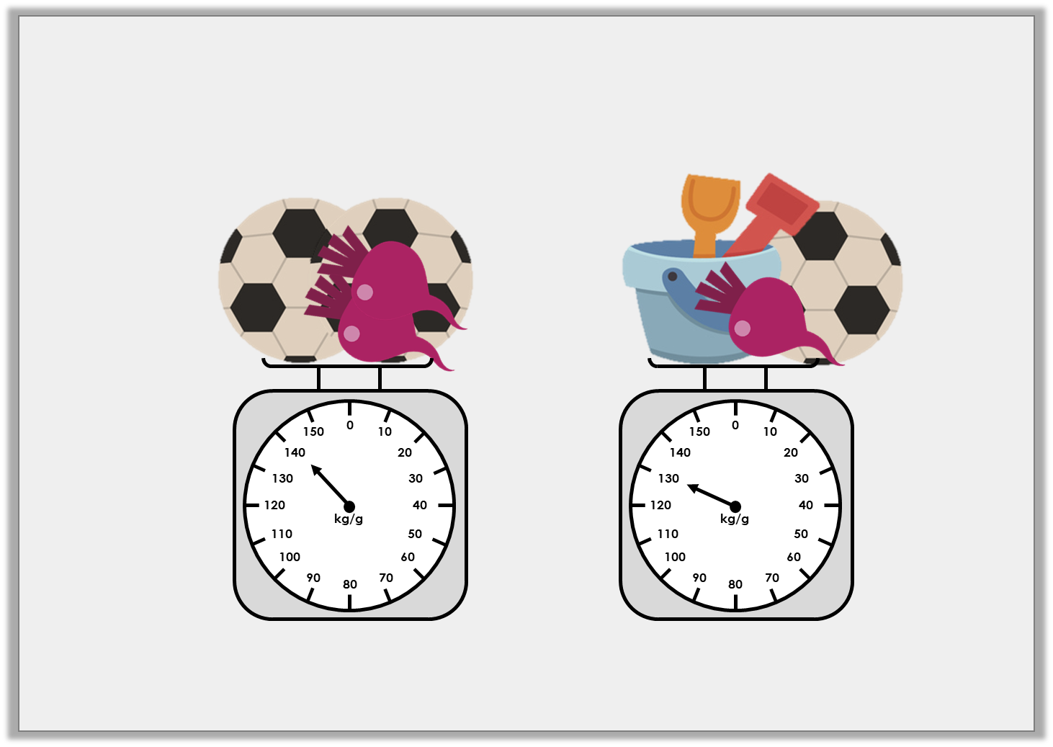
Problem Solving 2
If a beetroot weighs 30g and a bucket and spade weighs 60g, how much does one ball weigh?
© Classroom Secrets Limited 2018

Slide 20
Problem Solving 2
If a beetroot weighs 30g and a bucket and spade weighs 60g, how much does one ball weigh?
Ball = 40g.
© Classroom Secrets Limited 2018

