Slide 1



LIFE/work balance
We have started a #LIFEworkbalance campaign and we need your help to complete our LIFE/work balance survey.
We hope to publish the results soon, so please give 15 minutes of your time to help us get a true picture of school life.
Want to be a part of this campaign? Take the survey on our website and share it with your colleagues!
© Classroom Secrets Limited 2019

Slide 2
Year 3 – Summer Block 4 – Mass and Capacity – Add and Subtract Mass
About This Resource:
This PowerPoint has been designed to support your teaching of this small step. It includes a starter activity and an example of each question from the Varied Fluency and Reasoning and Problem Solving resources also provided in this pack. You can choose to work through all examples provided or a selection of them depending on the needs of your class.
National Curriculum Objectives:
Mathematics Year 3: (3M1b) Compare mass (kg/g)
Mathematics Year 3: (3M2b) Measure mass (kg/g)
More Year 3 Mass and Capacity resources.
Did you like this resource? Don’t forget to review it on our website.
© Classroom Secrets Limited 2018

Slide 3
Year 3 – Summer Block 4 – Mass and Capacity
Step 4: Add and Subtract Mass
© Classroom Secrets Limited 2018

Slide 4
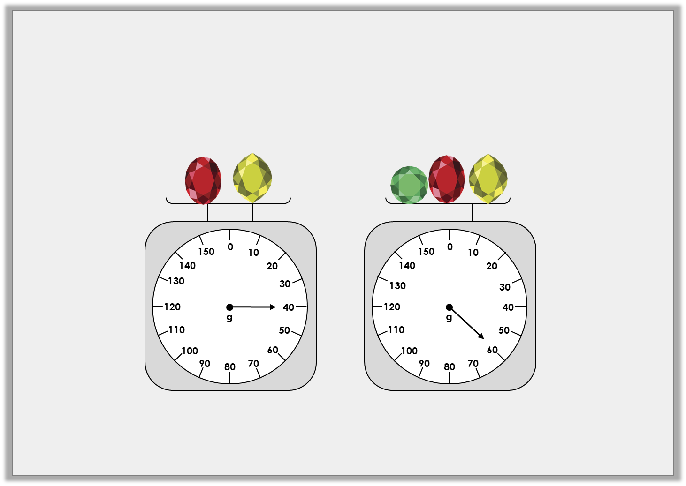
Introduction
One yellow jewel weighs 10g.
How much does each red and green jewel weigh?
How much would two of each jewel weigh in total?
© Classroom Secrets Limited 2018

Slide 5
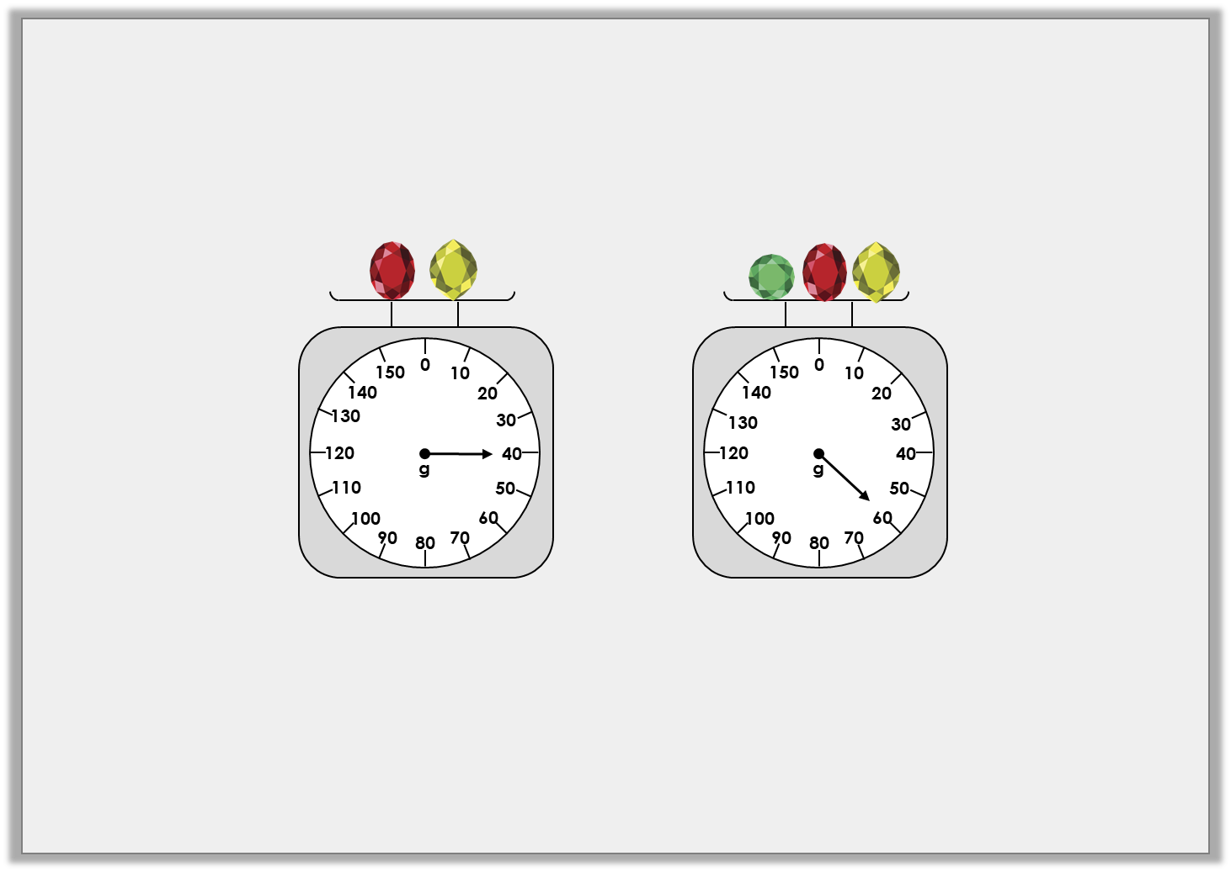
Introduction
One yellow jewel weighs 10g.
How much does each red and green jewel weigh?
40g – 10g = 30g. The red jewel weighs 30g.
60g – 30g – 10g = 20g. The green jewel weighs 20g.
How much would two of each jewel weigh in total?
10g + 10g + 20g + 20g + 30g + 30g = 120g
© Classroom Secrets Limited 2018

Slide 6
Varied Fluency 1
Complete the part-whole model.
2kg and 450g
1kg and 285g
kg
1
2
© Classroom Secrets Limited 2018

Slide 7
Varied Fluency 1
Complete the part-whole model.
2kg and 450g
1kg and 285g
kg
1
2
665g
© Classroom Secrets Limited 2018

Slide 8
Varied Fluency 2
Complete the bar model.
3kg and 100g | 450g
4kg and 650g
© Classroom Secrets Limited 2018

Slide 9
Varied Fluency 2
Complete the bar model.
3kg and 100g | 450g | 1kg and 100g
4kg and 650g
© Classroom Secrets Limited 2018

Slide 10
Varied Fluency 3
Use place value counters to find the difference between 4kg and 750g and 2 kg.
1
2
Thousands | Hundreds | Tens
1000
1000
100
100
10
10
1000
1000
100
100
10
10
100
100
10
100
© Classroom Secrets Limited 2018

Slide 11
Varied Fluency 3
Use place value counters to find the difference between 4kg and 750g and 2 kg.
2,250g or 2kg and 250g
1
2
Thousands | Hundreds | Tens
1000
1000
100
100
10
10
1000
1000
100
100
10
10
100
100
10
100
© Classroom Secrets Limited 2018

Slide 12
Varied Fluency 4
Find the total mass of these items.
A
C
0
50
1500
0
100
1
2
kg
1400
200
100
B
1300
300
450
150
1200
g
400
400
kg/g
1100
500
350
200
0
1000
600
250
750
50
900
800
700
300
700
100
650
150
600
g
200
550
250
500
300
450
400
350
© Classroom Secrets Limited 2018

Slide 13
Varied Fluency 4
Find the total mass of these items.
450g + 600g + 1kg and 400g = 2kg and 450g
A
C
0
50
1500
0
100
1
2
kg
1400
200
100
B
1300
300
450
150
1200
g
400
400
kg/g
1100
500
350
200
0
1000
600
250
750
50
900
800
700
300
700
100
650
150
600
g
200
550
250
500
300
450
400
350
© Classroom Secrets Limited 2018

Slide 14
Problem Solving 1
Yusuf is packing for his holiday. The maximum weight of his suitcase is 10kg. Find all of the possible combinations of three items he could put in his case. You must include the weight of the case.
Case – 4kg and 700g
Toiletry bag – 650g
Shoes – 1400g
Clothes – 2kg and 100g
Swimwear – 850g
Inflatable toy and pump – 2kg and 400g
© Classroom Secrets Limited 2018

Slide 15
Problem Solving 1
Yusuf is packing for his holiday. The maximum weight of his suitcase is 10kg. Find all of the possible combinations of three items he could put in his case. You must include the weight of the case.
Case – 4kg and 700g
Toiletry bag – 650g
Shoes – 1400g
Clothes – 2kg and 100g
Swimwear – 850g
Inflatable toy and pump – 2kg and 400g
Various answers, for example:
Inflatable toy and pump, shoes and swimwear (9kg and 350g)
Inflatable toy and pump, shoes and toiletry bag (9kg and150g)
Clothes, shoes and toiletry bag (8kg and 850g)
© Classroom Secrets Limited 2018

Slide 16
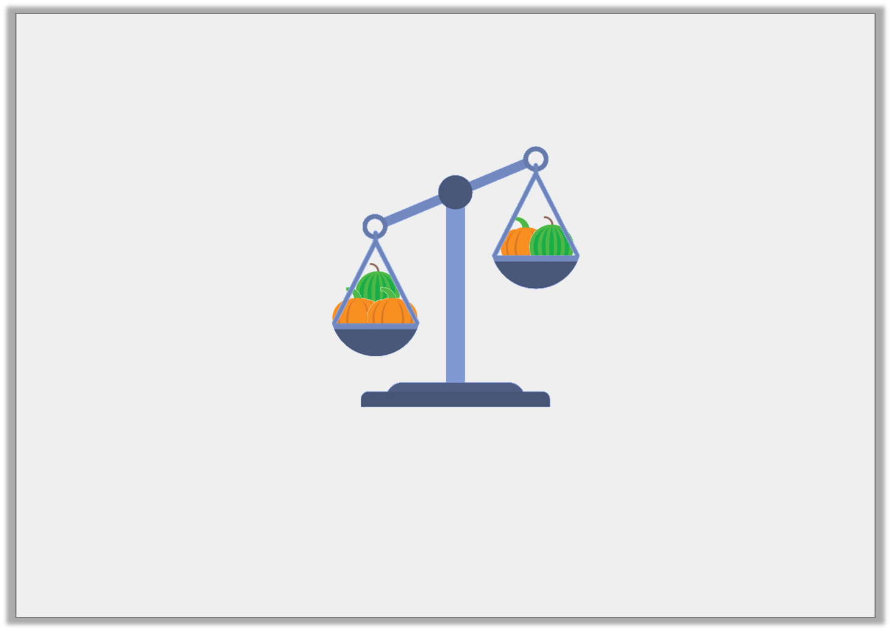
Reasoning 1
Liam adds another pumpkin to the right side of the scale. What will happen to the scale?
1kg and 400g
2kg and 150g
© Classroom Secrets Limited 2018

Slide 17
Reasoning 1
Liam adds another pumpkin to the right side of the scale. What will happen to the scale?
A pumpkin must weigh 750g because…
A watermelon must weigh 650g because…
The scale will balance because…
1kg and 400g
2kg and 150g
© Classroom Secrets Limited 2018

Slide 18
Reasoning 1
Liam adds another pumpkin to the right side of the scale. What will happen to the scale?
A pumpkin must weigh 750g because 2kg and 150g – 1kg and 400g = 750g.
A watermelon must weigh 650g because 1kg and 400g – 750g = 650g.
The scale will balance because 1kg and 400g + 750g = 2kg and 150g.
1kg and 400g
2kg and 150g
© Classroom Secrets Limited 2018

Slide 19
Problem Solving 1
Which missing weight is the odd one out – A, B or C? Convince me.
1kg and 305g | 450g | A
4,200g
620g | 300g | 1kg and 645g
B
535g
1kg and 700g
330g
C
© Classroom Secrets Limited 2018

Slide 20
Problem Solving 1
Which missing weight is the odd one out – A, B or C? Convince me.
A is the odd one out because 4k 200g – 1kg 775g = 2kg 445g whereas both B and C equal 2kg 565g or 2,565g.
1kg and 305g | 450g | A
4,200g
620g | 300g | 1kg and 645g
B
535g
1kg and 700g
330g
C
© Classroom Secrets Limited 2018

