Slide 1



LIFE/work balance
We have started a #LIFEworkbalance campaign and we need your help to complete our LIFE/work balance survey.
We hope to publish the results soon, so please give 15 minutes of your time to help us get a true picture of school life.
Want to be a part of this campaign? Take the survey on our website and share it with your colleagues!
© Classroom Secrets Limited 2018

Slide 2
Year 4 – Summer Block 1 – Properties of Shape – Triangles
About This Resource:
This PowerPoint has been designed to support your teaching of this small step. It includes a starter activity and an example of each question from the Varied Fluency and Reasoning and Problem Solving resources also provided in this pack. You can choose to work through all examples provided or a selection of them depending on the needs of your class.
National Curriculum Objectives:
Mathematics Year 4: (4G2a) Compare and classify geometric shapes, including quadrilaterals and triangles, based on their properties and sizes
More Year 4 Properties of Shape resources.
Did you like this resource? Don’t forget to review it on our website.
© Classroom Secrets Limited 2018

Slide 3
Year 4 – Summer Block 1 – Properties of Shape
Step 3: Triangles
© Classroom Secrets Limited 2018

Slide 4
Introduction
What is the same and what is different about these triangles?
What is the name of each triangle?
What do you know about it?
© Classroom Secrets Limited 2018

Slide 5
Introduction
What is the same and what is different about these triangles?
What is the name of each triangle?
What do you know about it?
Answers might include: different colours, different sizes, different shapes, all have 3 sides etc.
Isosceles
Has 2 sides of equal length.
Equilateral
Has 3 sides of equal length.
Scalene
Has 0 sides of equal length.
© Classroom Secrets Limited 2018

Slide 6
Varied Fluency 1
Tick the isosceles triangles.
B
C
A
D
© Classroom Secrets Limited 2018

Slide 7
Varied Fluency 1
Tick the isosceles triangles.
B
C
A
✓
✓
D
© Classroom Secrets Limited 2018

Slide 8
Varied Fluency 2
True or false? Connecting these dots will create a right angled triangle.
B
A
C
© Classroom Secrets Limited 2018

Slide 9
Varied Fluency 2
True or false? Connecting these dots will create a right angled triangle.
True
B
A
C
© Classroom Secrets Limited 2018

Slide 10
Varied Fluency 3
Sort the triangles into the table.
Scalene | Isosceles | Equilateral
C
A
D
B
© Classroom Secrets Limited 2018

Slide 11
Varied Fluency 3
Sort the triangles into the table.
Scalene | Isosceles | Equilateral
B
D
A
C
© Classroom Secrets Limited 2018

Slide 12
Varied Fluency 4
Use a ruler to draw a scalene triangle with the shortest
side measuring 5 cm.
© Classroom Secrets Limited 2018

Slide 13
Varied Fluency 4
Use a ruler to draw a scalene triangle with the shortest
side measuring 5 cm.
Check your partner’s triangle. It MUST be a scalene triangle and have one side that measures 5cm.
This triangle has a base that measures 5cm (but it may appear bigger on the whiteboard).
© Classroom Secrets Limited 2018

Slide 14
Problem Solving 1
Colour the triangles in this image which are scalene. Use a ruler to help.
© Classroom Secrets Limited 2018

Slide 15
Problem Solving 1
Colour the triangles in this image which are scalene. Use a ruler to help.
© Classroom Secrets Limited 2018

Slide 16
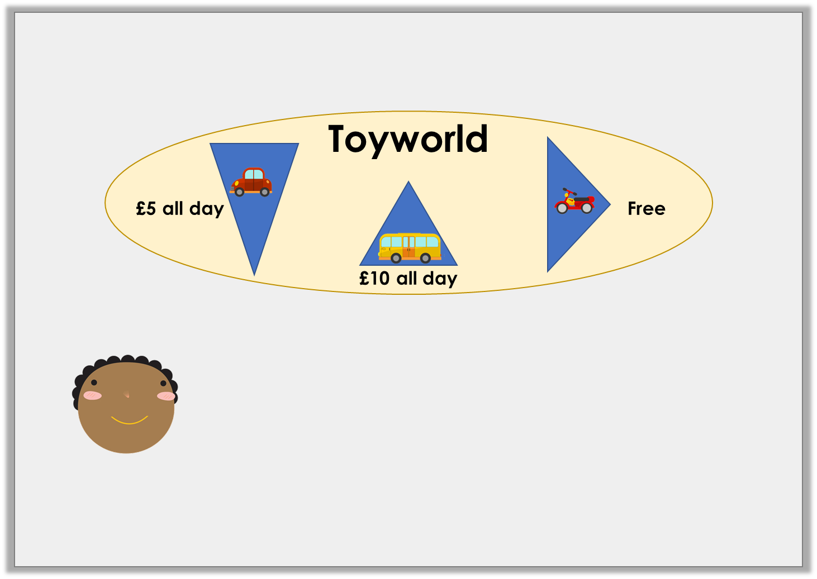
Reasoning 1
Holly is designing a logo for a car park.
She says,
Is she correct? Explain your answer.
The logo includes no scalene triangles.
© Classroom Secrets Limited 2018

Slide 17
Reasoning 1
Holly is designing a logo for a car park.
She says,
Is she correct? Explain your answer.
Yes because…
The logo includes no scalene triangles.
© Classroom Secrets Limited 2018

Slide 18
Reasoning 1
Holly is designing a logo for a car park.
She says,
Is she correct? Explain your answer.
Yes because the left and right triangles are isosceles because they have 2 equal sides and the middle triangle is equilateral because it has 3 equal sides.
The logo includes no scalene triangles.
© Classroom Secrets Limited 2018

Slide 19
Reasoning 2
Which triangle is the odd one out?
Why?
B
A
D
C
© Classroom Secrets Limited 2018

Slide 20
Reasoning 2
Which triangle is the odd one out?
Why?
C because…
B
A
D
C
© Classroom Secrets Limited 2018

Slide 21
Reasoning 2
Which triangle is the odd one out?
Why?
C because it is the only isosceles triangle.
The rest are equilateral.
B
A
D
C
© Classroom Secrets Limited 2018

