Slide 1



LIFE/work balance
We have started a #LIFEworkbalance campaign and we need your help to complete our LIFE/work balance survey.
We hope to publish the results soon, so please give 15 minutes of your time to help us get a true picture of school life.
Want to be a part of this campaign? Take the survey on our website and share it with your colleagues!
© Classroom Secrets Limited 2019

Slide 2
Year 3 – Summer Block 4 – Mass and Capacity – Compare Capacities
About This Resource:
This PowerPoint has been designed to support your teaching of this small step. It includes a starter activity and an example of each question from the Varied Fluency and Reasoning and Problem Solving resources also provided in this pack. You can choose to work through all examples provided or a selection of them depending on the needs of your class.
National Curriculum Objectives:
Mathematics Year 3: (3M9d) Measure, compare, add and subtract: lengths (m/cm/mm); mass (kg/g); volume/capacity (l/ml)
More Year 3 Mass and Capacity resources.
Did you like this resource? Don’t forget to review it on our website.
© Classroom Secrets Limited 2018

Slide 3
Year 3 – Summer Block 4 – Mass and Capacity
Step 7: Compare Capacities
© Classroom Secrets Limited 2018

Slide 4
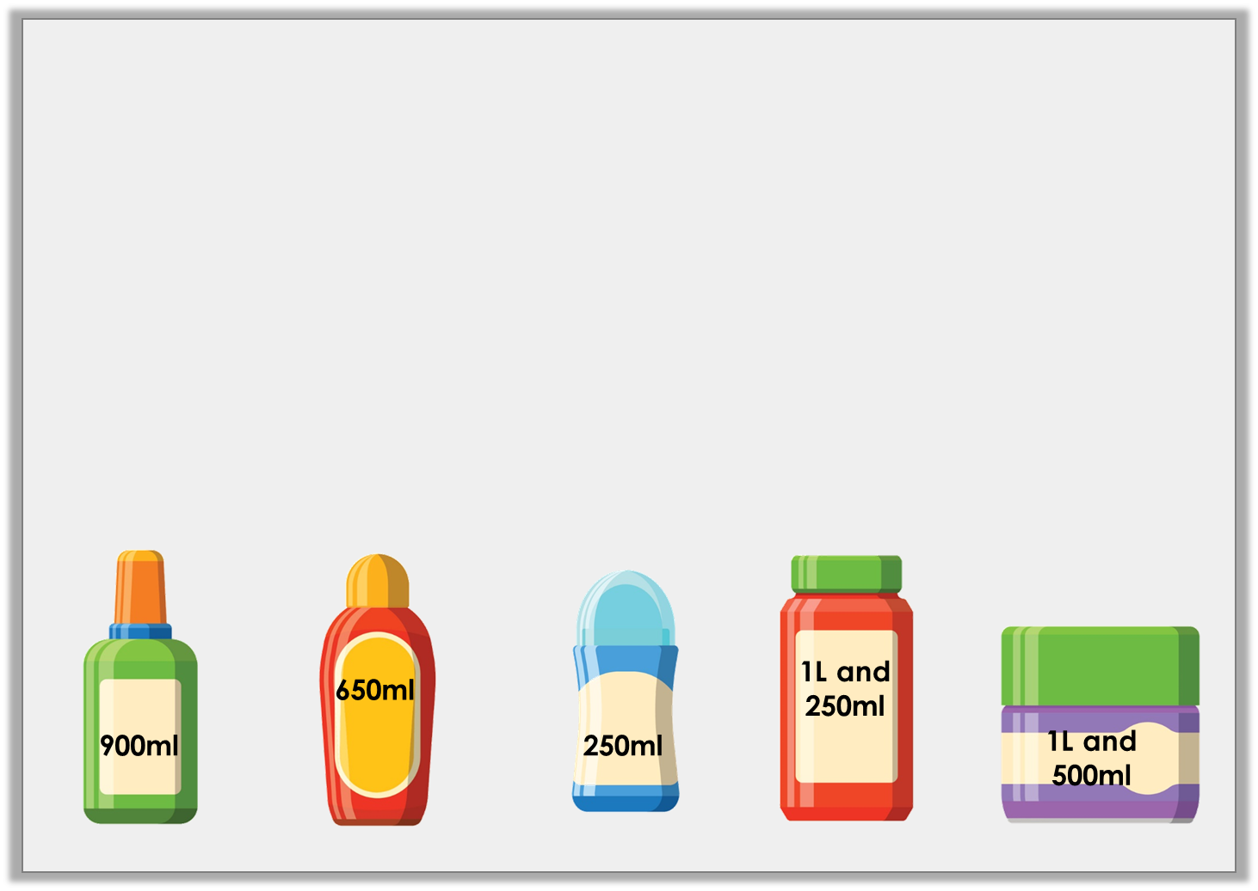
Introduction
Put the bottles on the number line.
0ml
500ml
1L
1L and 500ml
© Classroom Secrets Limited 2018

Slide 5
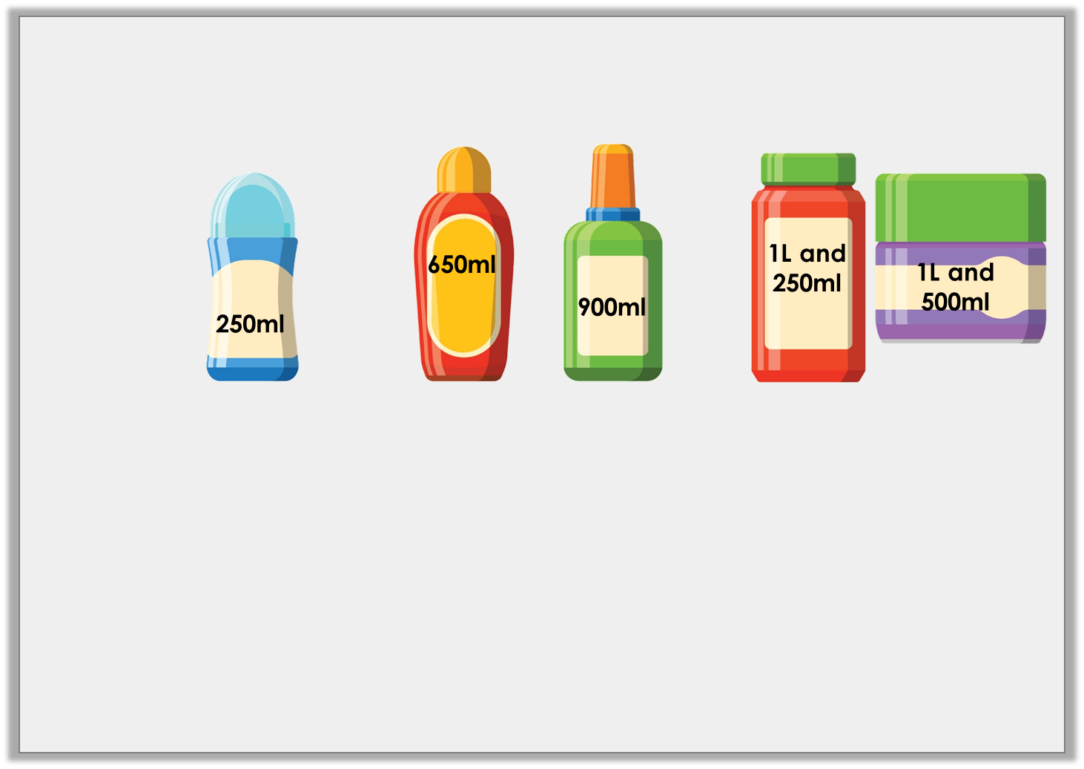
Introduction
Put the bottles on the number line.
0ml
500ml
1L
1L and 500ml
© Classroom Secrets Limited 2018

Slide 6
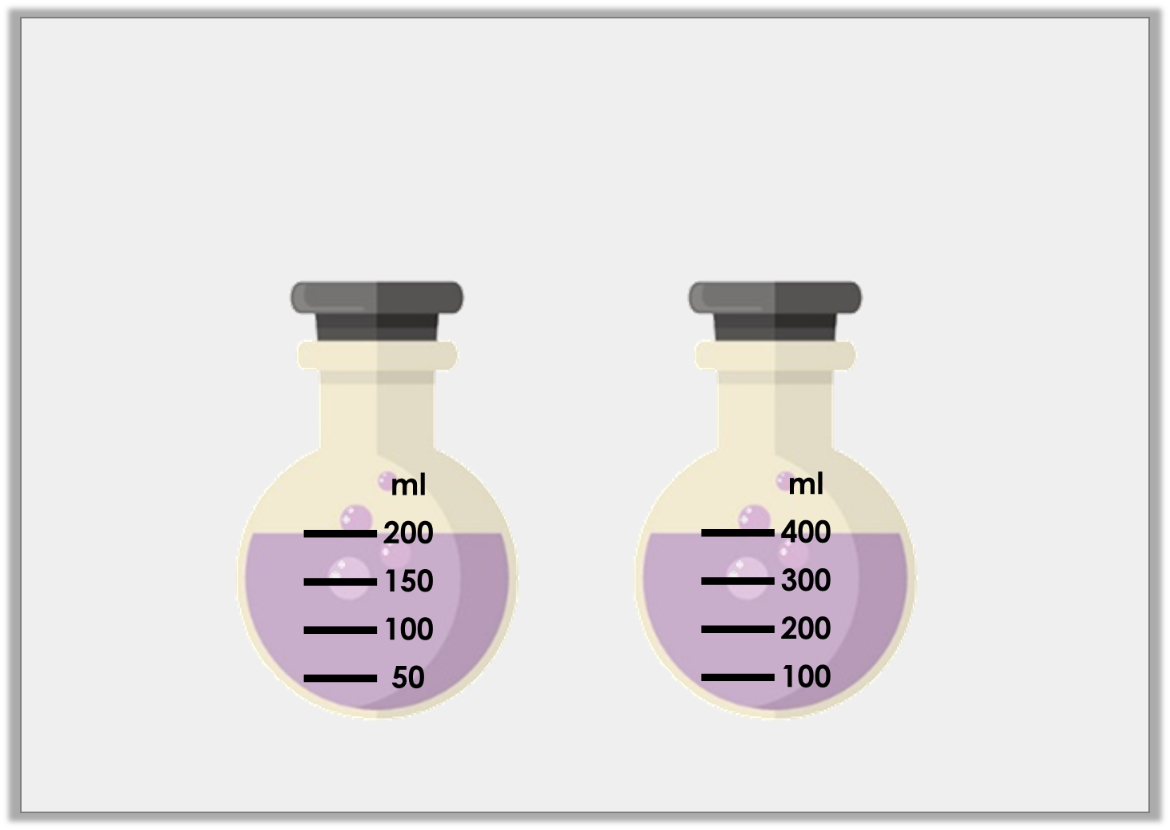
Varied Fluency 1
Which container holds the least amount of liquid?
A | B
© Classroom Secrets Limited 2018

Slide 7
Varied Fluency 1
Which container holds the least amount of liquid?
A | B
© Classroom Secrets Limited 2018

Slide 8
Varied Fluency 2
Use < or > to complete the sentences.
1L |  | 10ml
750ml |  | 2L
© Classroom Secrets Limited 2018

Slide 9
Varied Fluency 2
Use < or > to complete the sentences.
1L | > | 10ml
750ml | < | 2L
© Classroom Secrets Limited 2018

Slide 10
Varied Fluency 3
Is the statement true or false?
Beaker B contains the most liquid.
A
B
L
10
8
6
4
2
ml
400
300
200
100
© Classroom Secrets Limited 2018

Slide 11
Varied Fluency 3
Is the statement true or false?
False – Beaker B is holding 200ml but beaker A is holding 6L.
Beaker B contains the most liquid.
A
B
L
10
8
6
4
2
ml
400
300
200
100
© Classroom Secrets Limited 2018

Slide 12
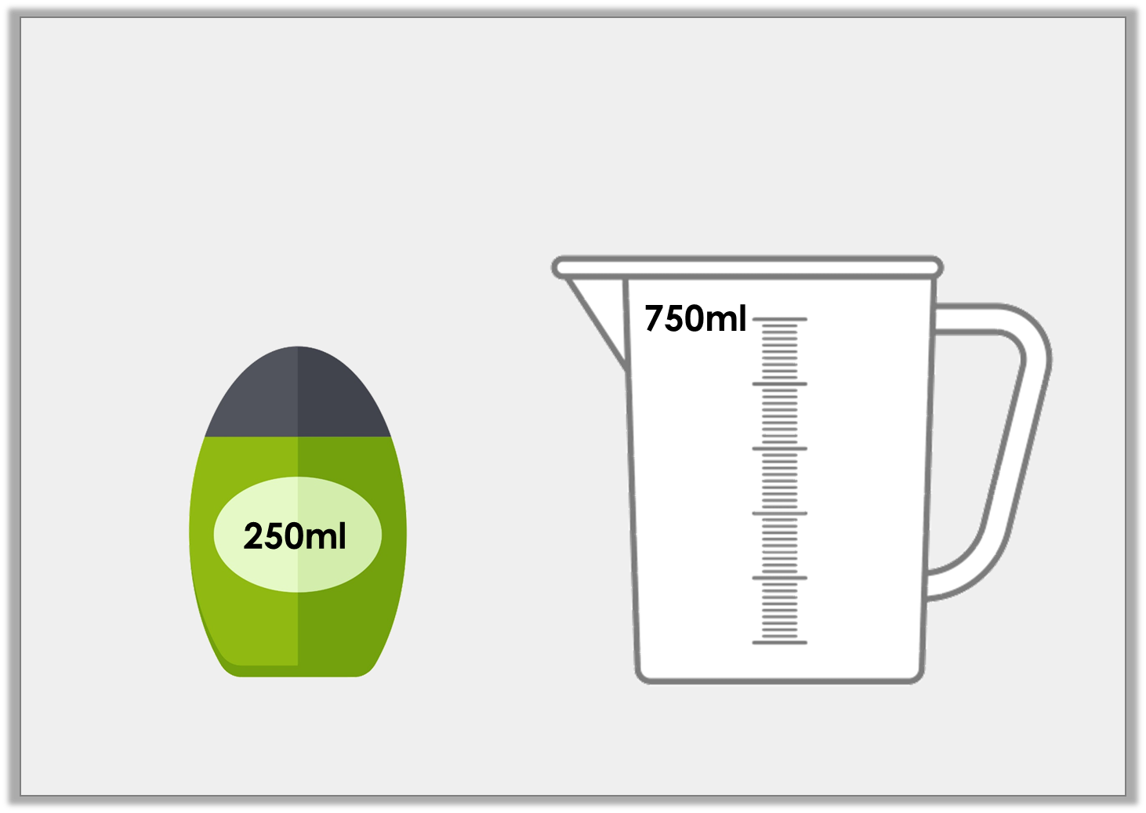
Varied Fluency 4
One bottle has a capacity of 250ml. How many bottles equal the capacity of the jug?
© Classroom Secrets Limited 2018

Slide 13
Varied Fluency 4
One bottle has a capacity of 250ml. How many bottles equal the capacity of the jug?
3 bottles
© Classroom Secrets Limited 2018

Slide 14
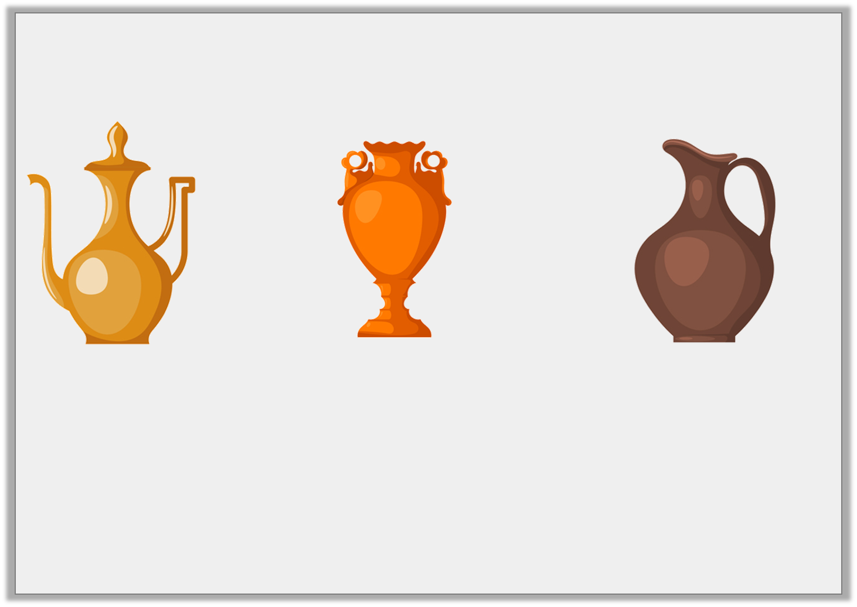
Problem Solving 1
You have 65L of water to share between the containers below.
All containers hold multiples of 5L. Pot A can only hold 5L and Pot B has a maximum capacity of 15L.
What volume of water could you pour in each?
<
<
A
B
C
© Classroom Secrets Limited 2018

Slide 15
Problem Solving 1
You have 65L of water to share between the containers below.
All containers hold multiples of 5L. Pot A can only hold 5L and Pot B has a maximum capacity of 15L.
What volume of water could you pour in each?
Various answers, for example:
A = 5L; B = 10L; C = 50L
<
<
A
B
C
© Classroom Secrets Limited 2018

Slide 16
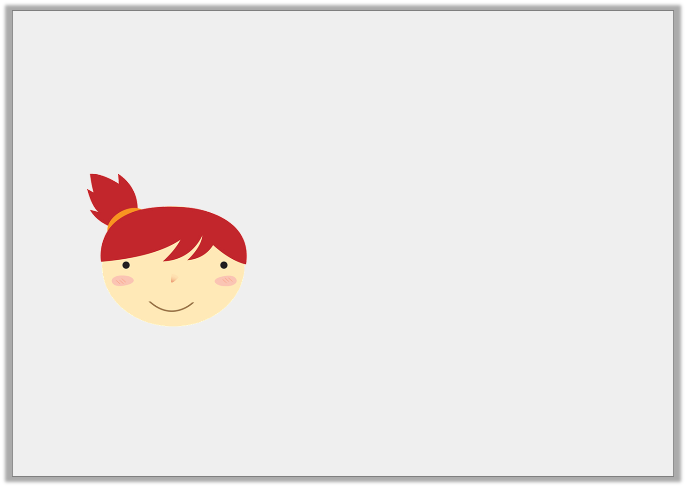
Reasoning 1
A 1L bucket holds ten times the amount of water held by a jar. Emma says:
Is Emma correct? Explain your answer.
A jar holds 200ml of water.
© Classroom Secrets Limited 2018

Slide 17
Reasoning 1
A 1L bucket holds ten times the amount of water held by a jar. Emma says:
Is Emma correct? Explain your answer.
Emma is incorrect because…
A jar holds 200ml of water.
© Classroom Secrets Limited 2018

Slide 18
Reasoning 1
A 1L bucket holds ten times the amount of water held by a jar. Emma says:
Is Emma correct? Explain your answer.
Emma is incorrect because 10 times less than 1L is 100ml.
A jar holds 200ml of water.
© Classroom Secrets Limited 2018

Slide 19
Reasoning 2
Sandi thinks that container A has a larger capacity than container B because 750 has a bigger value than 50.
Is she correct? Explain why.
ml
750
600
450
300
150
L
50
40
30
20
10
© Classroom Secrets Limited 2018

Slide 20
Reasoning 2
Sandi thinks that container A has a larger capacity than container B because 750 has a bigger value than 50.
Is she correct? Explain why.
Sandi is incorrect because…
ml
750
600
450
300
150
L
50
40
30
20
10
© Classroom Secrets Limited 2018

Slide 21
Reasoning 2
Sandi thinks that container A has a larger capacity than container B because 750 has a bigger value than 50.
Is she correct? Explain why.
Sandi is incorrect because container A is measured in ml and container B is measured in L.
ml
750
600
450
300
150
L
50
40
30
20
10
© Classroom Secrets Limited 2018

