Slide 1



LIFE/work balance
We have started a #LIFEworkbalance campaign and we need your help to complete our LIFE/work balance survey.
We hope to publish the results soon, so please give 15 minutes of your time to help us get a true picture of school life.
Want to be a part of this campaign? Take the survey on our website and share it with your colleagues!
© Classroom Secrets Limited 2019

Slide 2
Year 3 – Summer Block 4 – Mass and Capacity – Add and Subtract Capacities
About This Resource:
This PowerPoint has been designed to support your teaching of this small step. It includes a starter activity and an example of each question from the Varied Fluency and Reasoning and Problem Solving resources also provided in this pack. You can choose to work through all examples provided or a selection of them depending on the needs of your class.
National Curriculum Objectives:
Mathematics Year 3: (3M9d) Add and subtract volume/ capacity (l/ ml)
More Year 3 Mass and Capacity resources.
Did you like this resource? Don’t forget to review it on our website.
© Classroom Secrets Limited 2018

Slide 3
Year 3 – Summer Block 4 – Mass and Capacity
Step 8: Add and Subtract Capacities
© Classroom Secrets Limited 2018

Slide 4
Introduction
Match pairs of measurements to make 1L.
750ml
650ml
400ml
150ml
450ml
900ml
350ml
550ml
850ml
250ml
100ml
600ml
© Classroom Secrets Limited 2018

Slide 5
Introduction
Match pairs of measurements to make 1L.
750ml
650ml
400ml
150ml
450ml
900ml
350ml
550ml
850ml
250ml
100ml
600ml
© Classroom Secrets Limited 2018

Slide 6
Varied Fluency 1
Draw lines between the boxes to make these calculations correct.
Start |  | + or – |  | Equals
2L and 300ml |  | – 2L and 250ml |  | 1L and 500ml
3L and 750ml |  | +1L and 500ml |  | 3L and 500ml
1L and 750ml |  | +1L and 750ml |  | 3L and 800ml
© Classroom Secrets Limited 2018

Slide 7
Varied Fluency 1
Draw lines between the boxes to make these calculations correct.
Start |  | + or – |  | Equals
2L and 300ml |  | – 2L and 250ml |  | 1L and 500ml
3L and 750ml |  | +1L and 500ml |  | 3L and 500ml
1L and 750ml |  | +1L and 750ml |  | 3L and 800ml
© Classroom Secrets Limited 2018

Slide 8
Varied Fluency 2
Complete the part whole models.
2L and 200ml
5L and 600ml
4L and 500ml
9L and 100ml
© Classroom Secrets Limited 2018

Slide 9
Varied Fluency 2
Complete the part whole models.
10L and 100ml
6L and 900ml
2L and 200ml
5L and 600ml
4L and 500ml
9L and 100ml
© Classroom Secrets Limited 2018

Slide 10
Varied Fluency 3
Find the difference between the containers:
Container | Capacity
A | 3L and 400ml
B | 5L and 650ml
C | 1L and 750ml
A and C
B and C
© Classroom Secrets Limited 2018

Slide 11
Varied Fluency 3
Find the difference between the containers:
A and C = 3L and 400ml – 1L and 750ml = 1L and 650ml
B and C = 5L and 650ml – 1L and 750ml = 3L and 900ml
Container | Capacity
A | 3L and 400ml
B | 5L and 650ml
C | 1L and 750ml
A and C
B and C
© Classroom Secrets Limited 2018

Slide 12
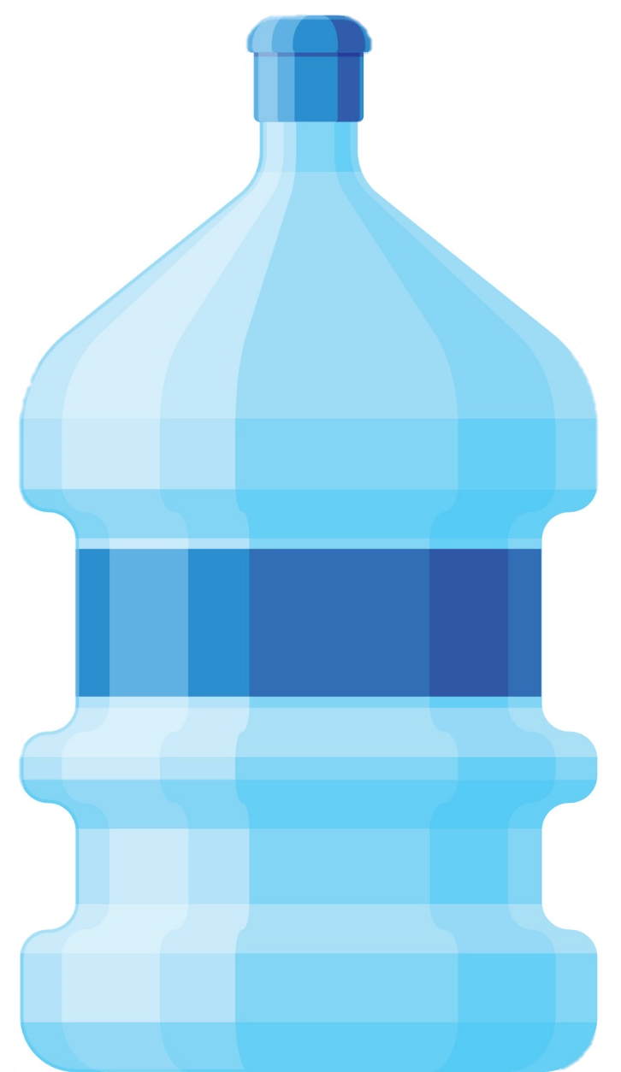
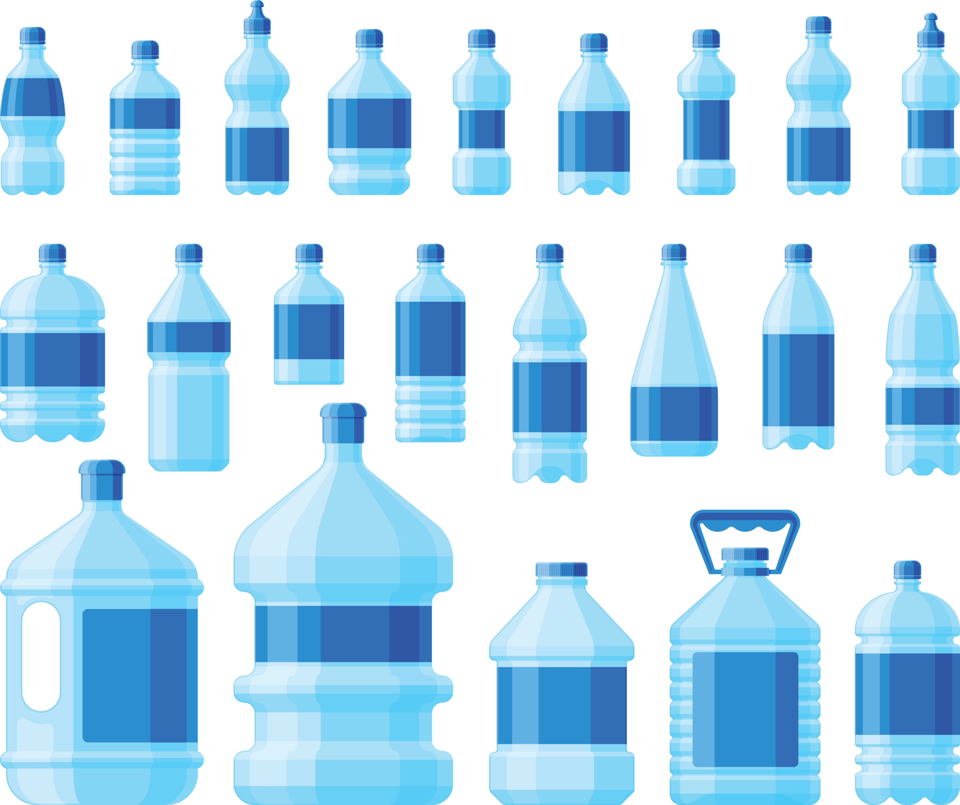
Varied Fluency 4
Which three of these containers would you need to have
a total of 6 L?
1
4
D
B
C
A
C
1 L | 4 L | L | 5 L
1
2
1
2
1
4
1
2
© Classroom Secrets Limited 2018

Slide 13
Varied Fluency 4
Which three of these containers would you need to have
a total of 6 L?
A, B and C
1
4
D
B
C
A
C
1 L | 4 L | L | 5 L
1
2
1
2
1
4
1
2
© Classroom Secrets Limited 2018

Slide 14
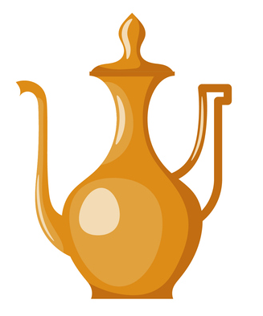
Problem Solving 1
Andy the alchemist is sorting through his oil lamps.
Oil lamp A holds 1L and 350ml more than oil lamp C. Oil lamp C’s capacity is double Oil lamp B’s capacity.
What are the capacities of
Oil lamp A and C?
Oil lamp B’s capacity = 300ml
© Classroom Secrets Limited 2018

Slide 15
Problem Solving 1
Andy the alchemist is sorting through his oil lamps.
Oil lamp A holds 1L and 350ml more than oil lamp C. Oil lamp C’s capacity is double Oil lamp B’s capacity.
A = 1L and 350ml + 600ml = 1L and 950ml
C = 300ml x 2 = 600ml
What are the capacities of
Oil lamp A and C?
Oil lamp B’s capacity = 300ml
© Classroom Secrets Limited 2018

Slide 16

Problem Solving 2
Find a way through the maze.
0
600ml | 2 L | 1L and 400ml
900ml | 2L and 300ml | 1L and 200ml
L | 2 L | 1L and 100ml
1
2
START
1
4
1
4
She drinks 4L and 400ml in total.
© Classroom Secrets Limited 2018

Slide 17
Problem Solving 2
Find a way through the maze.
0
600ml | 2 L | 1L and 400ml
900ml | 2L and 300ml | 1L and 200ml
L | 2 L | 1L and 100ml
1
2
START
1
4
1
4
She drinks 4L and 400ml in total.
© Classroom Secrets Limited 2018

Slide 18

Reasoning 1
Ben says, ‘The jug has a capacity large enough to make 2 lots of fruit punch.’
Is he correct? Prove it.
What is the difference between the capacity of the jug and the volume of the liquid?
Fruit Punch Recipe
2L and 500ml orange juice
1L and 100ml pineapple juice
6L and 500ml
© Classroom Secrets Limited 2018

Slide 19
Reasoning 1
Ben says, ‘The jug has a capacity large enough to make 2 lots of fruit punch.’
Is he correct? Prove it.
Ben is not correct because…
What is the difference between the capacity of the jug and the volume of the liquid?
Fruit Punch Recipe
2L and 500ml orange juice
1L and 100ml pineapple juice
6L and 500ml
© Classroom Secrets Limited 2018

Slide 20
Reasoning 1
Ben says, ‘The jug has a capacity large enough to make 2 lots of fruit punch.’
Is he correct? Prove it.
Ben is not correct because the total volume of the punch is 7L and 200ml (2L and 500ml + 1L and 100ml = 3L and 600ml + 3L and 600ml = 7L and 200ml).
What is the difference between the capacity of the jug and the volume of the liquid? 700ml.
Fruit Punch Recipe
2L and 500ml orange juice
1L and 100ml pineapple juice
6L and 500ml
© Classroom Secrets Limited 2018

