Slide 1



LIFE/work balance
We have started a #LIFEworkbalance campaign and we need your help to complete our LIFE/work balance survey.
We hope to publish the results soon, so please give 15 minutes of your time to help us get a true picture of school life.
Want to be a part of this campaign? Take the survey on our website and share it with your colleagues!
© Classroom Secrets Limited 2019

Slide 2
Year 3 – Spring Block 3 – Statistics – Bar Charts
About This Resource:
This PowerPoint has been designed to support your teaching of this small step. It includes a starter activity and an example of each question from the Varied Fluency and Reasoning and Problem Solving resources also provided in this pack. You can choose to work through all examples provided or a selection of them depending on the needs of your class.
National Curriculum Objectives:
Mathematics Year 3: (3S1) Interpret and present data using bar charts, pictograms and tables
Mathematics Year 3: (3S2) Solve one-step and two-step questions [for example, ‘How many more?’ and ‘How many fewer?’] using information presented in scaled bar charts and pictograms and tables
More Year 3 Statistics resources.
Did you like this resource? Don’t forget to review it on our website.
© Classroom Secrets Limited 2019

Slide 3
Year 3 – Spring Block 3 – Statistics
Step 2: Bar Charts
© Classroom Secrets Limited 2019

Slide 4
Introduction
Choose which bar chart uses the most appropriate scale?
Explain why.
12
11
10
9
8
7
6
5
4
3
2
1
0
24
22
20
18
16
14
12
10
8
6
4
2
0
A. | B.
 |  | Red |  | Blue |  | Green |  | Yellow
 |  | Red |  | Blue |  | Green |  | Yellow
© Classroom Secrets Limited 2019

Slide 5
Introduction
Choose which bar chart uses the most appropriate scale?
Explain why.
Various answers, for example: A uses a scale of 1 which uses the space in the bar chart better.
12
11
10
9
8
7
6
5
4
3
2
1
0
24
22
20
18
16
14
12
10
8
6
4
2
0
A. | B.
 |  | Red |  | Blue |  | Green |  | Yellow
 |  | Red |  | Blue |  | Green |  | Yellow
© Classroom Secrets Limited 2019

Slide 6
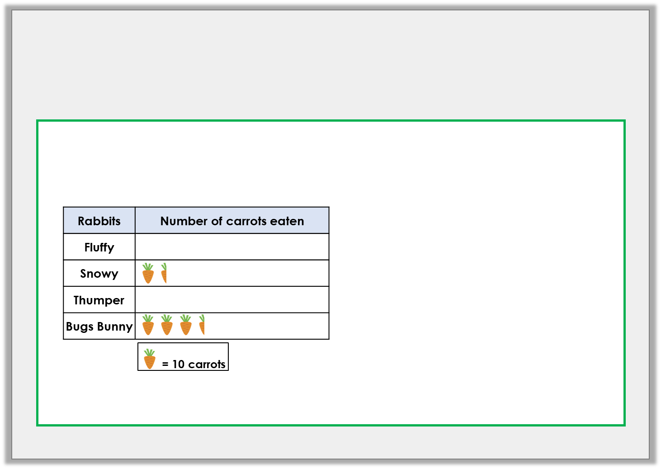
Varied Fluency 1
Use the information to complete the pictogram and the bar chart.
40
35
30
25
20
15
10
5
0
 |  | Fluffy |  | Snowy |  | Thumper |  | Bugs Bunny
© Classroom Secrets Limited 2019

Slide 7
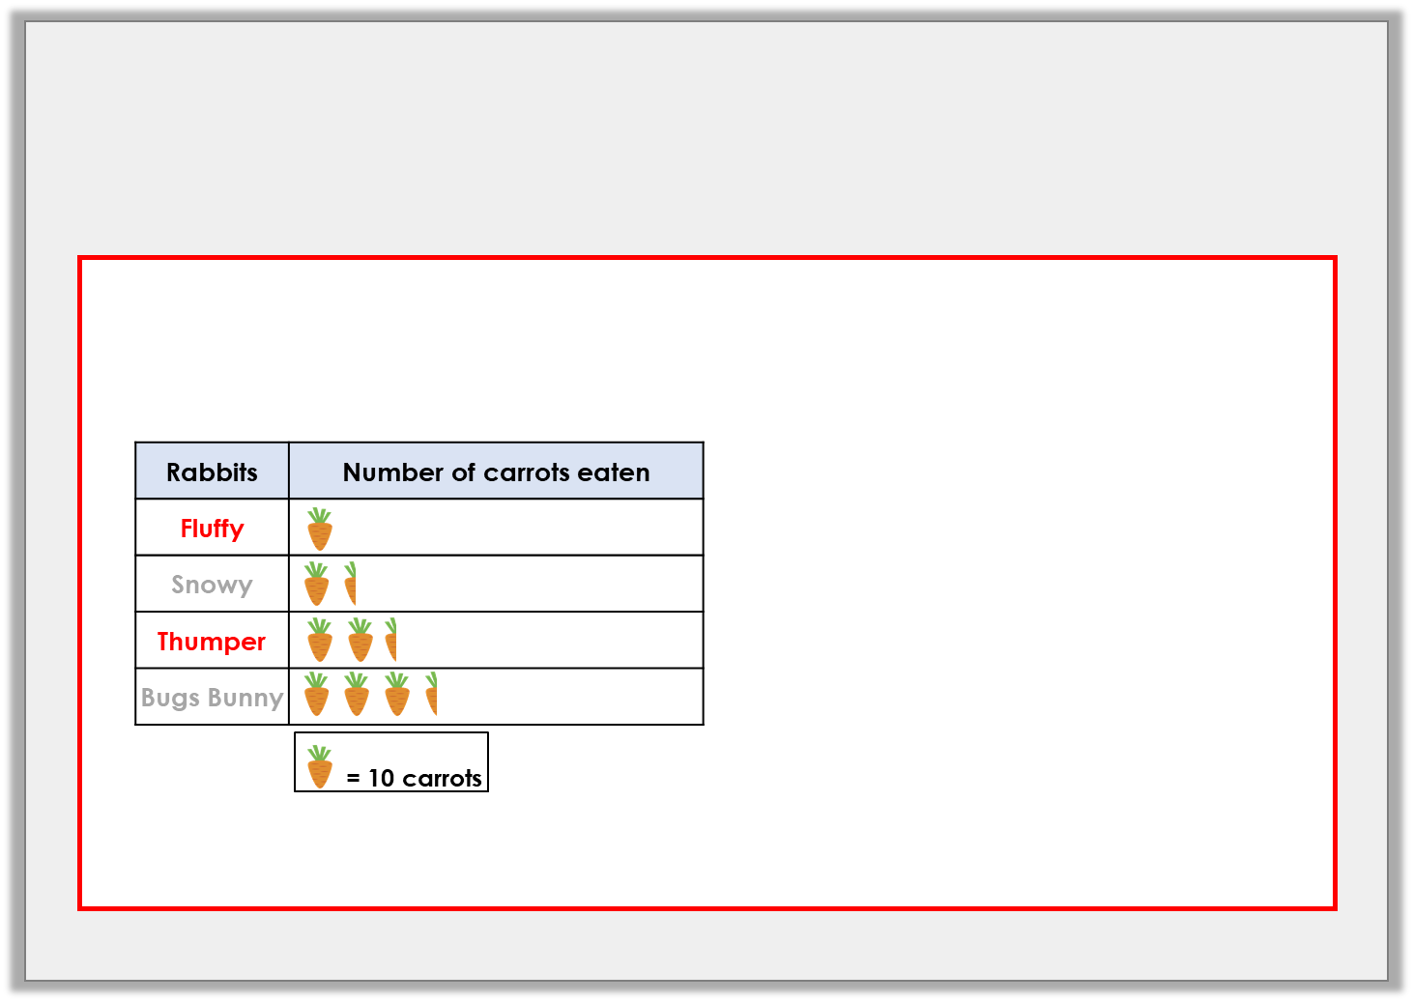
Varied Fluency 1
Use the information to complete the pictogram and the bar chart.
40
35
30
25
20
15
10
5
0
 |  | Fluffy |  | Snowy |  | Thumper |  | Bugs Bunny
© Classroom Secrets Limited 2019

Slide 8
Varied Fluency 2
Use this bar chart to answer the questions about
the number of goals scored in a tournament.
35
30
25
20
15
10
5
0
 |  | Team A |  | Team B |  | Team C |  | Team D |  | Team E
A. | Which team scored the most goals?
B. | How many more goals did Team A score than Team D?
C. | How many goals did Teams C and E score altogether?
D. | How many goals were scored in total?
© Classroom Secrets Limited 2019

Slide 9
Varied Fluency 2
Use this bar chart to answer the questions about
the number of goals scored in a tournament.
35
30
25
20
15
10
5
0
 |  | Team A |  | Team B |  | Team C |  | Team D |  | Team E
A. | Which team scored the most goals? Team E
B. | How many more goals did Team A score than Team D? 15
C. | How many goals did Teams C and E score altogether? 45
D. | How many goals were scored in total? 85
© Classroom Secrets Limited 2019

Slide 10
Varied Fluency 3
Create a bar chart using this tally chart.
Use a scale of 5 and add in the labels.
Favourite Dinosaur | Number of Children
T-Rex
Triceratops
Raptor
Diplodocus
© Classroom Secrets Limited 2019

Slide 11
Varied Fluency 3
Create a bar chart using this tally chart.
Use a scale of 5 and add in the labels.
35
30
25
20
15
10
5
0
 | T-Rex |  |  | Triceratops |  |  | Raptor |  |  | Diplodocus
Favourite Dinosaur | Number of Children
T-Rex
Triceratops
Raptor
Diplodocus
© Classroom Secrets Limited 2019

Slide 12
Problem Solving 1
The bar chart shows favourite drinks.
More children like juice than tea, but fewer like juice than milk. Complete the bar chart showing how many children could like tea and juice.
14
12
10
8
6
4
2
0
 |  | Milk |  | Water |  | Tea |  | Juice |  | Cola
© Classroom Secrets Limited 2019

Slide 13
Problem Solving 1
The bar chart shows favourite drinks.
More children like juice than tea, but fewer like juice than milk. Complete the bar chart showing how many children could like tea and juice.
Various answers, for example:
10 children like tea and 12 children like juice.
14
12
10
8
6
4
2
0
 |  | Milk |  | Water |  | Tea |  | Juice |  | Cola
© Classroom Secrets Limited 2019

Slide 14


Reasoning 1
Ben interprets the bar chart below about favourite types of P.E.
Is he correct? Explain your answer.
16
14
12
10
8
6
4
2
0
 |  | Gym |  | Dance |  | Games |  | Athletics
More children like athletics than games.
© Classroom Secrets Limited 2019

Slide 15
Reasoning 1
Ben interprets the bar chart below about favourite types of P.E.
Is he correct? Explain your answer.
Ben is not correct because…
16
14
12
10
8
6
4
2
0
 |  | Gym |  | Dance |  | Games |  | Athletics
More children like athletics than games.
© Classroom Secrets Limited 2019

Slide 16
Reasoning 1
Ben interprets the bar chart below about favourite types of P.E.
Is he correct? Explain your answer.
Ben is not correct because 4 children like athletics and 6 children like games.
16
14
12
10
8
6
4
2
0
 |  | Gym |  | Dance |  | Games |  | Athletics
More children like athletics than games.
© Classroom Secrets Limited 2019

Slide 17
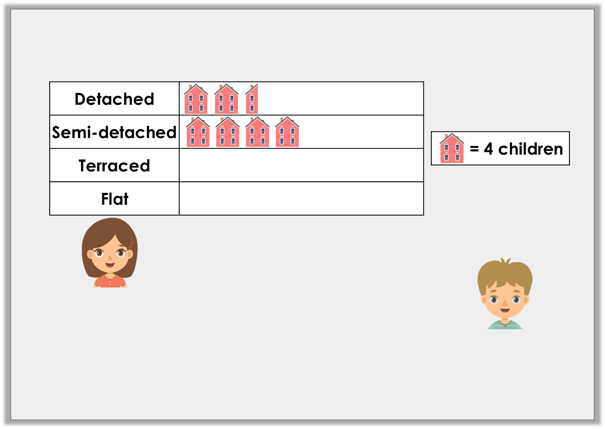
Problem Solving 2
A class collects data about houses.
Draw a bar chart to display this information.
Choose a suitable scale.
8 more children live in a flat than in a terraced house.
10 fewer children live in a terraced house than a semi.
© Classroom Secrets Limited 2019

Slide 18
Problem Solving 2
An example of the bar chart is shown below.
16
14
12
10
8
6
4
2
0
 |  | Detached | Semi-detached |  | Terraced |  |  | Flat
© Classroom Secrets Limited 2019

