Slide 2



Diving into Mastery Guidance for Educators
Each activity sheet is split into three sections, diving, deeper and deepest, which are represented by the following icons:
These carefully designed activities take your children through a learning journey, initially ensuring they are fluent with the key concept being taught; then applying this to a range of reasoning and problem-solving activities.
These sheets might not necessarily be used in a linear way. Some children might begin at the ‘Deeper’ section and in fact, others may ‘dive straight in’ to the ‘Deepest’ section if they have already mastered the skill and are applying this to show their depth of understanding.
Diving
Deeper
Deepest

Slide 3
National Curriculum Objective
Identify, describe and represent the position of a shape following a reflection or translation, using the appropriate language, and know that the shape has not changed.

Slide 4
Reflection with Coordinates
Diving
Jermaine wants to reflect the blue rectangle in the mirror line.
Draw the reflected shape.
The reflected shape is shown in green.
10
9
8
7
6
5
4
3
2
1
0
0
0
1
2
3
4
5
6
7
8
9
10

Slide 5

Reflection with Coordinates
Deeper
You could focus on one vertex at a time, counting the distance from the mirror line and repeating this distance across the mirror line, plotting the points as you go to show the reflected shape.
You could focus on one vertex at a time, counting the distance from the mirror line and repeating this distance across the mirror line, plotting the points as you go to show the reflected shape.
How could you reflect the shape if you didn’t have a mirror to hand?
Discuss with your Learning Partner.
10
9
8
7
6
5
4
3
2
1
0
0
0
1
2
3
4
5
6
7
8
9
10

Slide 6
Reflection with Coordinates
Deeper
When reflecting a shape in a horizontal mirror line that passes through the y-axis, the x coordinate is the same but the y coordinate changes.
Looking at a vertex of the original rectangle alongside the reflected vertex, what do you notice?
10
9
(3,9)
8
7
6
5
4
3
2
1
(3,1)
0
0
0
1
2
3
4
5
6
7
8
9
10

Slide 7

Reflection with Coordinates
Deepest
Shaun has reflected a square in the first quadrant.
Here is the reflected square.
The original coordinates of vertex A were (11,6).
How can you work out the coordinates of the original square? Discuss with your Learning Partner.
Has the square been reflected in a mirror line that passes through the x or y-axis? How do you know?
A
(4,6)
We know vertex A of the original square is (11,6) and the new position of A is (1,6). The difference between the x coordinates is 10. We can therefore deduce that the square is 5 squares from the mirror line.
We also know that the sides of the square are 3 squares in length. Vertex B was originally (14,6), C was (11,3) and
D was (14,3).
The mirror line passes through the x-axis. The original coordinate of A are (11,6) and A is now at (1,6). The x coordinate has changed and the y coordinate is identical. This shows that the mirror line is vertical and passes through the x-axis.
(1,3)
D

Slide 8
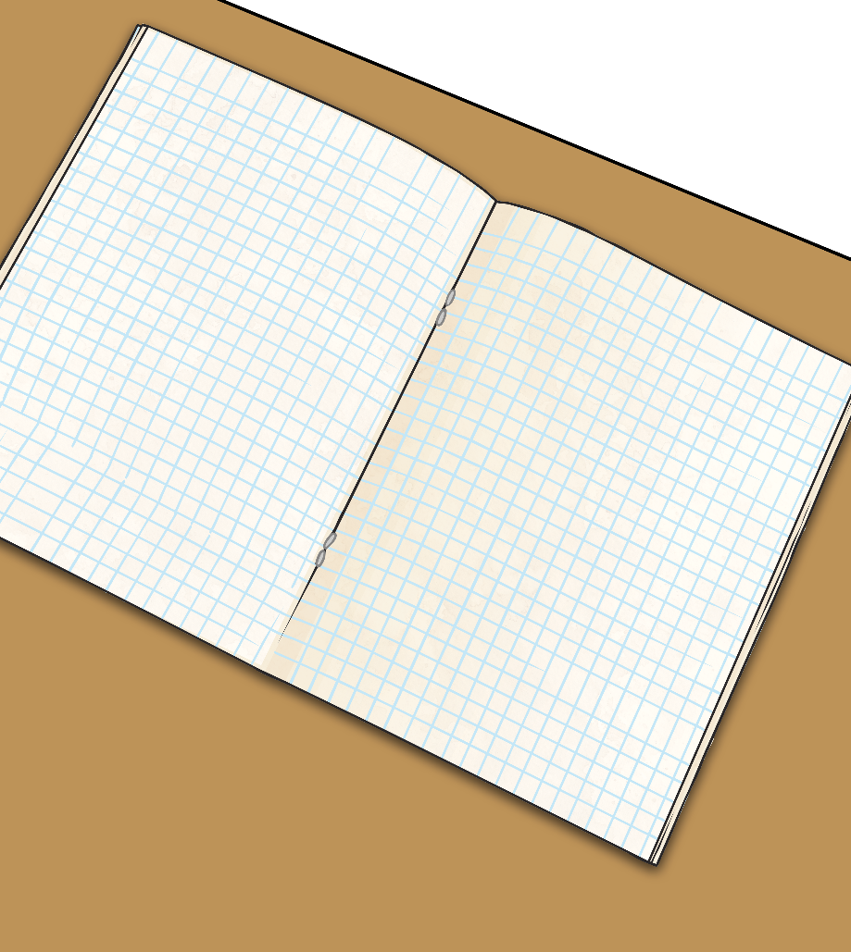
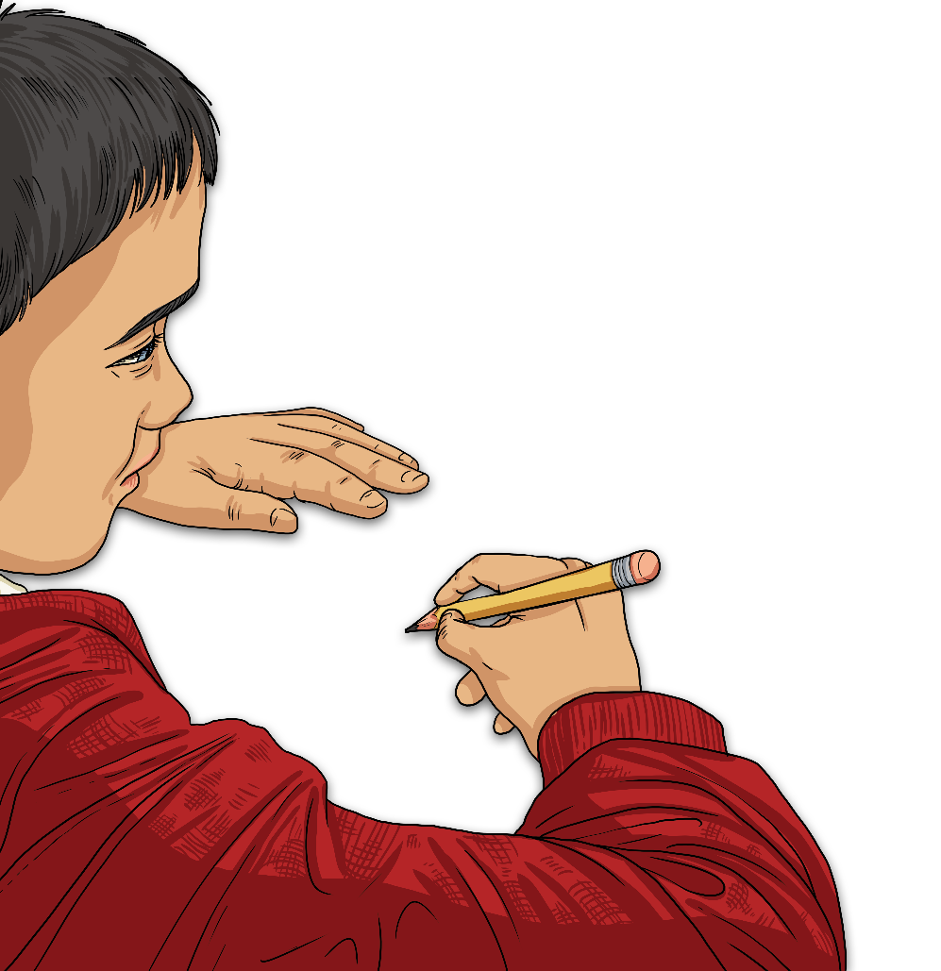
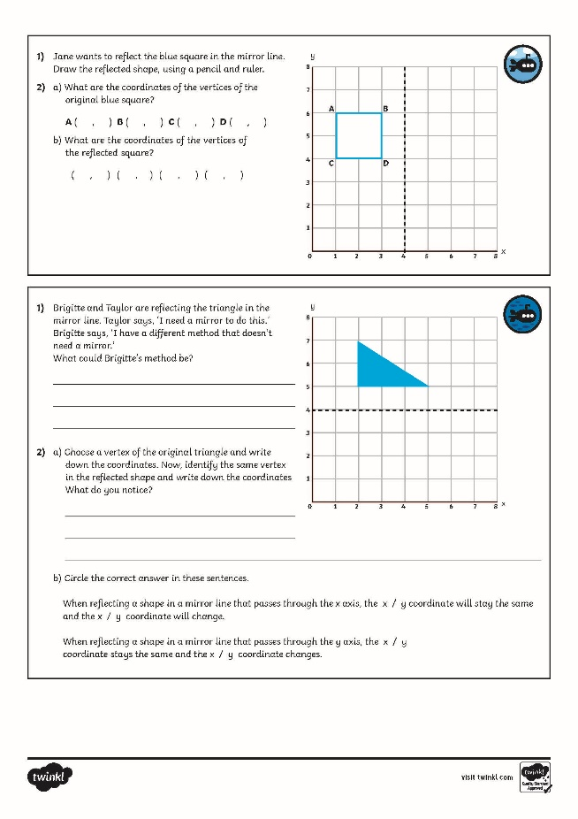
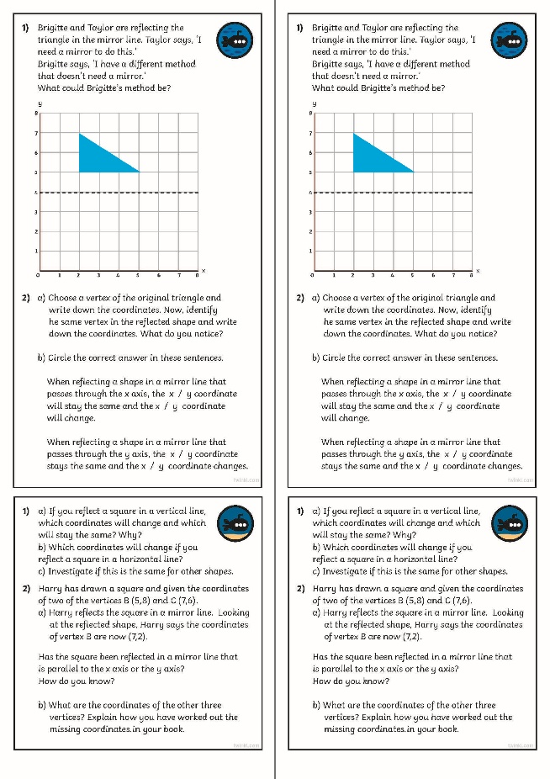
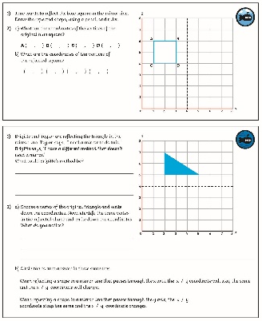
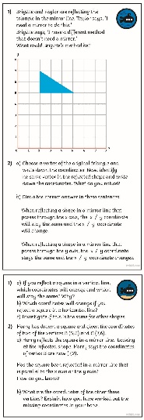
Reflection with Coordinates
Dive in by completing your own activity!

Slide 9
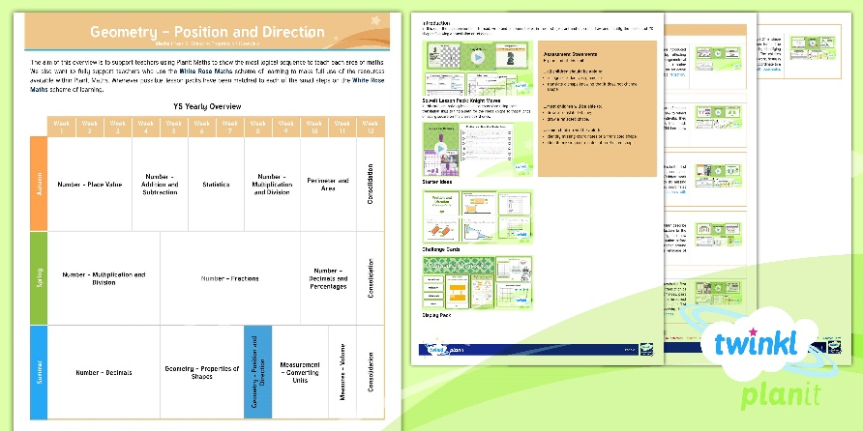
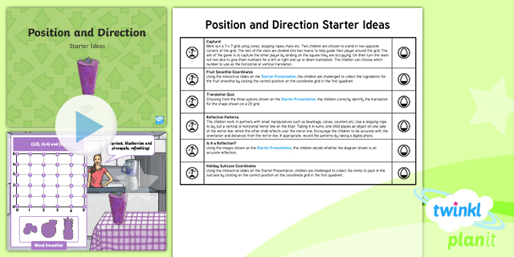

Need Planning to Complement this Resource?
National Curriculum Aim
Identify, describe and represent the position of a shape following a reflection or translation, using the appropriate language, and know that the shape has not changed.
For more planning resources to support this aim, click here.
Twinkl PlanIt is our award-winning scheme of work
with over 4000 resources.

