Slide 2



Diving into Mastery Guidance for Educators
Each activity sheet is split into three sections, diving, deeper and deepest, which are represented by the following icons:
These carefully designed activities take your children through a learning journey, initially ensuring they are fluent with the key concept being taught; then applying this to a range of reasoning and problem-solving activities.
These sheets might not necessarily be used in a linear way. Some children might begin at the ‘Deeper’ section and in fact, others may ‘dive straight in’ to the ‘Deepest’ section if they have already mastered the skill and are applying this to show their depth of understanding.
Diving
Deeper
Deepest

Slide 3
National Curriculum Objective
Identify, describe and represent the position of a shape following a reflection or translation, using the appropriate language, and know that the shape has not changed.

Slide 4



Translate
Diving
Describe the translations of the fruit (A) in each grid to their new positions (B).
A
B
A
A
B
B
3
1
left
down
left/right
up/down
3 right
1 down
1 left
3 down

Slide 5
Translate
Diving
Translate these shapes to their new position.
2 left
2 up
3 right
1 down
3 left
3 up

Slide 6

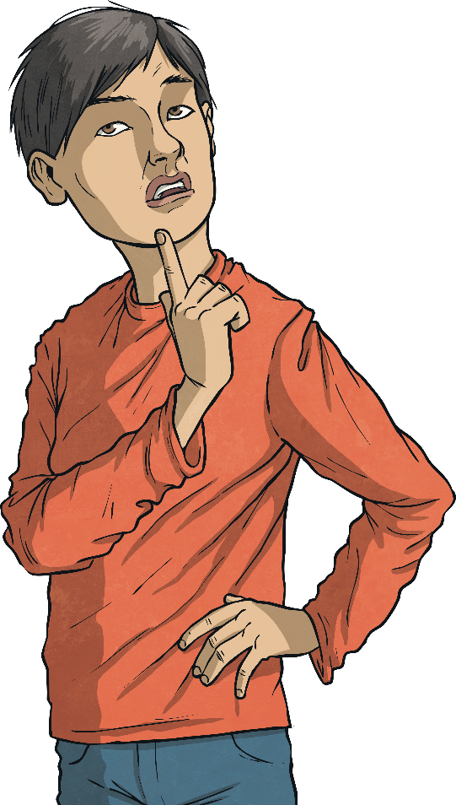
Translate
Deeper
Samira has translated shape A 2 right, 3 up. Has she done this correctly?
A
A
Samira has not done this correctly. A translated
shape must be exactly the same size. It should be congruent to the original.

Slide 7


Translate
Deepest
The square, triangle and rectangle have been translated to make a picture of a church. How was each shape translated?
Square - 2 right, 5 down
Rectangle - 8 right, 4 down
Triangle - 8 right, 4 up

Slide 8
Translate
Deepest
Translate the triangle, square and rectangle to new positions to create a picture. Write down the description of how each shape has been translated.
Can your learning partner follow your instructions to create an identical picture?

Slide 9

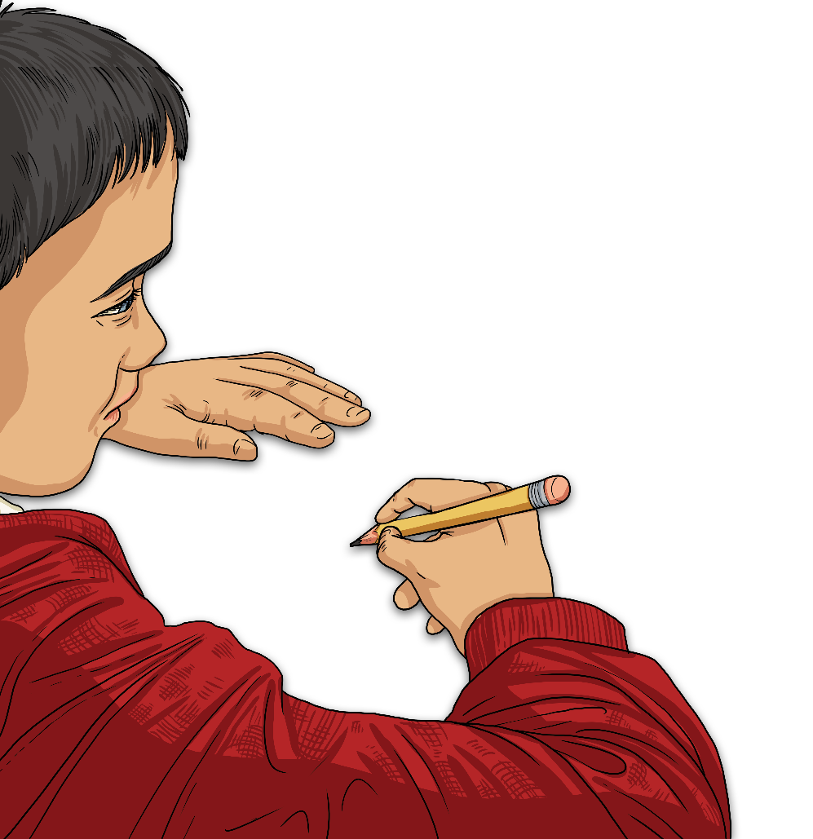
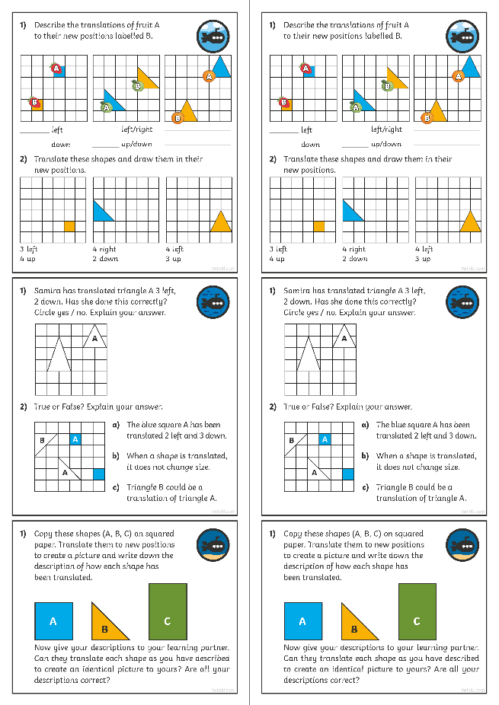
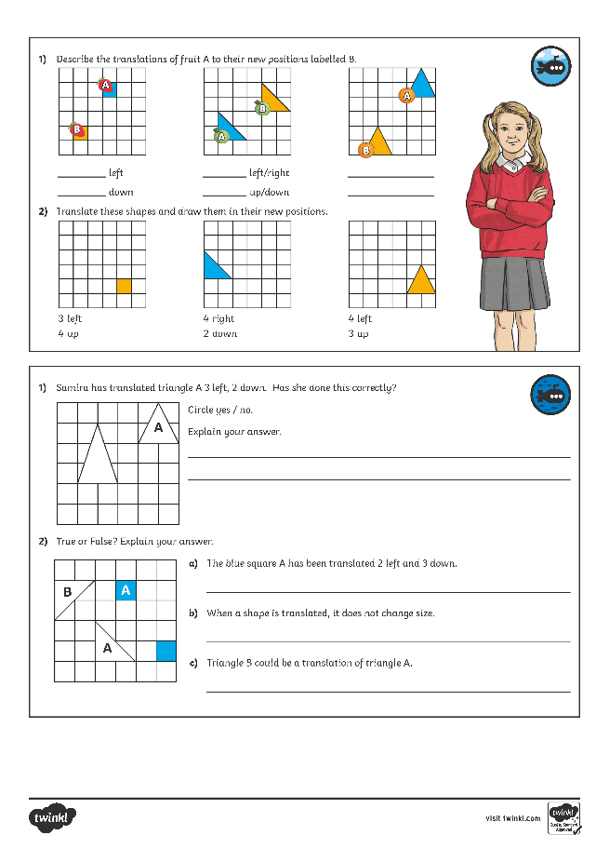
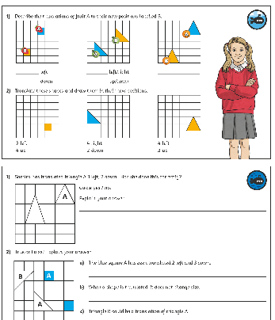
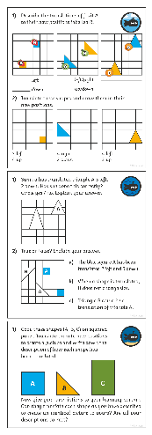
Translate
Dive in by completing your own activity!

Slide 10
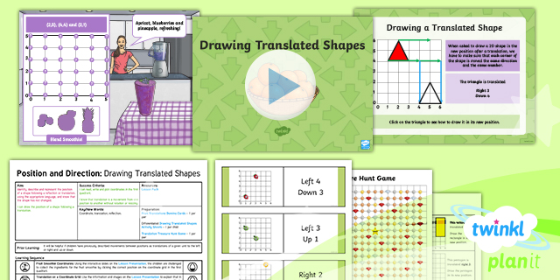
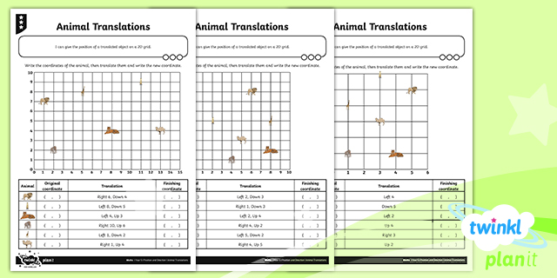

Need Planning to Complement this Resource?
National Curriculum Aim
Identify, describe and represent the position of a shape following a reflection or translation, using the appropriate language, and know that the shape has not changed.
For more planning resources to support this aim, click here.
Twinkl PlanIt is our award-winning scheme of work with over 4000 resources.

