Slide 1


Y5 M1d. Can interpret negative numbers in context, such as temperature
Commissioned by The PiXL Club Ltd.
September 2018
This resource is strictly for the use of member schools for as long as they remain members of The PiXL Club. It may not be copied, sold nor transferred to a third party or used by the school after membership ceases. Until such time it may be freely used within the member school.
All opinions and contributions are those of the authors. The contents of this resource are not connected with nor endorsed by any other company, organisation or institution.
PiXL Club Ltd endeavour to trace and contact copyright owners. If there are any inadvertent omissions or errors in the acknowledgements or usage, this is unintended and PiXL will remedy these on written notification.
© Copyright The PiXL Club Limited, 2018

Slide 2
Teachers’ Notes
The purpose of the priority therapies is to support the teaching of fundamental concepts for the year group.
The therapies can be taught to a whole class or a target group. Year 5 therapies are designed to take approximately 30 minutes. However, this is flexible: it may be that only part of the therapy is taught or it could, of course, be adapted or extended.
A vocabulary slide is included in each therapy. This identifies key words which relate to the taught concept along with a link to the ‘Vocabulary Shorts’ on PrimaryWise (20 activities to develop vocabulary). The intention is that the therapy begins with explicit teaching of this vocabulary.
The therapy adopts the ‘Teach, model and apply’ process with plenty of opportunities for pupils to demonstrate the taught skill.
Problem solving and reasoning activities are an integral part of each therapy.

Slide 3
Vocabulary: Number
negative
positive
ascending
descending
increase
decrease
Please select an activity from the ‘Vocabulary Shorts’ to develop understanding of the key vocabulary.

Slide 4

Teach
30°C is the temperature of a nice, sunny day.

Slide 5
Teach
At 10°C, you will need a coat!

Slide 6
Teach
But I live somewhere even colder!

Slide 7
Teach
At what temperature does water freeze?

Slide 8
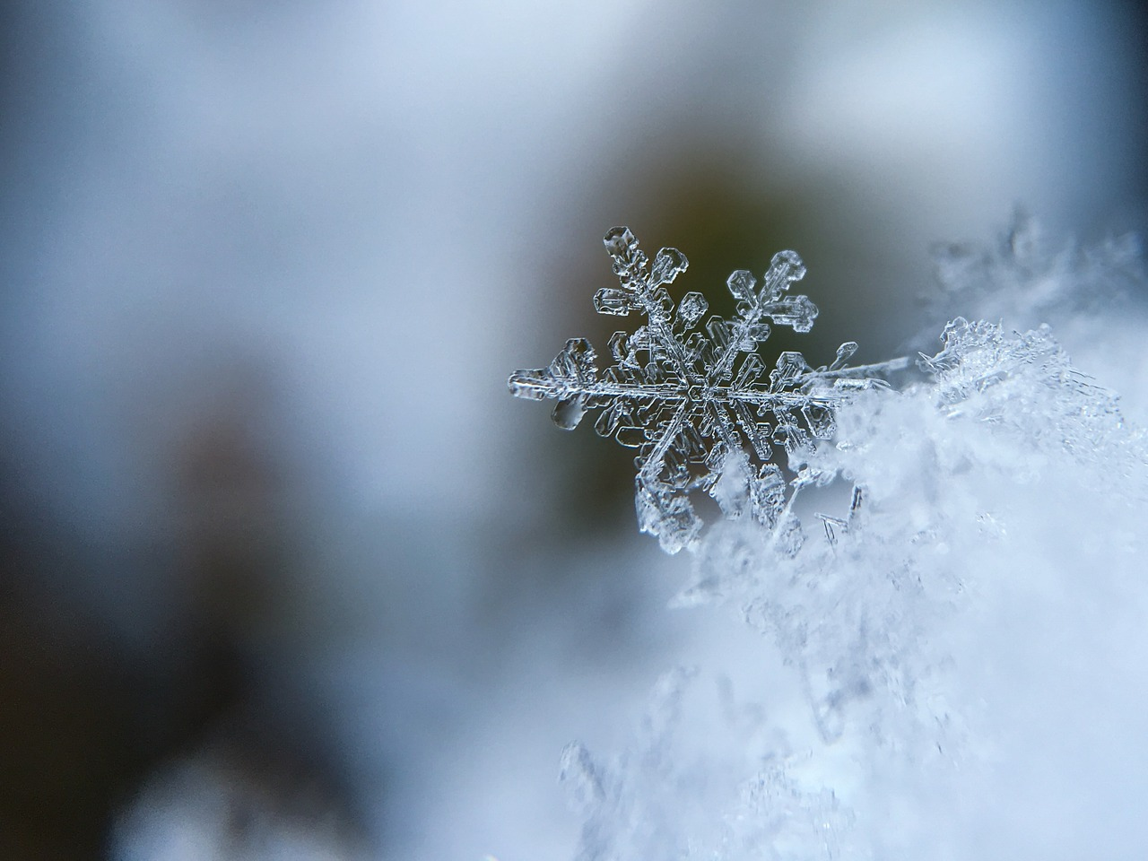
Teach
Water freezes at 0°C.

Slide 9

Teach
But how do we write temperatures even colder than 0°C?
0°C
1°C
2°C
3°C
4°C
5°C

Slide 10
Teach
These are negative numbers and can keep going forever!
-5°C
-4°C
-3°C
-2°C
-1°C
0°C
1°C
2°C
3°C
4°C
5°C

Slide 11
Teach
Numbers keep getting larger in this direction on our number line.
They are ascending.
-5°C
-4°C
-3°C
-2°C
-1°C
0°C
1°C
2°C
3°C
4°C
5°C

Slide 12
Teach
Numbers keep getting smaller in this direction on our number line.
They are descending.
-5°C
-4°C
-3°C
-2°C
-1°C
0°C
1°C
2°C
3°C
4°C
5°C

Slide 13
Model
We can use our number line to help us to order temperatures.
-5°C
-4°C
-3°C
-2°C
-1°C
0°C
1°C
2°C
3°C
4°C
5°C

Slide 14
Model
For example, let’s put the following temperatures in ascending order: -3°C, -4°C, 2°C
-5°C
-4°C
-3°C
-2°C
-1°C
0°C
1°C
2°C
3°C
4°C
5°C

Slide 15
Model
1. First, find or imagine the numbers on a number line.
For example, let’s put the following temperatures in ascending order: -3°C, -4°C, 2°C
-5°C
-4°C
-3°C
-2°C
-1°C
0°C
1°C
2°C
3°C
4°C
5°C

Slide 16
Model
1. First, find or imagine the numbers on a number line.
2. Ascending means getting larger, so we copy the numbers from left to right – smallest to biggest.
For example, let’s put the following temperatures in ascending order: -3°C, -4°C, 2°C
-5°C
-4°C
-3°C
-2°C
-1°C
0°C
1°C
2°C
3°C
4°C
5°C

Slide 17
Model
1. First, find or imagine the numbers on a number line.
2. Ascending means getting larger, so we copy the numbers from left to right – smallest to biggest.
For example, let’s put the following temperatures in ascending order: -3°C, -4°C, 2°C
The answer is -4°C, -3°C, 2°C
-5°C
-4°C
-3°C
-2°C
-1°C
0°C
1°C
2°C
3°C
4°C
5°C

Slide 18

Apply
Order the following temperatures from coldest to warmest (ascending order):
5°C -1°C 9°C -9 °C
-10°C
-9°C
-8°C
-7°C
-6°C
-5°C
-4°C
-3°C
-2°C
-1°C
0°C
1°C
2°C
3°C
4°C
5°C
6°C
7°C
8°C
9°C
10°C

Slide 19
Apply
Order the following temperatures from coldest to warmest (ascending order):
5°C -1°C 9°C -9 °C
-10°C
-9°C
-8°C
-7°C
-6°C
-5°C
-4°C
-3°C
-2°C
-1°C
0°C
1°C
2°C
3°C
4°C
5°C
6°C
7°C
8°C
9°C
10°C

Slide 20
Apply
Order the following temperatures from coldest to warmest (ascending order):
5°C -1°C 9°C -9 °C
The answer is -9°C, -1°C, 5°C, 9°C
-10°C
-9°C
-8°C
-7°C
-6°C
-5°C
-4°C
-3°C
-2°C
-1°C
0°C
1°C
2°C
3°C
4°C
5°C
6°C
7°C
8°C
9°C
10°C

Slide 21
Apply
Here is a table to show the average temperature in December in different countries:
Put the countries in order from coldest to warmest.
Country | Temperature
England | 6°C
Greenland | -6°C
Spain | 14°C
Iceland | -1°C

Slide 22
Apply
Here is a table to show the average temperature in December in different countries:
Put the countries in order from coldest to warmest.
Country | Temperature
England | 6°C
Greenland | -6°C
Spain | 14°C
Iceland | -1°C
Coldest
Warmest
Greenland
-6°C
Iceland
-1°C
England
6°C
Spain
14°C

Slide 23
Apply
Here is a table to show the average temperature in December in different American states:
Put the states in order from coldest to warmest.
Country | Temperature
California | 15°C
Alaska | -11°C
Minnesota | -5°C
Washington | 9°C

Slide 24
Apply
Here is a table to show the average temperature in December in different American states:
Put the states in order from coldest to warmest.
Country | Temperature
California | 15°C
Alaska | -11°C
Minnesota | -5°C
Washington | 9°C
Coldest
Warmest
Alaska
-11°C
Minnesota
-5°C
Washington
9°C
California
15°C

Slide 25
Model
We can also answer questions on temperature including negative numbers using a number line to help us.
-10°C
-9°C
-8°C
-7°C
-6°C
-5°C
-4°C
-3°C
-2°C
-1°C
0°C
1°C
2°C
3°C
4°C
5°C
6°C
7°C
8°C
9°C
10°C

Slide 26
Model
For example, if the temperature was -2°C and it increased by 5°C, what is the new temperature?
-10°C
-9°C
-8°C
-7°C
-6°C
-5°C
-4°C
-3°C
-2°C
-1°C
0°C
1°C
2°C
3°C
4°C
5°C
6°C
7°C
8°C
9°C
10°C

Slide 27
Model
For example, if the temperature was -2°C and it increased by 5°C, what is the new temperature?
The new temperature is 3°C.
+1
+1
+1
+1
+1
-10°C
-9°C
-8°C
-7°C
-6°C
-5°C
-4°C
-3°C
-2°C
-1°C
0°C
1°C
2°C
3°C
4°C
5°C
6°C
7°C
8°C
9°C
10°C

Slide 28
Apply
Your turn!
The temperature was -8°C and it increased by 11°C. What is the new temperature?
-10°C
-9°C
-8°C
-7°C
-6°C
-5°C
-4°C
-3°C
-2°C
-1°C
0°C
1°C
2°C
3°C
4°C
5°C
6°C
7°C
8°C
9°C
10°C

Slide 29
Apply
Your turn!
The temperature was -8°C and it increased by 11°C. What is the new temperature?
I can chunk my jumps to be quicker! Chunking at 0 breaks up the calculation.
+8
+3
-10°C
-9°C
-8°C
-7°C
-6°C
-5°C
-4°C
-3°C
-2°C
-1°C
0°C
1°C
2°C
3°C
4°C
5°C
6°C
7°C
8°C
9°C
10°C

Slide 30
Apply
Your turn!
The temperature was 3°C and it decreased by 7°C. What is the new temperature?
-10°C
-9°C
-8°C
-7°C
-6°C
-5°C
-4°C
-3°C
-2°C
-1°C
0°C
1°C
2°C
3°C
4°C
5°C
6°C
7°C
8°C
9°C
10°C

Slide 31
Apply
Your turn!
The temperature was 3°C and it decreased by 7°C. What is the new temperature?
-4
-3
-10°C
-9°C
-8°C
-7°C
-6°C
-5°C
-4°C
-3°C
-2°C
-1°C
0°C
1°C
2°C
3°C
4°C
5°C
6°C
7°C
8°C
9°C
10°C

Slide 32
Apply
Last one! Draw your own number line if you need one.
The temperature was 25°C and it decreased by 30°C. What is the new temperature?

Slide 33
Apply
Draw your own number line if you need one.
The temperature was 25°C and it decreased by 30°C. What is the new temperature?
-5°C
-25°C
-5°C
0°C
25°C
The answer is -5°C.

Slide 34
Apply
Draw your own number line if you need one.
The temperature was -12°C and it increased by 23°C. What is the new temperature?
+12°C
+11°C
-12°C
0°C
11°C
The answer is 11°C.

Slide 35


Evaluate
Can you interpret negative numbers in context, such as temperature?

