Slide 1


Y5 M1e. Can round any number up to 1,000,000 to the nearest 10, 100, 1000, 10,000 or 100,000
Commissioned by The PiXL Club Ltd.
July 2018
This resource is strictly for the use of member schools for as long as they remain members of The PiXL Club. It may not be copied, sold nor transferred to a third party or used by the school after membership ceases. Until such time it may be freely used within the member school.
All opinions and contributions are those of the authors. The contents of this resource are not connected with nor endorsed by any other company, organisation or institution.
PiXL Club Ltd endeavour to trace and contact copyright owners. If there are any inadvertent omissions or errors in the acknowledgements or usage, this is unintended and PiXL will remedy these on written notification.
© Copyright The PiXL Club Limited, 2018

Slide 2
Vocabulary: rounding numbers
round
rounding
estimate
estimating
approximate
approximating
Teacher’s Note:
See ‘Vocabulary Shorts’ resource below for ideas and games to develop and embed vocabulary.
Vocabulary Shorts
Notes:
To locate Vocabulary Shorts resource click on:
Currency
Whole School Materials
English
Writing
PiXL Vocabulary
Vocabulary Shorts PP

Slide 3
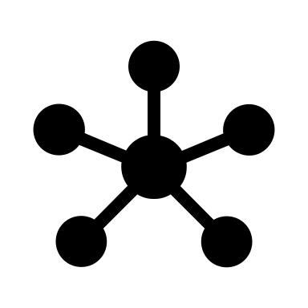
Vocabulary: Connect Two
Choose two of the following words. Connect two, demonstrating your understanding of the meaning of each word and the context in which it would be used.
rounding
estimating
approximating
integer
partitioning
______________ and_____________ are connected because…
e.g. Rounding and partitioning are connected because sometimes you have to look at the value of each digit by splitting them up (partitioning) to help you work out the number they are nearest to (rounding).
Notes:
To locate Vocabulary Shorts resource click on:
Currency
Whole School Materials
English
Writing
PiXL Vocabulary
Vocabulary Shorts PP

Slide 4
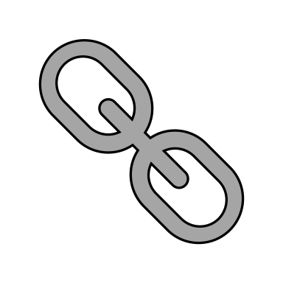
Vocabulary: Word Association
Word: estimate (verb)
Synonyms (same meaning) | Antonyms (opposite meaning) | Other connected language
approximate, guess, judge | calculate, measure | valuation, theory, belief, fact, precision
Now try your own word association using the word: integer (noun).
Notes:
To locate Vocabulary Shorts resource click on:
Currency
Whole School Materials
English
Writing
PiXL Vocabulary
Vocabulary Shorts PP

Slide 5
Vocabulary: Definition Match
Match the word to the correct definition:
estimating:
to write a number to a given amount of accuracy (e.g. to the nearest 1,000)
to give an answer that is not exactly correct, but is close enough to be useful in working out a calculation
rounding:
approximating:
to give a rough answer that may be a little less or a little more than the actual result
Notes:
To locate Vocabulary Shorts resource click on:
Currency
Whole School Materials
English
Writing
PiXL Vocabulary
Vocabulary Shorts PP

Slide 6
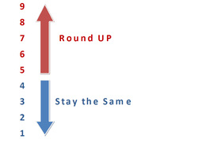

Can round any number up to 1,000,000 to the nearest 10, 100, 1000, 10,000 or 100,000
Rounding: to write a number to a given amount of accuracy (e.g. to the nearest 1,000).
Number lines can be very helpful at showing how we round.
20 21 22 23 24 25 26 27 28 29 30
Notes:
Go through other examples with children.

Slide 7
Can round any number up to 1,000,000 to the nearest 10, 100, 1000, 10,000 or 100,000
Rounding – quick challenge
Round the following numbers to the nearest 10:
72
35
137
394
2,608
9,285
Rounding definition:
To write a number to a given amount of accuracy
(e.g. to the nearest 10, 100,1,000 etc.)
Notes:
A quick challenge to check pre-existing knowledge.

Slide 8
Can round any number up to 1,000,000 to the nearest 10, 100, 1000, 10,000 or 100,000
Tips for rounding:
Underline the digit in the place value column it is to be rounded to.
Look to the right of the rounding place.
If the number is 5 or more, ‘let it soar’.
If the number is 4 or less, ‘let it rest’.
Numbers to the right of the rounding place turn to zero.
Here are some examples of rounding to 100:
878 900
1,015 1,000
323,627 323,600
Thousands | Hundreds | Tens | Ones
 | 8 | 7 | 8
 | 9 | 0 | 0
Notes:
Discussion around place value may need to be explored here.

Slide 9
Can round any number up to 1,000,000 to the nearest 10, 100, 1000, 10,000 or 100,000
Using a number line can help with rounding. Look at these examples of rounding numbers to the nearest 1,000.
8,000
8,672
9,000
4,000
4,367
5,000
Notes:
Repeat with other examples to consolidate.

Slide 10

Can round any number up to 1,000,000 to the nearest 10, 100, 1000, 10,000 or 100,000
Your turn
Round the following numbers to the nearest 100:
3,616
37,072
15,260
30,549
472,641
280,434
497,080
?

Slide 11
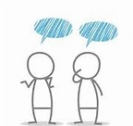
Problem solving
The attendance at a hockey match last Sunday was 2,837. What was the attendance to the nearest hundred?

Slide 12

Can round any number up to 1,000,000 to the nearest 10, 100, 1000, 10,000 or 100,000
Look at the number 7,289.
How would you round this number to the nearest 1,000?
Discuss with a partner.
Tips for rounding:
Underline the digit in the place value column it is to be rounded to.
Look to the right of the rounding place.
If the number is 5 or more, ‘let it soar’.
If the number is 4 or less, ‘let it rest’.
Numbers to the right of the rounding place turn to zero.
Use your Place Value Vocabulary Mat to help if you need to!

Slide 13

Can round any number up to 1,000,000 to the nearest 10, 100, 1000, 10,000 or 100,000
Rounding to 1000:
2,364 2,000
14,578 15,000
Tips for rounding:
Underline the digit in the place value column it is to be rounded to.
Look to the right of the rounding place.
If the number is 5 or more, ‘let it soar’
If the number is 4 or less, ‘let it rest’.
Numbers to the right of the rounding place turn to zero.
Round these to the nearest 1000:
8,830 4) 252,385
2) 15,618 5) 159,531
3) 220,487 6) 5,376,600

Slide 14
Can round any number up to 1,000,000 to the nearest 10, 100, 1000, 10,000 or 100,000
Your turn
Round these numbers to the nearest 10,000:
72,837
£86,180
51,765 km
573,480
675,012
Notes:
Revisit vocabulary from the beginning of the lesson if required.
Discuss links to measures and applying skills in other contexts.

Slide 15
Can round any number up to 1,000,000 to the nearest 10, 100, 1000, 10,000 or 100,000
Your turn
Round these numbers to the nearest 100,000:
863,000 ml
637,926
£270,127
825,195
1,472,502

Slide 16
Problem solving
When a number is rounded to the nearest 100, it is 400. When the same number is rounded to the nearest 10, it is 450. What could the number be?

Slide 17
Problem Solving
Show me a number that rounds to 326,000 when rounded to the nearest 1,000.
Notes:
Revisit vocabulary from the beginning of the lesson if required.

Slide 18
Problem Solving
The local bank will only give money out in multiples of £1,000. I want to take out £13,647 for a new car, but will now need to round the amount to the nearest £1,000. How much money will I need to withdraw?

Slide 19
Can round any number up to 1,000,000 to the nearest 10, 100, 1000, 10,000 or 100,000
Your turn
Round 3,461,742 to the…
nearest 10
nearest 100
nearest 1,000
nearest 10,000
nearest 100,000

Slide 20
Reasoning
Explain how you know…
Introduction
(introduce the statement being discussed)
Give your opinion
I think the statement is true…
In my opinion…
Prove it mathematically
I know this because…
In fact, the correct answer should be…
A further point to note is…
Conclusion
(sum up the key point)
Convince me that both 367,501 and 368,499 round to 368,000 to the nearest thousand.
Notes:
May need discussion around the word ‘convince’ and how to structure the reasoning answer.

Slide 21
Reasoning
Explain how you know…
Introduction
(introduce the statement being discussed)
Give your opinion
I think the statement is true…
In my opinion…
Prove it mathematically
I know this because…
In fact, the correct answer should be…
A further point to note is…
Conclusion
(sum up the key point)
Always, Sometimes or Never?
450,000 is closer to 500,000 than 400,000.

