Slide 1


Y5 M1f. Can solve problems using place value and number facts
Commissioned by The PiXL Club Ltd.
September 2018
This resource is strictly for the use of member schools for as long as they remain members of The PiXL Club. It may not be copied, sold nor transferred to a third party or used by the school after membership ceases. Until such time it may be freely used within the member school.
All opinions and contributions are those of the authors. The contents of this resource are not connected with nor endorsed by any other company, organisation or institution.
PiXL Club Ltd endeavour to trace and contact copyright owners. If there are any inadvertent omissions or errors in the acknowledgements or usage, this is unintended and PiXL will remedy these on written notification.
© Copyright The PiXL Club Limited, 2018

Slide 2
Teachers’ Notes
The purpose of the priority therapies is to support the teaching of fundamental concepts for the year group.
The therapies can be taught to a whole class or a target group. Year 5 therapies are designed to take approximately 30 minutes. However, this is flexible: it may be that only part of the therapy is taught or it could, of course, be adapted or extended.
A vocabulary slide is included in each therapy. This identifies key words which relate to the taught concept along with a link to the ‘Vocabulary Shorts’ on PrimaryWise (20 activities to develop vocabulary). The intention is that the therapy begins with explicit teaching of this vocabulary.
The therapy adopts the ‘Teach, model and apply’ process with plenty of opportunities for pupils to demonstrate the taught skill.
Problem solving and reasoning activities are an integral part of each therapy.

Slide 3
Vocabulary: Number
inverse
equal
factor
multiple
square
cube
prime
Please select an activity from the ‘Vocabulary Shorts’ to develop understanding of the key vocabulary.

Slide 4

Teach
We are going to use our knowledge of place value and number facts to solve problems.

Slide 5
Teach
First, let’s test our understanding of number facts by thinking about the following questions...

Slide 6
Teach
A multiple of 10 is always a multiple of 5.
The sum of two even numbers is divisible by 4.
Sometimes,
always or
never true?
A cube number is always odd.
If a number has 2 and 3 as factors, it will also have 6 as a factor.
Notes:
This is an opportunity for children to really explore the vocabulary and their understanding of it.

Slide 7
Teach
A multiple of 10 is always a multiple of 5.
The sum of two even numbers is divisible by 4.
Sometimes
Always
A cube number is always odd.
If a number has 2 and 3 as factors, it will also have 6 as a factor.
Sometimes
Always

Slide 8
Model
Is this number sentence true or false? Explain why.
4.14 - 0.9 = 4.5

Slide 9

Model
Is this number sentence true or false? Explain why.
4.14 - 0.9 = 4.5
We do not need to work out the answer here. We just need to have a good understanding of the place value of decimal numbers.

Slide 10
Model
Is this number sentence true or false? Explain why.
4.14 - 0.9 = 4.5
We know that 4.5 is larger than 4.14.
We also know that subtraction should result in a smaller answer. Therefore, it must be false.

Slide 11
Model
Is this number sentence true or false? Explain why.
4.14 - 0.9 = 4.5
We also know that 0.14 is smaller than 0.9.
This means that when we take away 0.9 from 4.14, the answer will be less than 4. The answer is false.

Slide 12
Apply
Your turn!
Is this number sentence true or false? Explain why.
7.21 – 0.6 = 7.15

Slide 13
Apply
Your turn!
Is this number sentence true or false? Explain why.
7.21 – 0.6 = 7.15
False, because 0.6 is more than 0.21, so we will be left with a number smaller than 7.

Slide 14
Apply
Your turn!
Is this number sentence true or false? Explain why.
6.1 + 0.62 = 6.72

Slide 15
Apply
Your turn!
Is this number sentence true or false? Explain why.
6.1 + 0.62 = 6.72
True, because we are adding 6 to the tenths column and 2 to the hundredths column.

Slide 16
Apply
Your turn!
Is this number sentence true or false? Explain why.
8.88 – 0.8 = 8.8

Slide 17
Apply
Your turn!
Is this number sentence true or false? Explain why.
8.88 – 0.8 = 8.8
False. If 8 is taken away from the tenths column, there will be 8 left in the hundreds column (8.08).

Slide 18
Teach
Let’s break down our understanding of place value even further.

Slide 19
Model
What is 45,000 equal to?
_____ thousands
_____ hundreds
_____ tens

Slide 20
Model
What is 45,000 equal to?
45 thousands
Divide 45,000 by 1,000 to find it is equal to 45 thousands.

Slide 21
Model
What is 45,000 equal to?
45 thousands
450 hundreds
Divide 45,000 by 100 to find it is equal to 450 hundreds.

Slide 22
Model
What is 45,000 equal to?
45 thousands
450 hundreds
4,500 tens
Divide 45,000 by 10 to find it is equal to 4,500 tens.

Slide 23
Apply
Your turn!
67,000 is equal to _____ hundreds.
23,000 is equal to _____ tens.
72,000 is equal to _____ thousands.

Slide 24
Teach
We are now going to explore place value in sequences.

Slide 25
Model
If you count forwards in ten thousands, would you ever get to 134,000? Why?
15,000 25,000 35,000…

Slide 26
Model
If you count forwards in ten thousands, would you ever get to 134,000? Why?
15,000 25,000 35,000…
No. You are only adding to the ten thousands column, so the number will always end in 5,000.

Slide 27
Apply
Your turn!
If you count backwards in thousands, would you ever get to 0? Why?
6,700 5,700 4,700…

Slide 28
Apply
Your turn!
If you count backwards in thousands, would you ever get to 0? Why?
6,700 5,700 4,700…
No. The sequence will go from 700 to -300, missing out 0.

Slide 29
Apply
Your turn!
If you count forwards in hundreds, would you ever get to 1400? Why?
600 700 800…

Slide 30
Apply
Your turn!
If you count forwards in hundreds, would you ever get to 1,400? Why?
600 700 800…
Yes. These are going up in multiples of 100, and 1,400 is a multiple of 100.

Slide 31
Apply
Your turn!
If you count backwards in hundreds, would you ever include 783?
1,673 1,573 1,473…

Slide 32
Apply
Your turn!
If you count backwards in hundreds, would you ever include 783?
1,673 1,573 1,473…
No. All numbers will end in 73, not 83. It is only the hundreds column that will change (above 0).

Slide 33
Model
Now let’s try a rounding problem…

Slide 34
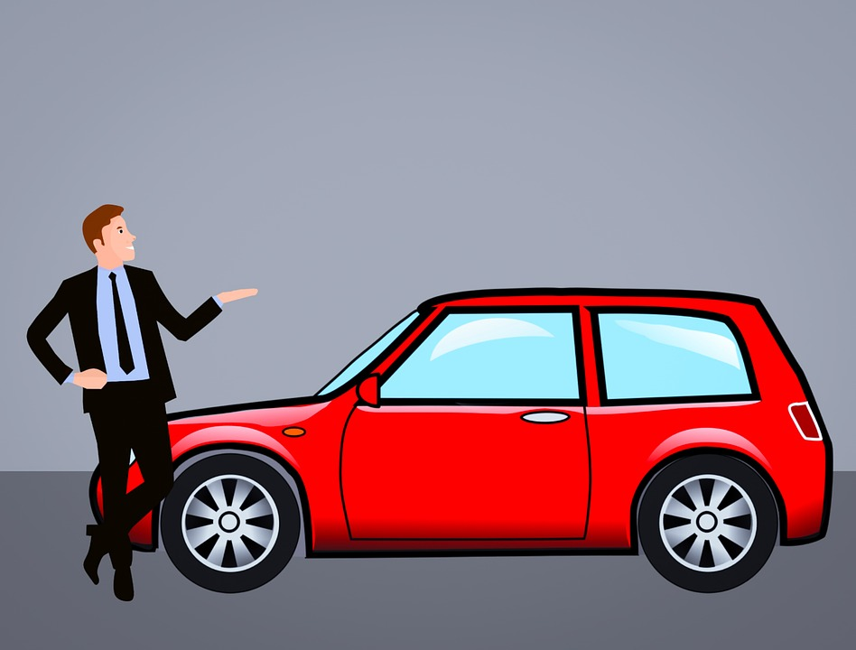
Model
Which is the cheapest new price?
Original price: £4,529
Sales person rounds the price to the nearest £1,000.
Original price: £4,899
Sales person rounds the price to the nearest £100.

Slide 35
Model
I would prefer the second price, because this car would become £4,900 whereas the first car would become £5,000.
Original price: £4,529
Sales person rounds the price to the nearest £1,000.
Original price: £4,899
Sales person rounds the price to the nearest £100.

Slide 36
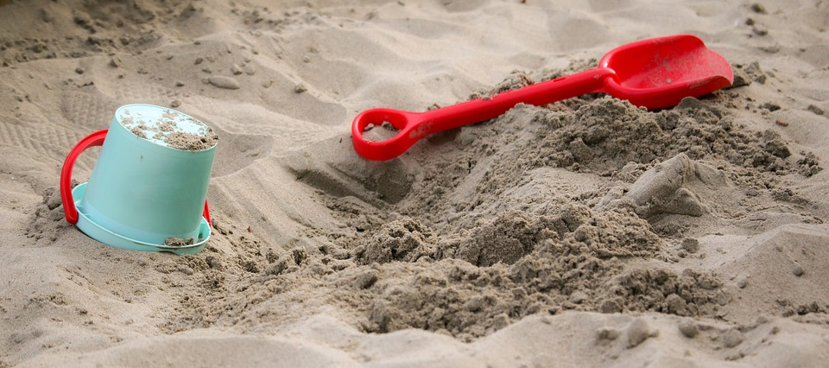
Apply
Your turn!
Which is the best deal for a beach holiday?
Original price: £1,255
New price rounds original price to the nearest 10.
Original price: £1,245
New price rounds original price to the nearest 100.

Slide 37
Model
I would prefer the second price, because this holiday would become £1,200 whereas the first holiday would become £1,260.
Original price: £1,255
New price rounds original price to the nearest 10.
Original price: £1,245
New price rounds original price to the nearest 100.

Slide 38
Teach
We can use our knowledge of place value to answer questions that have restrictions or rules.

Slide 39
Teach
We will need to know our number facts here, so make sure you have practised the vocabulary!

Slide 40
Model
1
6
2
4
8
Use the cards to make a number larger than 70,000.

Slide 41
Model
8
6
2
4
1
The only digit larger than 7 is 8, so this must go in the ten thousands column.

Slide 42
Model
8
6
2
4
1
But what if I introduced some more rules?

Slide 43
Model
8
6
2
4
1
Your number must be larger than 70,000 and it must be even.

Slide 44
Model
8
6
2
1
4
Now, we need to look again and swap an even number for the ones column.

Slide 45
Model
8
6
2
1
4
But what if I added another rule…

Slide 46
Model
8
6
2
1
4
That the 4 must be in the hundreds column?

Slide 47
Model
8
6
2
1
4
Now, we need to change the 4, but we must check our previous rules.

Slide 48
Model
8
6
4
1
2
Therefore, we must replace the 4 with another even number.

Slide 49
Model
8
6
4
1
2
By thinking about each rule one at a time and adjusting our number every time we make a change, we can create a number that follows all of the rules at once.

Slide 50
Apply
Your turn!
Use the digit cards to make a number that:
Is smaller than 40,000
Rounds to 30,000 to the nearest 10,000.
Is an odd number.
5
6
9
3
4

Slide 51
Apply
Your turn!
Use the digit cards to make a number that:
Is smaller than 45,000
Rounds to 30,000 to the nearest 10,000.
Is an odd number.
6
1
9
3
4
Possible answers are: 34,641
34,461
31,649 31,469

Slide 52
Apply
Your turn!
This is a 3-digit number
The digits add up to 6
It is a multiple of 10
The number in the hundreds column is prime

Slide 53
Apply
Your turn!
This is a 3-digit number
The digits add up to 6
It is a multiple of 10
The number in the hundreds column is prime
Possible answers are: 510
240
330

Slide 54
Apply
Your turn!
This is a 4-digit number
The digits add up to 10
It is even
The tens digit is 8

Slide 55
Apply
Your turn!
This is a 4-digit number
The digits add up to 10
It is even
The tens digit is 8
Possible answers are: 1180
2080

Slide 56
Apply
Your turn!
This is a 3-digit number
The ones digit is a square number
It has 2 as a factor
The tens digit is a cube number
It is greater than 900

Slide 57
Apply
Your turn!
This is a 3-digit number
The ones digit is a square number
It has 2 as a factor
The tens digit is a cube number
It is greater than 900
The answer must be: 984

Slide 58


Evaluate
Can you solve problems including place value and number facts?

