Slide 1


.
Y4 M3e Can multiply up to four-digit numbers by two-digit numbers using long multiplication
Commissioned by The PiXL Club Ltd.
June 2019
This resource is strictly for the use of member schools for as long as they remain members of The PiXL Club. It may not be copied, sold nor transferred to a third party or used by the school after membership ceases. Until such time it may be freely used within the member school.
All opinions and contributions are those of the authors. The contents of this resource are not connected with nor endorsed by any other company, organisation or institution.
PiXL Club Ltd endeavour to trace and contact copyright owners. If there are any inadvertent omissions or errors in the acknowledgements or usage, this is unintended and PiXL will remedy these on written notification.
© Copyright The PiXL Club Limited, 2019

Slide 2
Teachers’ Notes
The PiXL therapies can be taught to a whole class or a target group. Year 3-5 therapies are designed to take approximately 30-40 minutes. However, this is flexible: it may be that only part of the therapy is taught or it could, of course, be adapted or extended.
Each therapy begins with a LORIC activity to develop relevant learning behaviours.
This is followed by a vocabulary task, which uses the PiXL 5-phase approach to teach key mathematical vocabulary. Further resources to develop vocabulary can be found in the Whole School area.
Each therapy adopts the ‘Teach, model and apply’ process with opportunities for pupils to demonstrate the taught skill independently.
Problem solving and reasoning activities are an integral part of each therapy.

Slide 3
Progress across amber – the 4-stage model
The three therapy tests which accompany this resource can be used to revisit the taught skill to check that the pupil is able to perform it independently and consistently.
A
A child has successfully completed a therapy test independently, following a set of therapy sessions.
A child has successfully completed a therapy test independently, a period after the relevant therapy sessions – we would advise about 2 weeks.
A child has successfully applied their knowledge or skill in an unfamiliar context. This may be application across the curriculum or in a problem.
A pupil has successfully re-visited the skills at a later point, and applies these in an unfamiliar context or problem, or across the curriculum.
A
DA
G

Slide 4
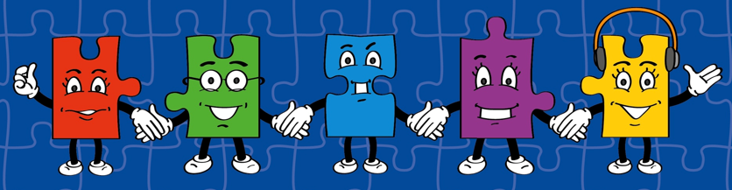

LORIC task
The LORIC task will focus on your Raj Resilience skills today:
Do not be put off by a difficult task.
Keep going – persevere.
Think about ways you can help yourself and others.

Slide 5
LORIC task
Using the numbers 5, 6 and 7, work out
the multiplication calculation which will
give the answer closest to 410.
?
?
x
?

Slide 6
Vocabulary activity
What is it not?
Explain to a partner what the word is not.
For example, if defining the word ‘addition’
you could say:
It is not a way to subtract numbers.
It is not a way to make a number larger.
Challenge: Can you use a range of sentence starters
and conjunctions when giving your clues?
multiply
times
groups of
repeated addition
DEFINE IT

Slide 7
Teach
You may have used the grid method or short multiplication for certain multiplication calculations. When multiplying three-digit and four-digit numbers by two-digits, it is much easier to use the long multiplication method.
 | 1 | 2
 | 1 | 2 | 4
x |  | 2 | 6
 | 7 | 4 | 4
2, | 4 | 8 | 0
3, | 2 | 2 | 4
1 | 1

Slide 8
Teach
Before calculating, it is important to estimate to give a rough idea of what the answer should be. This will also help you to check your answer and identify silly mistakes.
I round the two numbers to the nearest ten.
So 124 x 26 becomes 120 x 30
I know that 120 x 10 = 1,200 therefore 3 times that amount is 3,600.
The actual answer is 3,224.

Slide 9
Teach
When using the long multiplication method, you need to use both multiplication and addition skills.
It is important that you check each part of your answer carefully.
 | 2 | 3 | 1
 | 1, | 3 | 4 | 2
x |  |  | 3 | 7
 | 9, | 3 | 9 | 4
4 | 0, | 2 | 6 | 0
4 | 9, | 6 | 5 | 4
 |  | 1

Slide 10
Teach
This method requires two separate multiplications to work out 1,342 x 37:
1,342 x 7 and 1,342 x 30
The product of these two calculations is then added together.
 | 2 | 3 | 1
 | 1, | 3 | 4 | 2
x |  |  | 3 | 7
 | 9, | 3 | 9 | 4
4 | 0, | 2 | 6 | 0
4 | 9, | 6 | 5 | 4
 |  | 1

Slide 11
Model
The first part of long multiplication is multiplying the ones digit from the two-digit number (4) by each of the digits in the four-digit number (1,836). E.g.
4 x 6 = 24 (carrying the 2 over)
4 x 3 = 12
12 + 2 = 14 (carrying the 1 over)
4 x 8 = 32
32 + 1 = 33 (carrying the 3 over)
4 x 1 = 4. Then 4 + 3 = 7.
 | 3 | 1 | 2
 | 1, | 8 | 3 | 6
x |  |  | 2 | 4
 | 7, | 3 | 4 | 4

Slide 12
Model
Now we multiply each of the digits in the four-digit number (1,836) by 2. Because it is actually 20, and not 2, we put a zero in the first column.
Then we complete the following calculations:
2 x 6 = 12 (carrying the 1 over)
2 x 3 = 6. Then 6 + 1 = 7
2 x 8 = 16 (carrying the 1 over)
2 x 1 = 2. Then 2 + 1 = 3.
1 |  | 1
 | 1, | 8 | 3 | 6
x |  |  | 2 | 4
 | 7, | 3 | 4 | 4
3 | 6, | 7 | 2 | 0

Slide 13
Model
Finally, we add the products of both calculations together to get the final answer.
7,344 + 36,720 = 44,064
 | 1, | 8 | 3 | 6
x |  |  | 2 | 4
 | 7, | 3 | 4 | 4
3 | 6, | 7 | 2 | 0
4 | 4, | 0 | 6 | 4
1 | 1

Slide 14
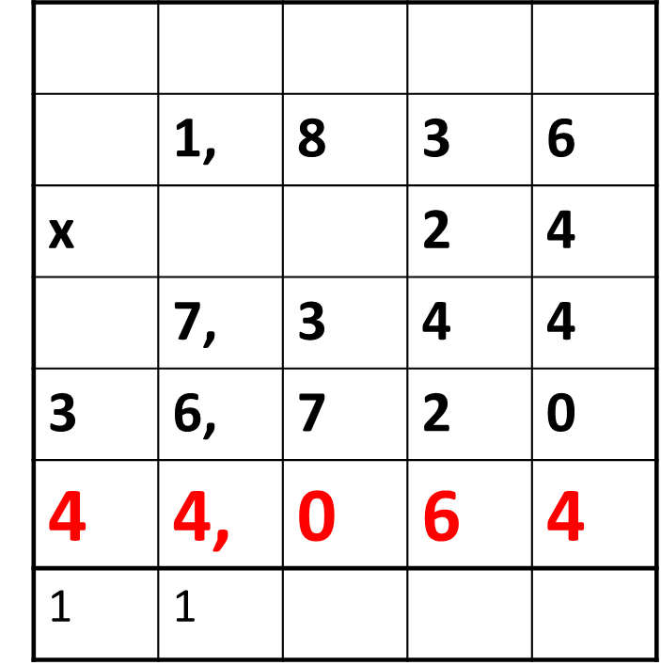
Apply
Remember to use the following layout to complete your long multiplication calculations:
Use the long multiplication method shown to work out the following:
542 x 15
984 x 25
3,859 x 28
1,483 x 56
2,647 x 73

Slide 15
Model – Problem Solving
Children in a school use 24 books in a year. There are 156 children in the school. How many books will the school use in total?
I know I need to multiply 24 by 156. The first thing I need to do is set my columns out correctly and then multiply each of the digits in 156 by 4. This equals 624.
 | 1 | 5 | 6
x |  | 2 | 4
 | 6 | 2 | 4
3, | 1 | 2 | 0
3, | 7 | 4 | 4
I then multiply each of the digits in 156 by 2. Because it is actually 20 and not 2, I put a zero in the first column.
This equals 3,120.
Finally, I add 624 + 3,120 together which gives me the answer 3,744.

Slide 16
Apply – Problem Solving
Remember to use the following layout to complete your long multiplication calculations:
Children in a school use 29 books in a year. There are 2,387 children in the school. How many books will the school use in total?

Slide 17
Apply – Problem Solving
Remember to use the following layout to complete your long multiplication calculations:
The football stadium sells tickets for £36 each. They sell 4,298 tickets. How much money do they make?

Slide 18
Apply – Reasoning Problem
Remember to use the following layout to complete your long multiplication calculations:
Put < or > in each box to make the statements correct:
3,678 x 25 987 x 94
1,369 x 47 1,216 x 53

