Slide 1


Y5 Therapy
4a. Can compare and order fractions whose denominators are multiples of the same number
Commissioned by The PiXL Club Ltd.
June 2018
This resource is strictly for the use of member schools for as long as they remain members of The PiXL Club. It may not be copied, sold nor transferred to a third party or used by the school after membership ceases. Until such time it may be freely used within the member school.
All opinions and contributions are those of the authors. The contents of this resource are not connected with nor endorsed by any other company, organisation or institution.
PiXL Club Ltd endeavour to trace and contact copyright owners. If there are any inadvertent omissions or errors in the acknowledgements or usage, this is unintended and PiXL will remedy these on written notification.
© Copyright The PiXL Club Limited, 2018

Slide 2
Vocabulary: fractions
denominator
numerator
multiples
equivalent
compare
order
Please select an activity from the ‘Vocabulary Shorts’ to develop understanding of the key vocabulary.
Notes:
Ensure that all pupils are clear on which number is the denominator and which is the numerator. Pupils may also require support in recalling what multiples are. It is important to emphasise that when ordering (for any type of question) they must read carefully if it is ordering in ascending as this is a common mistake.

Slide 3

Comparing fractions
4a. Can compare and order fractions whose denominators are multiples of the same number
Tell your partner which fractions have the same denominator.
$\frac{2}{3}$ $\frac{3}{6}$ $\frac{5}{12}$ $\frac{1}{6}$
In these fractions, there are 3 different denominators 3, 6 and 12. Before we can compare these fractions, we must find the common multiple for the denominators. What is the common multiple?
Notes:
Support the pupils to find the common multiples using their times table knowledge. Agree that the common multiple is 12.

Slide 4
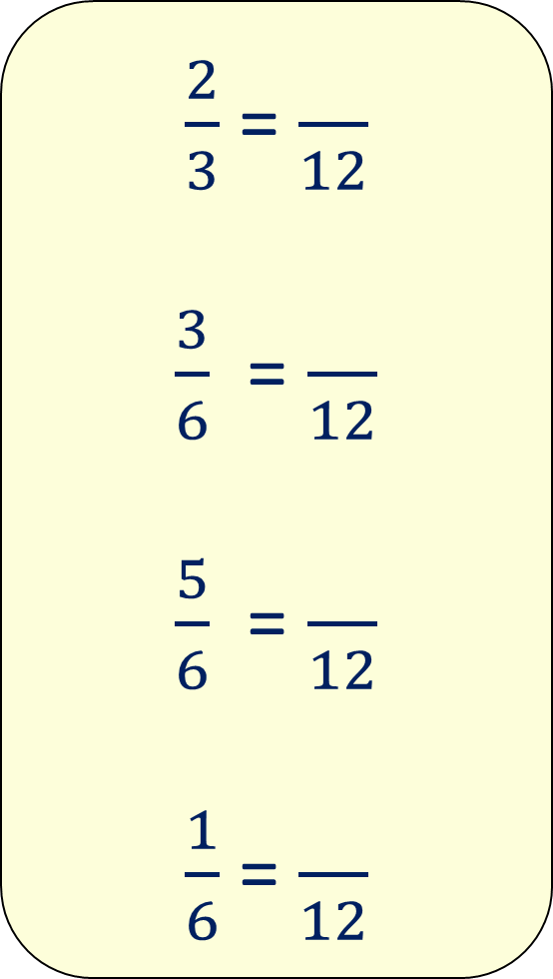
Comparing fractions
$\frac{2}{3}$ = $\frac{}{12}$
$\frac{3}{6}$ = $\frac{}{12}$
$\frac{5}{6}$ = $\frac{}{12}$
$\frac{1}{6}$ = $\frac{}{12}$
The denominators here are all multiples of 3. We must change all the denominators to 12, as this is the common multiple.
Now we must work out the numerator. Can you remember the rule to work this out?

Slide 5
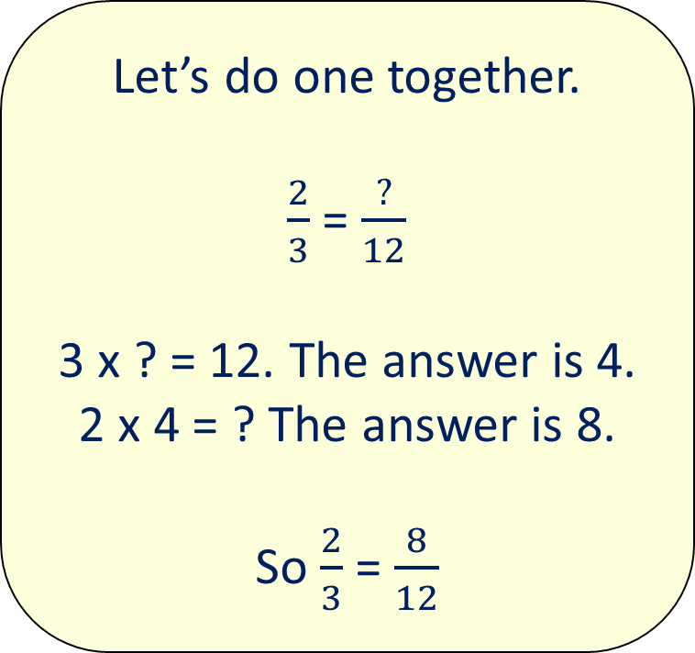
4a. Can compare and order fractions whose denominators are multiples of the same number
Let’s do one together.
$\frac{2}{3}$ = $\frac{?}{12}$
3 x ? = 12. The answer is 4.
2 x 4 = ? The answer is 8.
So $\frac{2}{3}$ = $\frac{8}{12}$
Start with the denominator to work out what number the denominator is multiplied by.
Now, go to the numerator, which we must multiply by 4 (because this is what we did with the denominator).
Multiply 2 by 4.
These are now equivalent fractions.

Slide 6
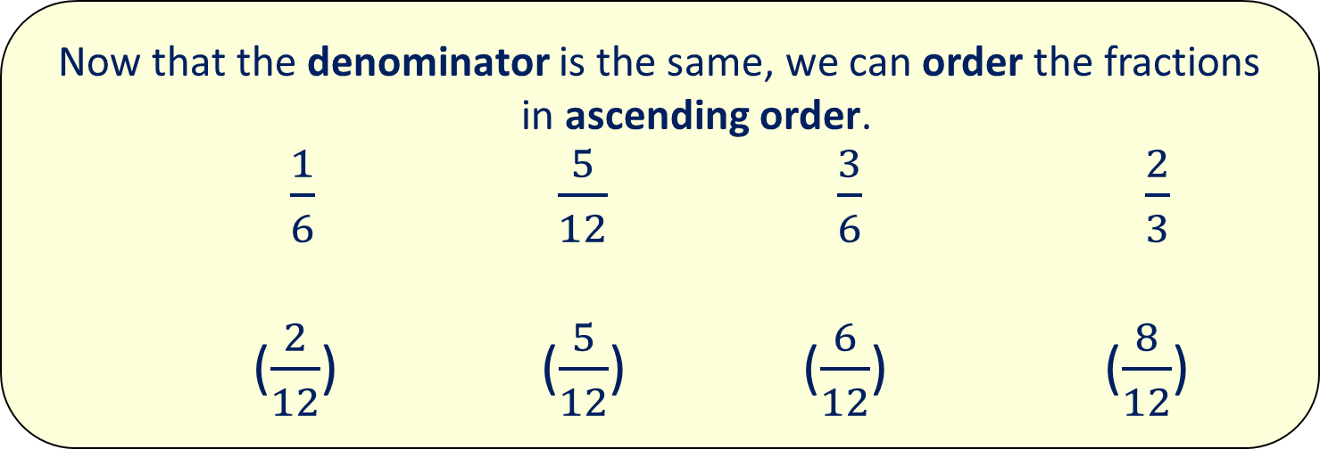
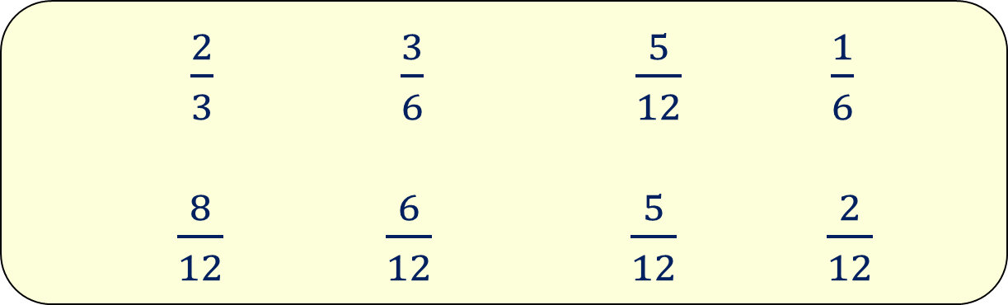
4a. Can compare and order fractions whose denominators are multiples of the same number
$\frac{2}{3}$ $\frac{3}{6}$ $\frac{5}{12}$ $\frac{1}{6}$
$\frac{8}{12}$ $\frac{6}{12}$ $\frac{5}{12}$ $\frac{2}{12}$
Remember, what you do to the denominator you do to the numerator.
Now that the denominator is the same, we can order the fractions in ascending order.
$\frac{1}{6}$ $\frac{5}{12}$ $\frac{3}{6}$ $\frac{2}{3}$
($\frac{2}{12}$) ($\frac{5}{12}$) ($\frac{6}{12}$) ($\frac{8}{12}$)
Notes:
Reinforce with the children the importance of writing the fractions as they were originally written. i.e. with the different denominators.

Slide 7
Let’s try one
$\frac{4}{5}$ $\frac{2}{10}$ $\frac{1}{20}$ $\frac{4}{10}$
1. Work out the common multiple for the denominator.
2. For each fraction, change the denominator to this common multiple.
3. Work out the numerator for each fraction, doing the same to the numerator as you did to the denominator.
4. Finally, order the numbers (remembering to write down the fractions that you were given to begin with.)
Notes:
Model for the children how to change the denominator to the common multiple of 20 as was shown in previous slides and then how to order these ensuring the original fractions are written down.

Slide 8
Now your turn:
Rewrite these fractions in ascending order.
$\frac{2}{3}$ $\frac{5}{6}$ $\frac{1}{12}$ $\frac{1}{24}$ $\frac{4}{6}$
$\frac{2}{5}$ $\frac{7}{15}$ $\frac{3}{25}$ $\frac{19}{20}$ $\frac{7}{20}$
$\frac{2}{3}$ $\frac{5}{9}$ $\frac{5}{18}$ $\frac{4}{6}$ $\frac{5}{6}$

Slide 9

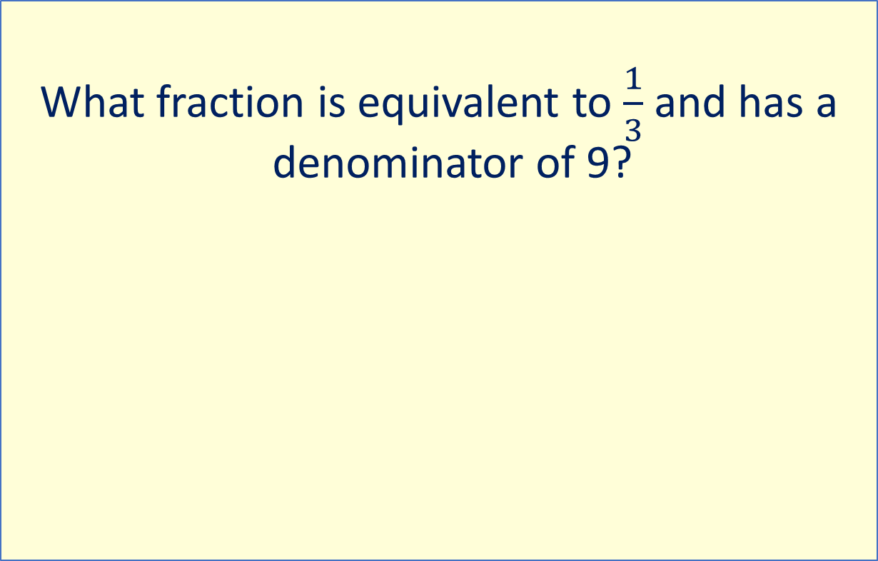
Problem solving
What fraction is equivalent to $\frac{1}{3}$ and has a denominator of 9?
Explain how you know to your partner.

Slide 10
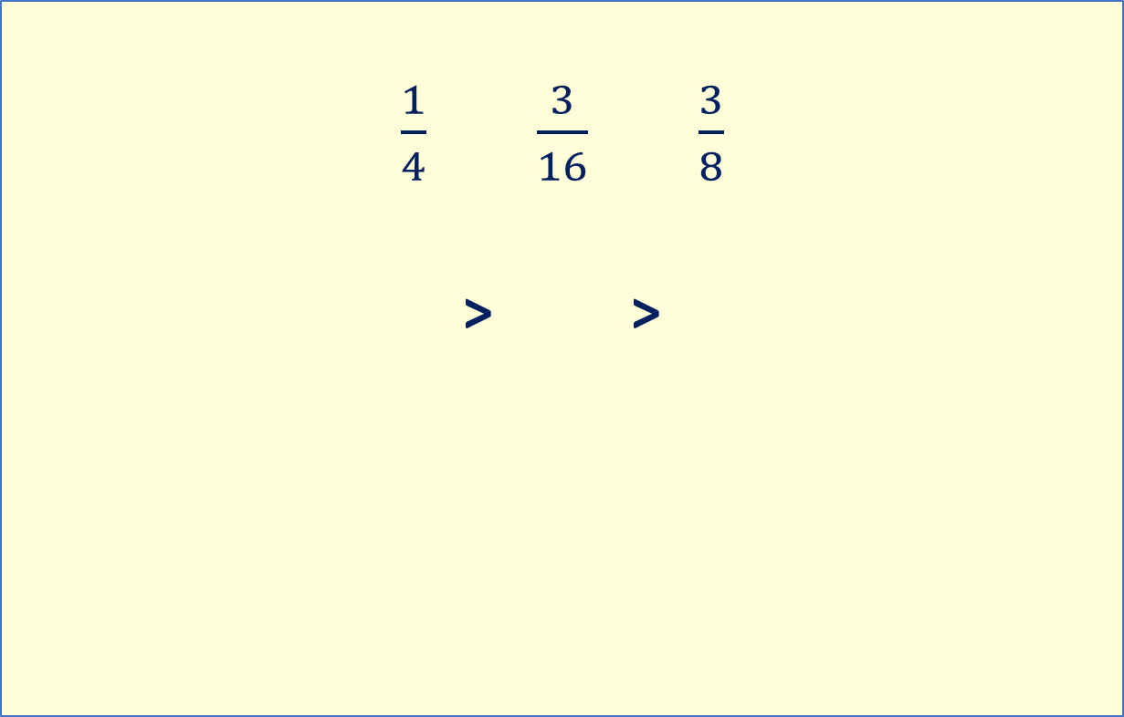
Problem solving
$\frac{1}{4}$ $\frac{3}{16}$ $\frac{3}{8}$
> >
Place the fractions in the correct boxes. Tell your partner how you worked it out.

Slide 11
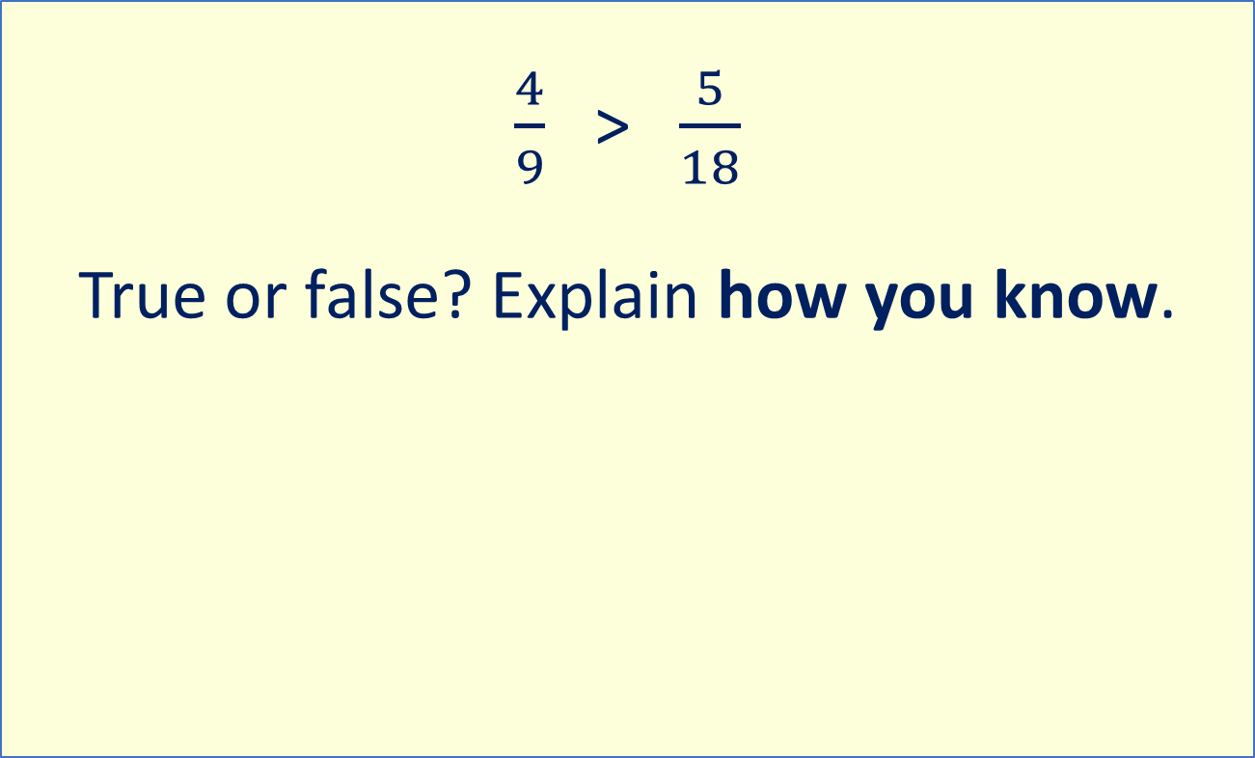
Reasoning
$\frac{4}{9}$ > $\frac{5}{18}$
True or false? Explain how you know.

Slide 12
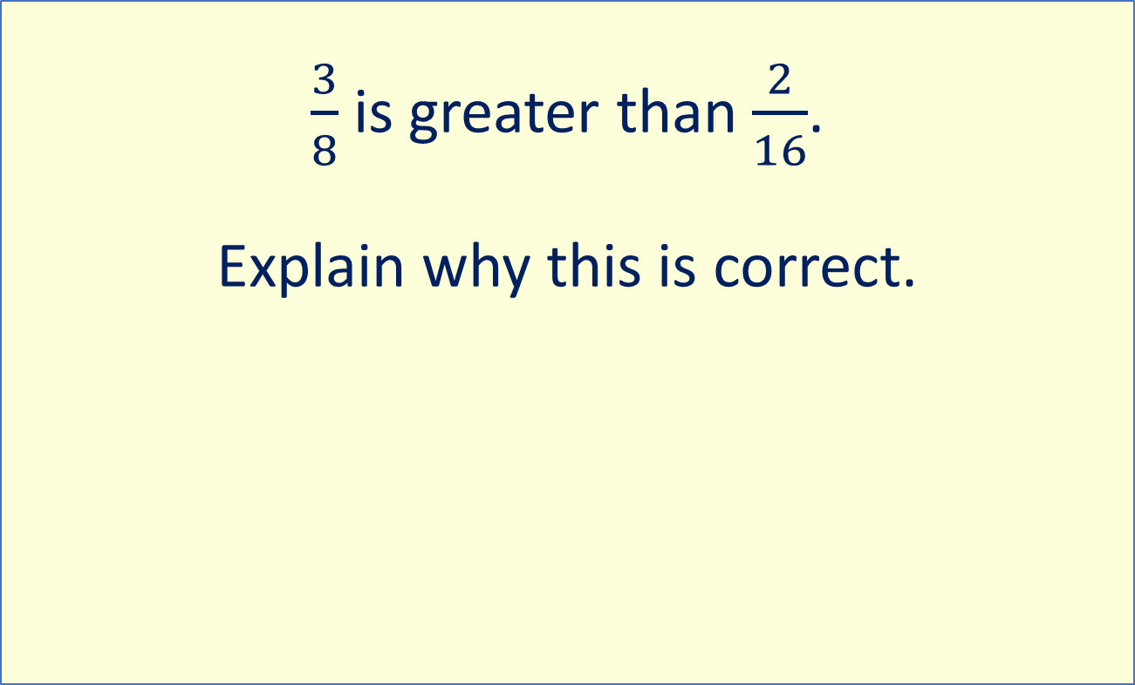
Reasoning
$\frac{3}{8}$ is greater than $\frac{2}{16}$.
Explain why this is correct.

