Slide 1


Y5 Therapy
4b. Can identify, name and write equivalent fractions of a given fraction, represented visually
Commissioned by The PiXL Club Ltd.
June 2018
This resource is strictly for the use of member schools for as long as they remain members of The PiXL Club. It may not be copied, sold nor transferred to a third party or used by the school after membership ceases. Until such time it may be freely used within the member school.
All opinions and contributions are those of the authors. The contents of this resource are not connected with nor endorsed by any other company, organisation or institution.
PiXL Club Ltd endeavour to trace and contact copyright owners. If there are any inadvertent omissions or errors in the acknowledgements or usage, this is unintended and PiXL will remedy these on written notification.
© Copyright The PiXL Club Limited, 2018

Slide 2
Vocabulary: fractions
denominator
numerator
simplify
equivalent
Please select an activity from the ‘Vocabulary Shorts’ to develop understanding of the key vocabulary.

Slide 3
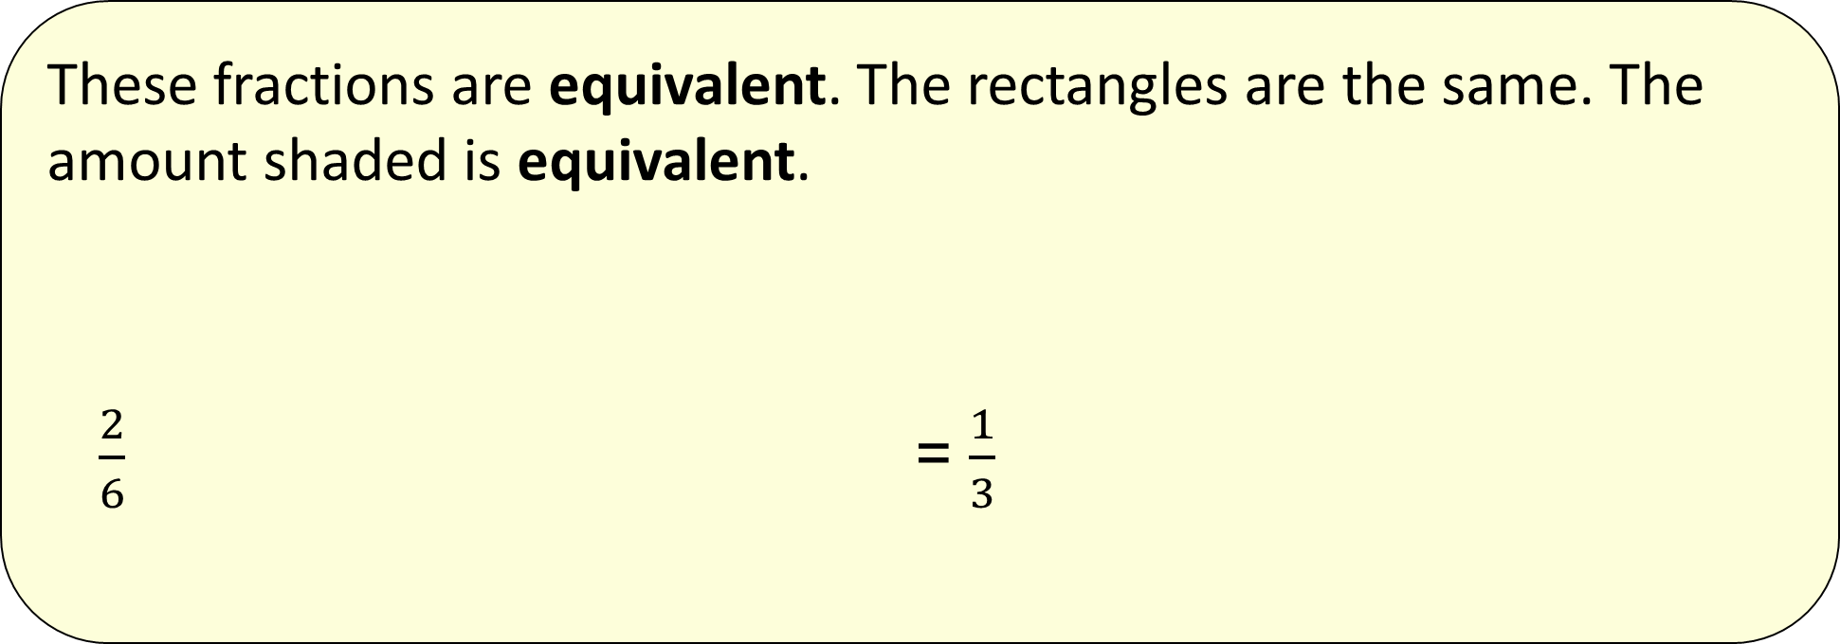
4b. Can identify, name and write equivalent fractions of a given fraction, represented visually
Equivalent fractions have the same value.
These fractions are equivalent. The rectangles are the same. The amount shaded is equivalent.
$\frac{2}{6}$ = $\frac{1}{3}$

Slide 4
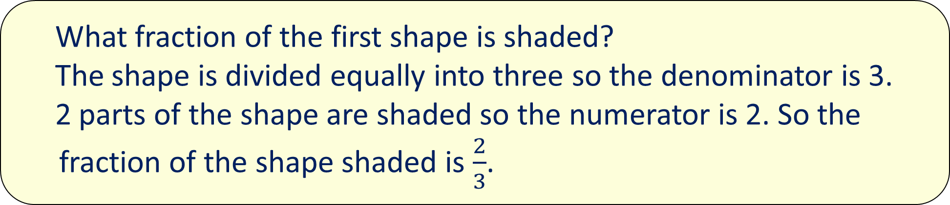
4b. Can identify, name and write equivalent fractions of a given fraction, represented visually
2
3
What fraction of the first shape is shaded?
The shape is divided equally into three so the denominator is 3.
2 parts of the shape are shaded so the numerator is 2. So the fraction of the shape shaded is $\frac{2}{3}$.

Slide 5
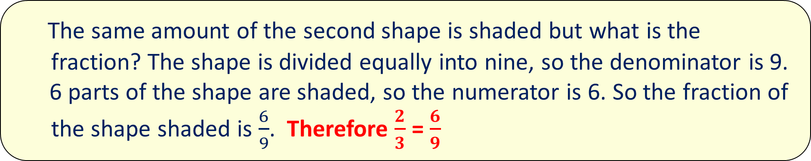
4b. Can identify, name and write equivalent fractions of a given fraction, represented visually
6
9
The same amount of the second shape is shaded but what is the fraction? The shape is divided equally into nine, so the denominator is 9.
6 parts of the shape are shaded, so the numerator is 6. So the fraction of the shape shaded is $\frac{6}{9}$. Therefore $\frac{2}{3}$ = $\frac{6}{9}$

Slide 6
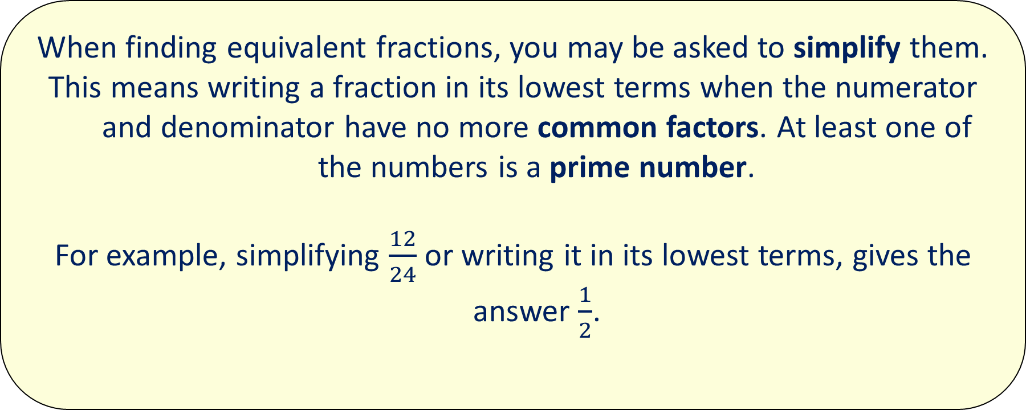
4b. Can identify, name and write equivalent fractions of a given fraction, represented visually
When finding equivalent fractions, you may be asked to simplify them.
This means writing a fraction in its lowest terms when the numerator and denominator have no more common factors. At least one of the numbers is a prime number.
For example, simplifying $\frac{12}{24}$ or writing it in its lowest terms, gives the answer $\frac{1}{2}$.

Slide 7
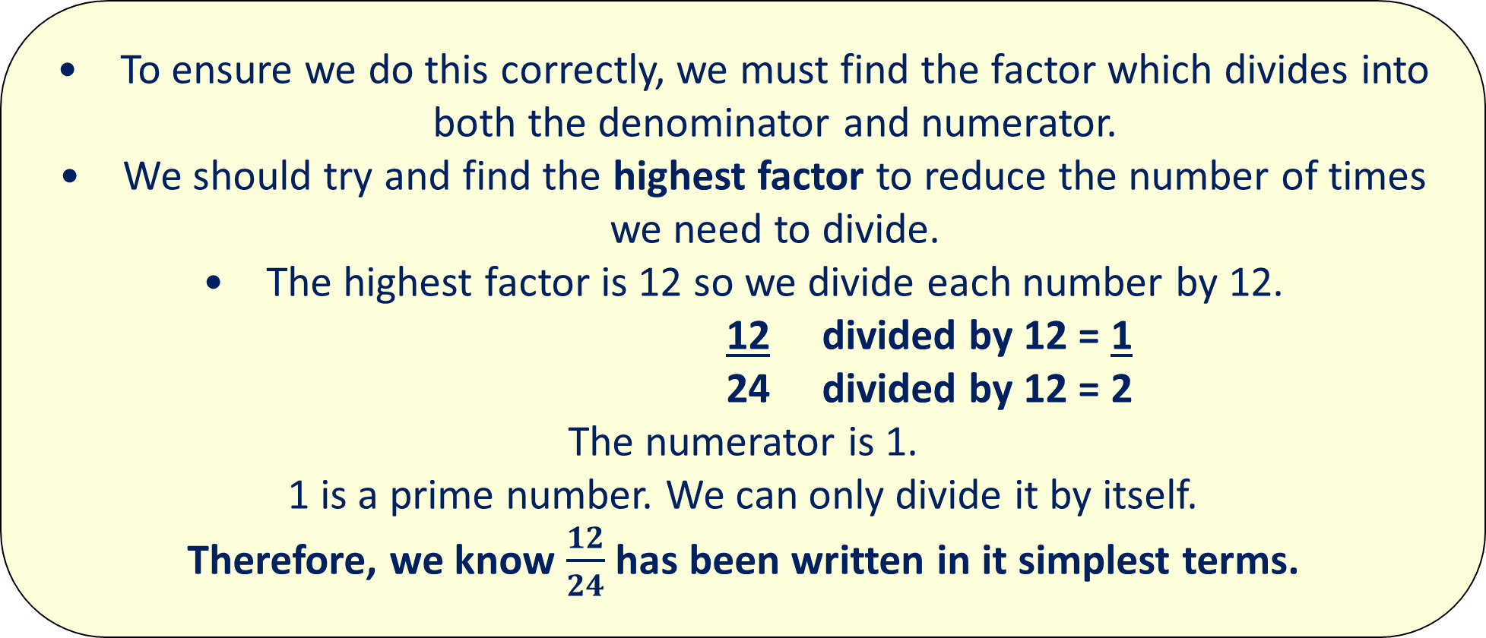
4b. Can identify, name and write equivalent fractions of a given fraction, represented visually
To ensure we do this correctly, we must find the factor which divides into both the denominator and numerator.
We should try and find the highest factor to reduce the number of times we need to divide.
The highest factor is 12 so we divide each number by 12.
12 divided by 12 = 1
24 divided by 12 = 2
The numerator is 1.
1 is a prime number. We can only divide it by itself.
Therefore, we know $\frac{12}{24}$ has been written in it simplest terms.

Slide 8

4b. Can identify, name and write equivalent fractions of a given fraction, represented visually
The shape below is shaded. What fraction of the shape is shaded in its simplest form?
$\frac{4}{6}$ is shaded $\frac{4}{6}$ = $\frac{2}{3}$

Slide 9
Now your turn:
What fraction of these shapes is shaded?
Write down the equivalent fractions.

Slide 10
Now your turn:
What fraction of this shape is shaded?
Write down the fraction in its simplest form.

Slide 11

Problem solving
What fraction of the first shape would have to be shaded to make these two fractions equivalent?
Explain how you know to your partner.

Slide 12
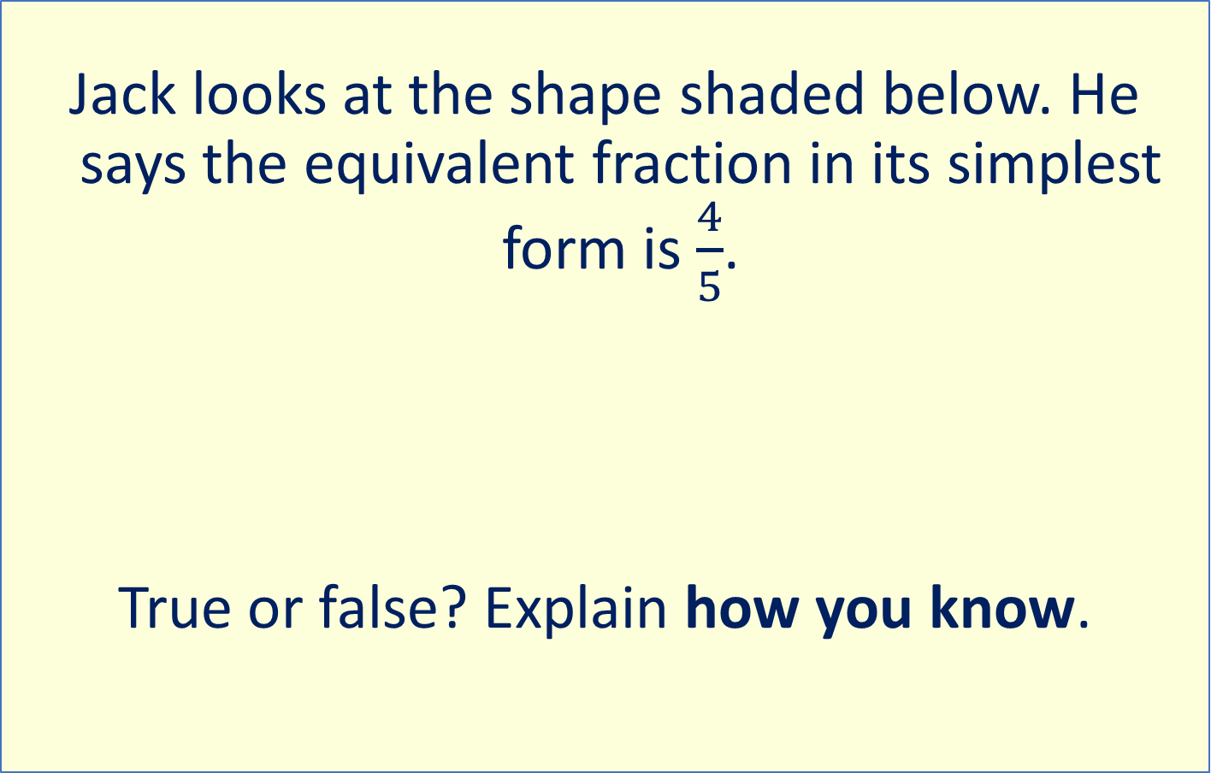
Reasoning
Jack looks at the shape shaded below. He says the equivalent fraction in its simplest form is $\frac{4}{5}$.
True or false? Explain how you know.

