Slide 1


.
Y5 M4c. Can recognise mixed numbers and improper fractions
Commissioned by The PiXL Club Ltd.
June 2019
This resource is strictly for the use of member schools for as long as they remain members of The PiXL Club. It may not be copied, sold nor transferred to a third party or used by the school after membership ceases. Until such time it may be freely used within the member school.
All opinions and contributions are those of the authors. The contents of this resource are not connected with nor endorsed by any other company, organisation or institution.
PiXL Club Ltd endeavour to trace and contact copyright owners. If there are any inadvertent omissions or errors in the acknowledgements or usage, this is unintended and PiXL will remedy these on written notification.
© Copyright The PiXL Club Limited, 2019

Slide 2
Teachers’ Notes
The PiXL therapies can be taught to a whole class or a target group. Year 3-5 therapies are designed to take approximately 30-40 minutes. However, this is flexible: it may be that only part of the therapy is taught or it could, of course, be adapted or extended.
Each therapy begins with a LORIC activity to develop relevant learning behaviours.
This is followed by a vocabulary task, which uses the PiXL 5-phase approach to teach key mathematical vocabulary. Further resources to develop vocabulary can be found in the Whole School area.
Each therapy adopts the ‘Teach, model and apply’ process with opportunities for pupils to demonstrate the taught skill independently.
Problem solving and reasoning activities are an integral part of each therapy.

Slide 3
Progress across amber – the 4-stage model
The three therapy tests which accompany this resource can be used to revisit the taught skill to check that the pupil is able to perform it independently and consistently.
A
A child has successfully completed a therapy test independently, following a set of therapy sessions.
A child has successfully completed a therapy test independently, a period after the relevant therapy sessions – we would advise about 2 weeks.
A child has successfully applied their knowledge or skill in an unfamiliar context. This may be application across the curriculum or in a problem.
A pupil has successfully re-visited the skills at a later point, and applies these in an unfamiliar context or problem, or across the curriculum.
A
DA
G

Slide 4
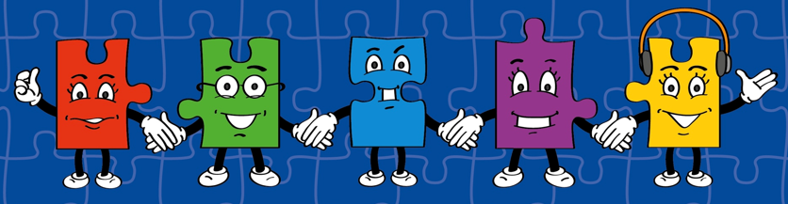
LORIC task
Play Guess the Fraction. Get into pairs. Each child chooses a fraction from the top of the next slide and writes it secretly on their whiteboard. Children take turns to ask ‘yes’ or ‘no’ questions until the fraction is guessed. Example questions are on the next slide.
Use this activity to help children develop their communication skills before you begin the therapy.

Slide 5


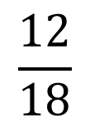



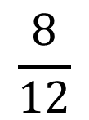

LORIC task
$$\frac{9}{20}$$
$$\frac{3}{8}$$
$$\frac{1}{4}$$
$$\frac{3}{6}$$
$$\frac{4}{8}$$
$$\frac{6}{9}$$
$$\frac{8}{12}$$
$$\frac{12}{18}$$
Example questions:
Is the denominator a multiple of 2?
Is the denominator a multiple of 3?
Is the denominator a multiple of 4?
Is the numerator a multiple of 3?
Is the numerator a multiple of 4?
Is the fraction less than half?

Slide 6
Vocabulary activity
Connect Two
Make connections between the two words and explain this using the sentence frame:
Mixed numbers and improper fractions are connected because…
To challenge pupils further, ask them to change one word and then reconnect this to their original word. How much do they have to change the connection that they made?
mixed numbers
improper fractions

Slide 7

Teach
What is a fraction?
$$\frac{1}{5}$$

Slide 8
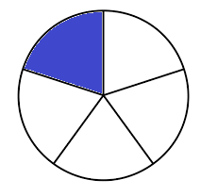
Teach
A fraction tells us a proportion of a whole.
$$\frac{1}{5}$$

Slide 9
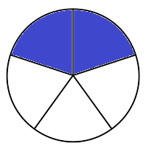
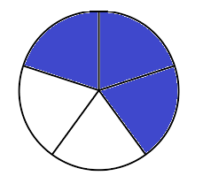
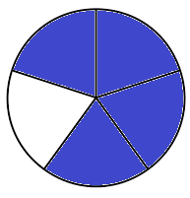
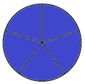





Teach
We can count in fractions.
$$\frac{1}{5}$$
$$\frac{2}{5}$$
$$\frac{3}{5}$$
$$\frac{4}{5}$$
$$\frac{5}{5}$$

Slide 10
Teach
What happens when we get to one whole? Can we continue to count?
$$\frac{1}{5}$$
$$\frac{2}{5}$$
$$\frac{3}{5}$$
$$\frac{4}{5}$$
$$\frac{5}{5}$$

Slide 11





Teach
There are two ways we can continue.
$$\frac{1}{5}$$
$$\frac{2}{5}$$
$$\frac{3}{5}$$
$$\frac{4}{5}$$
$$\frac{5}{5}$$

Slide 12












Teach
We can use improper fractions. Count these out loud with me.
$$\frac{1}{5}$$
$$\frac{2}{5}$$
$$\frac{3}{5}$$
$$\frac{4}{5}$$
$$\frac{5}{5}$$
$$\frac{6}{5}$$
$$\frac{7}{5}$$
$$\frac{8}{5}$$
$$\frac{9}{5}$$
$$\frac{10}{5}$$
$$\frac{11}{5}$$
$$\frac{12}{5}$$
We say this as “five fifths” etc. Improper fractions count the total number of parts. Notice, the pictures do not change. The fractions are the same, but they can be written in two different ways.

Slide 13

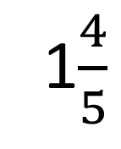

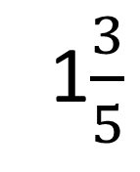
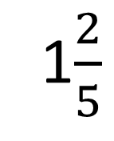
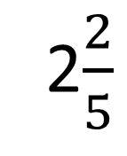


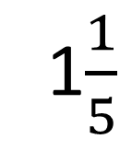
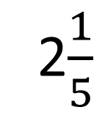

Teach
Or we can use mixed numbers. Count these out loud with me.
$$\frac{1}{5}$$
$$\frac{2}{5}$$
$$\frac{3}{5}$$
$$\frac{4}{5}$$
1$\frac{1}{5}$
1$\frac{2}{5}$
1$\frac{3}{5}$
1$\frac{4}{5}$
2$\frac{1}{5}$
2$\frac{2}{5}$
$$1$$
2
We say this as “one and one fifth” etc.
Mixed numbers tell us how many wholes there are and how many extra parts separately.

Slide 14
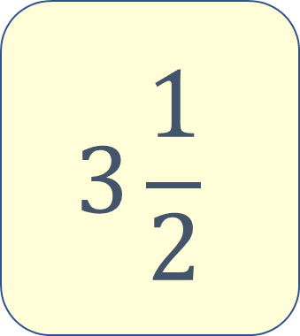
Model
Let’s draw the fraction circles for the following mixed number.
$$3\frac{1}{2}$$

Slide 15
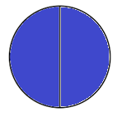
Model
First, we draw the ones. These are the whole numbers.
$$3\frac{1}{2}$$

Slide 16
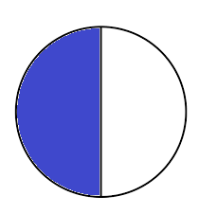
Model
Then, we draw the proper fraction.
This is one part out of 2 equal parts of the whole.
$$3\frac{1}{2}$$

Slide 17
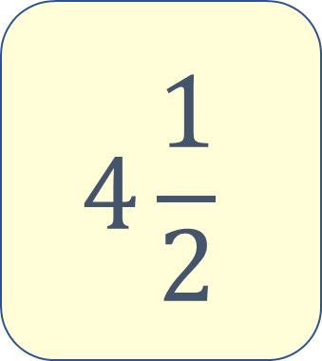
Apply
Draw the fraction circles for the following mixed number.
$$4\frac{1}{2}$$

Slide 18
Apply
Draw the fraction circles for the following mixed number.
$$4\frac{1}{2}$$

Slide 19
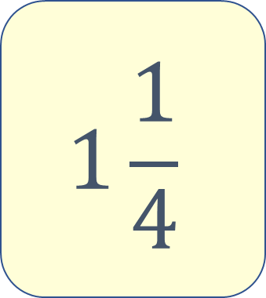
Apply
Draw the fraction circles for the following mixed number.
$$1\frac{1}{4}$$

Slide 20
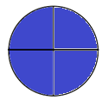
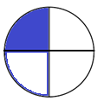
Apply
Draw the fraction circles for the following mixed number.
$$1\frac{1}{4}$$

Slide 21
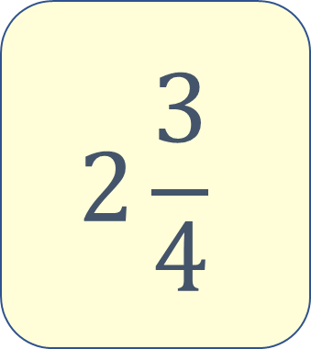
Apply
Draw the fraction circles for the following mixed number.
$$2\frac{3}{4}$$

Slide 22
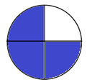
Apply
Draw the fraction circles for the following mixed number.
$$2\frac{3}{4}$$

Slide 23
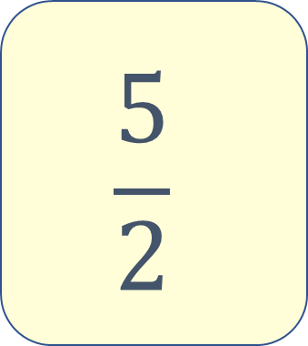
Model
Draw the fraction circles for the following improper fraction.
$$\frac{5}{2}$$

Slide 24
Model
Draw the fraction circles for the following improper fraction.
$$\frac{5}{2}$$
First, think about what this improper fraction means. This improper fraction is five halves.

Slide 25

Model
Draw the fraction circles for the following improper fraction.
$$\frac{5}{2}$$
Then we can sketch the five halves, grouping every two halves to make one whole.

Slide 26
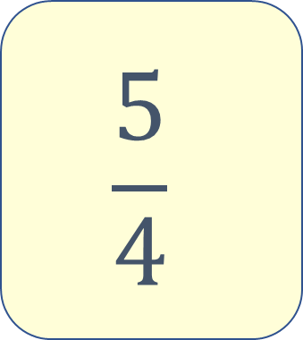
Apply
Draw the fraction circles for the following improper fraction.
$$\frac{5}{4}$$

Slide 27
Apply
Draw the fraction circles for the following mixed number.
$$\frac{5}{4}$$

Slide 28
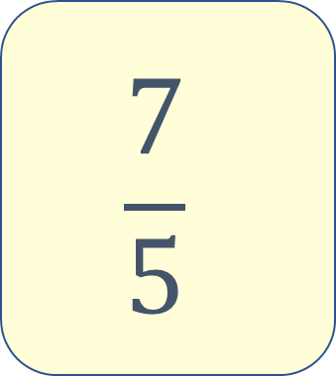
Apply
Draw the fraction circles for the following improper fraction.
$$\frac{7}{5}$$

Slide 29
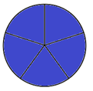
Apply
Draw the fraction circles for the following improper fraction.
$$\frac{7}{5}$$

Slide 30
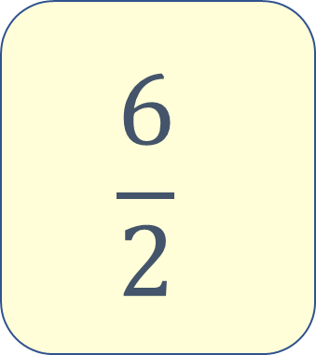
Apply
Draw the fraction circles for the following improper fraction.
$$\frac{6}{2}$$

Slide 31
Apply
Draw the fraction circles for the following improper fraction.
$$\frac{6}{2}$$

Slide 32
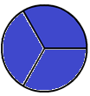
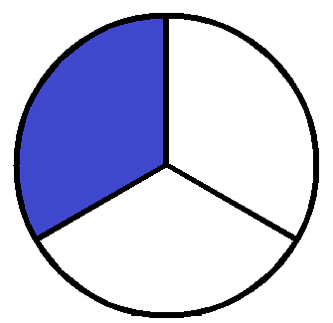
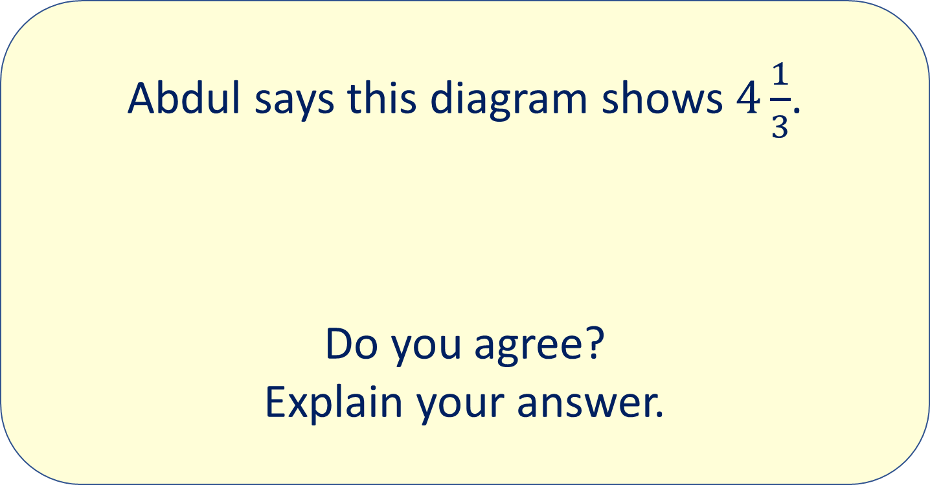
Apply
Abdul says this diagram shows $4\frac{1}{3}$.
Do you agree?
Explain your answer.

Slide 33
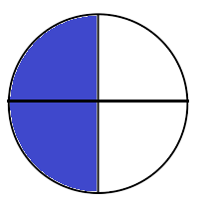
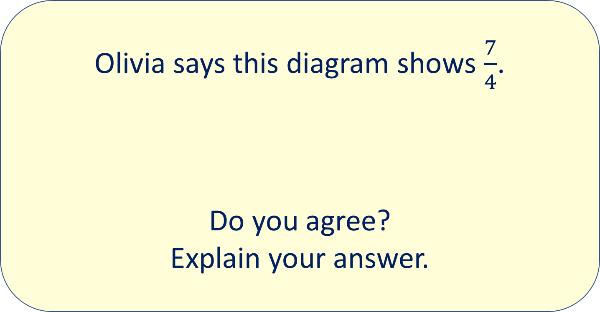
Apply
Olivia says this diagram shows $\frac{7}{4}$.
Do you agree?
Explain your answer.

Slide 34
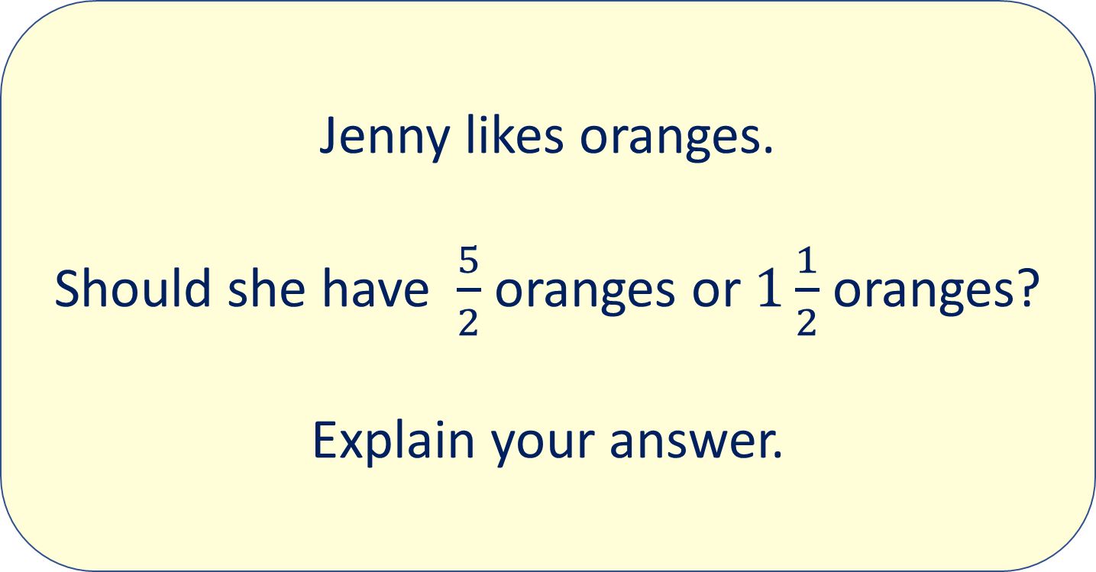
Apply
Jenny likes oranges.
Should she have $\frac{5}{2}$ oranges or $1\frac{1}{2}$ oranges?
Explain your answer.

