Slide 1


Y5 Therapy
4e. Can add fractions with the same denominator and denominators that are multiples of the same number
Commissioned by The PiXL Club Ltd.
June 2018
This resource is strictly for the use of member schools for as long as they remain members of The PiXL Club. It may not be copied, sold nor transferred to a third party or used by the school after membership ceases. Until such time it may be freely used within the member school.
All opinions and contributions are those of the authors. The contents of this resource are not connected with nor endorsed by any other company, organisation or institution.
PiXL Club Ltd endeavour to trace and contact copyright owners. If there are any inadvertent omissions or errors in the acknowledgements or usage, this is unintended and PiXL will remedy these on written notification.
© Copyright The PiXL Club Limited, 2018

Slide 2
Vocabulary: fractions
denominator
numerator
multiples
equivalent
Please select an activity from the ‘Vocabulary Shorts’ to develop understanding of the key vocabulary.

Slide 3

Can add fractions with the same denominator
$\frac{1}{5}$ + $\frac{2}{5}$ = $\frac{3}{5}$
Tell your partner which number is the denominator.
+
=
To add fractions with the same denominator, simply add the numerators together. The denominator remains the same.

Slide 4
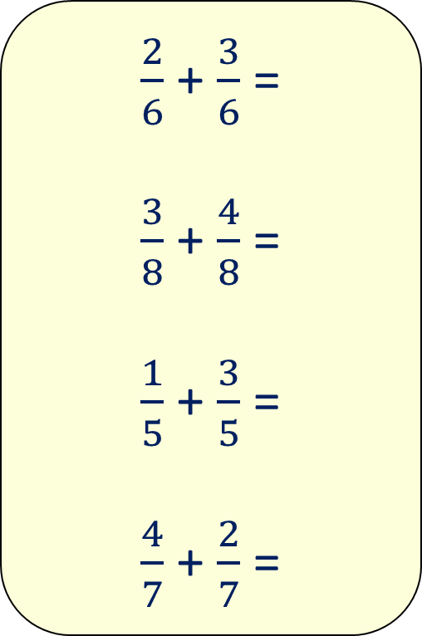
Now your turn:
$\frac{2}{6}$ + $\frac{3}{6}$ =
$\frac{3}{8}$ + $\frac{4}{8}$ =
$\frac{1}{5}$ + $\frac{3}{5}$ =
$\frac{4}{7}$ + $\frac{2}{7}$ =

Slide 5
Can add fractions with denominators that are multiples of the same number
$\frac{2}{3}$ + $\frac{1}{6}$ =
To add fractions with denominators that are multiples of the same number, you must convert the fractions into equivalent fractions with the same denominator.
Then add the numerators.

Slide 6
Can add fractions with denominators that are multiples of the same number
$\frac{2}{3}$ + $\frac{1}{6}$ =
How would you add these fractions? Why is it more challenging?

Slide 7
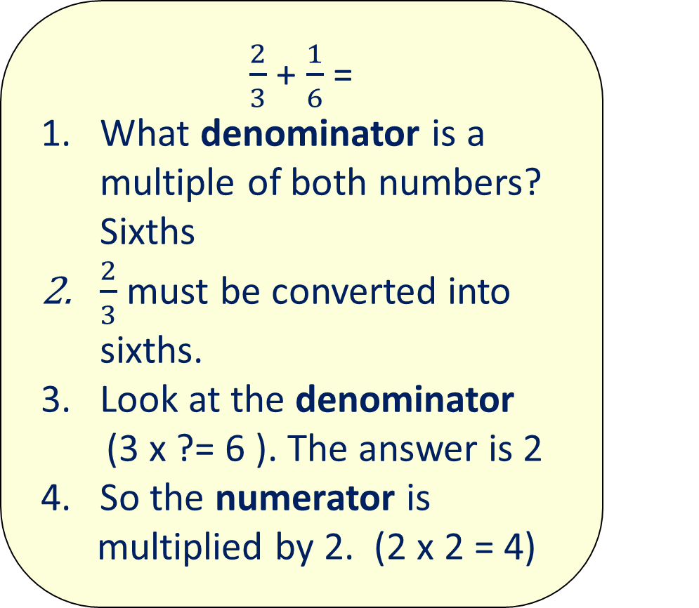
Can add fractions with denominators that are multiples of the same number
$\frac{2}{3}$ + $\frac{1}{6}$ =
What denominator is a multiple of both numbers? Sixths
$\frac{2}{3}$ must be converted into sixths.
Look at the denominator
(3 x ?= 6 ). The answer is 2 4. So the numerator is
multiplied by 2. (2 x 2 = 4)
X 2
2
4
=
3
6
=
X 2

Slide 8
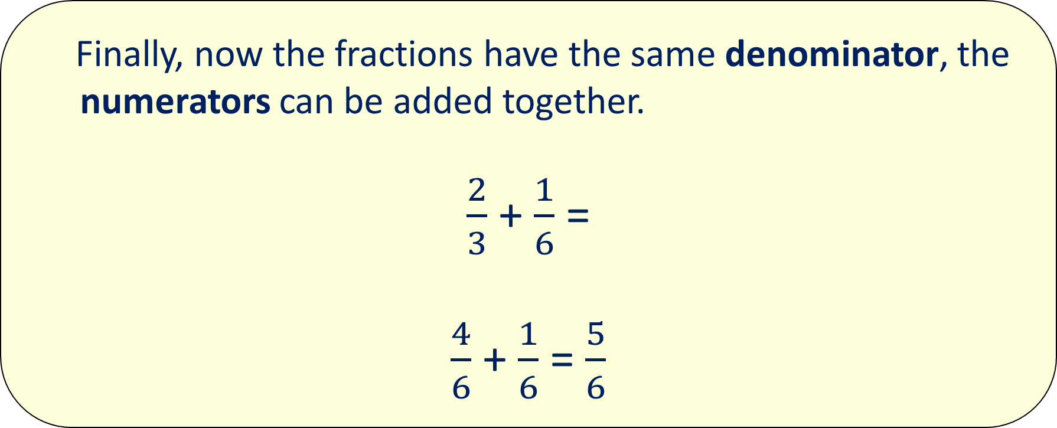
Can add fractions with denominators that are multiples of the same number
Finally, now the fractions have the same denominator, the numerators can be added together.
$\frac{2}{3}$ + $\frac{1}{6}$ =
$\frac{4}{6}$ + $\frac{1}{6}$ = $\frac{5}{6}$

Slide 9
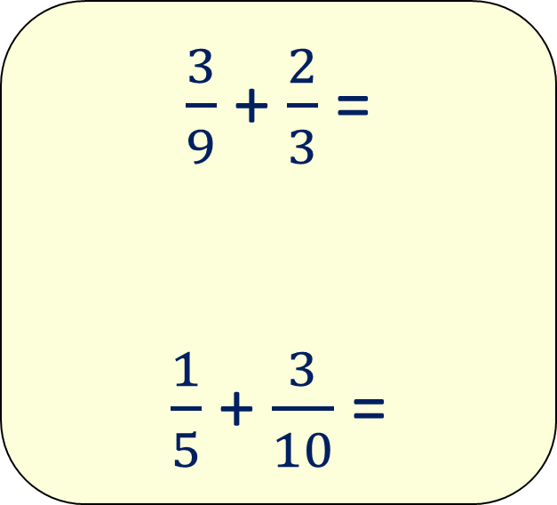
Now your turn:
$\frac{3}{9}$ + $\frac{2}{3}$ =
$\frac{1}{5}$ + $\frac{3}{10}$ =

Slide 10



Problem solving
Add the fractions in the squares at the bottom, to work out the total in the top square.
?
22/3
$$\frac{2}{9}$$
$\frac{1}{3}$

Slide 11
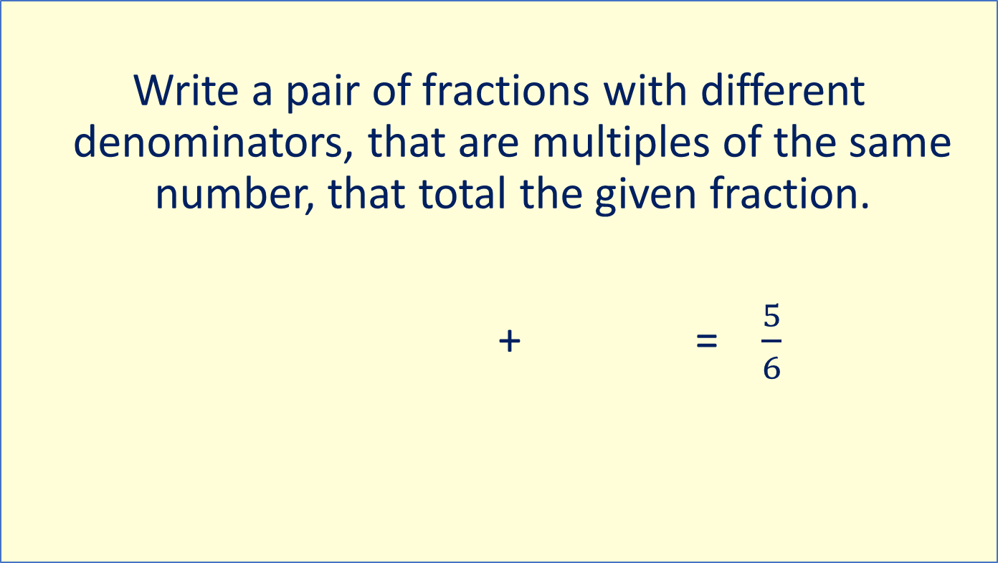
Problem solving
Write a pair of fractions with different denominators, that are multiples of the same number, that total the given fraction.
+ = $\frac{5}{6}$

Slide 12
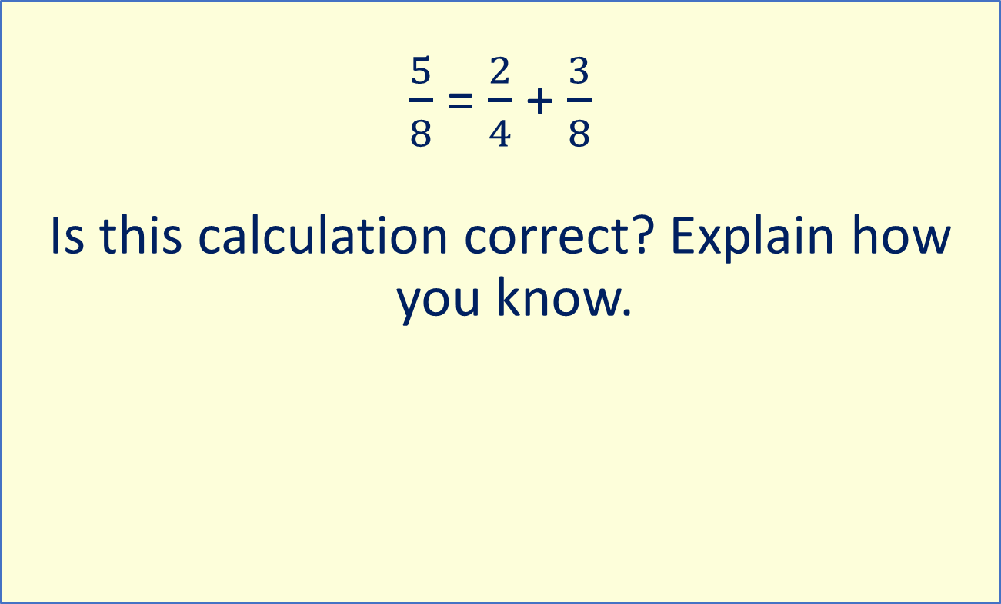
Reasoning
$\frac{5}{8}$ = $\frac{2}{4}$ + $\frac{3}{8}$
Is this calculation correct? Explain how you know.

