Slide 1


Y5 Therapy
4f. Can subtract fractions with the same denominator and denominators that are multiples of the same number
Commissioned by The PiXL Club Ltd.
June 2018
This resource is strictly for the use of member schools for as long as they remain members of The PiXL Club. It may not be copied, sold nor transferred to a third party or used by the school after membership ceases. Until such time it may be freely used within the member school.
All opinions and contributions are those of the authors. The contents of this resource are not connected with nor endorsed by any other company, organisation or institution.
PiXL Club Ltd endeavour to trace and contact copyright owners. If there are any inadvertent omissions or errors in the acknowledgements or usage, this is unintended and PiXL will remedy these on written notification.
© Copyright The PiXL Club Limited, 2018

Slide 2
Vocabulary: fractions
denominator
numerator
multiples
equivalent
Please select an activity from the ‘Vocabulary Shorts’ to develop understanding of the key vocabulary.

Slide 3

Can subtract fractions with the same denominator
$\frac{5}{6}$ - $\frac{2}{6}$ = $\frac{3}{6}$
Tell your partner which number is the denominator.
-
=
To subtract fractions with the same denominator, simply subtract the numerators. The denominator remains the same.

Slide 4
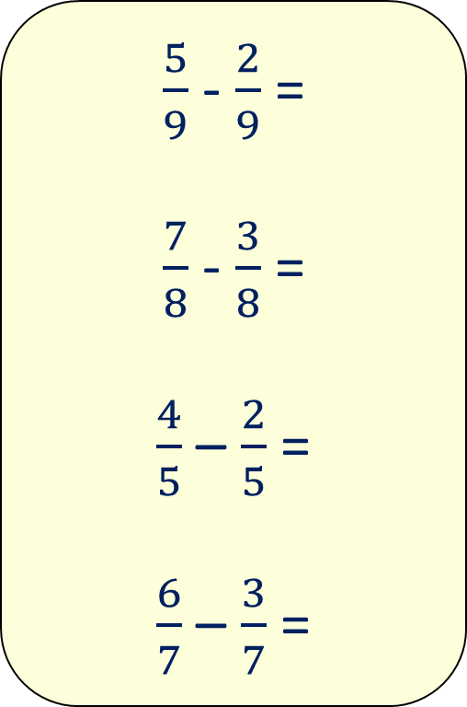
Now your turn:
$\frac{5}{9}$ - $\frac{2}{9}$ =
$\frac{7}{8}$ - $\frac{3}{8}$ =
$\frac{4}{5}$ – $\frac{2}{5}$ =
$\frac{6}{7}$ – $\frac{3}{7}$ =

Slide 5
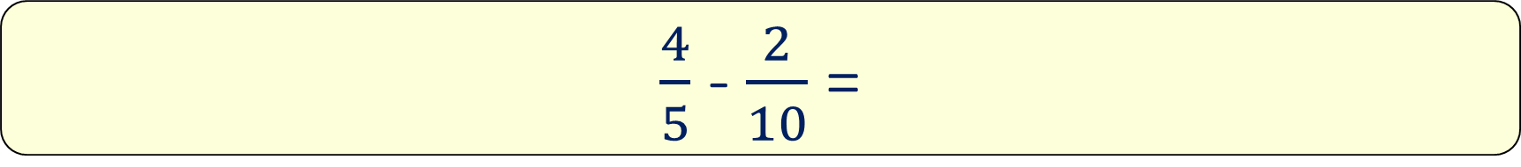
Can subtract fractions with denominators that are multiples of the same number
$\frac{4}{5}$ - $\frac{2}{10}$ =
To subtract fractions with denominators that are multiples of the same number, you must convert the fractions into equivalent fractions with the same denominator.
Then subtract the numerators.

Slide 6
Can subtract fractions with denominators that are multiples of the same number
$\frac{4}{5}$ - $\frac{2}{10}$ =
How would you subtract these fractions? Why is it more challenging?

Slide 7
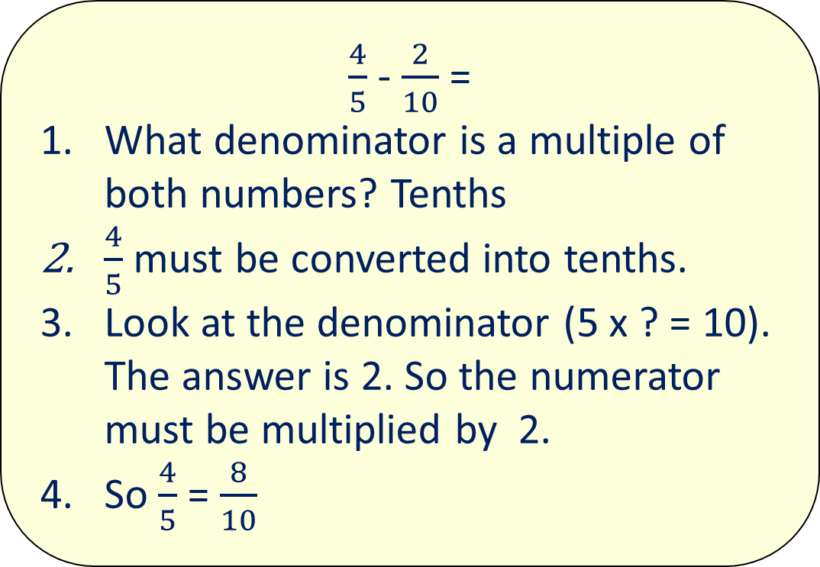
Can add fractions with denominators that are multiples of the same number
$\frac{4}{5}$ - $\frac{2}{10}$ =
What denominator is a multiple of both numbers? Tenths
$\frac{4}{5}$ must be converted into tenths.
Look at the denominator (5 x ? = 10). The answer is 2. So the numerator must be multiplied by 2.
So $\frac{4}{5}$ = $\frac{8}{10}$
X 2
4
8
=
5
10
X 2

Slide 8
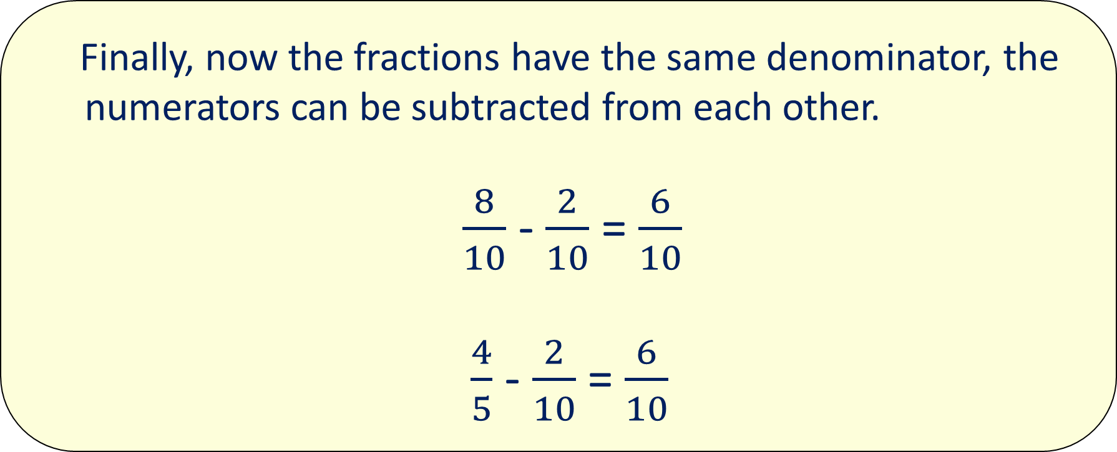
Can add fractions with denominators that are multiples of the same number
Finally, now the fractions have the same denominator, the numerators can be subtracted from each other.
$\frac{8}{10}$ - $\frac{2}{10}$ = $\frac{6}{10}$
$\frac{4}{5}$ - $\frac{2}{10}$ = $\frac{6}{10}$

Slide 9
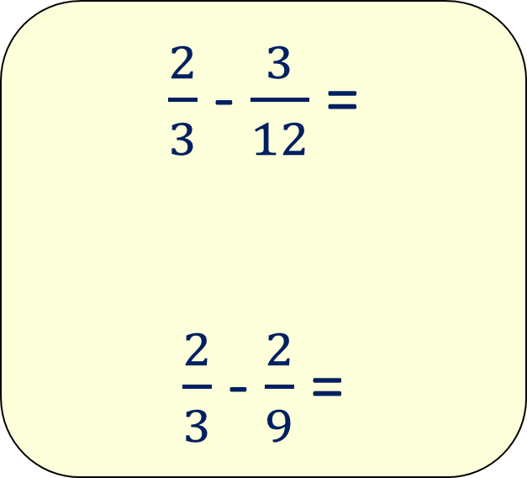
Now your turn:
$\frac{2}{3}$ - $\frac{3}{12}$ =
$\frac{2}{3}$ - $\frac{2}{9}$ =

Slide 10



Problem solving
The fraction on top is the total of the two fractions in the squares at the bottom. Work out the missing fraction.
$$\frac{5}{6}$$
22/3
?
$\frac{1}{3}$

Slide 11
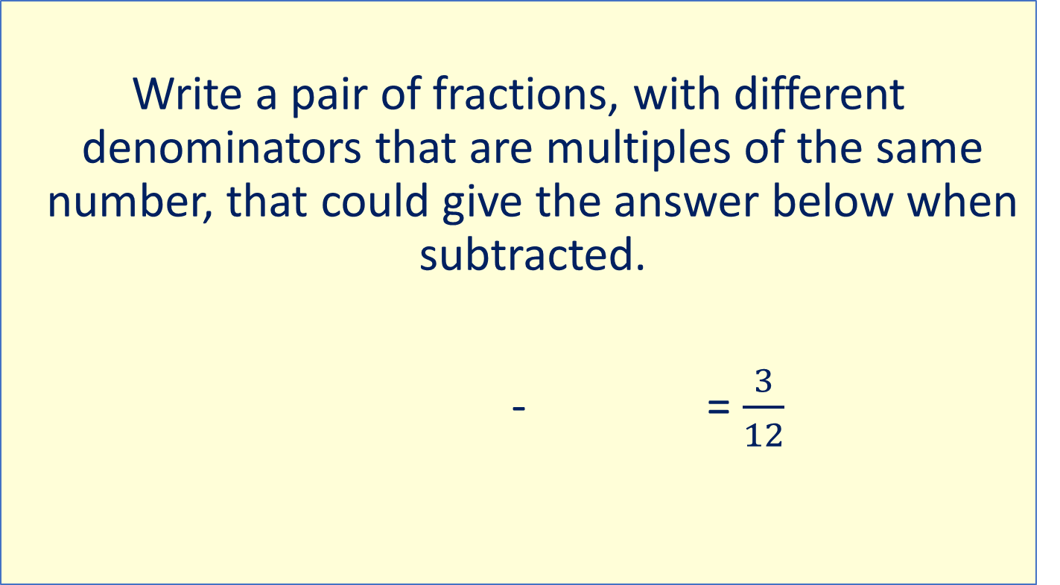
Problem solving
Write a pair of fractions, with different denominators that are multiples of the same number, that could give the answer below when subtracted.
- = $\frac{3}{12}$

Slide 12
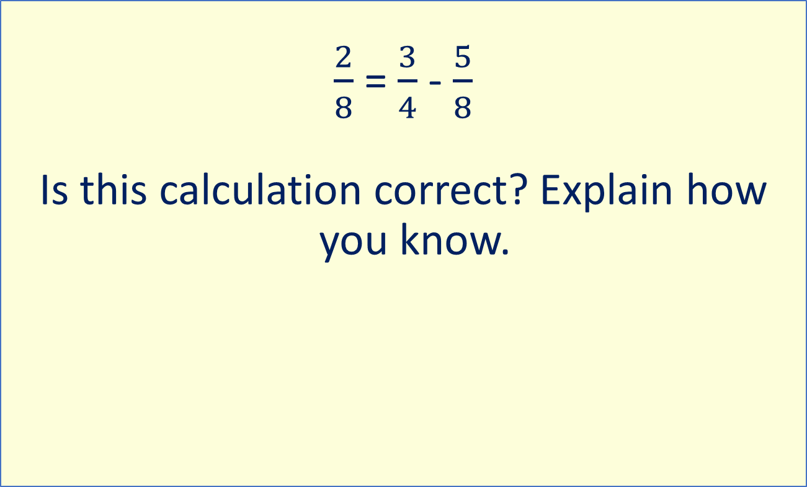
Reasoning
$\frac{2}{8}$ = $\frac{3}{4}$ - $\frac{5}{8}$
Is this calculation correct? Explain how you know.

