Slide 1


Y5 M4i. Can recognise and use thousandths
Commissioned by The PiXL Club Ltd.
August 2018
This resource is strictly for the use of member schools for as long as they remain members of The PiXL Club. It may not be copied, sold nor transferred to a third party or used by the school after membership ceases. Until such time it may be freely used within the member school.
All opinions and contributions are those of the authors. The contents of this resource are not connected with nor endorsed by any other company, organisation or institution.
PiXL Club Ltd endeavour to trace and contact copyright owners. If there are any inadvertent omissions or errors in the acknowledgements or usage, this is unintended and PiXL will remedy these on written notification.
© Copyright The PiXL Club Limited, 2018

Slide 2
Teachers’ Notes
The purpose of the priority therapies is to support the teaching of fundamental concepts for the year group.
The therapies can be taught to a whole class or a target group. Year 5 therapies are designed to take approximately 30 minutes. However, this is flexible: it may be that only part of the therapy is taught or it could, of course, be adapted or extended.
A vocabulary slide is included in each therapy. This identifies key words which relate to the taught concept along with a link to the ‘Vocabulary Shorts’ on PrimaryWise (20 activities to develop vocabulary). The intention is that the therapy begins with explicit teaching of this vocabulary.
The therapy adopts the ‘Teach, model and apply’ process with plenty of opportunities for pupils to demonstrate the taught skill.
Problem solving and reasoning activities are an integral part of each therapy.

Slide 3
Vocabulary: fractions
tenth
hundredth
thousandth
equivalent
Please select an activity from the ‘Vocabulary Shorts’ to develop understanding of the key vocabulary.

Slide 4

Teach
Name the columns on the place value grid.
Ten Thousands | Thousands | Hundreds | Tens | Ones | Tenths | Hundredths
?
?
?
?
?
?
?

Slide 5
Teach
What is this column called?
Ten Thousands | Thousands | Hundreds | Tens | Ones | Tenths | Hundredths

Slide 6
Teach
This column represents thousandths.
Ten Thousands | Thousands | Hundreds | Tens | Ones | Tenths | Hundredths | Thousandths

Slide 7

Teach
1
1000
0.001
One thousandth is one part out of a thousand equal parts.
As you can see, it is tiny when compared to one whole.

Slide 8
Teach
We can write decimal thousandths as a fraction. They are equivalent.
1
1000
0.001 =

Slide 9
Model
How would two thousandths look as both a fraction and a decimal?
2
1000
Ones | Tenths | Hundredths | Thousandths
0 | 0 | 0 | 2
Notes:
Teacher note: Click once in slideshow mode to reveal the fraction. Click again to reveal the decimal.

Slide 10
Teach
We can partition decimals into tenths, hundredths and thousandths.
0.123 = 0.1 + 0.02 + 0.003

Slide 11
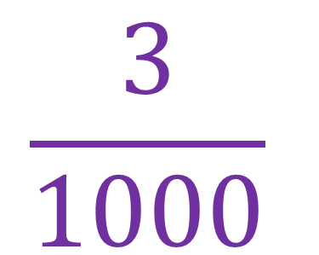
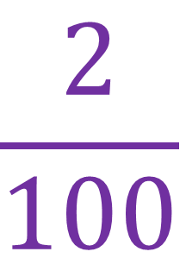
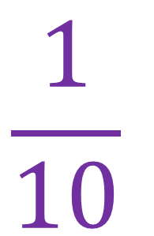
Teach
Or I can partition the number into fractions.
$$\frac{1}{10}$$
$$\frac{2}{100}$$
$$\frac{3}{1000}$$
0.123 =
+
+

Slide 12
Apply
Partition the following decimals into decimal sums.
0.543 = 0.394 =
0.126 = 0.065 =

Slide 13
Apply
Partition the following decimals into fraction sums.
0.827 = 0.987 =
0.104 = 0.453 =

Slide 14
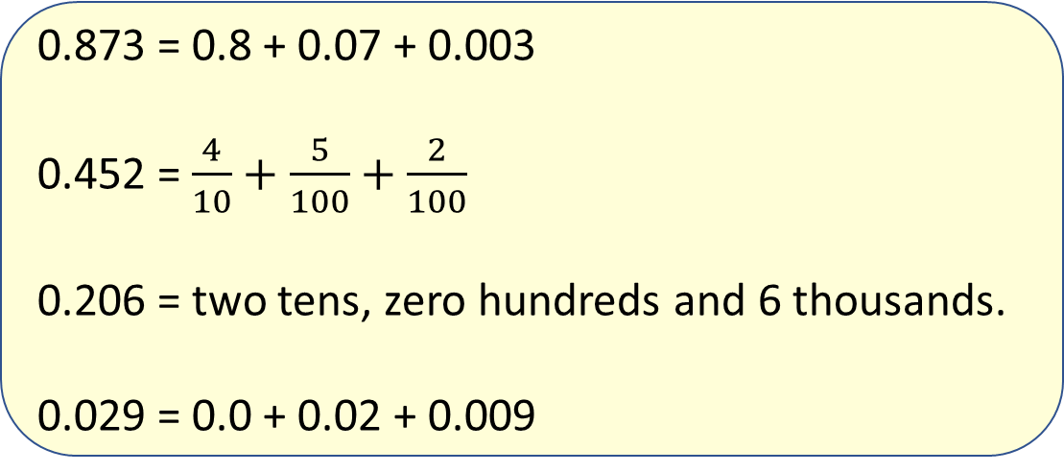
Apply
Identify which of the following calculations are correct and which need correcting.
0.873 = 0.8 + 0.07 + 0.003
0.452 = $\frac{4}{10}+\frac{5}{100}+\frac{2}{100}$
0.206 = two tens, zero hundreds and 6 thousands.
0.029 = 0.0 + 0.02 + 0.009
Explain your answer.

Slide 15
Apply
Identify which of the following calculations are correct and which need improving.
0.873 = 0.8 + 0.07 + 0.003

Slide 16
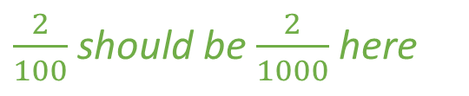
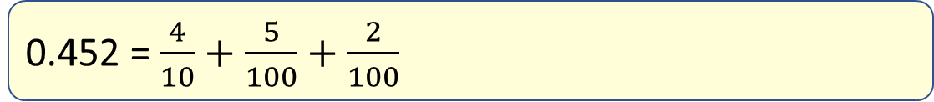
Apply
Identify which of the following calculations are correct and which need improving.
0.452 = $\frac{4}{10}+\frac{5}{100}+\frac{2}{100}$
$\frac{2}{100}$should be $\frac{2}{1000}$here

Slide 17
Apply
Identify which of the following calculations are correct and which need improving.
It should say tenths, hundredths and thousandths.
0.206 = two tens, zero hundreds and 6 thousands.

Slide 18
Apply
Identify which of the following calculations are correct and which need improving.
Although you do not need 0 or 0.0, this is still a correct answer.
0.029 = 0.0 + 0.02 + 0.009

Slide 19
Teach
We can also write an equivalent fraction for thousandths without partitioning.
Ones | Tenths | Hundredths | Thousandths
0 | 3 | 1 | 2

Slide 20
Teach
Let’s draw a diagram to help us.
Ones | Tenths | Hundredths | Thousandths
0 | 3 | 1 | 2
Here, I have
3 tenths, 1 hundredth and
2 thousandths.

Slide 21
Teach
I can exchange each tenth and hundredth for thousandths.
Ones | Tenths | Hundredths | Thousandths
0 | 3 | 1 | 2

Slide 22
Teach
0.312 is equivalent to
312 thousandths!
Ones | Tenths | Hundredths | Thousandths
0 | 3 | 1 | 2
312
1000

Slide 23
Model
I can now find the equivalent fraction for any decimal number with thousandths.
Ones | Tenths | Hundredths | Thousandths
0 | 2 | 6 | 4
264
1000
0.264
Notes:
Teacher note: Click once in slideshow mode to reveal the place value mat. Click again to reveal the fraction.

Slide 24
Model
I can find the equivalent fraction for any decimal number with thousandths.
Ones | Tenths | Hundredths | Thousandths
0 | 6 | 0 | 2
602
1000
0.602
Notes:
Teacher note: Click once in slideshow mode to reveal the place value mat. Click again to reveal the fraction.

Slide 25
Model
I can also find the equivalent fraction for any decimal thousandth that includes ones, tenths, hundredths and thousandths.
Ones | Tenths | Hundredths | Thousandths
5 | 2 | 8 | 4
5
284
1000
5.284
Notes:
Teacher note: Click once in slideshow mode to reveal the place value mat. Click again to reveal the fraction.

Slide 26
Apply
Write down the equivalent fraction for each of these decimals.
0.673 = 5.034
2.834 = 12.903

Slide 27
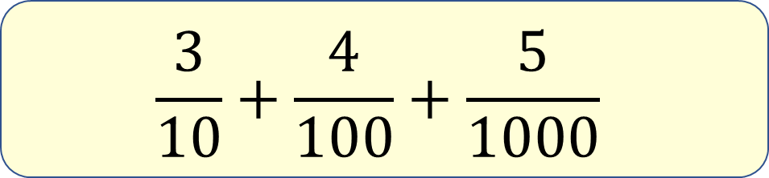
Apply
Three tenths, four hundredths and five thousandths.
Find the incorrect equivalence. Explain why.
1.345
0.3+0.04+0.005
$$\frac{3}{10}+\frac{4}{100}+\frac{5}{1000}$$

Slide 28
Apply
Three tenths, four hundredths and five thousandths.
There are no ones in the other numbers! The other statements are all equal to 0.345.
1.345
0.3+0.04+0.005
$$\frac{3}{10}+\frac{4}{100}+\frac{5}{1000}$$

Slide 29


Evaluate
Can you recognise and use thousandths?

