Slide 1


.
Y5 M4j. Can round decimals with 2 decimal places to the nearest whole number and to one decimal place
Commissioned by The PiXL Club Ltd.
June 2019
This resource is strictly for the use of member schools for as long as they remain members of The PiXL Club. It may not be copied, sold nor transferred to a third party or used by the school after membership ceases. Until such time it may be freely used within the member school.
All opinions and contributions are those of the authors. The contents of this resource are not connected with nor endorsed by any other company, organisation or institution.
PiXL Club Ltd endeavour to trace and contact copyright owners. If there are any inadvertent omissions or errors in the acknowledgements or usage, this is unintended and PiXL will remedy these on written notification.
© Copyright The PiXL Club Limited, 2019

Slide 2
Teachers’ Notes
The PiXL therapies can be taught to a whole class or a target group. Year 3-5 therapies are designed to take approximately 30-40 minutes. However, this is flexible: it may be that only part of the therapy is taught or it could, of course, be adapted or extended.
Each therapy begins with a LORIC activity to develop relevant learning behaviours.
This is followed by a vocabulary task, which uses the PiXL 5-phase approach to teach key mathematical vocabulary. Further resources to develop vocabulary can be found in the Whole School area.
Each therapy adopts the ‘Teach, model and apply’ process with opportunities for pupils to demonstrate the taught skill independently.
Problem solving and reasoning activities are an integral part of each therapy.

Slide 3
Progress across amber – the 4-stage model
The three therapy tests which accompany this resource can be used to revisit the taught skill to check that the pupil is able to perform it independently and consistently.
A
A child has successfully completed a therapy test independently, following a set of therapy sessions.
A child has successfully completed a therapy test independently, a period after the relevant therapy sessions – we would advise about 2 weeks.
A child has successfully applied their knowledge or skill in an unfamiliar context. This may be application across the curriculum or in a problem.
A pupil has successfully re-visited the skills at a later point, and applies these in an unfamiliar context or problem, or across the curriculum.
A
DA
G

Slide 4
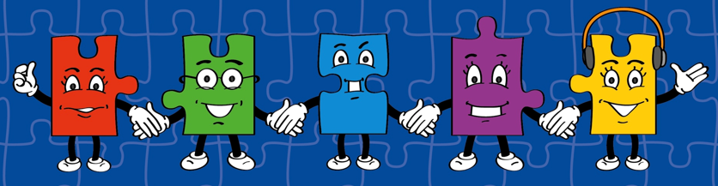
LORIC task
Make a sequence using 4 of the following decimals. Explain to a partner what pattern you have made. For example, 0.2, 0.4, 0.6, 0.8 is increasing by 0.2 each time.
Use this activity to help children develop their organisation skills before you begin the therapy.
2.2 2.7 2.8 3.0 2.5 2.6
2.0 2.1 2.5 3.5 4.0 2.4

Slide 5
Vocabulary activity
round
tenth
hundredth
Choose a word and choose a method from the diagram to describe it to the group.
The word is…
Act it out
Give a definition or use it in a sentence
Draw a picture of it
Describe it without saying the word itself
Give examples of similar spellings/ rhyming words
Give words that are similar

Slide 6
Teach
We can round numbers to give an estimation or an approximate value.

Slide 7
Teach
What is a hundredth?

Slide 8

Teach
One hundredth is one part out of one hundred equal parts.
$$\frac{1}{100}$$

Slide 9
Teach
As you can see, it is very small when compared to one whole!
$$\frac{1}{100}$$

Slide 10
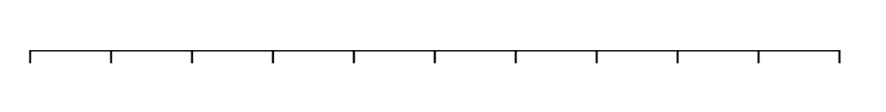
Teach
We can divide each whole number into ten tenths.
0
0.1
0.2
0.3
0.4
0.5
0.6
0.7
0.8
0.9
1

Slide 11
Teach
We can put a zero in the hundredths column to give these as hundredths.
One tenth = ten hundredths
0
0.10
0.20
0.30
0.40
0.50
0.60
0.70
0.80
0.90
1

Slide 12
Teach
We can divide each whole number into
one hundred hundredths.
0
0.10
0.20
0.30
0.40
0.50
0.60
0.70
0.80
0.90
1
Let’s zoom in to see what lies between 0 and 0.10
0
0.01
0.02
0.03
0.04
0.05
0.06
0.07
0.08
0.09
0.10

Slide 13
Teach
What is half of 100?

Slide 14
Teach
Half of 100 is 50, so anything that is 50 hundredths or greater will round up to the nearest whole number.
A number that has less than 50 hundredths will round down to the nearest whole number.
0
0.10
0.20
0.30
0.40
0.50
0.60
0.70
0.80
0.90
1

Slide 15
Model
Round 5.67 to the nearest whole number.
First, think about what the whole numbers just below and just above our number are.
?
5.10
5.20
5.30
5.40
5.50
5.60
5.70
5.80
5.90
?

Slide 16
Model
Round 5.67 to the nearest whole number.
Next, consider where our number is on a number line between these whole numbers.
5
5.10
5.20
5.30
5.40
5.50
5.60
5.70
5.80
5.90
6

Slide 17
Model
Round 5.67 to the nearest whole number.
As this number is larger than 5.5 or 5.50, the midpoint between 5 and 6, it will round up to 6.
6
5
5.10
5.20
5.30
5.40
5.50
5.60
5.70
5.80
5.90

Slide 18
Apply
Round 2.09 to the nearest whole number.

Slide 19
Apply
2.09 rounds to 2 to the nearest whole number.
2
2.10
2.20
2.30
2.40
2.50
2.60
2.70
2.80
2.90
3

Slide 20
Apply
Round 7.83 to the nearest whole number.

Slide 21
Apply
7.83 rounds to 8 to the nearest whole number.
7
7.10
7.20
7.30
7.40
7.50
7.60
7.70
7.80
7.90
8

Slide 22
Apply
Round 6.49 to the nearest whole number.

Slide 23
Apply
6.49 rounds to 6 to the nearest whole number.
6
6.10
6.20
6.30
6.40
6.50
6.60
6.70
6.80
6.90
7

Slide 24
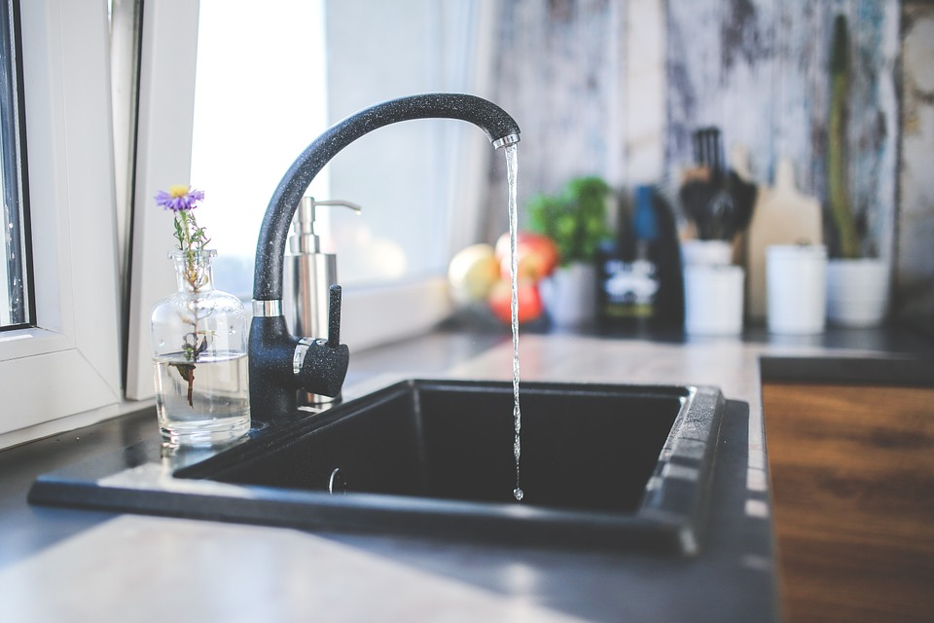
Apply
Zoe measures a sink to be 52.17cm.
What does the sink measure to the nearest centimetre?

Slide 25
Teach
Sometimes we might need to be more accurate and round to the nearest tenth.
0
0.10
0.20
0.30
0.40
0.50
0.60
0.70
0.80
0.90
1

Slide 26
Model
Round 0.13 to the nearest tenth.
What is the nearest tenth just below and just above our number?

Slide 27
Model
Let’s zoom in to see where 0.13 lies. Note – we can write 0.1 and 0.2 or 0.10 and 0.20 for the nearest tenths.
0
0.10
0.20
0.30
0.40
0.50
0.60
0.70
0.80
0.90
1
0.10
0.11
0.12
0.13
0.14
0.15
0.16
0.17
0.18
0.19
0.20

Slide 28
Model
Now, we look at the digit in the hundredths column to decide whether to round up or down.
0
0.10
0.20
0.30
0.40
0.50
0.60
0.70
0.80
0.90
1
0.10
0.11
0.12
0.13
0.14
0.15
0.16
0.17
0.18
0.19
0.20

Slide 29
Model
Because this digit is a 3, we round down to 0.1.
If the number were 5 or more, we would round up.
0
0.10
0.20
0.30
0.40
0.50
0.60
0.70
0.80
0.90
1
0.10
0.11
0.12
0.13
0.14
0.15
0.16
0.17
0.18
0.19
0.20

Slide 30
Apply
Round 6.49 to the nearest tenth.

Slide 31
Apply
6.49 rounds to 6.5 to the nearest tenth.
6.4
6.41
6.42
6.43
6.44
6.45
6.46
6.47
6.48
6.49
6.5

Slide 32
Apply
Round 3.25 to the nearest tenth.

Slide 33
Apply
3.25 rounds to 3.3 to the nearest tenth. Remember,
5 always rounds up.
3.2
3.21
3.22
3.23
3.24
3.25
3.26
3.27
3.28
3.29
3.3

Slide 34
Apply
Round 8.98 to the nearest tenth.

Slide 35
Apply
8.98 rounds to 9 to the nearest tenth. This is the same as if it were rounded to the nearest whole number.
8.9
8.91
8.92
8.93
8.94
8.95
8.96
8.97
8.98
8.99
9.0

Slide 36
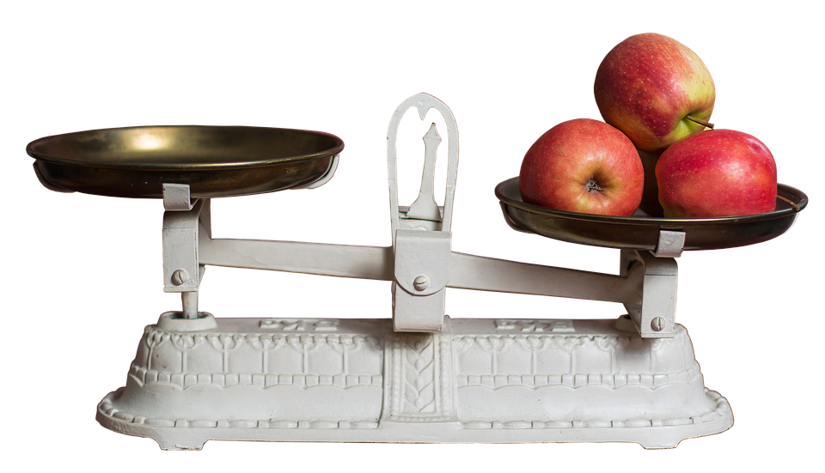
Apply
Khush weighs apples for an apple pie to be 1.34kg.
What do the apples weigh to the nearest tenth?

Slide 37
Apply
Annabel says 5.02 to the nearest tenth rounds to the same number as 4.49 to the nearest whole number.
Do you agree?
Explain your answer.

